Slide 1
Parallel implementation of revised simplex algorithm on cloud
By Rahul Khanolkar
Advisor : Dr. Sergio Salinas Date: 12/07/2017

Slide 2
Outline
Introduction
Parallel implementation of simplex algorithm
Results
Conclusions

Slide 3


Slide 4

Industrial internet of things
Data from mobile devices, cars, etc.
Data from traffic signals
Smart watches, health devices, etc.
Smart appliances such as GPS, trackers, etc.

Slide 5

Finance Industries
Spending patterns
Credit information
Financial situations

Slide 6

Transportation
Mobility related data
Vehicles real time status
Driver and company data
External data such as traffic, weather, etc.

Slide 7
Linear Programming in Big Data
Internet of things
Optimize node deployment to reduce sensor energy consumption
Financial strategies
Decision making to maximize the profit
Transportation
Optimize to find best route
Factory floor logistics
Notes:
It is a method used in decision making in business for obtaining the maximum and minimum value of a linear expression S.T satisfying certain given linear inequalities.
Linear expression consists of a linear function of the involved variables, which are to maximized or minimized, S.t given linear constraints.
Optimal value: Max or min value of an objective function is known as objective value.

Slide 8
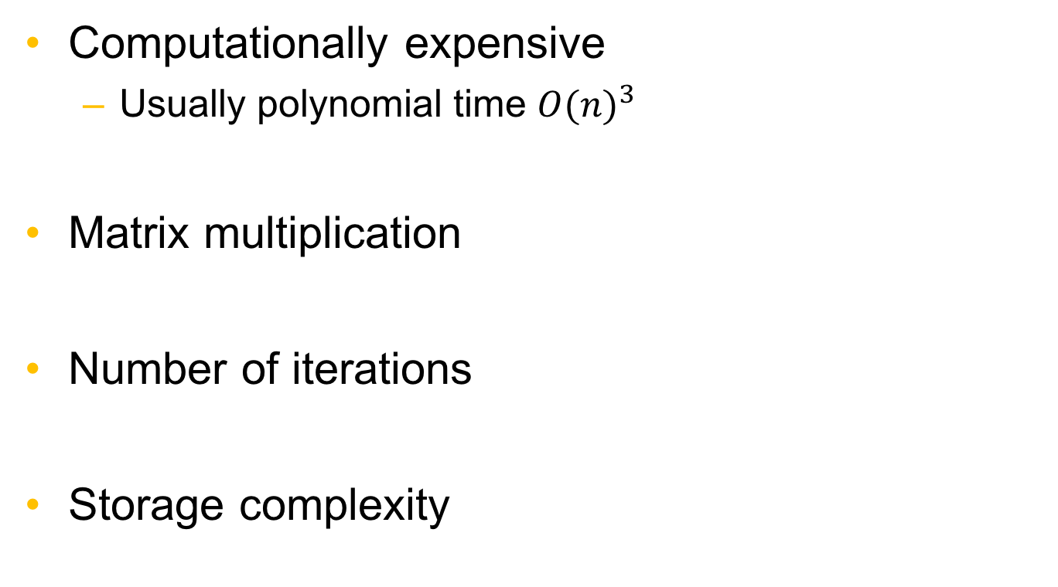
Challenges of solving LP’s in big data
Computationally expensive
Usually polynomial time ${O(n)}^{3}$
Matrix multiplication
Number of iterations
Storage complexity

Slide 9
Cloud and its advantages
Seemingly infinite resources available on demand
Ability to pay for use of computing resources on a short term basis as needed
Avoid up-front hardware expenses

Slide 10
Existing solutions to solve large-scale LPs
Single node LP solution
Employ distributed memory approaches
Use simplex algorithm
Parallel computations
Previous works lack scalability in big data.

Slide 11
Our Approach
Distribute LP solution algorithms to many computing nodes at the cloud.

Slide 12
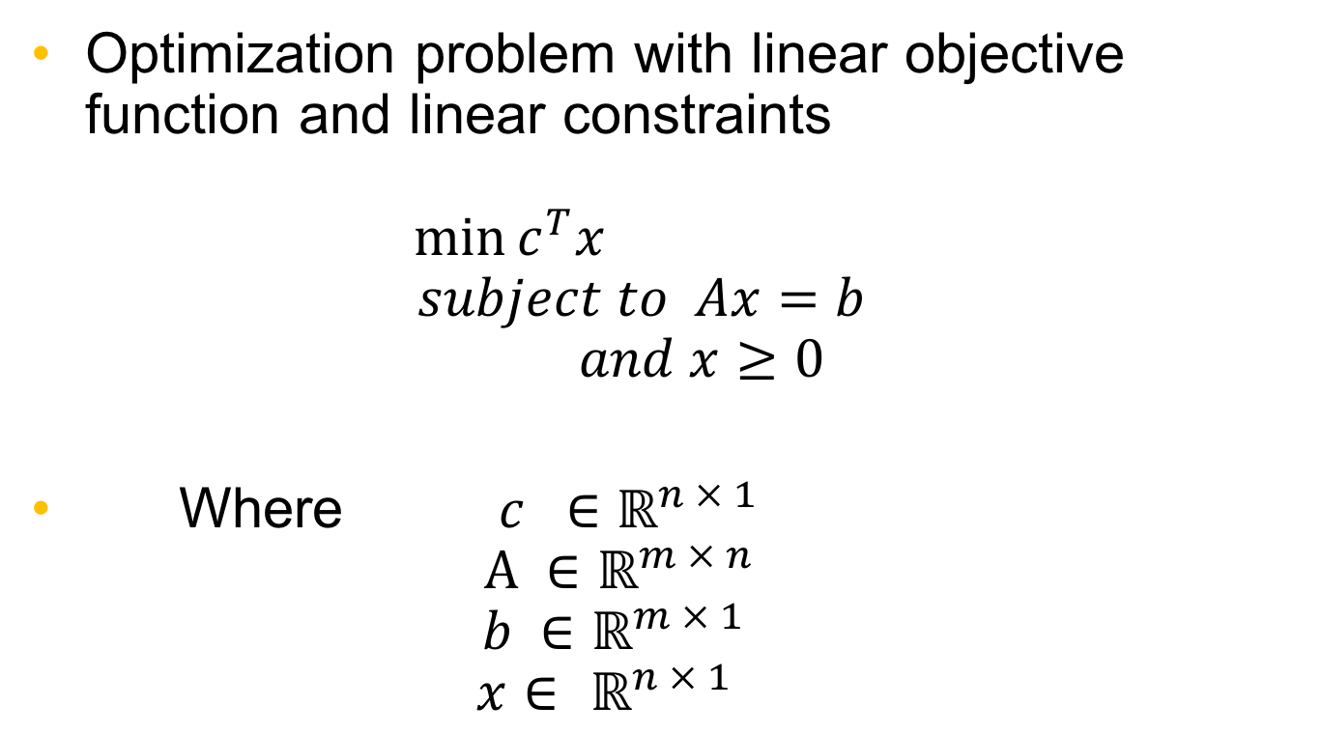
Linear Programs
Optimization problem with linear objective function and linear constraints $\min{c^{T}x}$ $subject to Ax=b$ $and x≥0$
Where ${ c}^{}∈$ $ℝ^{n × 1}$ $A ∈$ $ℝ^{m × n}$ $b ∈$ $ℝ^{m × 1}$ $x∈ ℝ^{n × 1}$

Slide 13
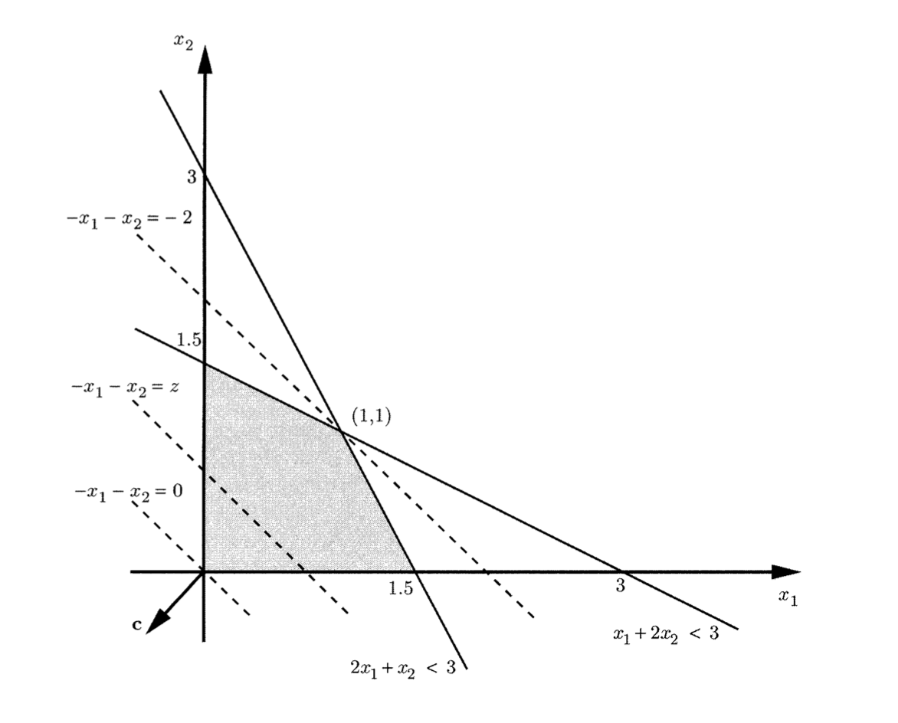
Graphical solution of Linear programming
Notes:
Explain graph and show how optimanl value circulates between that area to find minimum

Slide 14
The Simplex Algorithm
Initialization
Revised simplex iteration
Termination

Slide 15
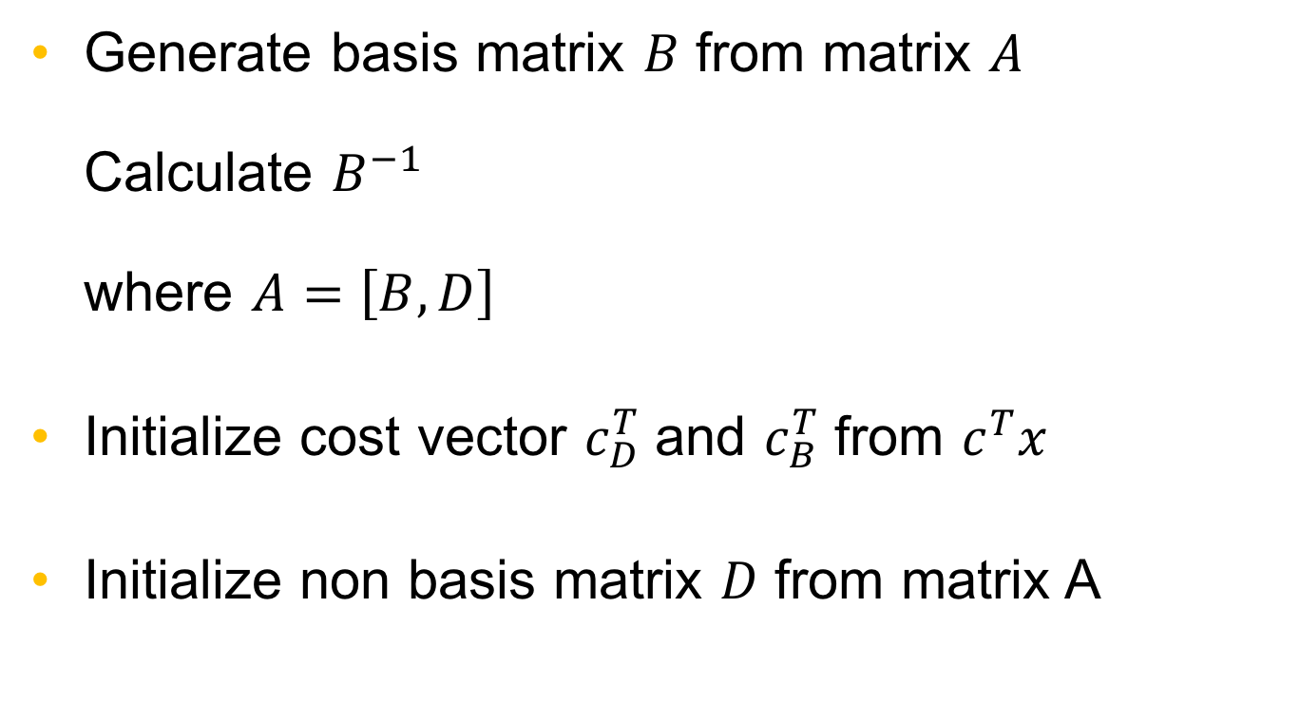
Initialization
Generate basis matrix $B$ from matrix $A$ Calculate $B^{−1}$ where $A=\left[B, D\right]$
Initialize cost vector $c_{D}^{T}$ and $c_{B}^{T}$ from $c^{T}x$
Initialize non basis matrix $D$ from matrix A

Slide 16
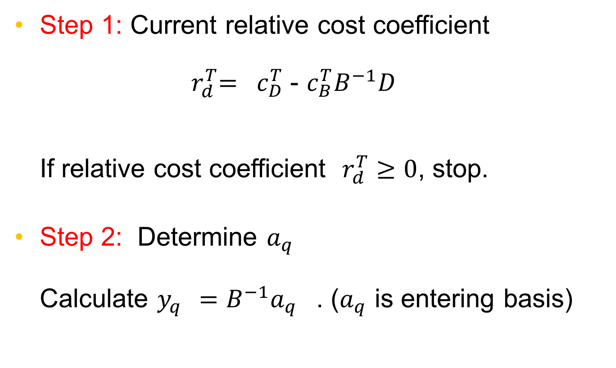
Revised Simplex Algorithm
Step 1: Current relative cost coefficient ${ r}_{d}^{T}= c_{D}^{T}$ - $c_{B}^{T}B^{−1}D$ If relative cost coefficient $r_{d}^{T}≥0$, stop.
Step 2: Determine $a_{q}$ Calculate $y_{q}^{}=B^{−1}{a_{q}}_{}^{}$. ($a_{q}$ is entering basis)

Slide 17
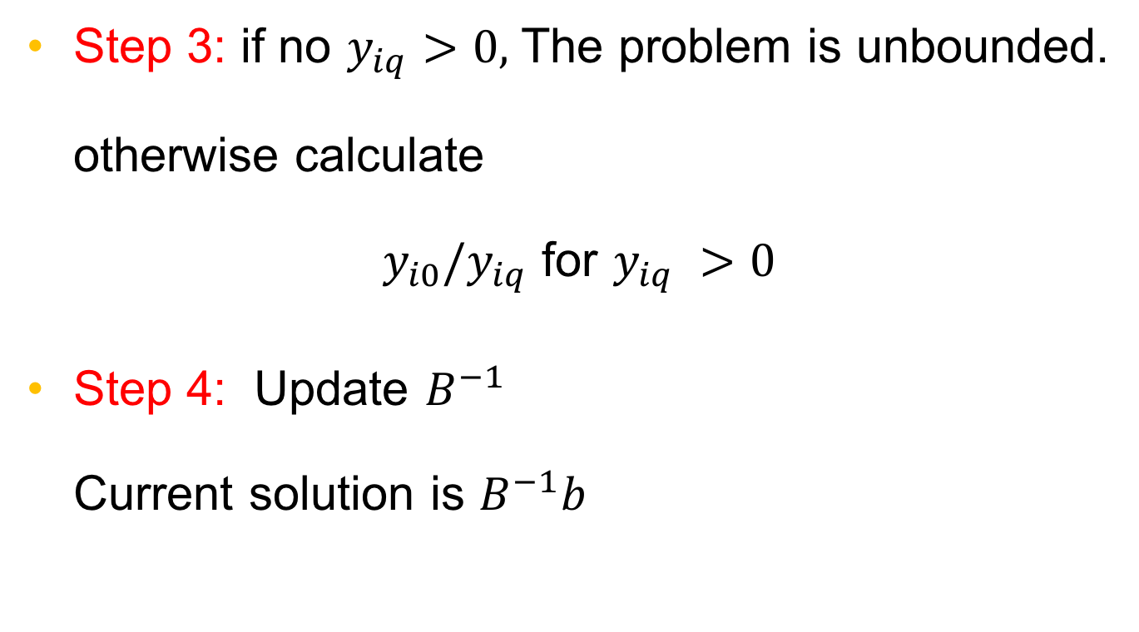
Revised Simplex Algorithm Continued
Step 3: if no $y_{iq}>0,$ The problem is unbounded. otherwise calculate $y_{i0}/y_{iq}$ for $y_{iq} >0$
Step 4: Update $B^{−1}$ Current solution is $B^{−1}b$

Slide 18
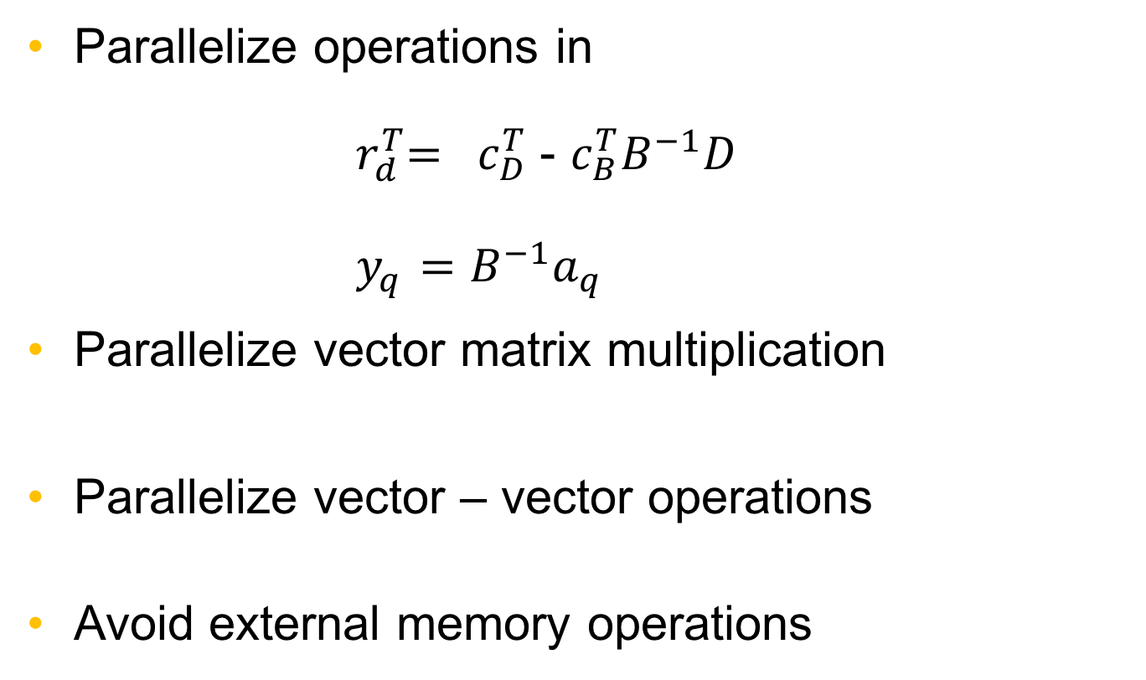
Proposed parallel Simplex algorithm
Parallelize operations in ${ r}_{d}^{T}= c_{D}^{T}$ - $c_{B}^{T}B^{−1}D$ ${ y}_{q}^{}=B^{−1}{a_{q}}_{}^{}$
Parallelize vector matrix multiplication
Parallelize vector – vector operations
Avoid external memory operations

Slide 19
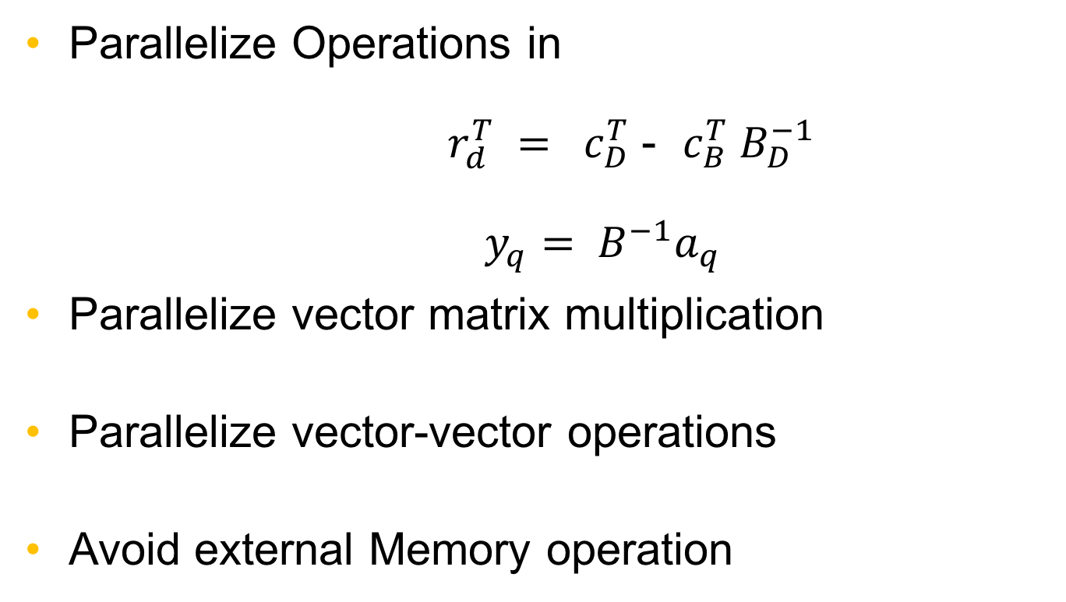
Proposed parallel Simplex algorithm
Notes:
Paralellize v

Slide 20
Experiment Setup
Cloud Cluster
Amazon Web Services EC2
Node Configurations
1 virtual CPU
1 GB RAM
Software
Python 2.7
Apache Spark 2.1.1
Notes:
Explain what software and hardware resources you are using to test your implementation.

Slide 21

Parallel Implementation of Simplex at the Cloud
Apache Spark
Open source framework
Recovery of partitions
Interactive nodes
Fast speed

Slide 22

Apache Spark
Efficient parallel computation
Real time and batch processing
Easy to use
Notes:
Smooth transition
100 times faster than hadoop
Real and batch processing
Machine learning algorithm
Recovery of partitions
Interactive nodes
AWS
EC2
Explain that in this project you are using Spark. Explain why Spark is a good solution to do this.
Mention current cloud implementations to solve LPs.

Slide 23

Apache spark Implementation
Used machine learning library from Spark for matrix operations
Scipy and numpy libraries for non parallel operations
Notes:
Explain what library and functions we are using

Slide 24
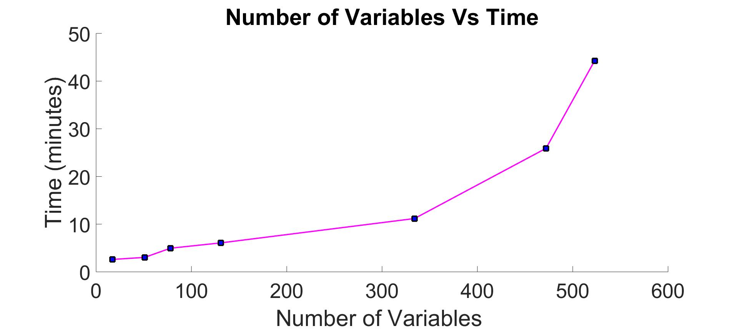
Time vs Matrix size
Notes:
No of variables
Set cga fontsize , linewidth 22

Slide 25
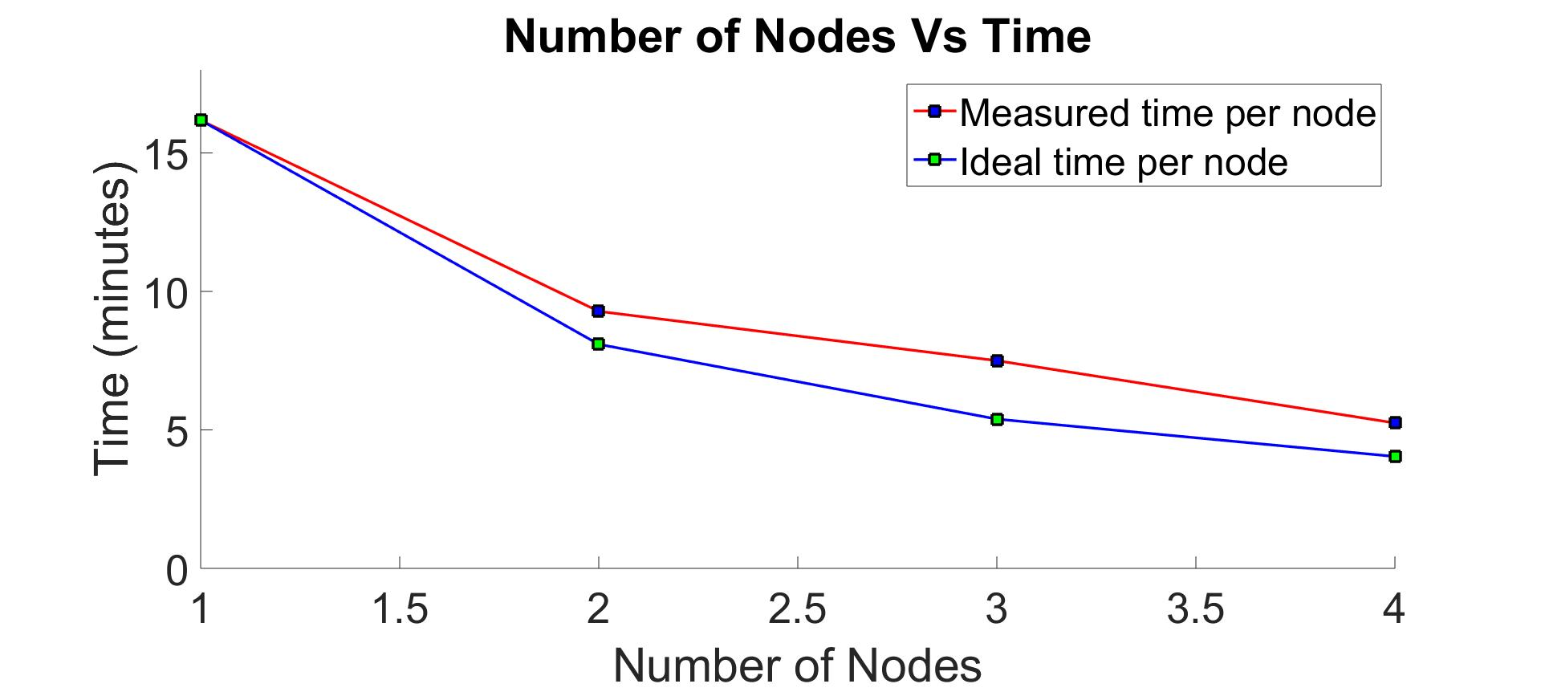
Nodes Vs Time (334 variables)

Slide 26
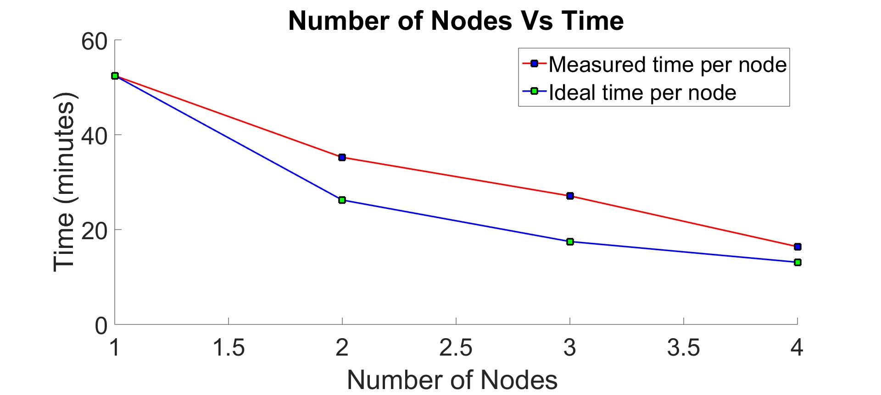
Nodes Vs Time (530 variables)

Slide 27
Result verification
Calculated benchmark LP with known solution
Compared to known solutions to verify correctness
Notes:
Benchmark LP with known Objective functions,

Slide 28
Conclusion
Investigated LP for big data analysis
Implemented revised simplex algorithm on cloud
Parallel computation
Evaluated performance of the implementation
Observed that we reduce the computation time with additional nodes

Slide 29
Future works
Parallelize scalar divisions
More accurate control of matrix parallelization
Implement other known parallel algorithm
Security issues

Slide 30


Thank you
30

Slide 31
Questions?
31

