Slide 1


Beginner’s Python – Session One
The AZ Code Club Team
Blank Template
Filled Template

Slide 2


Session Content
Setting up Google Colab
Printing
Arithmetic with Python
Variables and variable typing

Slide 3

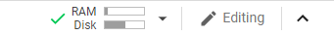
Using Google Colab
Colab is an interactive editor for Python in the cloud
To get started, open Google Colab in Chrome
Sign in using your personal Google account
Click ‘New Notebook’ or, if this is not an option, ‘File > New Notebook’
Top right hand corner should look like this
If not, click ‘connect’

Slide 4
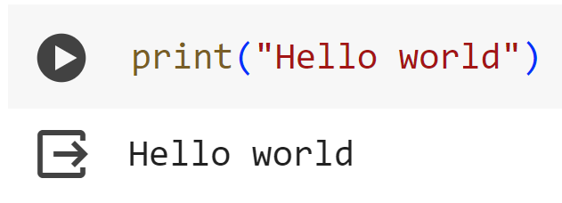
Using Google Colab
Google colab is a notebook environment. We can organise code into cells which we run one at a time, with output from a given cell displayed beneath that cell.
Cells can be run by hitting play, or pressing ‘shift + enter’

Slide 5
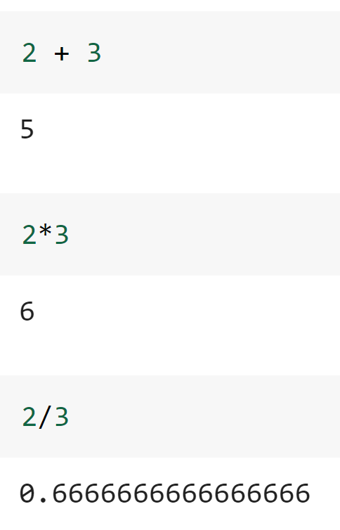
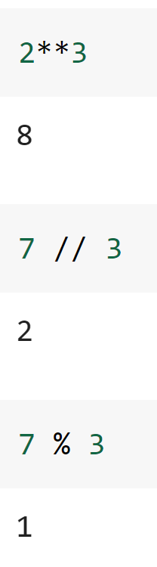
Python as a Fancy Calculator
The simplest use case of python is for arithmetic. Python contains easy to use syntax for all the most common arithmetic operations.
addition
exponentiation
multiplication
integer division
remainder
division

Slide 6
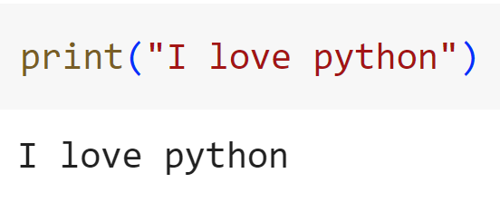
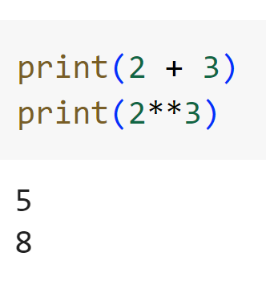
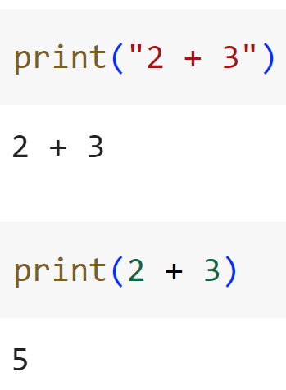
Printing
The print() function explicitly tells python to write something to the output.
Note: “I love python” is a string. The “ ” marks tell python to treat what is inside them as pure text, not as code to be executed.
print() also accepts non-string arguments.
Try running this cell without the print functions to see why we need them!

Slide 7
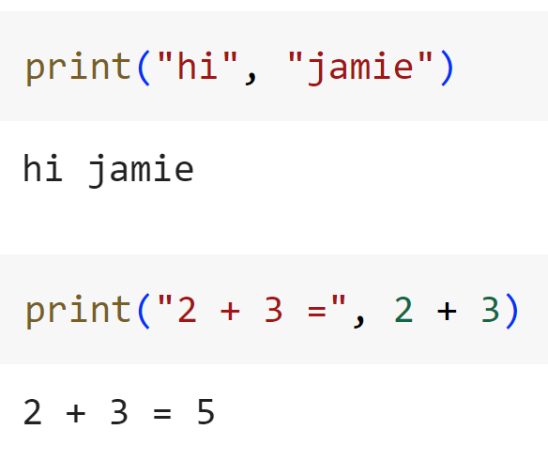
Printing
print() accepts multiple arguments, it will print the concatenation of them, with each argument separated by a space.
Remember to separate each input using a comma
As we can see above, Python is happy to combine both text and arithmetic.

Slide 8
Printing and Arithmetic Puzzles
Print your three favourite colours by passing them as three separate inputs to print()
Calculate 26, multiplied by 66, plus 13
Perform the same calculation but with 13 added to 66 before multiplication by 26 (python recognises brackets to define the order of operations)

Slide 9
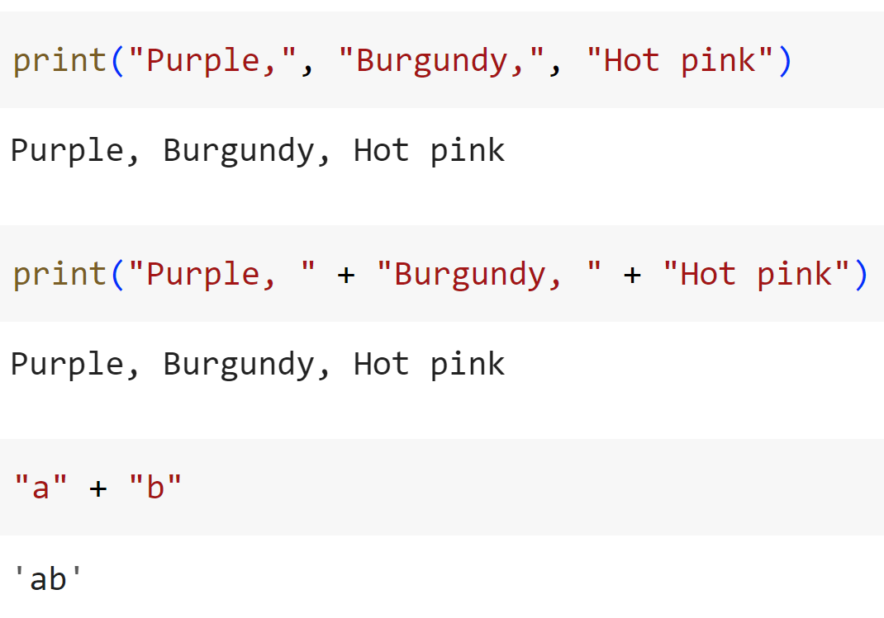
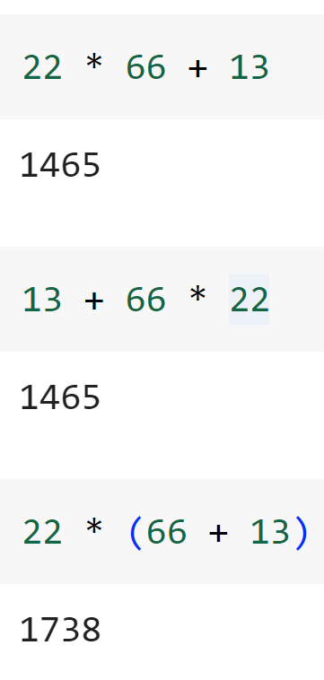
Printing Puzzles Solutions
+ can be used to concatenate strings with no spaces
python recognises order of operations by default. We can use brackets () to override this.

Slide 10
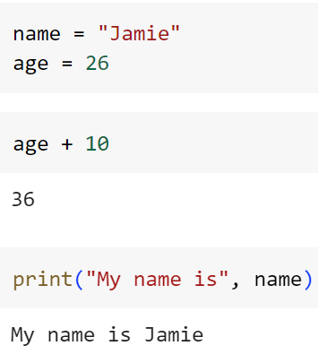
Variables
Variables allow you to store information for later use in your code
We assign a value to a variable name using the = symbol
We can then refer to these quantities via their name in later code
Once you’ve created a variable it will continue to exist until you either delete it or close your browser

Slide 11
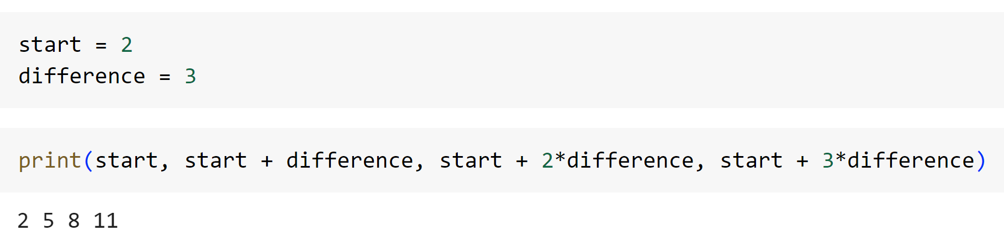
Why use Variables?
If we want to change the value of something, it is much less work when that thing is stored as a variable!
less work = less errors
Using variables also often makes code more readable

Slide 12
Variables Puzzles
Create two variables called name and age, giving them the value of your name and age respectively
Get Python to print these in the following format:
Hi, my name is David and I am 24
Print what your age will be in 5 years’ time
Super Bonus: Create a variable whose value is any number. Print that number, twice the number, and one less than the number. Now change the number. How did using variables make this process easier?

Slide 13
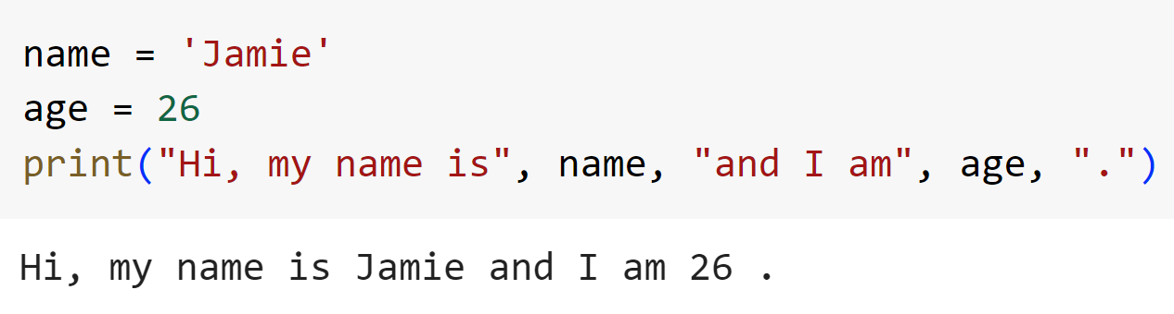
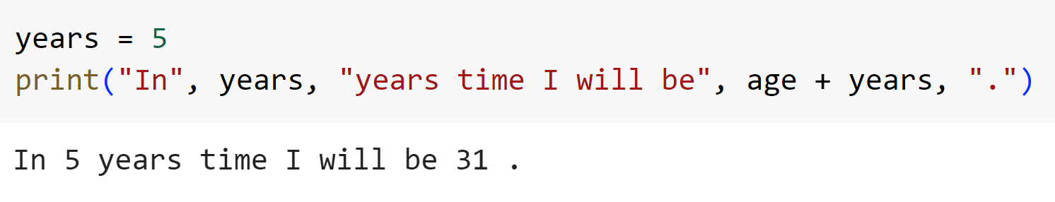
Variables Puzzles Solutions

Slide 14
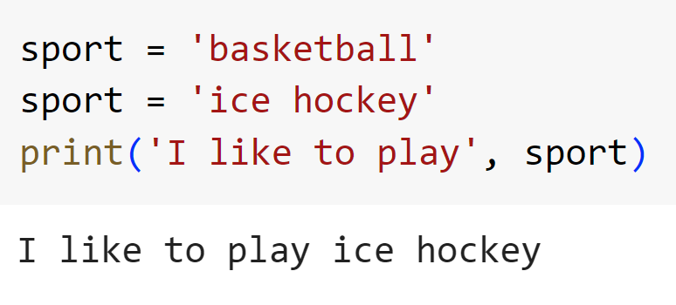
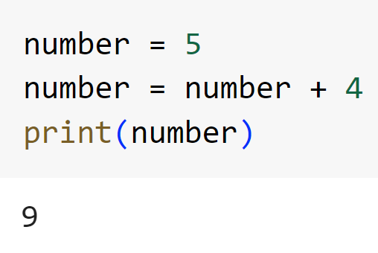
Manipulating Variables
Python will only remember the last value that you assigned to a variable
The act of giving a variable a new value is known as overwriting
Pay attention to the bracketed numbers next to code cells. These show which order cells were run in (which doesn’t have to be top to bottom!)

Slide 15
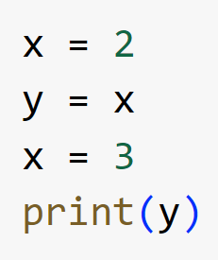
Manipulating Variables Puzzles
Run the following lines of code:
What do you think the output of this will be?

Slide 16
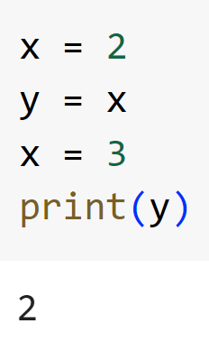
Manipulating Variables Puzzles Solutions
Not what you expected? Remember: the equals symbol in Python means ‘assign the value on the right to the variable on the left’. It has nothing to do with the equals symbol in maths.
Here, the third line says “assign the variable y the value of the variable x”. When Python sees x it remembers that it has a value of 2 so this becomes y = 2
Changing x after makes no difference since the last value y was set to was 2, regardless

Slide 17
Variable Types
There are different types of variable in Python. Some we have seen:
string (e.g. “Hello”)—text in quotes, called strings because they are a string of characters
integer (e.g. 4)
float (e.g. 3.14)—decimal numbers, called floats due to how Python stores them (Google ‘floating-point arithmetic’ if you’re curious)
There are many types that we haven’t come across (yet!):
boolean (True/False)
list, tuple, set
dictionary

Slide 18

Aside: Functions
We keep on using this word ‘function’—what does it mean?
A function is essentially a command you can tell Python to follow
They always follow the following format:
That is, a function name (which almost always starts with a lowercase letter) followed by a pair of brackets, which we fill with inputs separated by commas
print(), type(), int(), float(), and str() are all functions

Slide 19
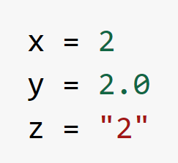
Variable Types Puzzles
Define the following variables
What types do you think they will each have? Check!
Create two string variables. What happens when we add them together using `+` and print the result?
Bonus: What happens when we multiply a string by an integer?

Slide 20
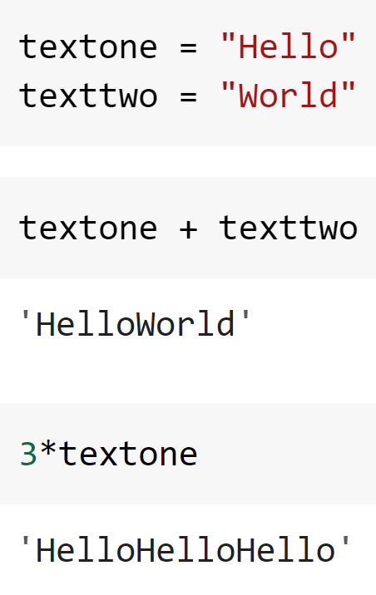
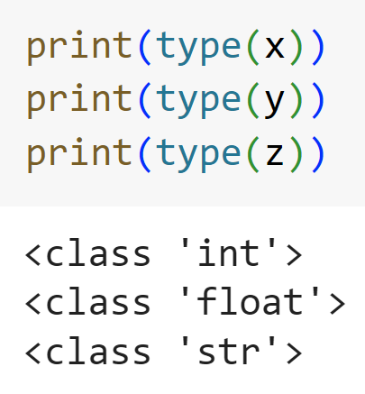
Variable Types Puzzles Solutions

Slide 21

More Variable Puzzles
Create a variable `pi` with the value 3.14 and a variable `radius` with any value of your choosing
Use these to print the circumference and area of a circle with radius equal to the value of `radius`
You may need the following formulae:
Bonus: use the round() function to round your answer to 2 decimal places. This takes two inputs, a number to round and the number of decimal places to round to (separated by a comma, remember!)
$$Area=π×r×r$$
$$Circumference=2×π×r$$

Slide 22
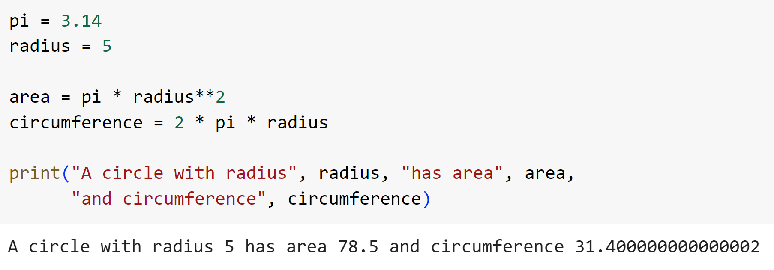
More Variable Puzzles Solutions
Note, in most cases, Python ignores extra spaces and new lines
Therefore we can go onto a new line after printing area without changing how Python executes the code. It just makes it easier for us to read!

Slide 23
Next Time
Accepting user input
More variable typing
Storing lists of numbers
Finding the total, length, min and max of a list
See you then!

