Slide 1


Beginner’s Python – Session Seven
The AZ Code Club Team
Blank Template
Filled Template

Slide 2
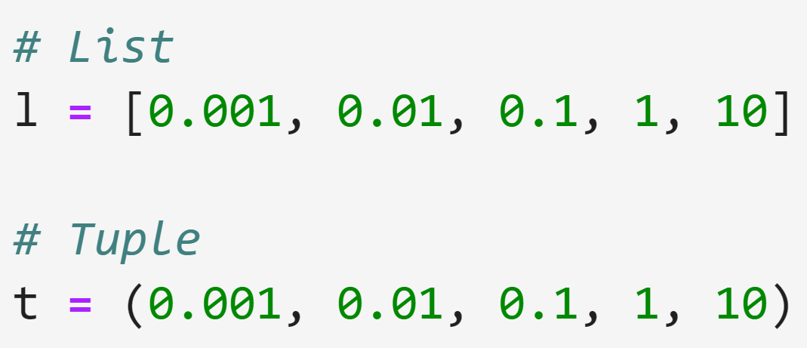

Beginners Python Session 7 - Dictionaries
Starter Questions:
What are the relative advantages of lists and tuples, i.e. why might you choose to use one over the other?
Are there any common disadvantages of both lists and tuples?

Slide 3
Limitations of Lists and Tuples
Lists and tuples are flexible data types but they also have limitations
They are a great way to store data that has a well-defined order and so can be indexed by non-negative integers
What can we do when the data we have to store doesn’t have such a nice structure? — We use a dictionary!
Index | Value
0 | Beijing
1 | New Delhi
2 | Tokyo
3 | Moscow
Key | Value
England | London
France | Paris
Germany | Berlin
Spain | Madrid
List/tuple paradigm
Dictionary paradigm

Slide 4
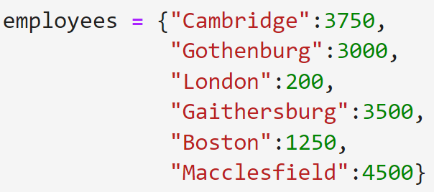
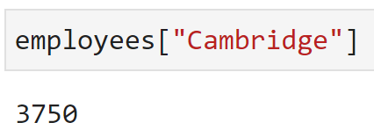
Dictionaries
We create dictionaries in Python using curly brackets {}
We then separate multiple items by commas
Each item is formed of a key-value pair separated by a colon
Keys are typically strings, integers, or floats and can be thought of as the ‘address’ of the value
We access dictionaries’ values in the same way as a list
Dictionaries, unlike lists, have no defined order

Slide 5
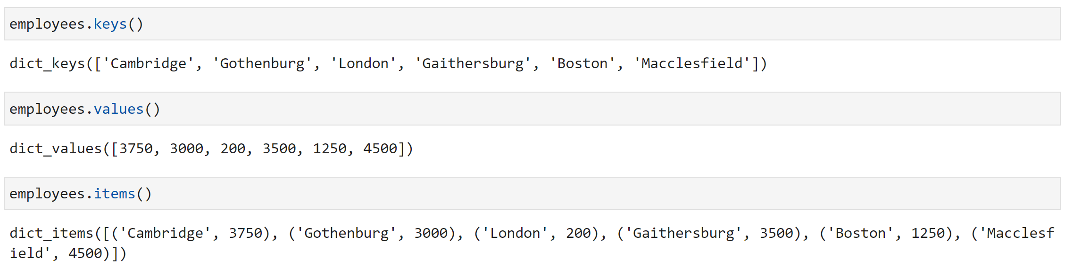
Components of a Dictionary
The indexing objects of a dictionary are called keys
The values are called values
The (key, value) pairs are called items

Slide 6
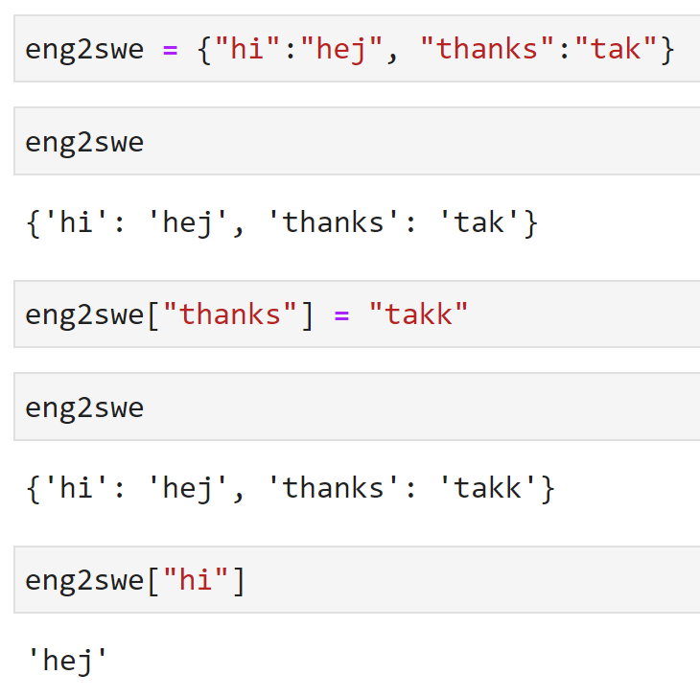
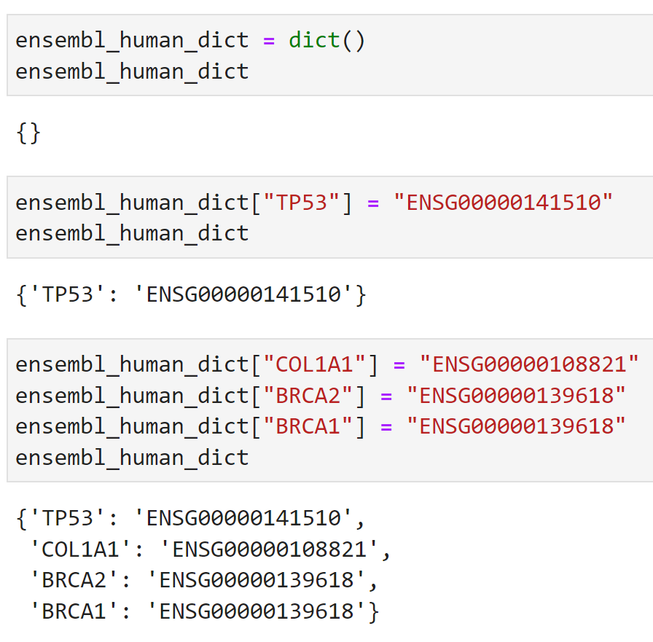
Dictionaries – More Examples
Different ways of referring to the same gene
English-Swedish lookup
The function dict() creates an empty dictionary
Values can be overwritten after dictionary creation. Dictionaries are mutable
New items can be added to a dictionary after it’s creation.

Slide 7
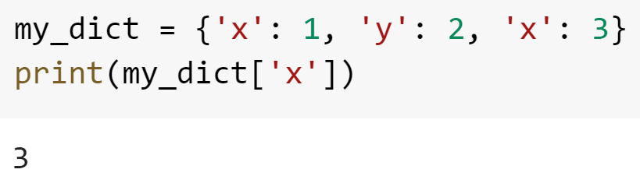
Dictionaries Puzzles
Create a dictionary with some information about you. Try to include at least one value of each of the types integer, string, list and Boolean.
Print out some of the values of the dictionary
What do you think the following code will do? Try it.

Slide 8
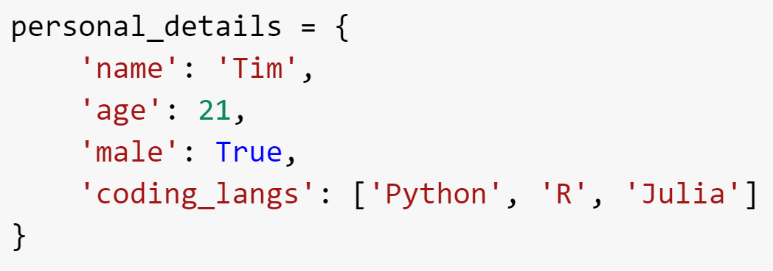
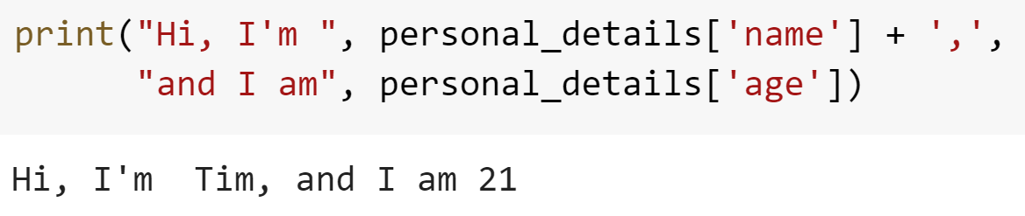
Dictionaries Puzzles – Solutions

Slide 9
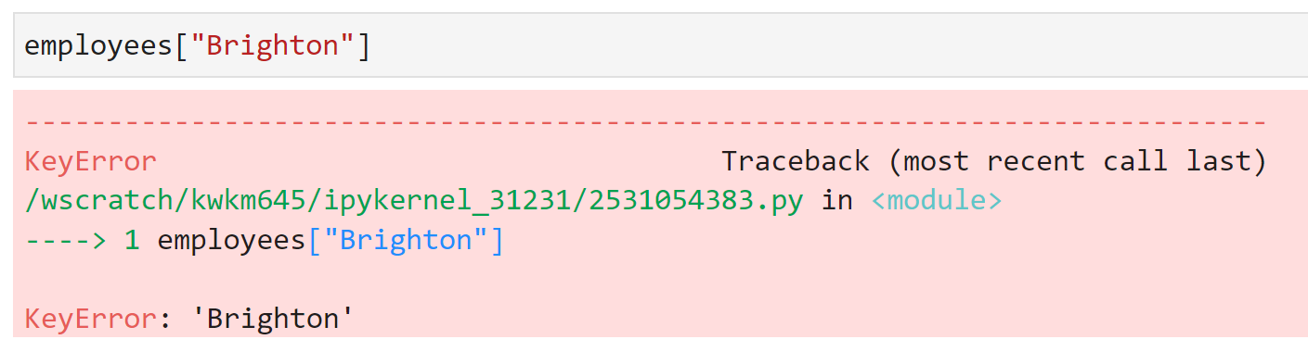
Dictionaries
What happens when we try to access a key that doesn’t exist in a dictionary?

Slide 10
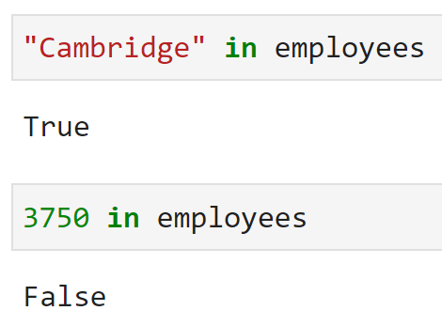
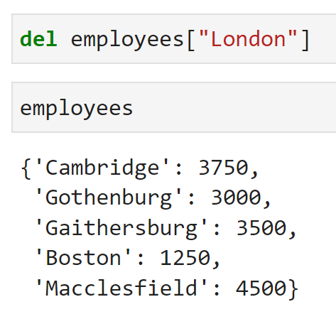
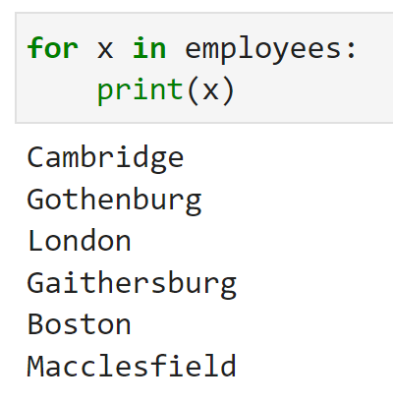
Working with Dictionaries
By default, python usually interacts with dictionaries via their keys
Check for membership
Looping over a dictionary
Deleting an entry

Slide 11
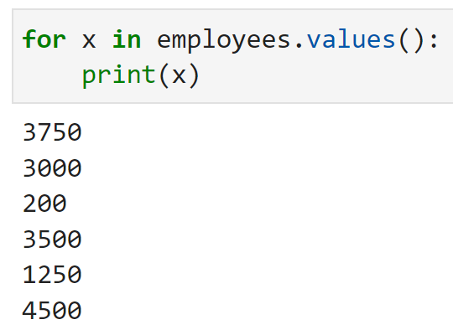
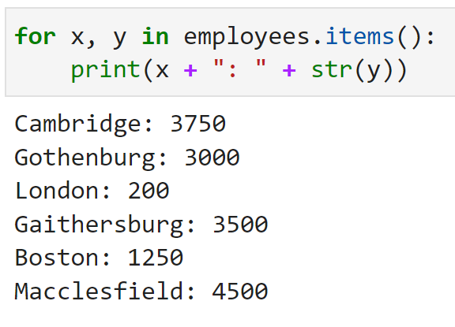
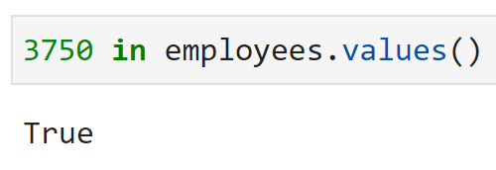
Working with Dictionaries
If you want to interact with a dictionary via it’s keys or items, this can be done manually.

Slide 12
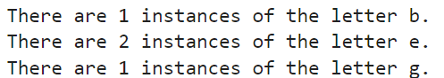
More Dictionaries Puzzles
Create a function that takes a string as input, and outputs a dictionary containing the number of times each character appears in the string. Try running it on the string “beginners python”.
Modify the function so it prints an output of the form below (bonus points if you can correct my grammar):
There are many modifications you could make to this function, e.g. printing out the letters in order of frequency, dealing with capital letters. I encourage you to do some experimenting in your own time.

Slide 13
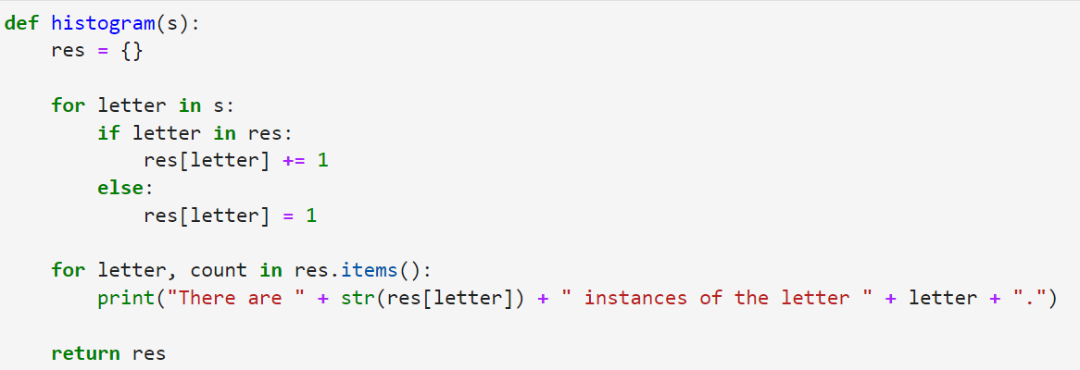
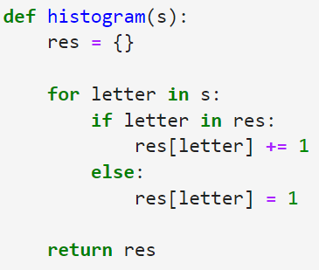
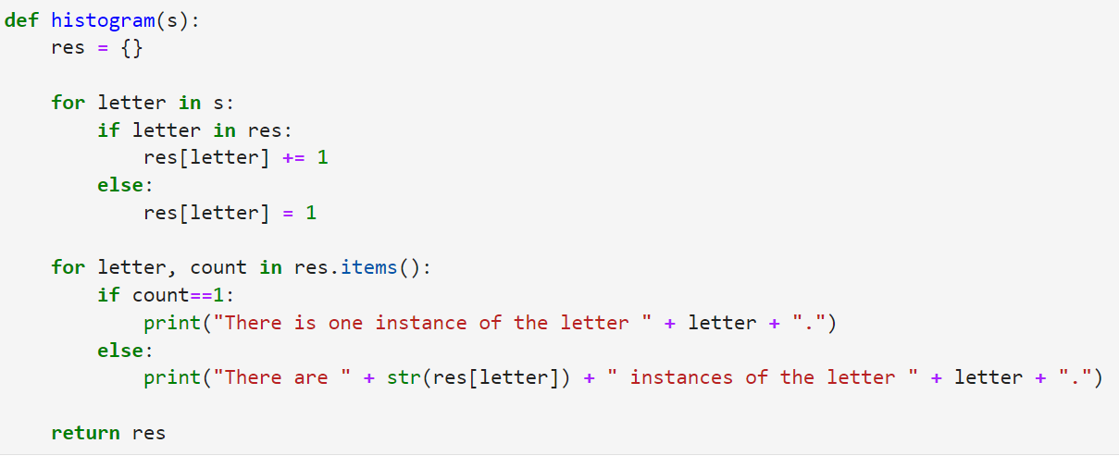
More Dictionaries Puzzles – Solutions
With print functionality
Initial solution
With correct grammar

Slide 14
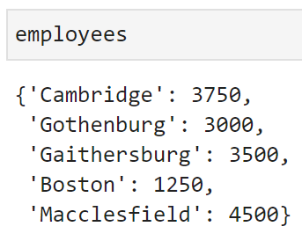
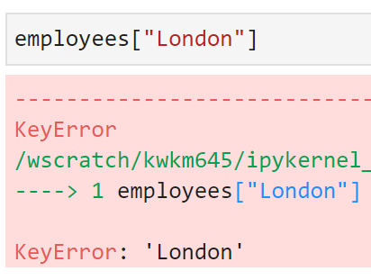
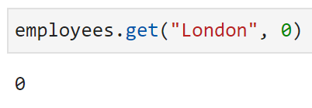
Handling Missing Keys
The .get() method allows you to specify a default value to return if the given key does not appear in the dictionary.

Slide 15
Dictionaries and Lists
Lists can appear as values in a dictionary (though this can quickly get confusing with double indexing – d[“x”][0])
However, lists cannot be used as keys. This is because they are mutable – they can be altered after their creation, and without re-assignment.
Tuples are immutable, and thus can be used as keys.
Can a dictionary be used as a key in another dictionary? 🤔

Slide 16
Advanced Dictionaries Puzzles
Use the .get() method to re-write the function you wrote in the previous exercise without any if statements.
Create a function that takes as input a dictionary g, and returns a dictionary h such that
the keys of h are the values g
The value of h[y] is a is a list of keys x such that g[x] = y
e.g. if g = {“a”:1, “b”:1, “c”:2}, then h should be such that h[1] = [“a”, “b”], h[2] = [“c”]

Slide 17
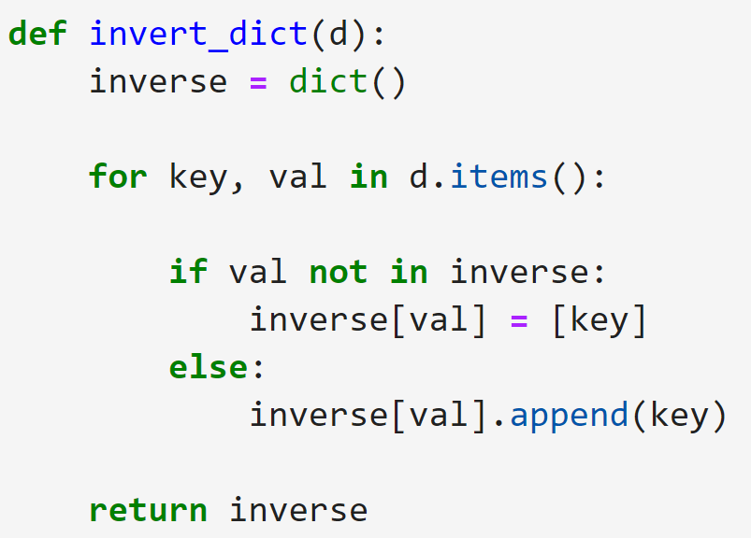
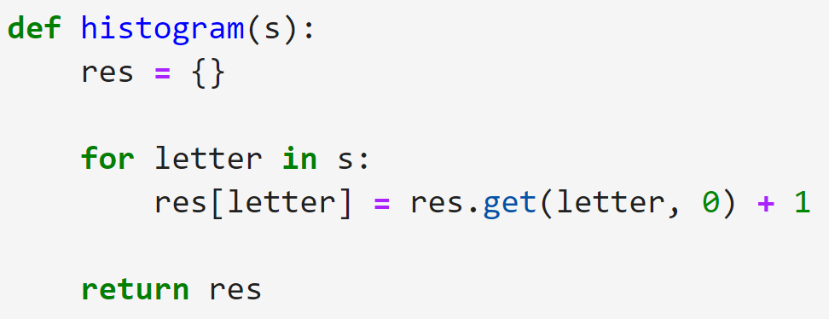
Advanced Dictionaries Puzzles – Solutions

