Slide 1
SOFTWARE PROJECT PRESENTATION · 2026
GLASSWALL
Web page
name, email, phone, card
On the device
read · detect · redact
A privacy-preserving browser agent with on-device visual perception
Over the network
⟦EMAIL#1⟧ ⟦PHONE#2⟧
LLM planner
returns one action
An AI agent that fills web forms without the AI ever seeing your personal data.
Real values never leave the browser. The form still fills.

Slide 2
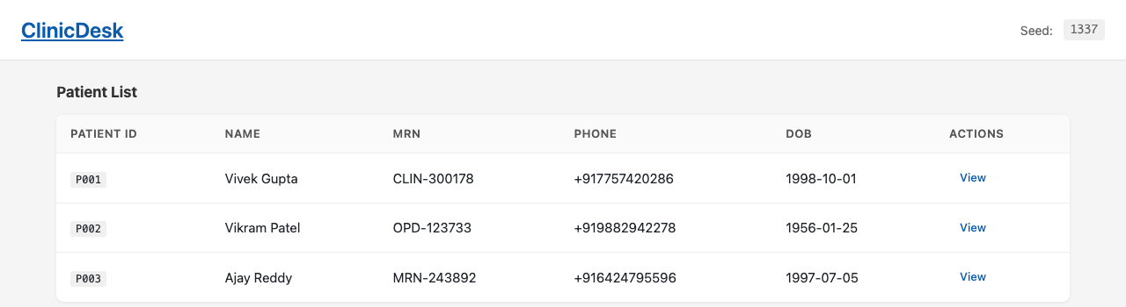
DESCRIPTION
What GLASSWALL is, and why
A Chrome extension plus a small server that let an AI model operate a web page for the user, without the model ever receiving the personal data on that page.
THE PROBLEM TODAY
1
Reads the page on the device
structure, text and pixels
Browser agents upload the whole screen to a cloud model.
2
Replaces personal values with handles
an email becomes ⟦EMAIL#1⟧
Anything the detector misses is sent as-is.
The AI plans, the device acts
the real value is filled in locally
Hiding a value from the AI means it cannot fill the form.
3
GLASSWALL Privacy-preserving browser agent
2

Slide 3
SOLUTION
One step of the agent loop
1 SEE
2 SANITIZE
3 GATE
4 REASON
5 ACT
on device
on device
on device
server
on device
Read the page. Run OCR and name detection locally.
Personal values become handles like ⟦EMAIL#1⟧. Sensitive pixels are blacked out.
One exit for all traffic. Anything that still looks personal is blocked.
An LLM reads the handle-only page and returns one action.
Check the action, resolve handles from the local vault, execute.
one action comes back, then runs on the device
LEAVES THE DEVICE
Page structure, labels and handles.
Under BALANCED policy, a screenshot redacted on the device.
NEVER LEAVES THE DEVICE
Real values, raw screenshots, cookies, storage.
Under STRICT policy, no screenshot is even taken.
GLASSWALL Privacy-preserving browser agent
3

Slide 4
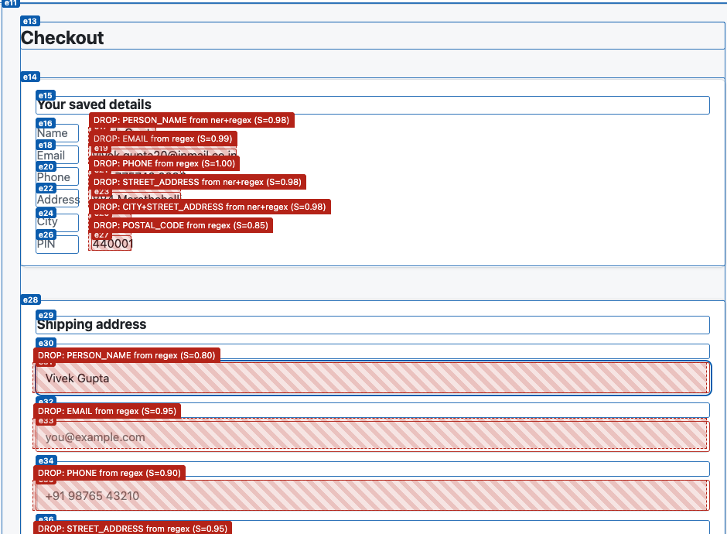
FEASIBILITY
Already built and running
1
Working prototype
Chrome extension, gateway server and three test websites.
2
Runs on an ordinary laptop
Models ship inside the extension. About 1 to 2 s of local work per step.
3
Any LLM
Works with a local model (Ollama) or any hosted API. A scripted fallback always answers.
4
Tested end to end
503 unit tests, automated browser runs, and a leak test that can fail.
A real run on a checkout page. Blue: elements the AI may act on. Red: values removed on the device.
GLASSWALL Privacy-preserving browser agent
4

Slide 5
TECHNICAL APPROACH
Architecture and stack
CHROME TAB
EXTENSION · runs on the device
GATEWAY · server
Content script
reads the page, performs the action
Orchestrator
runs the loop, validates every action
Node + Fastify
builds the prompt, checks the model's action
Local models
NER and OCR in WebAssembly
TRUST BOUNDARY
Privacy library
detect, redact, vault, gate
Side panel
task, policy, trace, confirmation
LLM providers
Ollama, Groq, OpenRouter, Anthropic
one network call, checked payloads only
STACK
Client
TypeScript · Chrome MV3 · React · Zod
On-device AI
ONNX Runtime Web · Transformers.js · Tesseract.js
Server
Node.js · Fastify · OpenAI-compatible APIs
Tooling
pnpm · Vitest · Playwright · ESLint
GLASSWALL Privacy-preserving browser agent
5

Slide 6
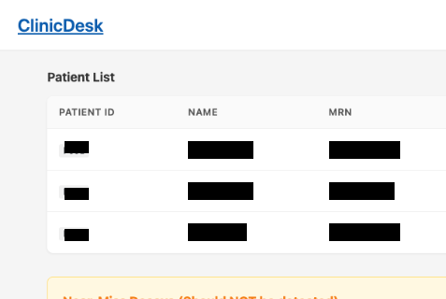
RESULTS
Measured end to end with the real extension
Page elements found
Personal data caught
Redaction precision
Local work per step
Time per step
Tasks completed
97.8 %
100 %
95.6 %
1.8 s
2.1 s
33 / 33
precision 99.7 %
0 leaks
regions that needed hiding
payload 41 KB
p95 2.7 s
6 tasks · 3 seeds · 2 policies
Automated runs on three test websites, on an ordinary laptop (Apple M1, 8 GB).
WHAT LEAVES THE DEVICE (REAL CAPTURES)
WITH A REAL LLM PLANNER
11 / 11 tasks completed · 0 leaks
3.4 s per step, median
Privacy results did not change; only network and model time was added.
Before: the page as rendered.
After: the only image that can leave.
GLASSWALL Privacy-preserving browser agent
6

Slide 7
SCALABILITY
Why it scales, and what comes next
WHY IT SCALES
NEXT STEPS
All perception runs on the user's device, so the server stays small.
A smaller, faster NER model on WebGPU.
Each step sends about 17 to 40 KB, not a full screenshot.
A face and document detector for images.
Works with any LLM: local and offline, or hosted.
A hosted server with TLS and per-user limits.
Same privacy boundary on every website, by design.
Firefox support and a signed audit log.
GLASSWALL Privacy-preserving browser agent
7

Slide 8
Thank you
Questions and discussion
GLASSWALL · A privacy-preserving browser agent with on-device visual perception
Source and reports: github.com/rkhooda/GlassWall

