Slide 1
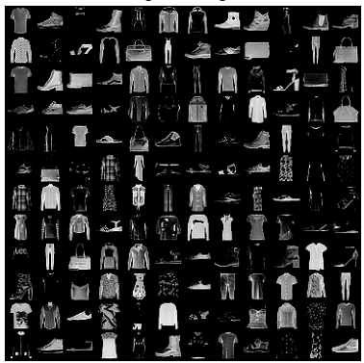


Real
Baseline
Aligned-MO

