Slide 1
FIM 590-002 Group Project: Prediction of Probability of Charged using Lending Club Dataset
Under the Guidance OF
Dr. Ram Valluru
Group Members:
Jingjing Zhang
Kartheek Manavarthi
Muktanidhi S Dhotrad
Rohit Khurana
Sandeep Girada

Slide 2
1. TOPIC & DATA
Project Objective: If we are given a set of acquisition attributes with respect to a loan on lending club, how can an investor decide to invest or not?
Dataset
Why this Data?
Lending Club
Tools
Investor Decision based upon the Loan Acquisition Attributes
Orange
Excel
Analysis & Results
Statistical Analysis
Python

Slide 3
2. Data Exploration & Transformations
Data
Data Exploration (EDA)
Excluded all Loans with “Other” Statuses
Defined Target
Target Variable: Loan_Status
Lending Club Dataset
Binary (Fully Paid or Charged Off)
Record size: 2 million
Number of Predictors:- ~ 50 variables
Predict Probability of Default
Result
Notes:
Explain that an investor can decide if he/she knows the probability of default, which we are modeling, looking at charged-off loans and fully paid loans.
We are excluding all other loans with any other statuses.
Explain the features that we are going to use and why, define target. Explain transformations if any (continuing or discretizing variables). If we are making imputations in place of null values, explain how and why.
Visualization plots using features (Box, Scatter, Distributions, Outliers)

Slide 4
Transformations and Methods (2. Data Exploration & Transformations)
DTI:
Simple mean imputer for DTI
Negatives DTI were made zero,
home_ownership
Values like (RENT, MORTGAGE, OWN, OTHER) created dummies for each
Test and Train divided by stratified sampling
Data Segregation: 20% holdout, all performance done on holdout, fitting is done using 5-fold validation
Notes:
Explain that an investor can decide if he/she knows the probability of default, which we are modeling, looking at charged-off loans and fully paid loans.
We are excluding all other loans with any other statuses.
Explain the features that we are going to use and why, define target. Explain transformations if any (continuing or discretizing variables). If we are making imputations in place of null values, explain how and why.
Visualization plots using features (Box, Scatter, Distributions, Outliers)

Slide 5
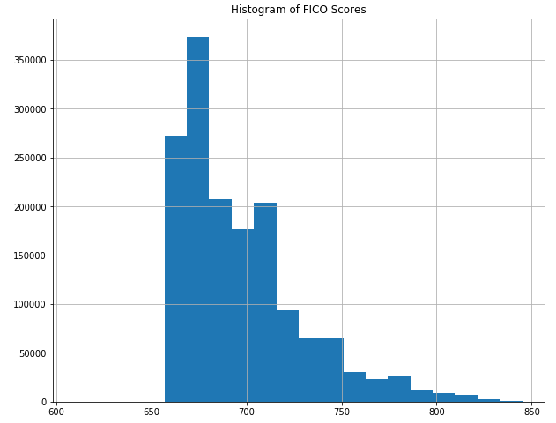
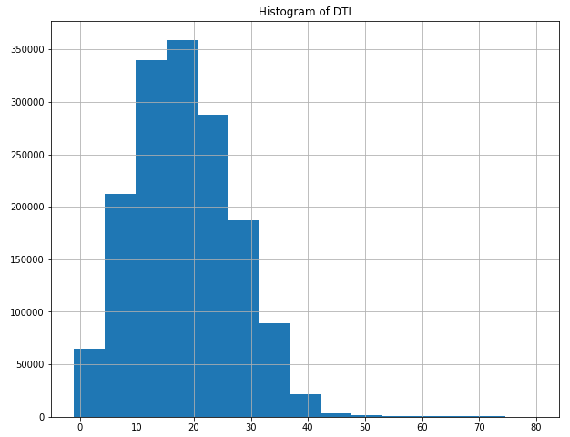
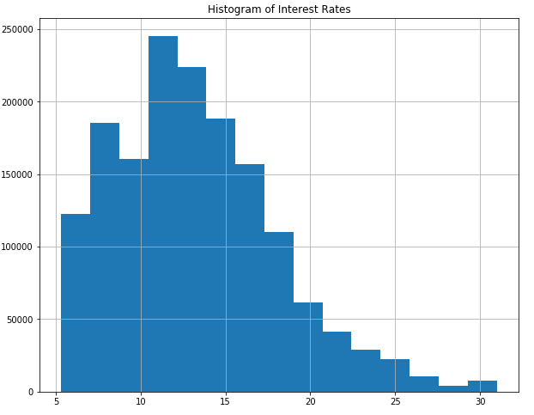
DATA Visualization – Features (2. Data Exploration & Transformations)
Notes:
Explain that an investor can decide if he/she knows the probability of default, which we are modeling, looking at charged-off loans and fully paid loans.
We are excluding all other loans with any other statuses.
Explain the features that we are going to use and why, define target. Explain transformations if any (continuing or discretizing variables). If we are making imputations in place of null values, explain how and why.
Visualization plots using features (Box, Scatter, Distributions, Outliers)

Slide 6
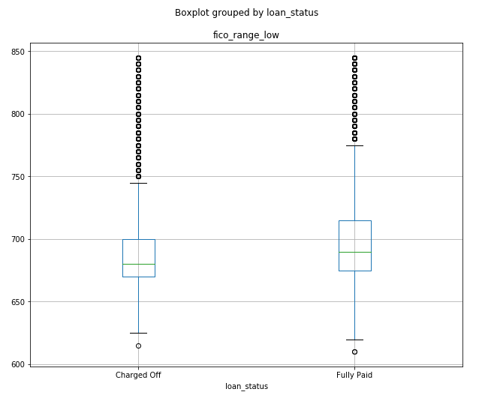
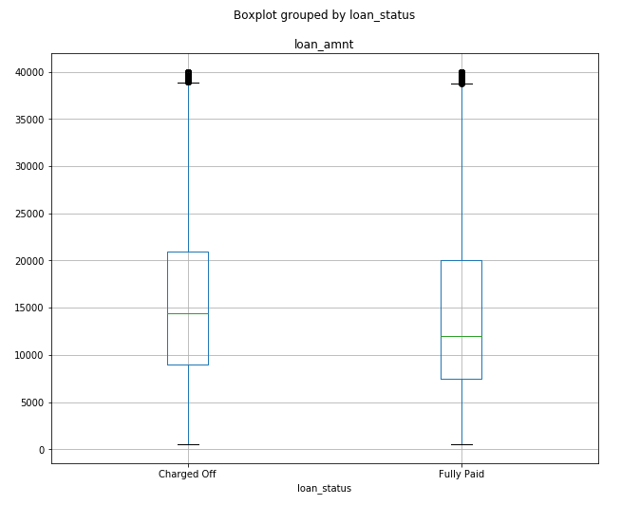
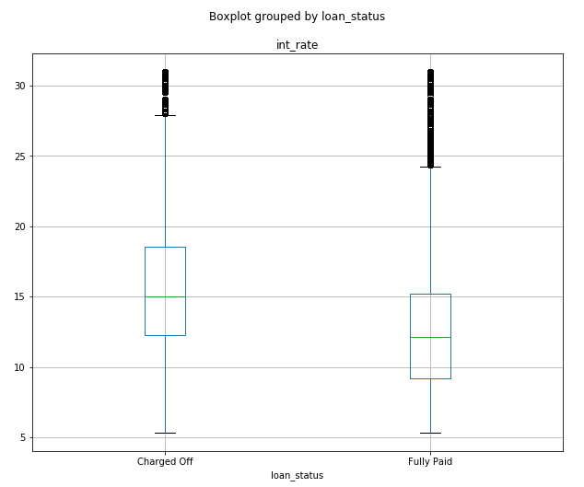
DATA Visualization – Features Against Target Variable (2. Data Exploration & Transformations)
Notes:
Explain that an investor can decide if he/she knows the probability of default, which we are modeling, looking at charged-off loans and fully paid loans.
We are excluding all other loans with any other statuses.
Explain the features that we are going to use and why, define target. Explain transformations if any (continuing or discretizing variables). If we are making imputations in place of null values, explain how and why.
Visualization plots using features (Box, Scatter, Distributions, Outliers)

Slide 7
Feature Selection and Target Variable
Independent Variables
Interest Rates
Debt to Income (DTI)
Loan Amount
Loan Purpose
FICO_Range_LOW
Home Ownership
Target Variable
Delinquency in Last 2 Years
Loan_Status
Credit Inquiries in Last 6 Months

Slide 8
3. Model Building & Assessment
Models
Gradient Boasting Classifier Algorithm
Assessment
AUC
Model Report
Random Forest
ROC Curve
Logistic Regression
We have also tried LightGBM and GBC (Gradient Boosting Classifier) Algorithms
Notes:
Explain that an investor can decide if he/she knows the probability of default, which we are modeling, looking at charged-off loans and fully paid loans.
We are excluding all other loans with any other statuses.
Explain the features that we are going to use and why, define target. Explain transformations if any (continuing or discretizing variables). If we are making imputations in place of null values, explain how and why.
Visualization plots using features (Box, Scatter, Distributions, Outliers)

Slide 9
Model 1: LOGISTICS Regression Model Analysis (3. Model Building & Assessment)
Unbalanced | Balanced
 | precision | recall | F1 - score | support
0 | 0.81 | 0.99 | 0.89 | 315389
1 | 0.50 | 0.05 | 0.10 | 77128
 | precision | recall | F1 - score | support
0 | 0.88 | 0.65 | 0.75 | 315389
1 | 0.31 | 0.63 | 0.41 | 77128
accuracy |  |  | 0.80 | 392517
Macro avg | 0.65 | 0.52 | 0.49 | 392517
Weighted avg | 0.75 | 0.80 | 0.73 | 392517
accuracy |  |  | 0.65 | 392517
Macro avg | 0.59 | 0.64 | 0.58 | 392517
Weighted avg | 0.77 | 0.65 | 0.68 | 392517
AUC: | 0.69238999
AUC: | 0.69334827
 | Predicted 0 | Predicted 1
Actual 0 | 311207 | 4182
Actual 1 | 72981 | 4147
 | Predicted 0 | Predicted 1
Actual 0 | 206274 | 109115
Actual 1 | 28857 | 48271
Notes:
Explain that an investor can decide if he/she knows the probability of default, which we are modeling, looking at charged-off loans and fully paid loans.
We are excluding all other loans with any other statuses.
Explain the features that we are going to use and why, define target. Explain transformations if any (continuing or discretizing variables). If we are making imputations in place of null values, explain how and why.
Visualization plots using features (Box, Scatter, Distributions, Outliers)

Slide 10
Model 2: Random Forest Model Analysis (3. Model Building & Assessment)
Unbalanced | Balanced
 | precision | recall | F1 - score | support
0 | 0.80 | 0.99 | 1.00 | 315389
1 | 0.60 | 0.05 | 0.01 | 77128
 | precision | recall | F1 - score | support
0 | 0.88 | 0.63 | 0.73 | 315389
1 | 0.30 | 0.66 | 0.42 | 77128
accuracy |  |  | 0.80 | 392517
Macro avg | 0.70 | 0.50 | 0.46 | 392517
Weighted avg | 0.76 | 0.80 | 0.72 | 392517
accuracy |  |  | 0.80 | 392517
Macro avg | 0.59 | 0.64 | 0.57 | 392517
Weighted avg | 0.77 | 0.63 | 0.67 | 392517
AUC: | 0.699777506
AUC: | 0.6997674957
 | Predicted 0 | Predicted 1
Actual 0 | 314875 | 514
Actual 1 | 76351 | 777
 | Predicted 0 | Predicted 1
Actual 0 | 197245 | 118144
Actual 1 | 25997 | 51131
Notes:
Explain that an investor can decide if he/she knows the probability of default, which we are modeling, looking at charged-off loans and fully paid loans.
We are excluding all other loans with any other statuses.
Explain the features that we are going to use and why, define target. Explain transformations if any (continuing or discretizing variables). If we are making imputations in place of null values, explain how and why.
Visualization plots using features (Box, Scatter, Distributions, Outliers)

Slide 11
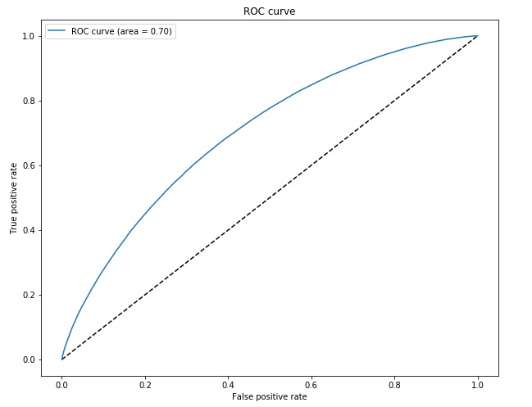
Model 2: Random Forest Model Analysis (3. Model Building & Assessment)
Notes:
Explain that an investor can decide if he/she knows the probability of default, which we are modeling, looking at charged-off loans and fully paid loans.
We are excluding all other loans with any other statuses.
Explain the features that we are going to use and why, define target. Explain transformations if any (continuing or discretizing variables). If we are making imputations in place of null values, explain how and why.
Visualization plots using features (Box, Scatter, Distributions, Outliers)

Slide 12
Model 3: gradient boosting classifier Model (3. Model Building & Assessment)
 | Predicted 0 | Predicted 1
Actual 0 | 313466 | 1923
Actual 1 | 74658 | 2470
AUC: | 0.699712
accuracy |  |  | 0.80 | 392517
Macro avg | 0.68 | 0.51 | 0.48 | 392517
Weighted avg | 0.76 | 0.80 | 0.73 | 392517
 | precision | recall | F1 - score | support
0 | 0.81 | 0.99 | 0.89 | 315389
1 | 0.56 | 0.03 | 0.06 | 77128
Notes:
Explain that an investor can decide if he/she knows the probability of default, which we are modeling, looking at charged-off loans and fully paid loans.
We are excluding all other loans with any other statuses.
Explain the features that we are going to use and why, define target. Explain transformations if any (continuing or discretizing variables). If we are making imputations in place of null values, explain how and why.
Visualization plots using features (Box, Scatter, Distributions, Outliers)

Slide 13
Cost Function for Comparison
Model | Balancing | False Positive ($0.1) | False Negative ($0.9) | Cost of Prediction
Logistic Regression | Unbalanced | 4182 | 72981 | $ 66,106.5
 | Balanced | 109115 | 28857 | $ 36,882.8
Random Forest | Unbalanced | 514 | 76351 | $ 68,767.3
 | Balanced | 118144 | 25997 | $ 35,208.7
Gradient Boosting | Unbalanced | 1923 | 74658 | $ 67,384.5

Slide 14
Thank You

