Slide 1

WalkAbout
Ryszard Kilarski
Notes:
1. Description of the project => what's the problem you're trying to solve
2. The demo. If your app is long or very complex, you just have to show the most important aspect and discuss the others. You may take screenshots of the entire app and include that in your submission
3. Brief discussion of what went right and what didn't and how you overcame the problems
4. A brief overview of the key items you learned doing the project.
rec@bu.edu.

Slide 2
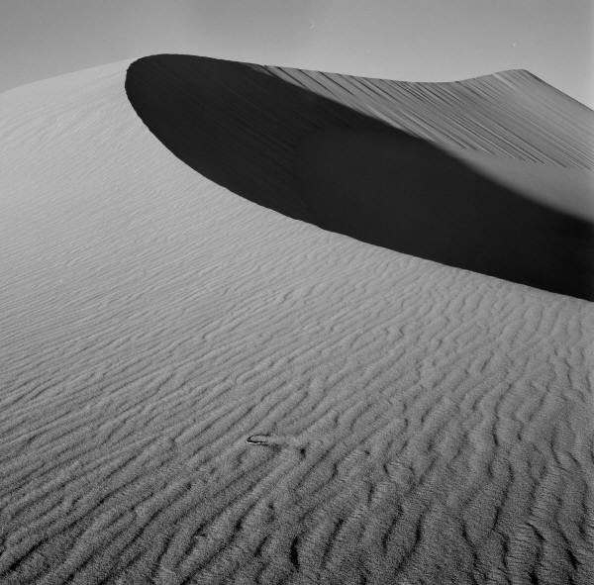
Project Description, Problem Statement

Slide 3
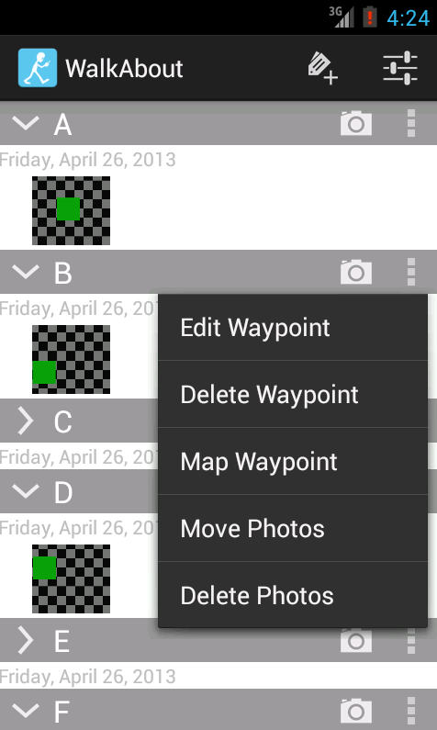
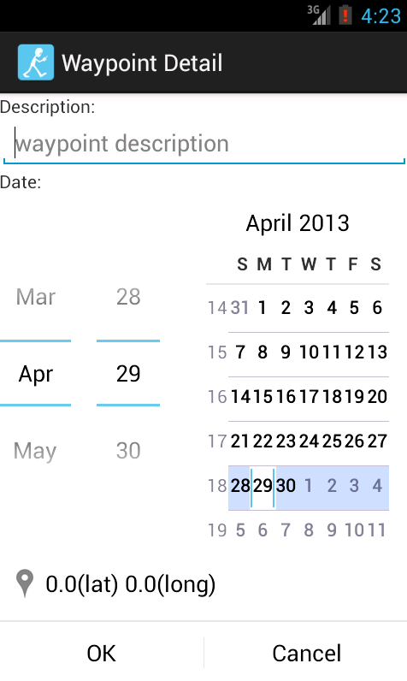
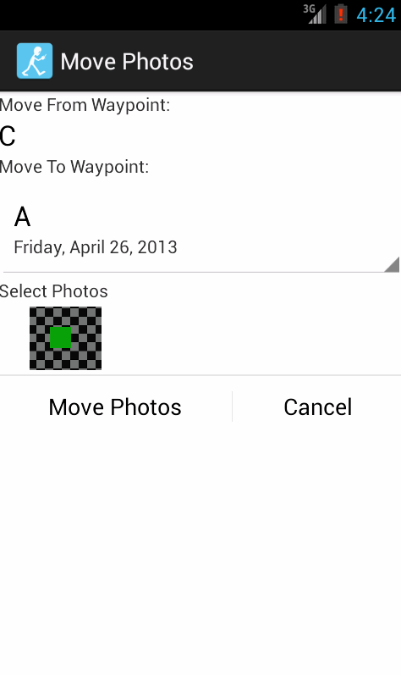
Demonstration
Notes:
2. The demo. If your app is long or very complex, you just have to show the most important aspect and discuss the others. You may take screenshots of the entire app and include that in your submission

Slide 4
What Went Right
User Interface Design
Notes:
3. Brief discussion of what went right and what didn't and how you overcame the problems
4. A brief overview of the key items you learned doing the project.
rec@bu.edu.

Slide 5
What Went Wrong
Maps Integration
Notes:
3. Brief discussion of what went right and what didn't and how you overcame the problems
rec@bu.edu.

Slide 6

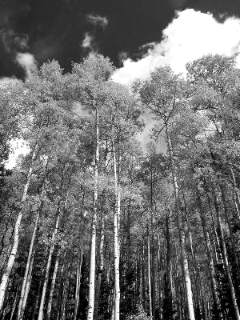
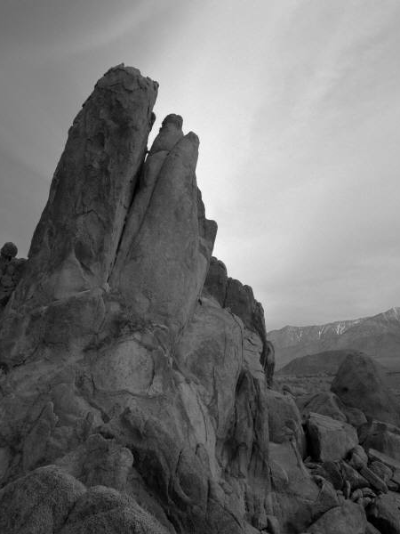
Key Items Learned
Notes:
4. A brief overview of the key items you learned doing the project.

