Slide 1
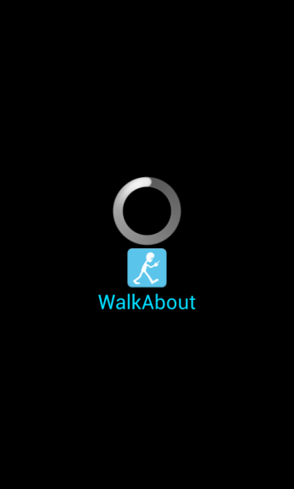

WalkAbout
Ryszard Kilarski
emrys@bu.edu
Notes:
1. Description of the project => what's the problem you're trying to solve
2. The demo. If your app is long or very complex, you just have to show the most important aspect and discuss the others. You may take screenshots of the entire app and include that in your submission
3. Brief discussion of what went right and what didn't and how you overcame the problems
4. A brief overview of the key items you learned doing the project.
rec@bu.edu.

Slide 2
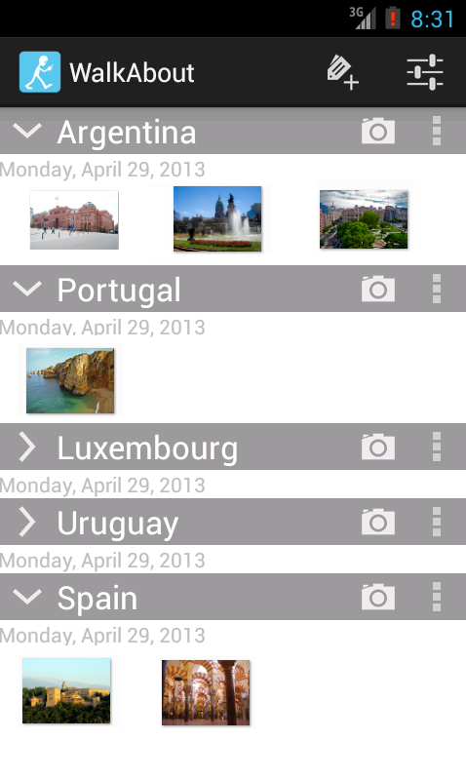
What is WalkAbout?
Application that allows for
Photo Organization
Photo Mapping
Who is it for?
Photographers who like organizing their photos by area (waypoints) and like to see the results on a map.

Slide 3
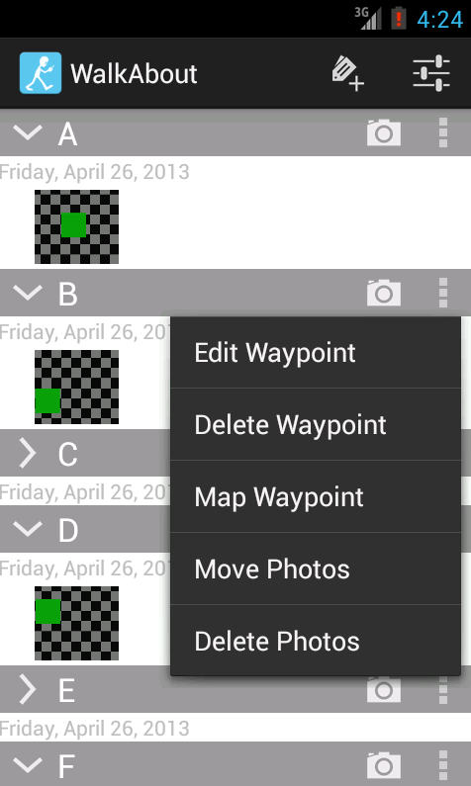
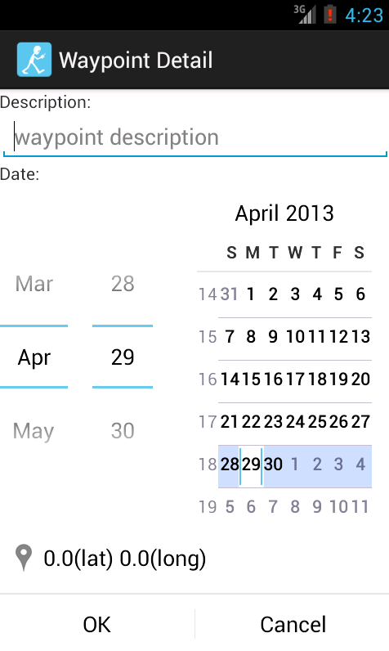
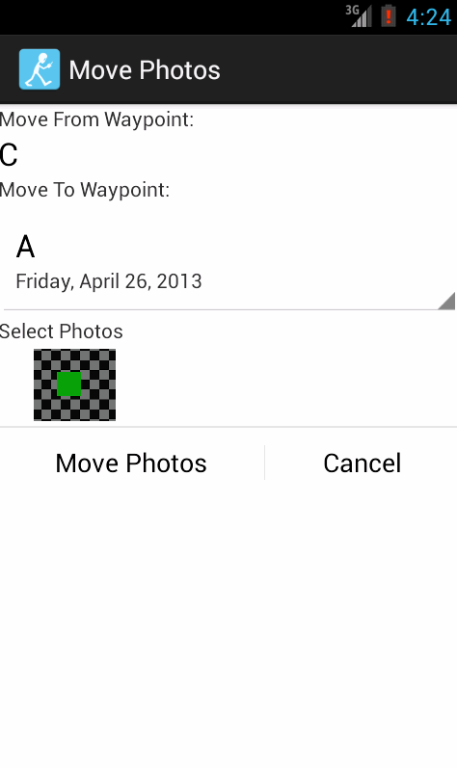
Demonstration
Adding and editing Waypoints
Taking Photos and moving them between Waypoints
Deleting Photos and Waypoints
Mapping Photos

Slide 4
What Went Right
User Interface Design
Android Intents and available applications
Notes:
3. Brief discussion of what went right and what didn't and how you overcame the problems
4. A brief overview of the key items you learned doing the project.
rec@bu.edu.

Slide 5
What Went Wrong
Maps Integration
Not having an Android Device
Notes:
3. Brief discussion of what went right and what didn't and how you overcame the problems
rec@bu.edu.

Slide 6



Key Items Learned
Easier to develop than equivalent iPhone applications (though the Android Development Toolkit for Eclipse is a bit wonky).
Some parts are not as mature as they should be, but Android is changing FAST.
Built from the ground-up for modularity, reuse, and connectivity.
Notes:
4. A brief overview of the key items you learned doing the project.

Slide 7
WalkAbout
Ryszard Kilarski
emrys@bu.edu
Notes:
1. Description of the project => what's the problem you're trying to solve
2. The demo. If your app is long or very complex, you just have to show the most important aspect and discuss the others. You may take screenshots of the entire app and include that in your submission
3. Brief discussion of what went right and what didn't and how you overcame the problems
4. A brief overview of the key items you learned doing the project.
rec@bu.edu.

