Slide 1
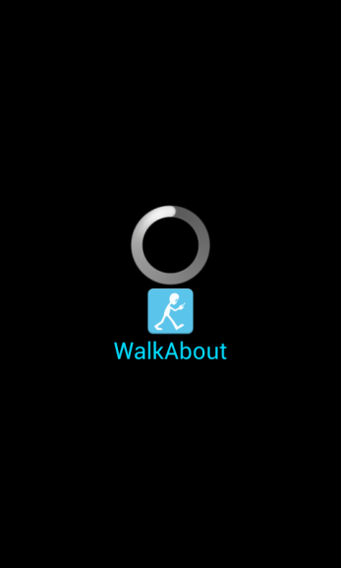

WalkAbout
Ryszard Kilarski
emrys@bu.edu

Slide 2
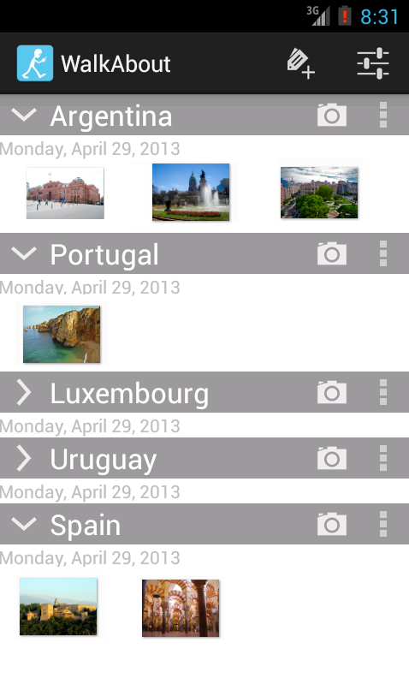
What is WalkAbout?
Application that allows for
Organization
Mapping
for photographs.
Who is it for?
Travelers who like organizing their photos by area (waypoints) and like to see the photos on a map.

Slide 3
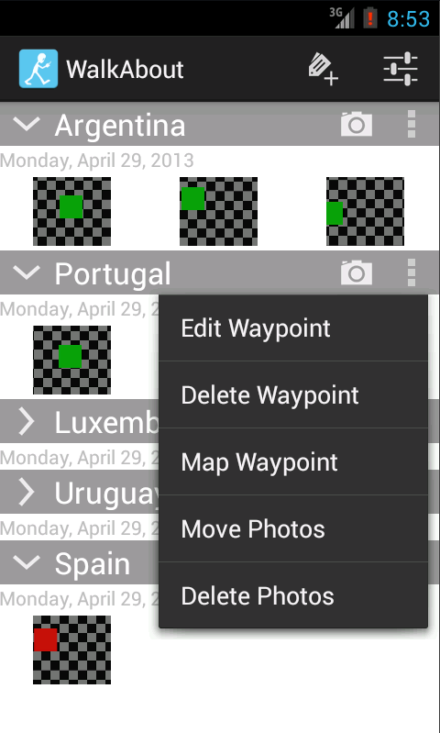
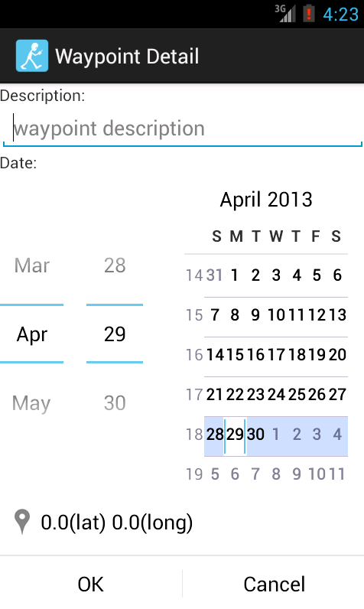
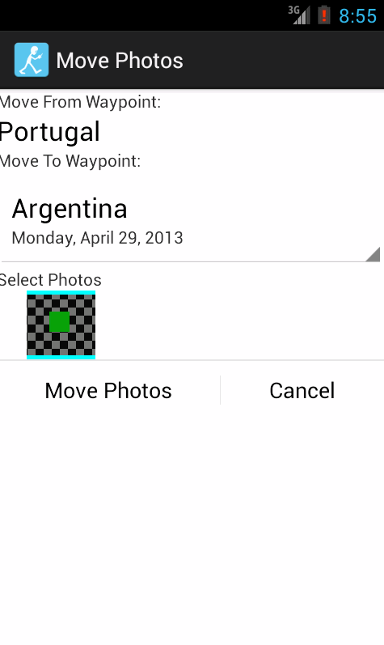
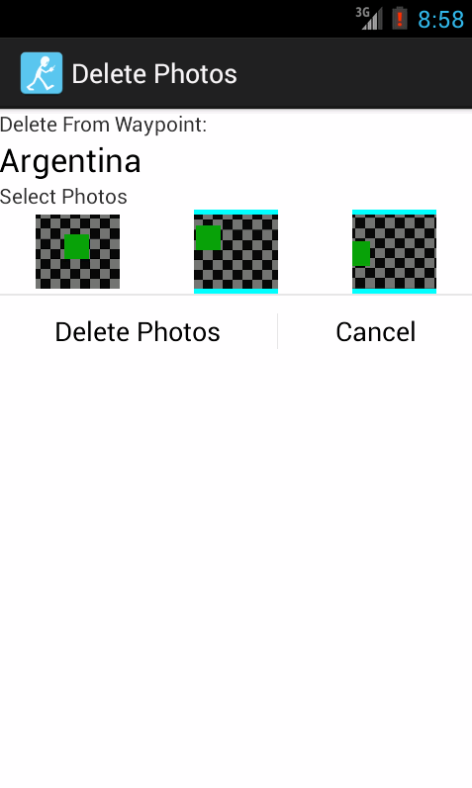
Demonstration
Adding and editing Waypoints
Taking Photos and moving them between Waypoints
Deleting Photos and Waypoints
Mapping Photos

Slide 4
What Went Right
User Interface Design
Android Intents and available applications
Ease of programming when familiar with Java

Slide 5
What Went Wrong
Maps Integration
Not having an Android Device
Android Emulator

Slide 6

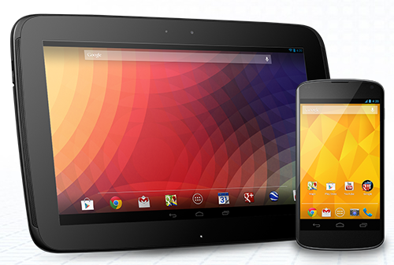

Key Items Learned
Easier to develop than equivalent iPhone applications (though the Android Development Toolkit for Eclipse is a bit wonky).
Some parts are not as mature as they should be (I’m looking at you, Android Emulator), but Android is changing FAST.
Built from the ground-up for modularity, reuse, and connectivity.

Slide 7
WalkAbout
Ryszard Kilarski
emrys@bu.edu

