Slide 1

HashiCorp Certified Vault Associate: Vault Management
Understanding Vault Architecture
Ned Bellavance
Founder, Ned in the Cloud LLC
@ned1313 | nedinthecloud.com

Slide 2
Overview
Exam overview
Vault architecture
Data flow and encryption Seal options

Slide 3
Exam Overview

Slide 4

Compare authentication methods
Create Vault policies Assess Vault tokens
Manage Vault leases
Compare and configure Vault secrets engines Utilize Vault CLI
Utilize Vault UI
Be aware of the Vault API Explain Vault architecture Explain encryption as a service

Slide 5
Explain Vault architecture
Explain encryption as a service

Slide 6
Describe the encryption of data stored by Vault
Describe cluster strategy Describe storage backends Describe the Vault agent Describe secrets caching
Be aware of identities and groups
Describe Shamir secret sharing and unsealing Be aware of replication
Describe seal/unseal Explain response wrapping
Explain the value of short-lived, dynamically generated secrets

Slide 7



Globomantics Scenario

Slide 8
Vault Architecture

Slide 9




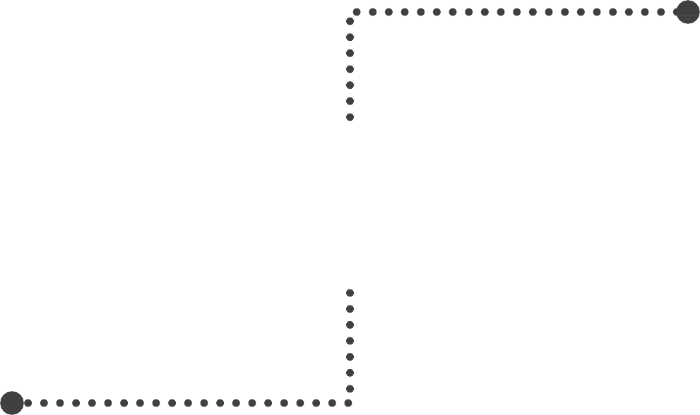









Vault Conceptual Architecture
Authentication
Policy
Secrets
Clients
Audit

Slide 10





Vault Logical Architecture
TLS
Certificate
Encryption Keys

Slide 11



Encryption Keys
Encryption keys
Protect data written to storage
Stored on disk
Master key Protects encryption
keys
Stored on disk
Unseal key Protects master key Stored as shares or
externally

Slide 12
Seal Options
Shamir secret sharing
Key shares
Required threshold
Configured at initialization
Used for sensitive operations
Auto-unseal
External service
Recovery key shares
Set by Vault server configuration
Seal Migration

Slide 13




Unsealing Vault

Slide 14

Globomantics Scenario
Use Case
Vault startup should not require human intervention
Privileged operations should require three people
Vault will have access to an HSM
Solution
Set seal type to pkcs11 with HSM values
Create recovery keys with at least four shares and a threshold of three

Slide 15

Key Takeaways
All data that leaves the barrier will be encrypted.
Data leaving the front-end API is encrypted using TLS. Data written to back-end storage is encrypted using the Encryption keys.
The Encryption keys are protected by the Master key which is protected by the Unseal key.
The Unseal key is never stored in Vault and can be broken into Shamir key shares or stored on a Cloud/HSM service.
The Vault must be unsealed before use with the Unseal key.

Slide 16
Up Next: Deploying a Basic Vault Server

