Slide 1

Interacting with Vault
Ned Bellavance
Founder, Ned in the Cloud LLC
@ned1313 | nedinthecloud.com

Slide 2
Overview
Run Vault in dev mode
Use the CLI, UI, and API Configure environment variables

Slide 3
Running Vault in Development Mode

Slide 4



Running Vault
Download Vault
Start Vault
Access Vault

Slide 5

Installation
# Windows – use Chocolatey
choco install vault
# Mac – use Homebrew brew tap hashicorp/tap
brew install hashicorp/tap/vault
# Linux – use your package manager
curl -fsSL https://apt.releases.hashicorp.com/gpg | sudo apt-key add –
sudo apt-add-repository "deb [arch=amd64] https://apt.releases.hashicorp.com $(lsb_release -cs) main" sudo apt-get update && sudo apt-get install vault

Slide 6




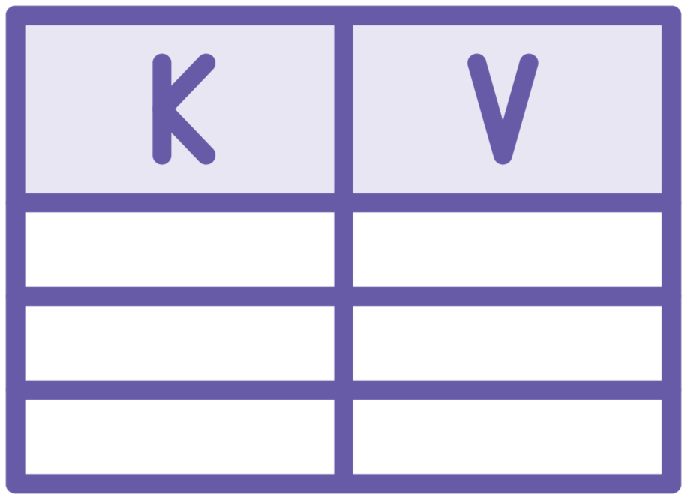
Development Mode
Running on localhost without SSL
In-memory storage Starts unsealed
UI enabled
Key/Value secrets engine enabled

Slide 7
Dev Server
# Launch Vault in development mode
vault server –dev
# Store Vault server address in environment variable
#Linux and macOS
export VAULT_ADDR=http://127.0.0.1:8200 # Windows PowerShell
$env:VAULT_ADDR="http://127.0.0.1:8200"
# Log into Vault
vault login

Slide 8

Tasks:
Demo
Download Vault
Start Vault in development mode
Access Vault with root token
Pre-requisites:
Exercise files
Internet connection
Code editor

Slide 9

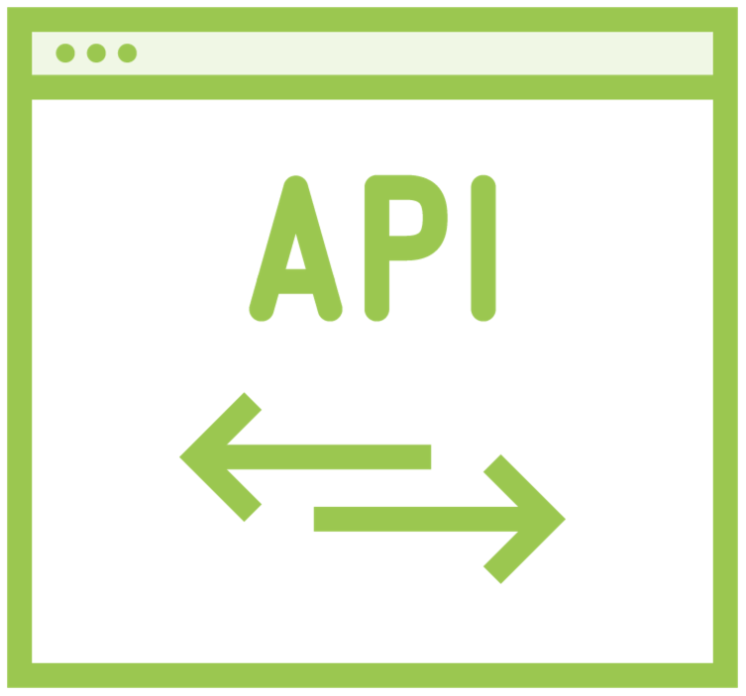
Interacting with Vault
CLI
UI
API

Slide 10
Vault CLI
# Basic vault command structure
vault <command> <subcommand> [options] [ARGUMENTS]
# Getting help with vault vault <command> -help vault path-help PATH

Slide 11
VAULT_ADDR – Address of the Vault server
VAULT_TOKEN – Token value for requests
VAULT_SKIP_VERIFY – No verify TLS cert VAULT_FORMAT – Specify output format
Environment Variables

Slide 12
Vault UI
Uses the API
Not enabled by default Run on same port as API
Basic console

Slide 13
Vault API
RESTful
Used by UI and CLI
Only way to interact with Vault
curl with X-Vault-Token header

Slide 14

Key Takeaways
Vault is a single binary for client and server
Vault can be started in dev mode for local testing All Vault communication goes through the API
You can interact with Vault using the CLI, UI, or API Use VAULT_ADDR and VAULT_TOKEN with the CLI

Slide 15
Up Next: Authenticating to Vault

