Slide 1

Planning for High Availability
Ned Bellavance
Founder, Ned in the Cloud LLC
@ned1313 | nedinthecloud.com

Slide 2

Overview
Vault clustering options
Cluster communications Replication options

Slide 3
Vault Server Clustering

Slide 4
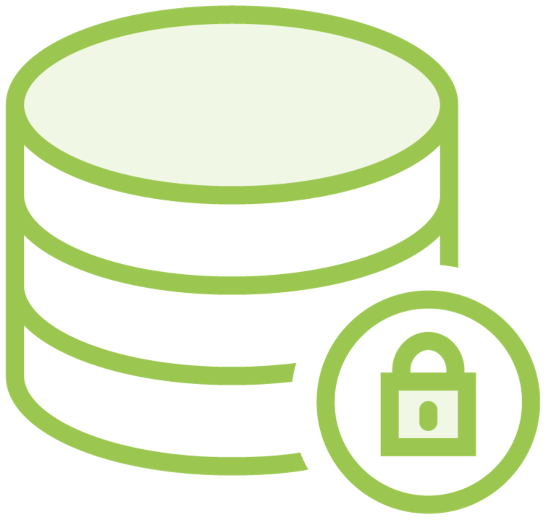

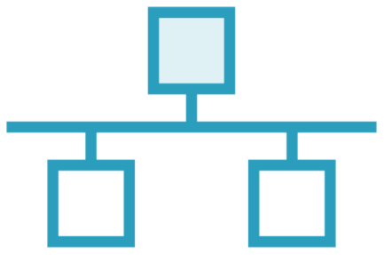

High Availability Components
Compute
Network
Storage

Slide 5
Compute
Active and standby
Forward or redirect Read-only for Enterprise Lock based in datastore Different storage for HA

Slide 6
Network Components
Listener cluster_address
Node cluster_addr
Node api_addr
Direct access
Load balancer

Slide 7

Cluster Communications
listener "tcp" {
address = 10.1.1.1:8200
cluster_address = 10.1.1.1:8201
}
listener "tcp" {
address = 10.1.1.2:8200
cluster_address = 10.1.1.2:8201
}

Slide 8
Cluster Communications
cluster_addr = https://server1:8201 api_addr = https://server1:8200
cluster_addr = https://server2:8201 api_addr = https://server2:8200

Slide 9


Network Traffic - Request Forwarding
DNS
cluster_addr = https://server1:8201
vault.local A 10.1.1.1
A 10.1.1.2
Client

Slide 10

Network Traffic - Request Forwarding
cluster_addr = https://server1:8201
Client

Slide 11
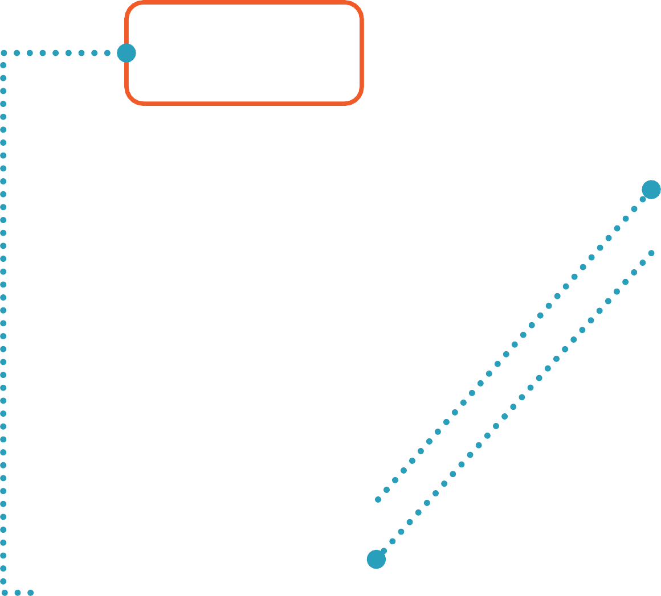
Network Traffic – Client Redirection
DNS
api_addr = https://server1:8200
vault.local A 10.1.1.1
A 10.1.1.2
Client

Slide 12

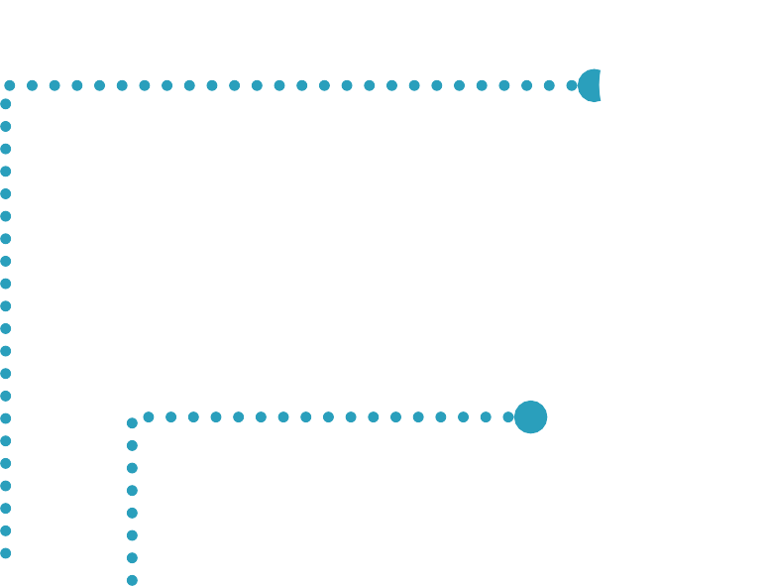
Network Traffic – Client Redirection
api_addr = https://server1:8200
Client

Slide 13

Globomantics Scenario
Use Case
Vault services need to be highly available
Storage backend must be HA capable and HashiCorp supported
Minimize external dependencies
Solution
Select Integrated Storage as the backend
Deploy at least three nodes for HA
Use DNS round-robin and request forwarding

Slide 14
Vault Replication

Slide 15

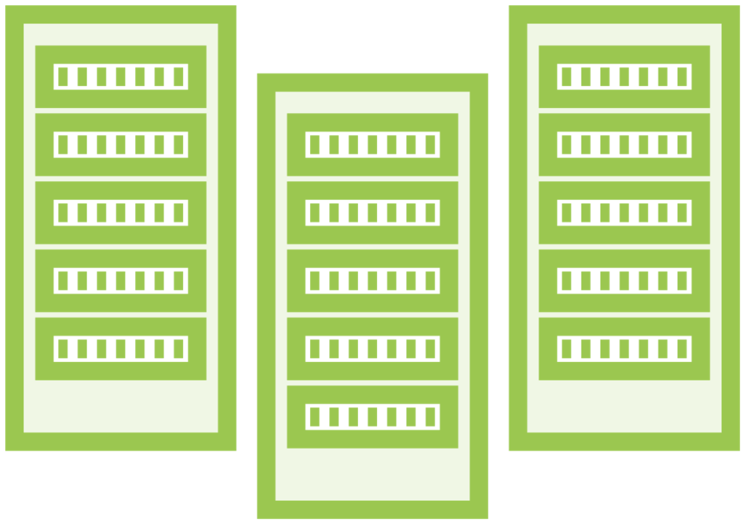


Vault Replication
Enterprise only
Cluster is unit of replication
Replication is one-to-many
Replication is asynchronous

Slide 16
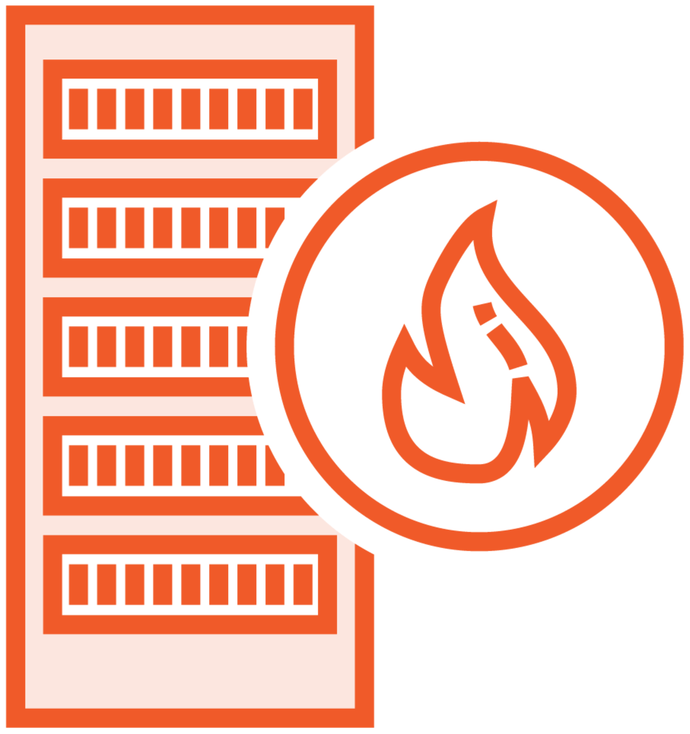

Replication Options
Disaster recovery Replicates tokens and leases No requests to secondaries
Performance Replicates data only
Read-only requests allowed

Slide 17
Globomantics Scenario
Use Case
Vault services must be available within five minutes after an outage
Current tokens and leases should be honored
Solution
Create a secondary cluster in another data center
Purchase an Enterprise license
Configure disaster recovery replication

Slide 18

Key Takeaways
Vault clusters are composed of one active and one or more standby nodes. Storage for a Vault cluster must support HA for locking.
Client requests can be handled through request forwarding (default) or client redirection.
Vault replication is an Enterprise feature and occurs between a primary cluster and one or more secondary clusters.
Disaster recovery clusters synchronize all data and cannot service requests.
Performance clusters do not synchronize tokens and leases and can service read-only requests.

Slide 19
Up Next: Working with the Identity Engine

