Slide 1

Configuring Vault Policies
Ned Bellavance
Founder, Ned in the Cloud LLC
@ned1313 | nedinthecloud.com

Slide 2

Overview
Policy overview
Policy syntax Design a policy Configure a policy

Slide 3
Vault Policy Overview

Slide 4
Policies define permissions in Vault
Multiple options for assignment
- Token, identity, auth methods
Most specific wins No versioning
Default policy Root policy
Vault Policy

Slide 5

default.hcl
# Allow tokens to look up their own properties
path "auth/token/lookup-self" {...
# Allow tokens to renew themselves path "auth/token/renew-self" {...
# Allow tokens to revoke themselves path "auth/token/revoke-self" {...
# Allow a token to look up its own capabilities on a path
path "sys/capabilities-self" {...
# Allow a token to look up its own entity by id or name path "identity/entity/id/{{identity.entity.id}}" {...

Slide 6

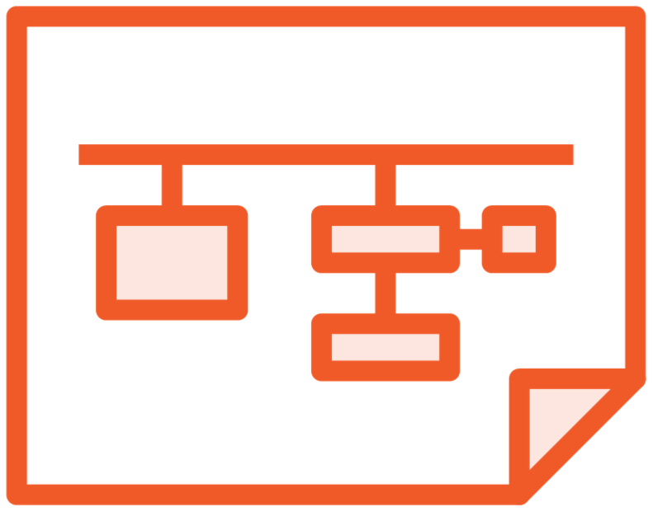

Policy Syntax
HCL or JSON
Path
Capabilities

Slide 7
Path Examples
# Basic path expression
path "somepath/in/vault"
# Using the glob '*'
# Match "secrets/globo/web1/" and "secrets/globo/webapp/apikeys" path "secrets/globo/web*"
# Using the path segment match '+'
# Match "secrets/globo/webapp1/apikeys" and "secrets/globo/webapp2/apikeys" path "secrets/globo/+/apikeys"

Slide 8
Path Examples cont.
# Using a parameter
# Resolve to the name of the entity path "secret/{{identity.entity.name}}/*"
# Used in the default policy
# Allow a token to look up its own entity by id or name path "identity/entity/id/{{identity.entity.id}}" {…
path "identity/entity/name/{{identity.entity.name}}" {…

Slide 9



Capabilities
List - enumerate keys
No access to key data
Not implied by the read
Sudo – special permissions
Root-protected paths
Do not imply other actions
Deny – disable access
Overrides all other actions
Denies the full path
Standard CRUD capabilities
Create – create a new key Read – read data from a key Update – alter data for a key
Delete – remove a key

Slide 10
Capability Examples
# Allow read access to an apikey
path "secrets/globo/webapp/apikey" { capabilities = ["read"]
}
# Allow read and list access to webapp path
path "secrets/globo/webapp/*" { capabilities = ["read","list"]
}

Slide 11
Capability Examples cont.
# Allow full access to apikey in globo paths
path "secrets/globo/+/apikey" {
capabilities = ["create","read","update","delete"]
}
# Deny access to the globo privileged path path "secrets/globo/webapp/*" {
capabilities = ["create","read","list","update","delete"]
}
path "secrets/globo/webapp/privileged*" { capabilities = ["deny"]
}

Slide 12

Globomantics Scenario
Use Case
Junior administrators need to manage secrets engines
Follow the principle of least privileged access
No access to contents of secrets engines
Solution
Create a secrets engine management policy
Assign the policy to junior administrators

Slide 13
Globomantics Scenario
Use Case
Grant access to the accounting secrets engine
Deny access to privileged information for regular accountants
Allow management of metadata
Solution
Create an accounting policy
Add a deny rule for privileged path
Add access to the metadata path

Slide 14
Policy Creation and Assignment

Slide 15



Policy Assignment
Directly on token when created
Applied through an authentication method
Assigned to an entity through the identity secrets engine

Slide 16
Working with Policies
# List existing policies
vault policy list
# Read the contents of a policy
vault policy read [options] NAME vault policy read secrets-mgmt
# Write a new policy or update an existing policy
vault policy write [options] NAME PATH | <stdin> vault policy write secrets-mgmt secrets-mgmt.hcl

Slide 17
Working with Policies
# Delete a policy
vault policy delete [options] NAME vault policy delete secrets-mgmt
# Format a policy per HCL guidelines
vault policy fmt [options] PATH vault policy fmt secrets-mgmt.hcl

Slide 18

Demo
Tasks:
Create two policies
Generate a token with a policy
Update a policy
Delete a policy

Slide 19
Assigning a Policy
# Associate directly with a token
vault token create –policy="secrets-mgmt"
# Assign to a user in userpass
vault write auth/userpass/users/ned token_policies="secrets-mgmt"
# Assign to an entity in identity
vault write identity/entity/name/ned policies="secrets-mgmt"

Slide 20

Key Takeaways
Policies are associated with tokens directly or indirectly, defining the actions allowed by the token
The root policy can do ANYTHING. It cannot be modified or deleted.
The default policy is assigned to new tokens by default. It can be modified, but not deleted.
Paths define where actions can be taken; capabilities define what actions can be taken.
Policies can be assigned directly to a token, through an auth method, or through the identity secrets engine.

Slide 21
Up Next: Using Vault Tokens

