Slide 1

Using Secrets Engines
Ned Bellavance
Founder, Ned in the Cloud LLC
@ned1313 | nedinthecloud.com

Slide 2

Overview
Secrets engine overview
Selecting an engine Enabling an engine Using secrets engines

Slide 3
Secrets Engine Overview

Slide 4



Secrets Engines
Secrets engines are plugins used by Vault to handle sensitive data
Store
Sensitive data is stored securely by Vault
Generate
Vault generates and manages sensitive data
Encrypt
Vault provides encryption services for existing data

Slide 5
Secrets Engine Categories
Cloud AWS, Azure, GCP
Database MSSQL, PostreSQL,
MondoDB
Internal Key/Value, Identity,
Transit
Identity Active Directory,
OpenLDAP
Certificate SSH, PKI, Venafi
Tokens Consul, Nomad

Slide 6



Identity Engine
Entities
Maintains clients for Vault
Enabled by default
Cannot be disabled Cannot enable multiple
Aliases
Groups

Slide 7




Cubbyhole
Enabled by default
Cannot be disabled or moved
Created per service token
Only accessible by token

Slide 8

Dynamic vs. Static Secrets
Static secrets
Store existing data securely
Manual lifecycle management
Key/Value engine
Dynamic secrets
Generate data on demand
Lease issued for each secret
Automatic lifecycle management
Majority of secrets engines
Consul engine

Slide 9

Globomantics Scenario
Use Case
Database administrators want to provide applications and developer access to a MySQL database
Credentials should be dynamically generated and short-lived
TTL should be based on client type
Solution
Enable Database secrets engine with MySQL plugin
Configure roles and policies for applications and developers

Slide 10


Key Value Engine
v1 & v2
Version 1 and 2 available
Store key/value pairs at a path
Versioning and metadata

Slide 11
Key Value Engine Versions
Version 1
No versioning, last key wins Faster with fewer storage calls Deleted items are gone
Can be upgraded to version 2 Default version on creation
Version 2
Versioning of past secrets Possibly less performant
Deleted items and metadata retained Cannot be downgraded
Can be specified at creation

Slide 12
Globomantics Scenario
Use Case
Application developer needs to store API keys in secure location
API keys should be versioned with previous versions available
Developers will generate the API keys
Solution
Enable an instance of the Key Value engine version 2
Create a policy granting developers access

Slide 13

Transit Engine
Encryption as a service
Does not store data Supported actions:
Encrypt/decrypt
Sign and verify
Generate hashes
Create random bytes
Engine manages keys

Slide 14
Globomantics Scenario
Use Case
Application developer needs to encrypt data written to object storage
Data will be generated by application
Vault does not need to store data
Solution
Enable an instance of the Transit engine
Create policies granting developers and application access

Slide 15
Enabling Secrets Engines

Slide 16
Secrets Engine Lifecycle
Enable
Tune
Configure
Move
Disable

Slide 17

Configuring Secrets Engines
All engines are enabled on /sys/mounts
Engines are enabled on a path
Defaults to engine name
Engines can be moved
Revokes all existing leases
May impact policies
Engines can be tuned and configured
Tuning settings are common for all engines
Configuration settings are specific to an engines

Slide 18

Working with Secrets Engines
# List existing secrets engines
vault secrets list
# Enable a new secrets engine
vault secrets enable [options] TYPE vault secrets enable –path=GloboKV kv
# Tune a secrets engine setting
vault secrets tune [options] PATH
vault secrets tune –description="Globomantics Default KV" GloboKV

Slide 19
Working with Secrets Engines
# Move an existing secrets engine
vault secrets move [options] SOURCE DEST vault secrets move GloboKV GloboKV1
# Disable a secrets engine
vault secrets disable [options] PATH vault secrets disable GloboKV1

Slide 20

Example Secrets Engines
Key Value
Consul

Slide 21

Demo
Tasks:
Enable secrets engines
Configure secrets engines
Access secrets engines

Slide 22
Using Secrets Engines

Slide 23
Authenticate with policy
Access through CLI, UI, or API
Interacting with Secrets Engine
Most engines use standard commands
read, list, write, and delete
Key Value uses vault kv commands
K/V version 1 can use standard commands

Slide 24
Interacting with the Consul Engine
# Use vault write to configure roles
vault write ROLE_PATH [SETTINGS K=V]
vault write consul/roles/my-role name=my-role policies=consul-policy
# Use vault read to retrieve credentials
vault read CRED_PATH
vault read consul/creds/my-role

Slide 25
Interacting with the Key Value Engine
# Writing a secret value
vault kv put [options] KEY [DATA K=V]
vault kv put GloboKV/apikeys/d101 token=1234567890
# Listing secret keys
vault kv list [options] PATH vault kv list GloboKV/apikeys/
# Reading a secret value
vault kv get [options] KEY
vault kv get –version=1 GloboKV/apikeys/d101

Slide 26
Interacting with the Key Value Engine
# Deleting a value
vault kv delete [options] KEY
vault kv delete –versions=1 GloboKV/apikeys/d101
# Destroying a value
vault kv destroy [options] KEY
vault kv destroy –versions=1 GloboKV/apikeys/d101

Slide 27



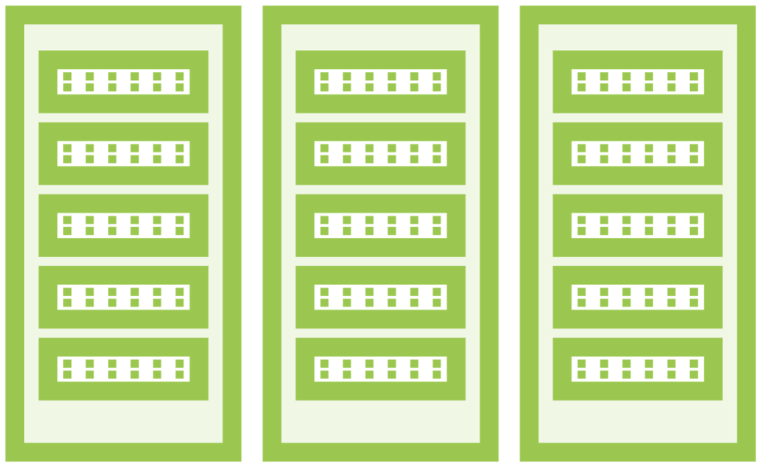
Response Wrapping

Slide 28

Response Wrapping

Slide 29
Using Response Wrapping
# Request wrapping for any command
vault command –wrap-ttl=<duration> PATH
vault kv get –wrap-ttl=<duration> GloboKV/apikeys/d101
# Unwrap using the issued token
vault unwrap [options] [TOKEN]
vault unwrap s.a1xgFuJZgw1KJPY2MGUPdMLw

Slide 30

Key Takeaways
Secrets engines are Vault plug-in that can store, generate, and encrypt data.
Static secrets engines store external data in Vault. Dynamic secrets engines generate credentials or data and managed the lifecycle.
The Transit engine provides encryption as a service for encypt/decrypt, sign/verify, and hashing or random data.
Secrets engines must be enabled, tuned, and configured. They can be moved, but will lose all lease data.

Slide 31
Key Takeaways
The Key Value engine has two versions and its own command set:
vault kv.
Interacting with secrets engines at the command line uses read, write, list, and delete.
Response wrapping creates a cubbyhole to store data and a single-use token to retrieve it.

Slide 32
Up Next: Using Vault Leases

