Slide 1

Course Review and Exam Prep Tips
Ned Bellavance
Founder, Ned in the Cloud LLC
@ned1313 | nedinthecloud.com

Slide 2


Overview
Exam overview
Exam experience Preparation tips

Slide 3



Exam Details
Online proctored 60 minutes
2 years
Multiple choice Fill in the blank Hotspot
Ten objectives Associate level

Slide 4
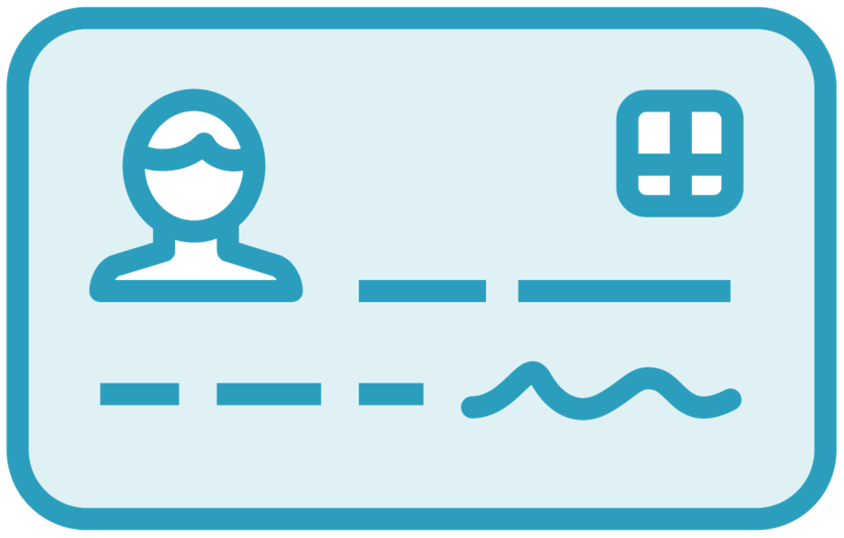





Primary Categories
Auth methods
Policy
Tokens and leases
Secrets engines
Vault interaction
Architecture

Slide 5





Exam Prep Tips
Study key concepts
Review common paths Spend time with the CLI Understand API and UI basics
Experiment!

Slide 6
Exam Day Tips
Sort questions
Ask why
Don't overthink it
Log in early
Relax

Slide 7
Additional Resources
Vault certification study guide on Leanpub
Vault videos on Ned in the Cloud YouTube
Pluralsight Vault courses
HashiCorp Learn site

Slide 8

Thank You!
@ned1313

