Slide 1
Analyzing the Impact of Socioeconomic Factors on Student Exam Performance
Reagan Kinsey
COP2073

Slide 2
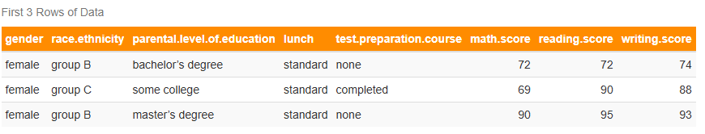
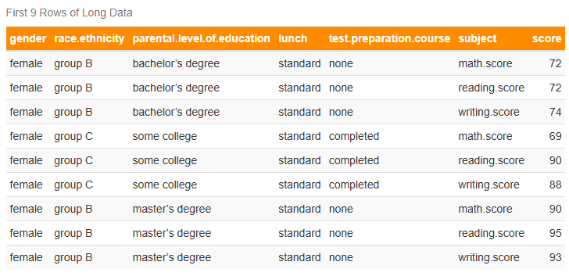
Data
_________________
The data set contains 1,000 observations and eight variables.

Slide 3
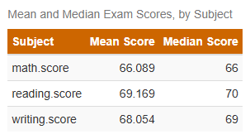
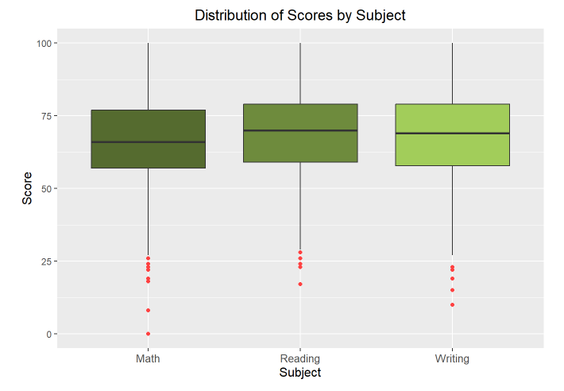
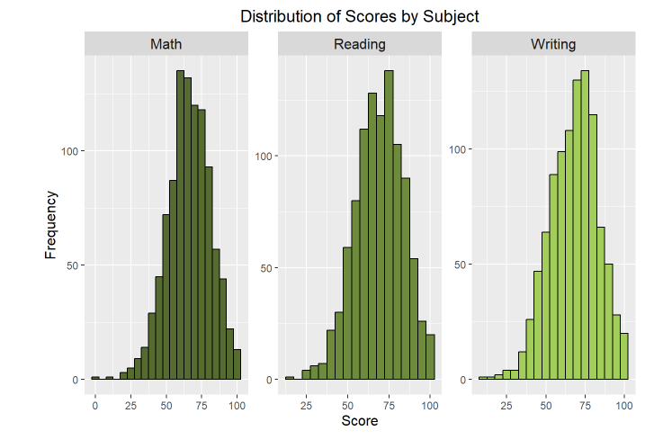
Overview
_____________________________
The IQR for each subject is similar, suggesting no substantial variation in exam scores for most of the population. The distribution of exam scores across all subjects for the entire data set is slightly right-skewed.

Slide 4
Impact of Lunch Status on Exam Scores

Slide 5
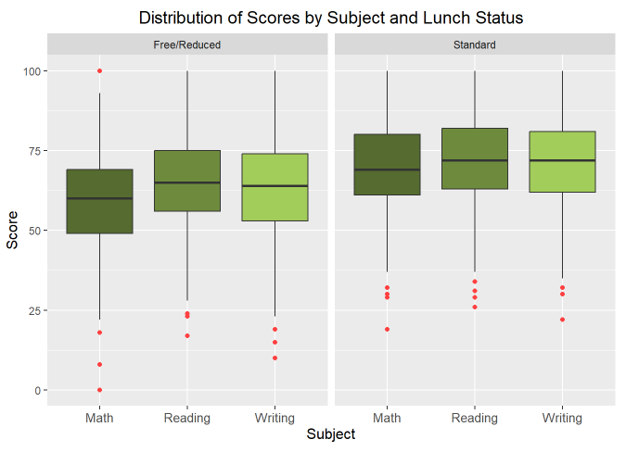
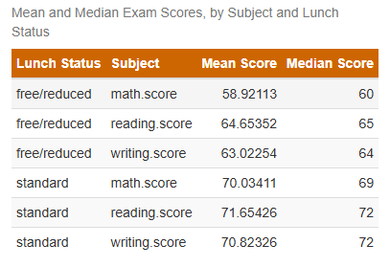
Visualizations
__________________________________________
On average, students with a standard lunch status perform better on exams than students with a free/reduced lunch status. The variance suggests that this specific subset of students may share a common trait.

Slide 6
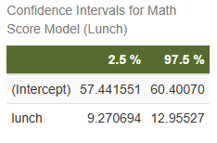
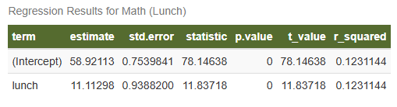
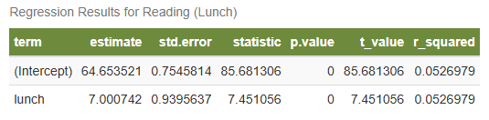
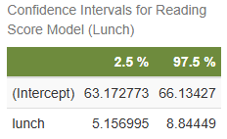
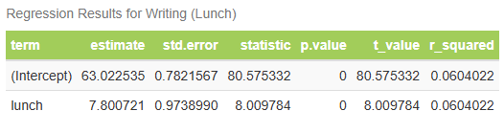
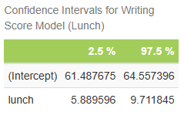
H₀: Lunch status has no effect on exam scores
H_{A}: Lunch status has an effect on lunch status
____________________________
Statistics

Slide 7
11.1 pts
7.0 pts
7.8 pts
Math
Reading
Writing
Results
________________________
Standard lunch status has a statistically significant positive effect on exam scores and is associated with an increase of approximately:
_____________________________
12.31%
5.23%
Variance
6.04%
Math
Reading
Writing

Slide 8
Questions?

