Slide 1



AW_Report
View in Power BI
Last data refresh:
27/01/2021 22:53:36 E. South America Standard Time
Downloaded at:
27/01/2021 22:58:16 E. South America Standard Time

Slide 2
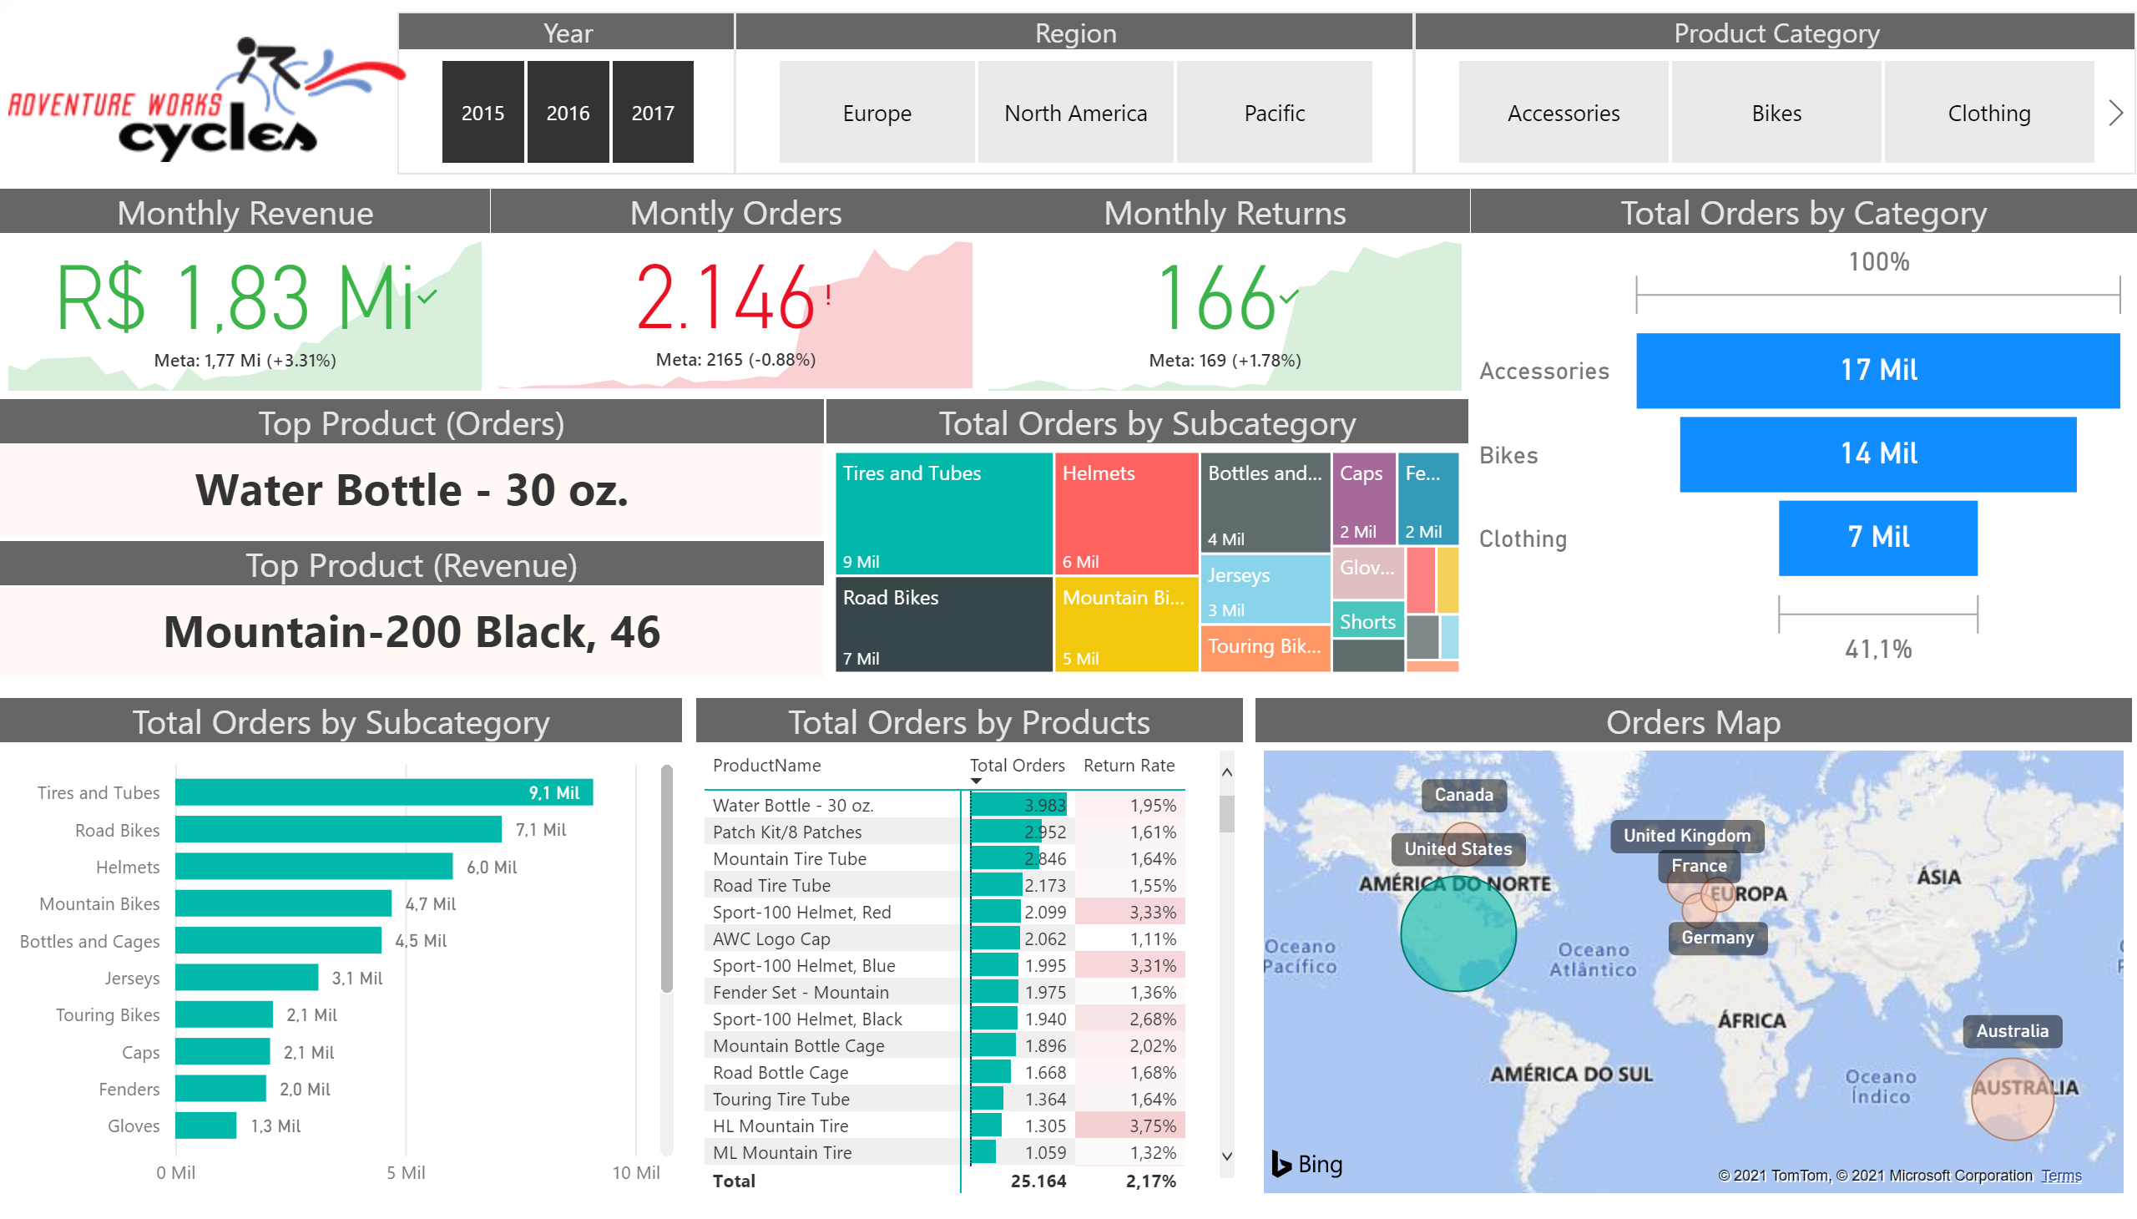
Exec Summary
Notes:
Total Orders by Subcategory
No alt text provided.
Total Orders by Subcategory
No alt text provided.
Total Orders by Products
No alt text provided.
Monthly Revenue
No alt text provided.
Montly Orders
No alt text provided.
Monthly Returns
No alt text provided.
Top Product (Orders)
No alt text provided.
Top Product (Revenue)
No alt text provided.
Orders Map
No alt text provided.
Total Orders by Category
No alt text provided.
Year
No alt text provided.
Region
No alt text provided.
Product Category
No alt text provided.
image
No alt text provided.

Slide 3
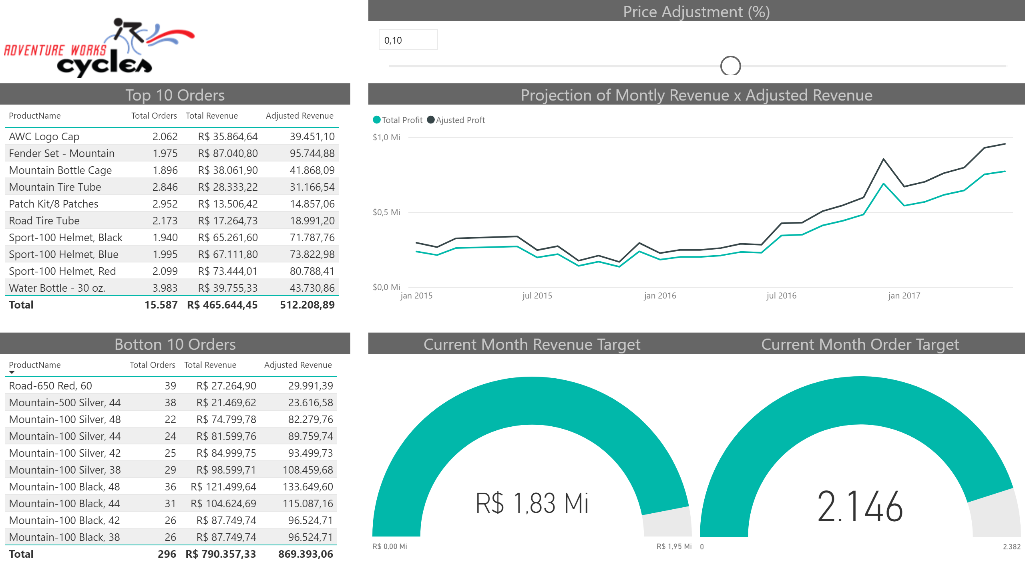
Products Detail
Notes:
Top 10 Orders
No alt text provided.
Botton 10 Orders
No alt text provided.
Current Month Order Target
No alt text provided.
Current Month Revenue Target
No alt text provided.
Price Adjustment (%)
No alt text provided.
Projection of Montly Revenue x Adjusted Revenue
No alt text provided.
image
No alt text provided.

Slide 4
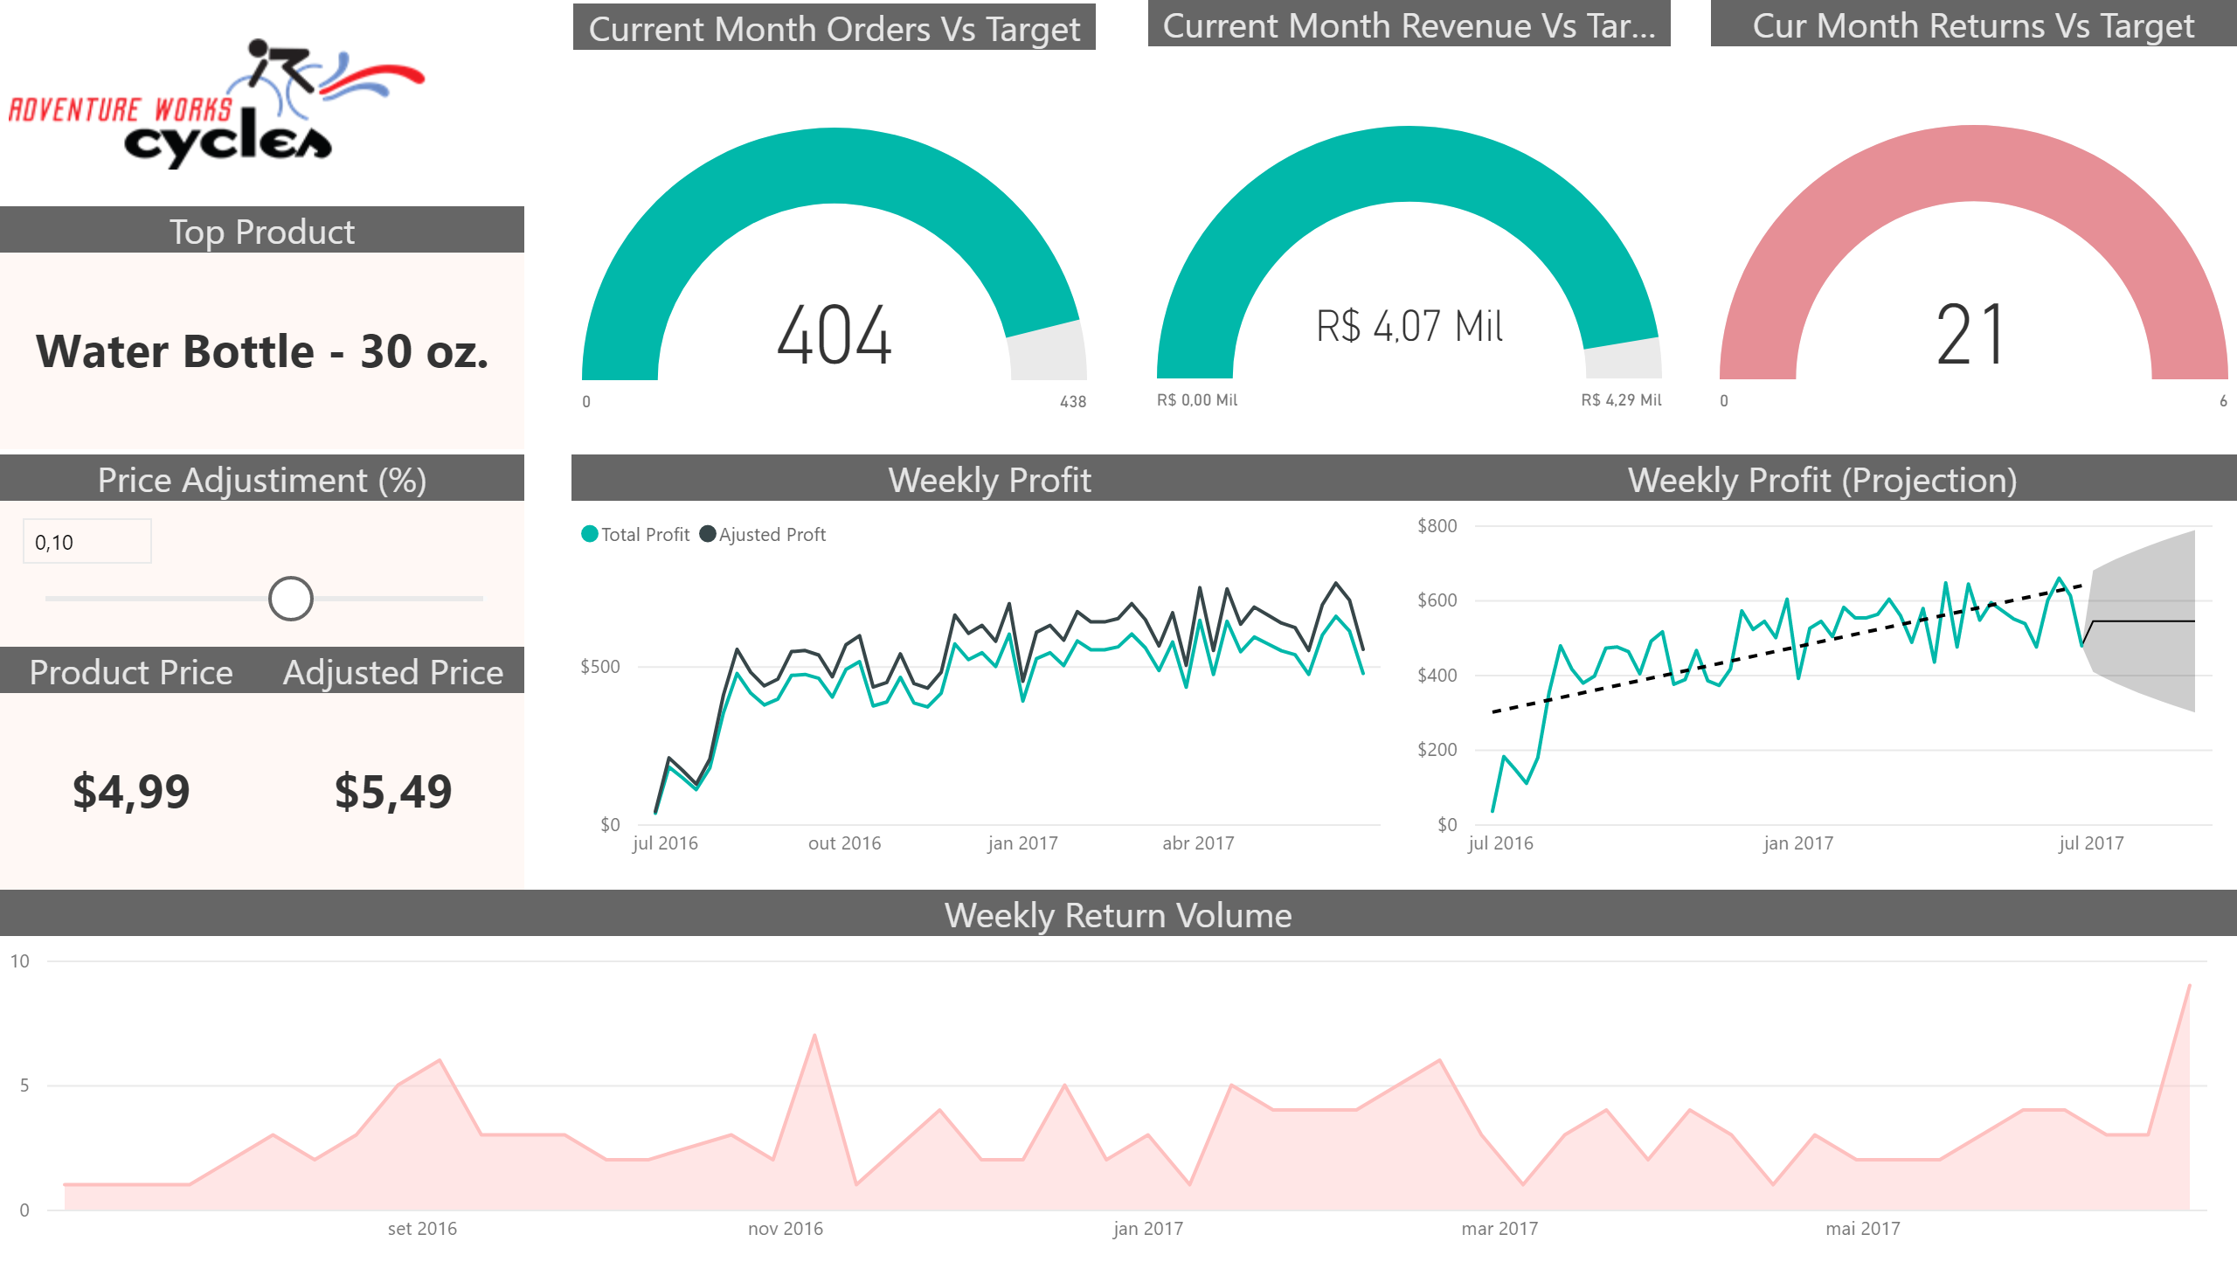
Top Product Detail
Notes:
Weekly Profit (Projection)
No alt text provided.
Weekly Return Volume
No alt text provided.
Current Month Orders Vs Target
No alt text provided.
Current Month Revenue Vs Target
No alt text provided.
Cur Month Returns Vs Target
No alt text provided.
Top Product
No alt text provided.
Price Adjustiment (%)
No alt text provided.
Weekly Profit
No alt text provided.
image
No alt text provided.
Adjusted Price
No alt text provided.
Product Price
No alt text provided.

Slide 5
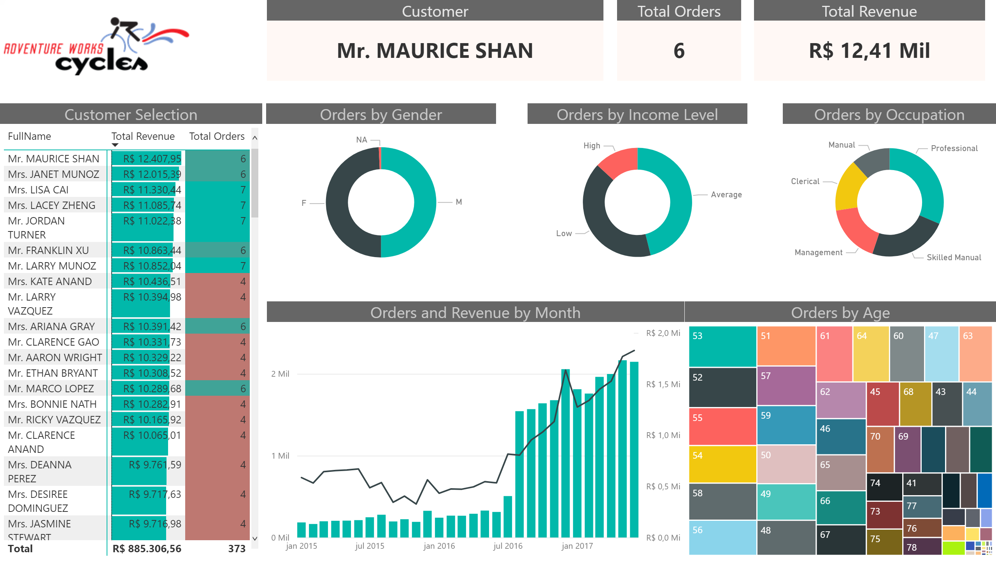
Customers Detail
Notes:
Customer Selection
No alt text provided.
Orders by Gender
No alt text provided.
Orders by Income Level
No alt text provided.
Orders by Occupation
No alt text provided.
Orders and Revenue by Month
No alt text provided.
Orders by Age
No alt text provided.
Customer
No alt text provided.
Total Revenue
No alt text provided.
Total Orders
No alt text provided.
image
No alt text provided.

