Slide 1
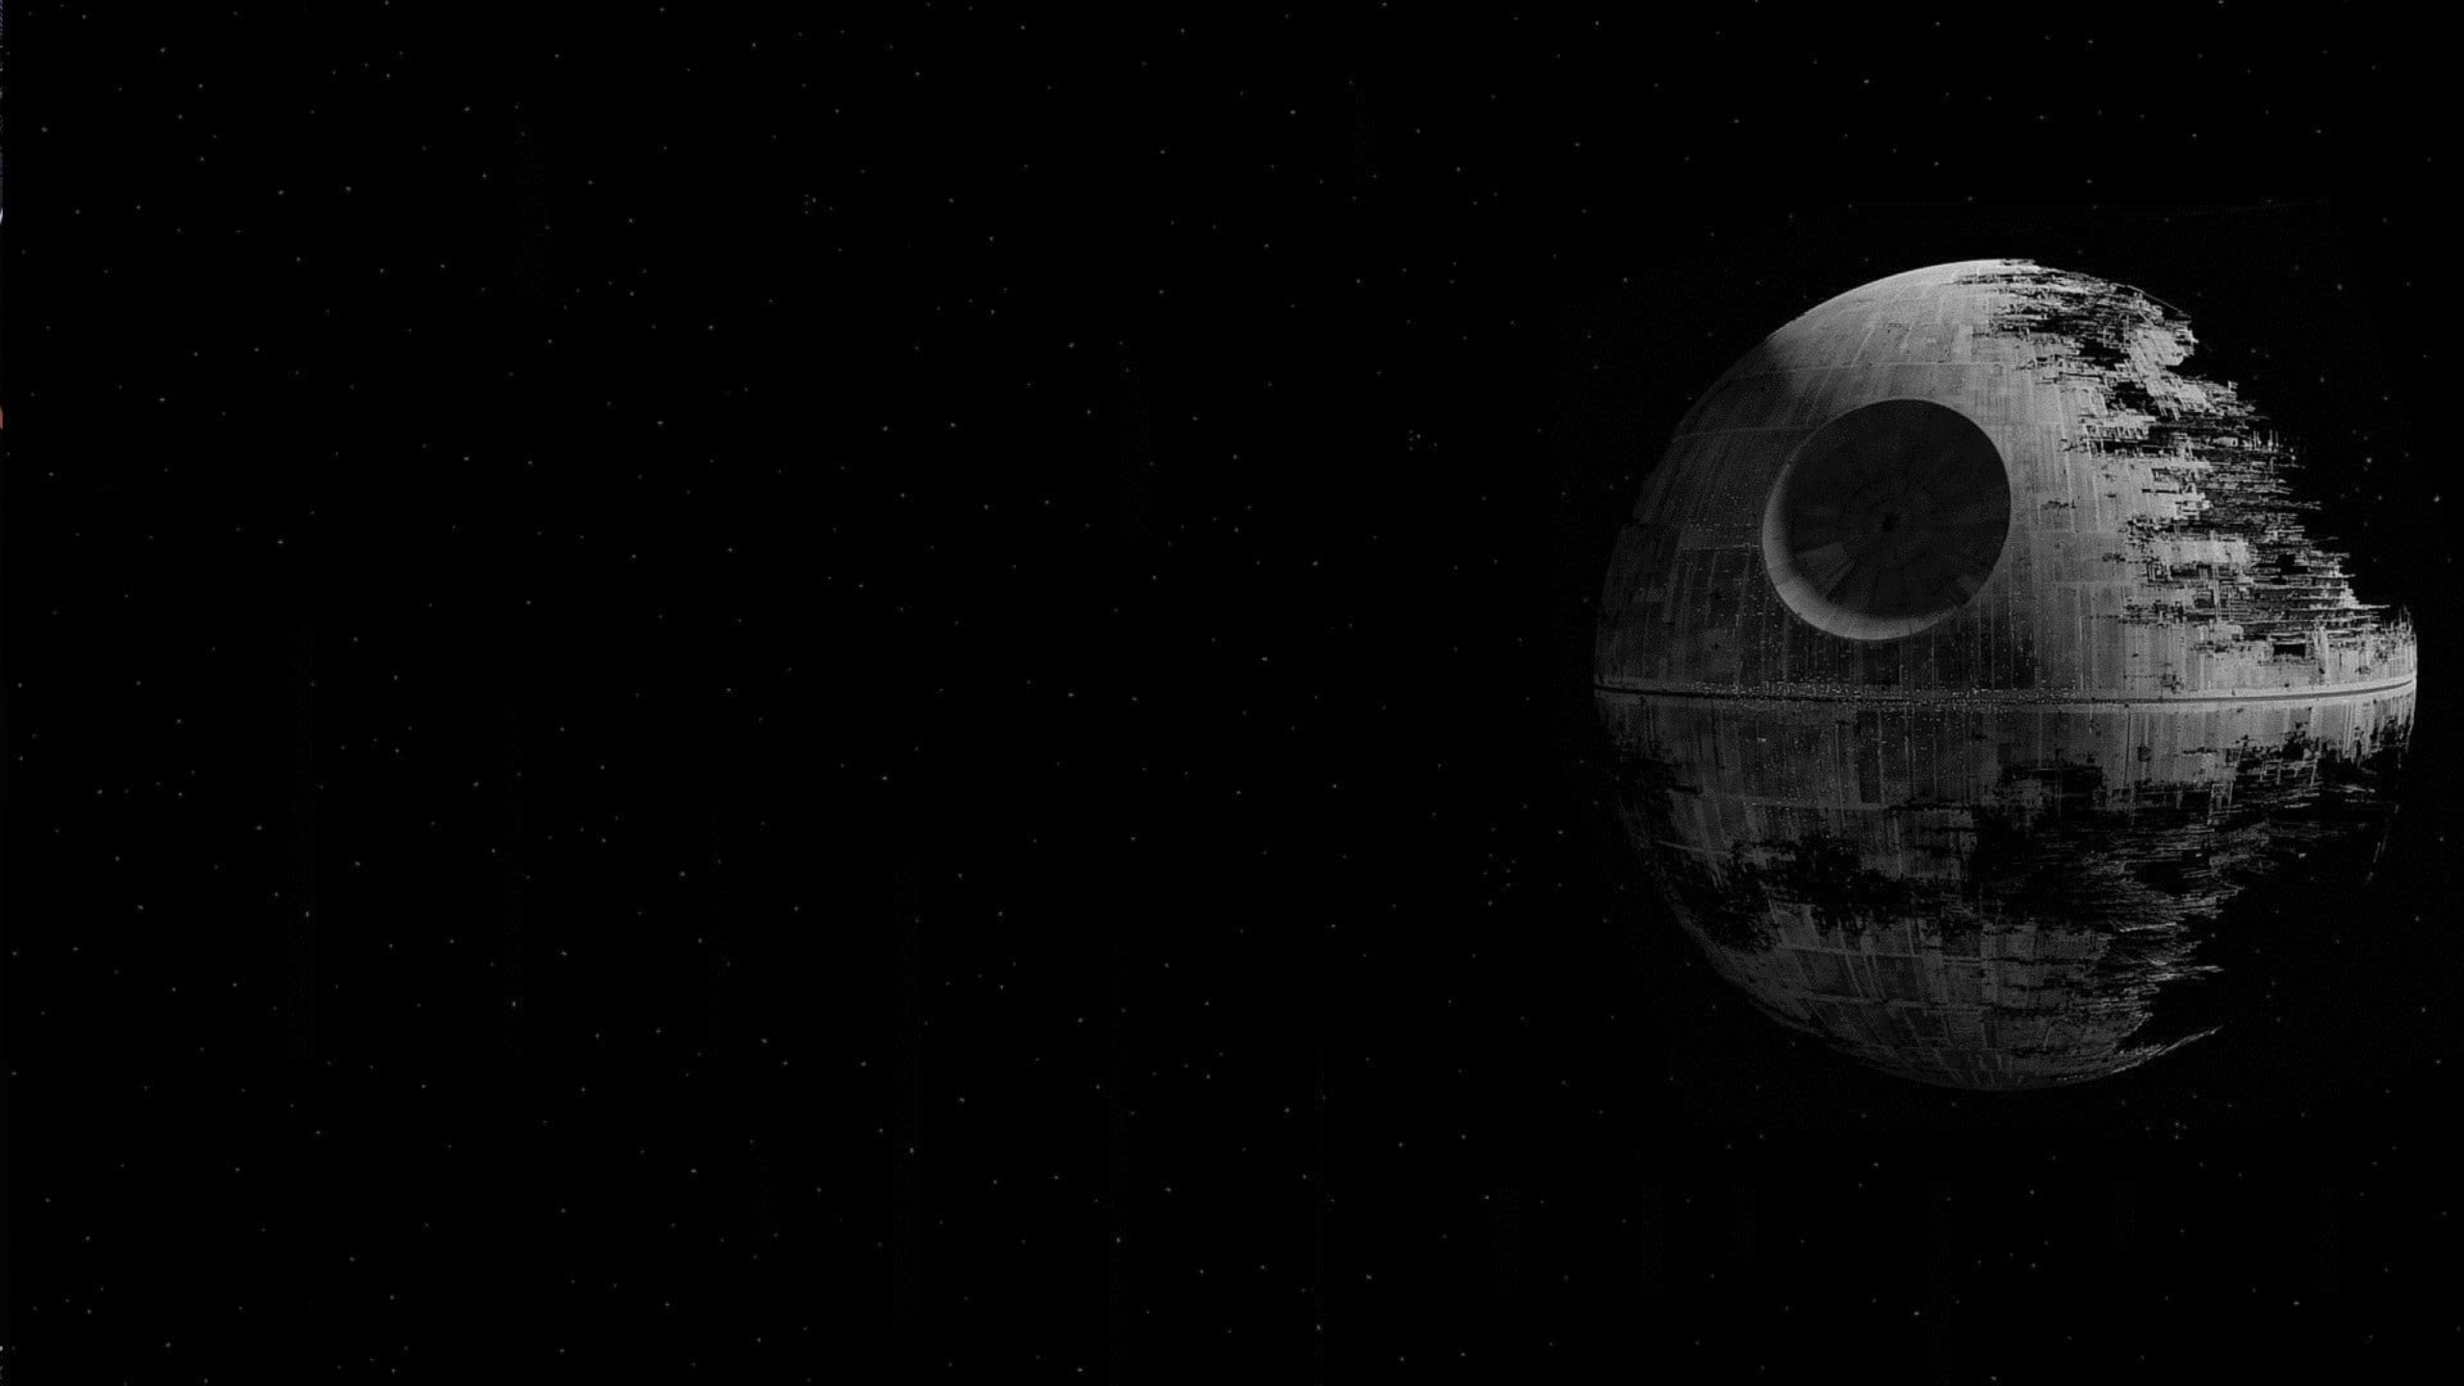
Star Wars The Data Strikes Back
Robert Kirsten
Rutgers Boot Camp Project 1 –Data Visualization

Slide 2
An analytical and statistical analysis of the creativity behind STAR WARS
What kind of data is available and what kinds of stories can it tell?
SWAPI
People, Places, Things? How much of there is it available?
Episodes 1-6 only
Can we tell who the most important characters are from the data?
How many characters are there?
Is there a difference in how the data can be viewed or interpreted by the user?
Theatrical Release versus Chronological Order?
Someone who has seen the films versus someone who has not?
Are there any funny patterns or trends within the datasets? Between the datasets?
Jabba
Can creativity be statistically quantified?
Kind of, maybe? TBD

Slide 3
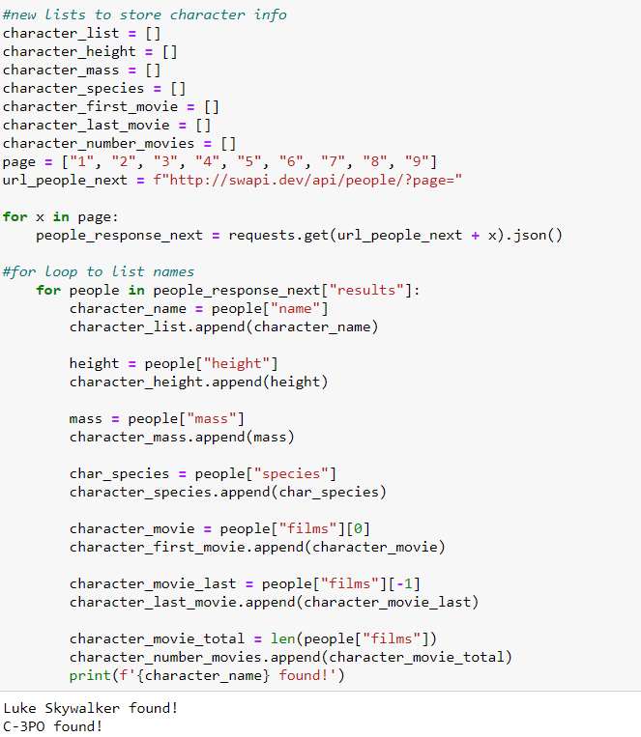
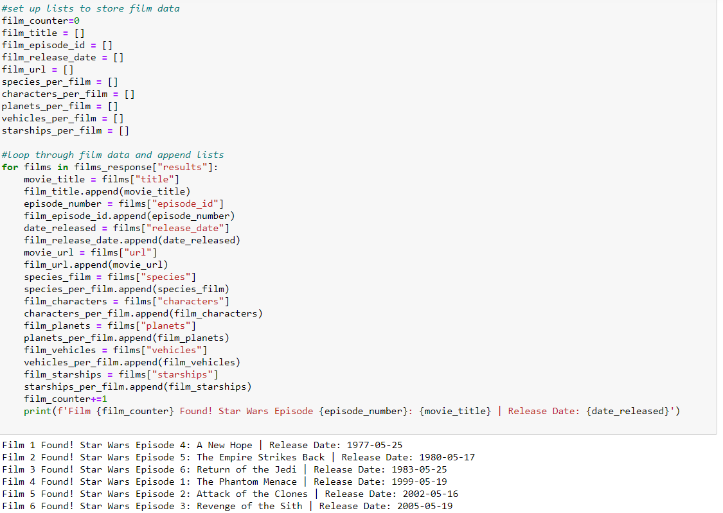
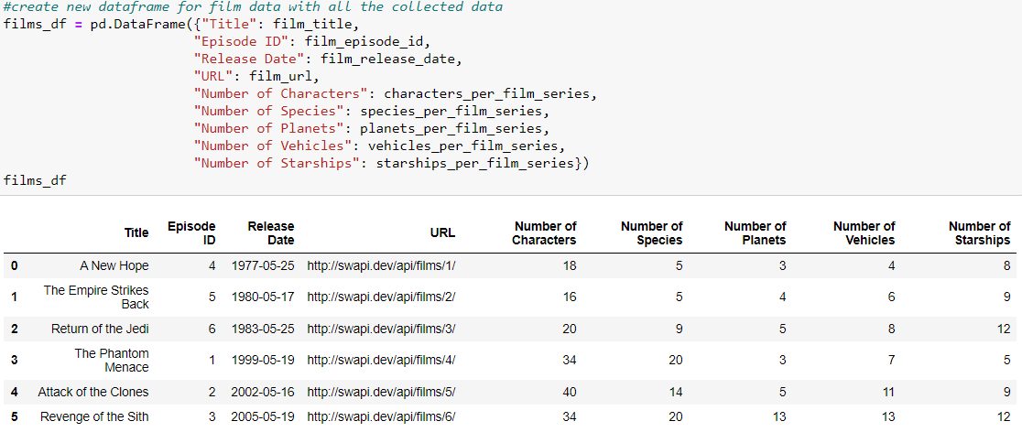
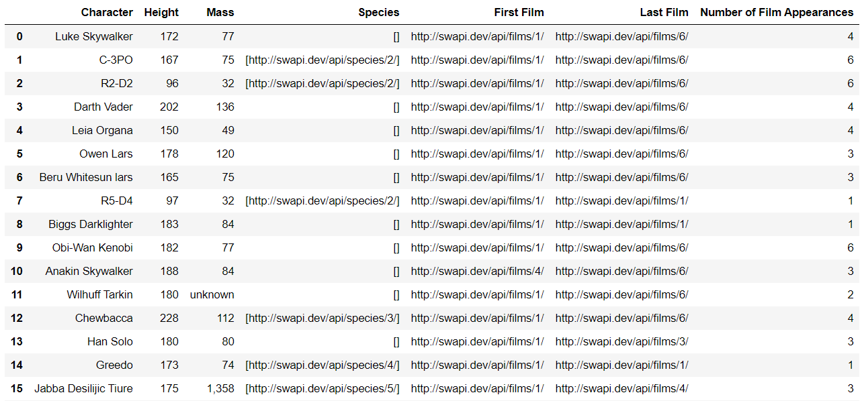
Data Wrangling

Slide 4
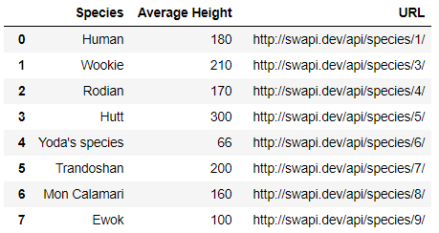
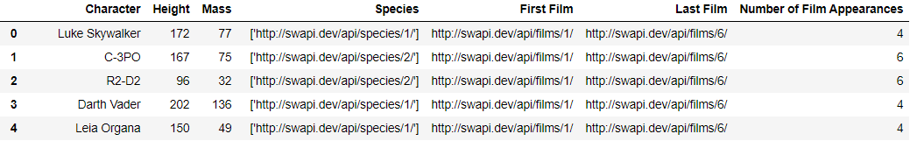
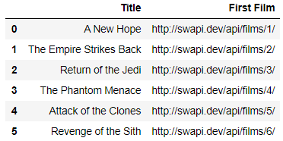
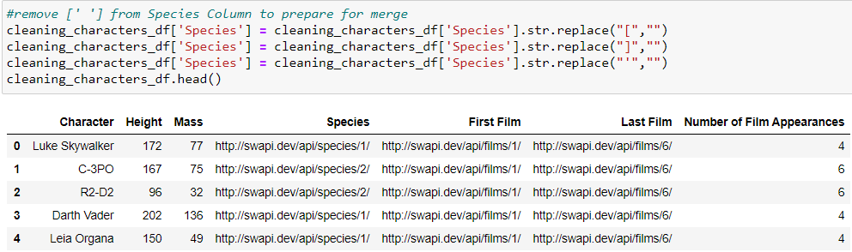
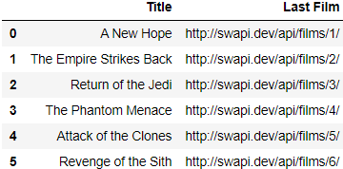
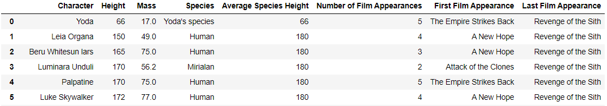
Data Cleaning – Exploration, Cleaning, Insights, Problems

Slide 5
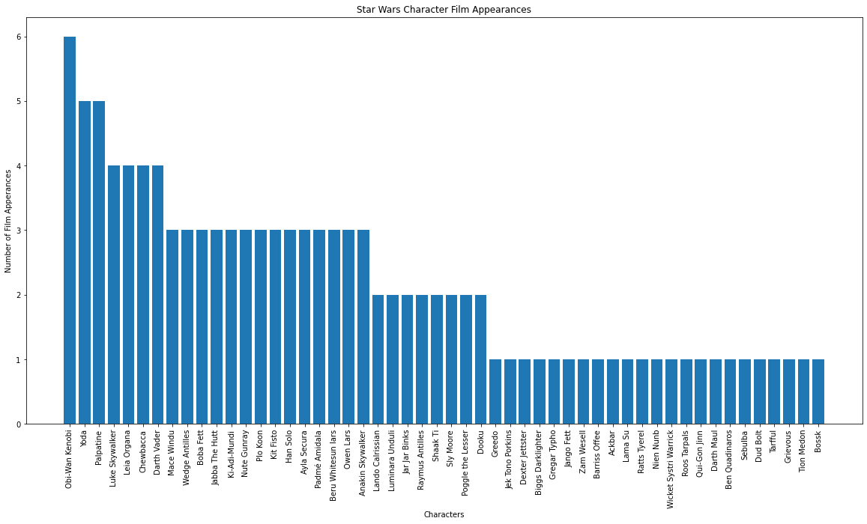
Data Analysis

Slide 6
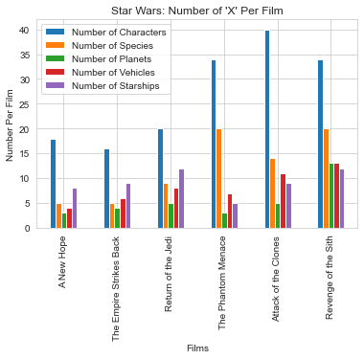
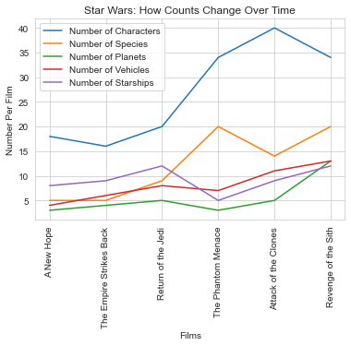
Star Wars by Release Order

Slide 7
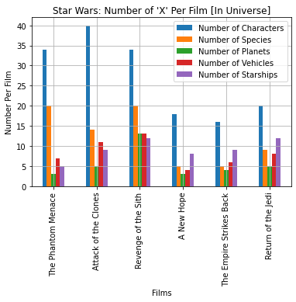
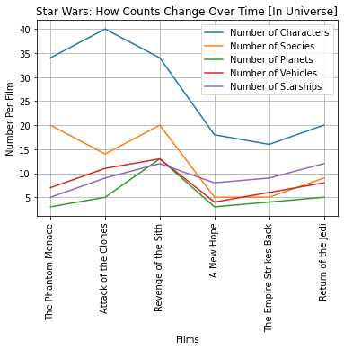
Star Wars by In Universe Order

Slide 8
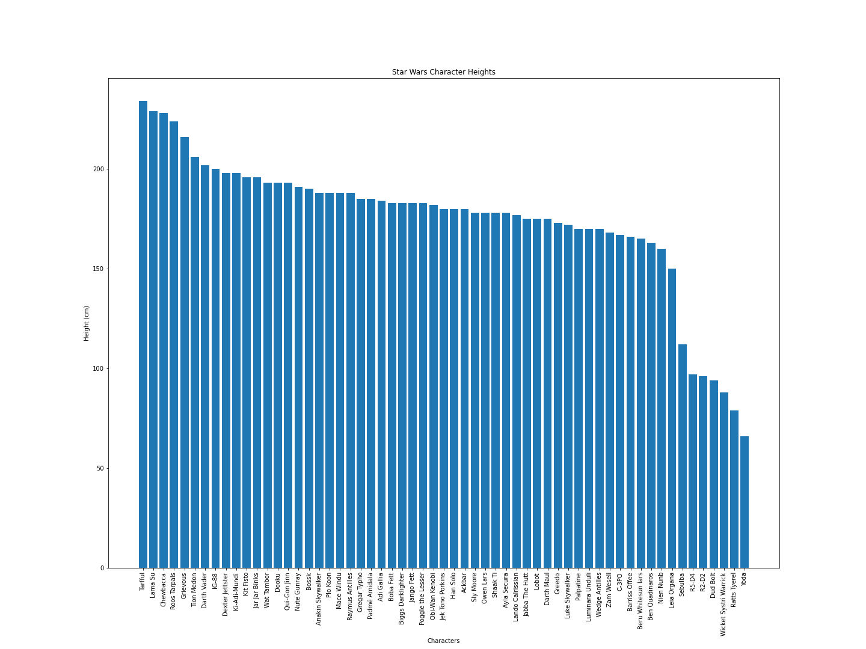
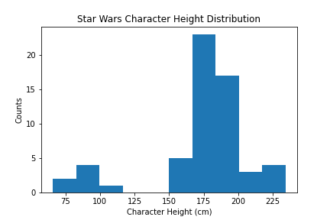
Character Heights
pvalue=0.00018438028390007074)
------------------------------------
The sample standard deviation is 35.2
The sample variance is 1241.4
------------------------------------
The mean height of Star Wars characters is
174.4 cm or 68.4 in

Slide 9
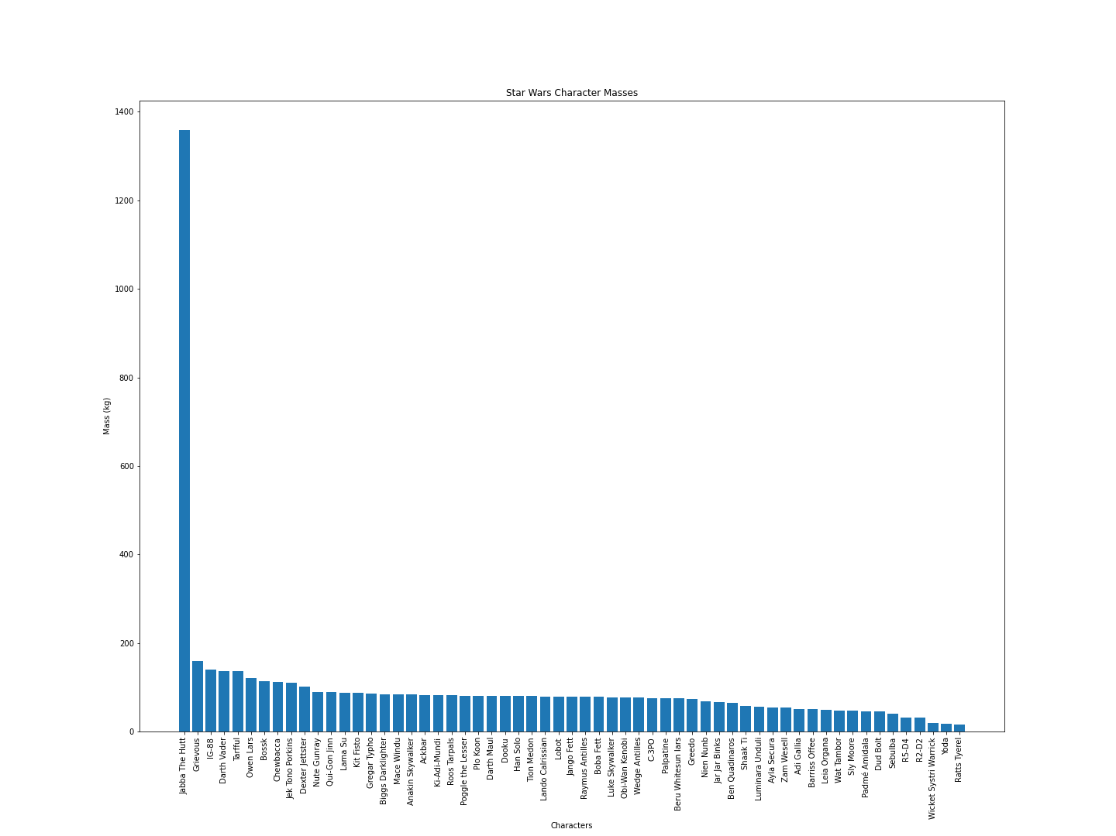
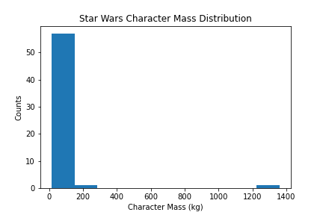
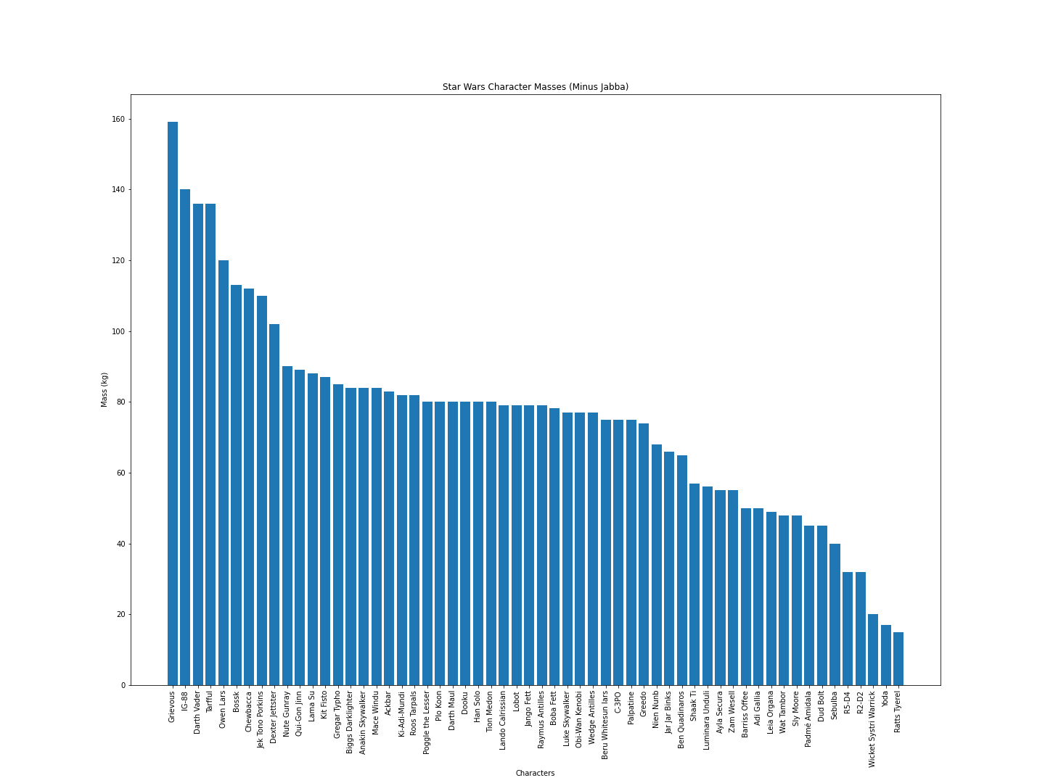
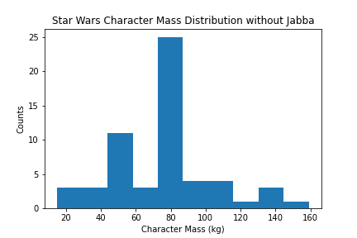
Can one person Hutt truly make a difference?
Masses with Jabba
pvalue=1.7377320722567525e-24)
---------------------------
The sample standard deviation is 168.0
The sample variance is 28229.0
---------------------------
The mean mass of Star Wars characters with Jabba is
97.3kg or 214.5lbs
Masses without Jabba
pvalue=0.09846414031271)
--------------------------The sample standard deviation is 29.0
The sample variance is 841.0
---------------------------The mean mass of Star Wars characters without Jabba is
75.6kg or 166.7lbs

Slide 10
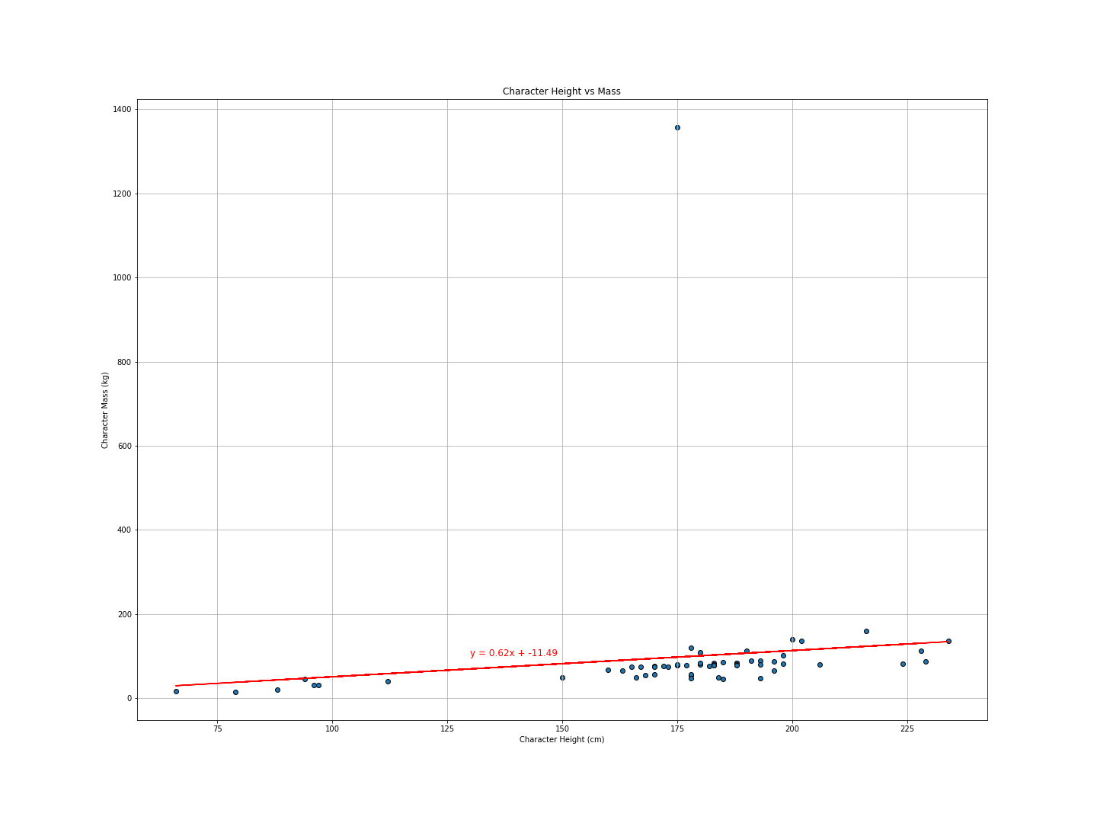
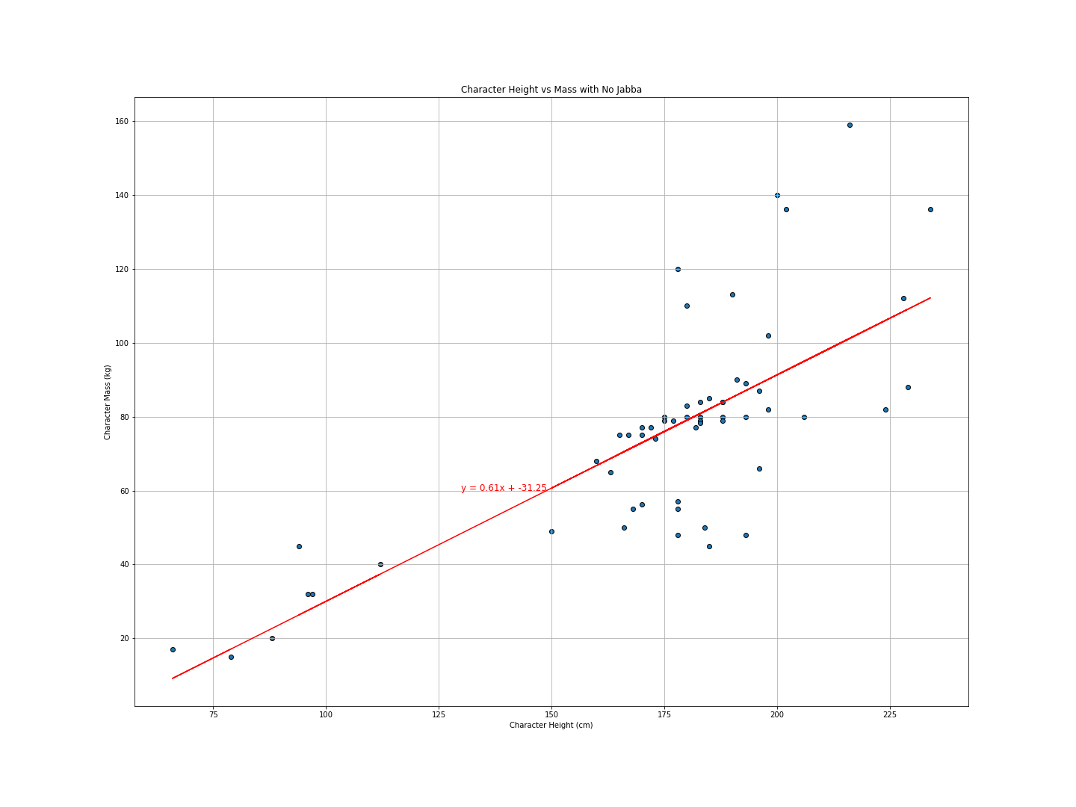
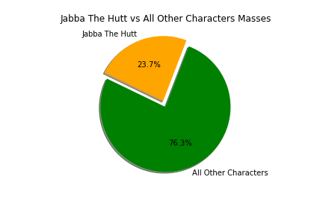
Apparently one Hutt can make a difference
With Jabba
Without Jabba
The r-squared is 0.01712
The r-squared is 0.56379

Slide 11
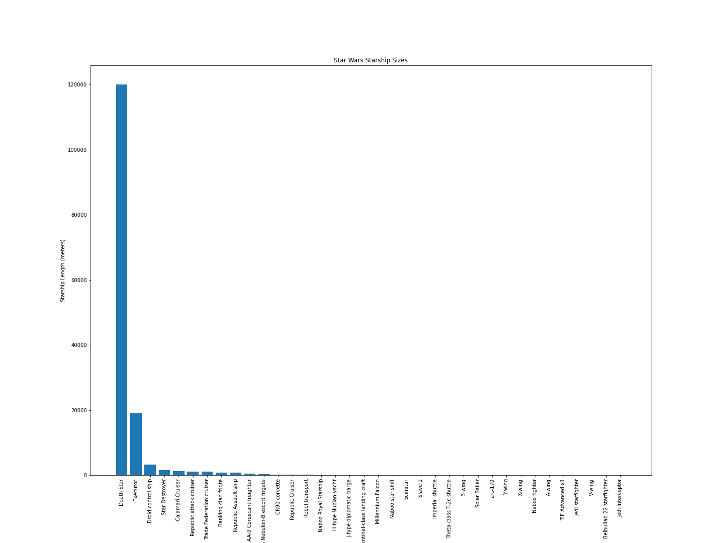
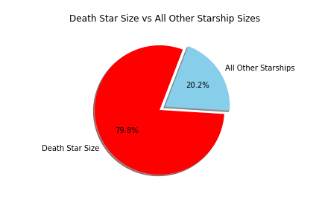
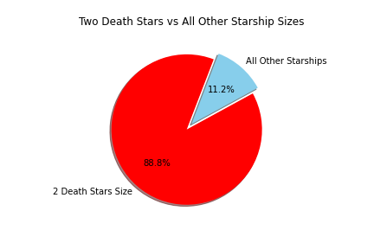
Death Star vs ALL

Slide 12
Discussion
It’s difficult to quantify creativity
Regression towards the mean might be a norm
The same data can be displayed in different ways and interpreted differently by different people
Jabba is massive. The Death Star is massiver
The Death Star had to be stopped by any means necessary
Resources
Control

Slide 13
Post Mortem
Difficulties:
Lack of data
Incomplete data
Only the first 6 movies
Certain tasks
Cleaning certain items with Pandas – used CSV
Exporting figures with correct sizes
With two more weeks:
Fully Merged with pivot table for ship captains, planets, etc
Spoken word counts versus screen time
Cost of creating the Death Star
Size of Death Star or other ships versus real Spaceships

Slide 14
Questions?

