Slide 1
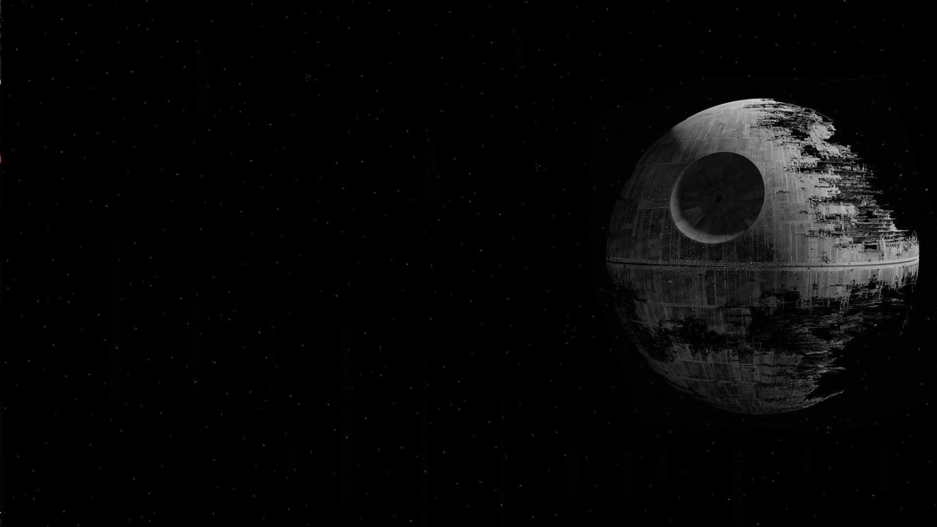
Star Wars The Data Strikes Back
Robert Kirsten
Rutgers Boot Camp Project 1 –Data Visualization

Slide 2
An analytical and statistical analysis of the creativity behind STAR WARS
What kind of data is available and what kinds of stories can it tell?
SWAPI
People, Places, Things? How much of there is it available?
Episodes 1-6 only
Is there a difference in how the data can be viewed or interpreted by the user?
Theatrical Release versus Chronological Order?
Someone who has seen the films versus someone who has not?
Are there any funny patterns or trends within the datasets? Between the datasets?
Jabba
Can creativity be statistically quantified?
Kind of, maybe? TBD

Slide 3
Questions & Data
Elaborate on the questions you asked, describing what kinds of data you needed to answer them, and where you found it

Slide 4
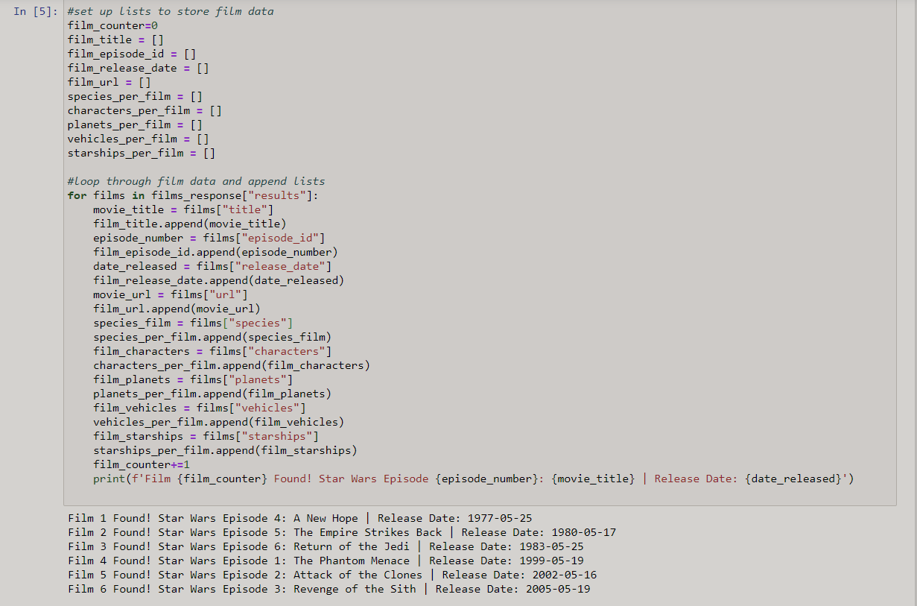
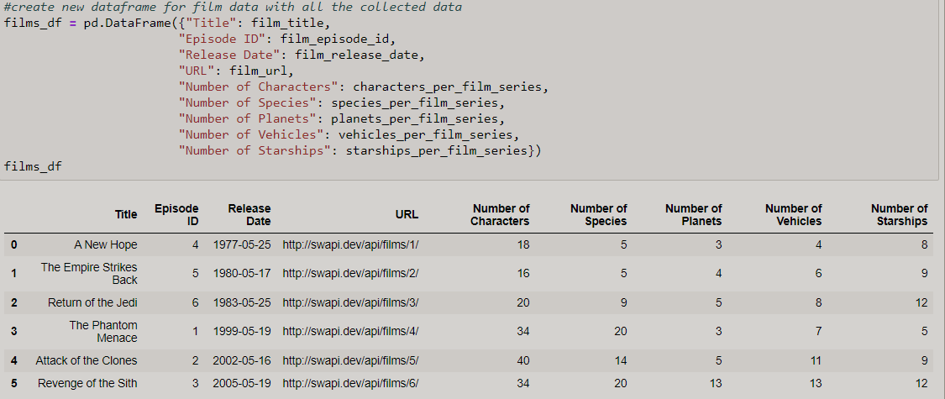
Data Wrangling

Slide 5
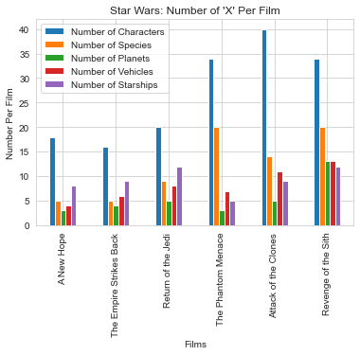
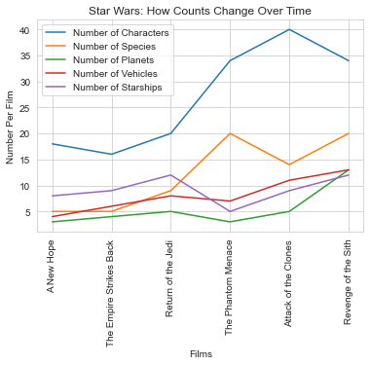
Star Wars by Release Order

Slide 6
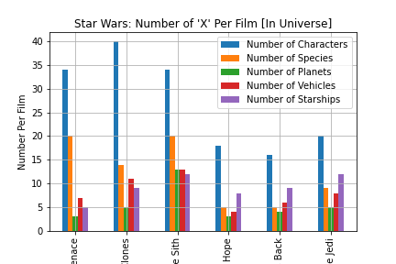
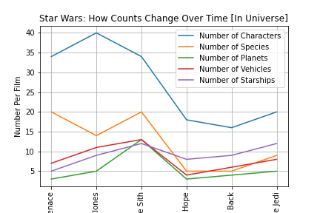
Star Wars by In Universe Order

Slide 7
Data Cleanup & Exploration
Describe the exploration and cleanup process
Discuss insights you had while exploring the data that you didn't anticipate
Discuss any problems that arose after exploring the data, and how you resolved them
Present and discuss interesting figures developed during exploration, ideally with the help of Jupyter Notebook

Slide 8
Data Analysis
Discuss the steps you took to analyze the data and answer each question you asked in your proposal
Present and discuss interesting figures developed during analysis, ideally with the help of Jupyter Notebook

Slide 10
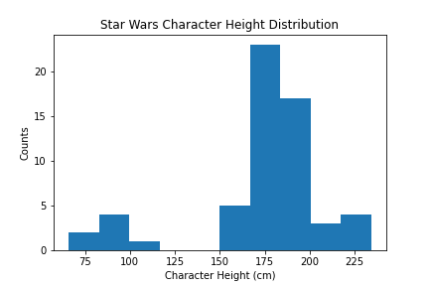
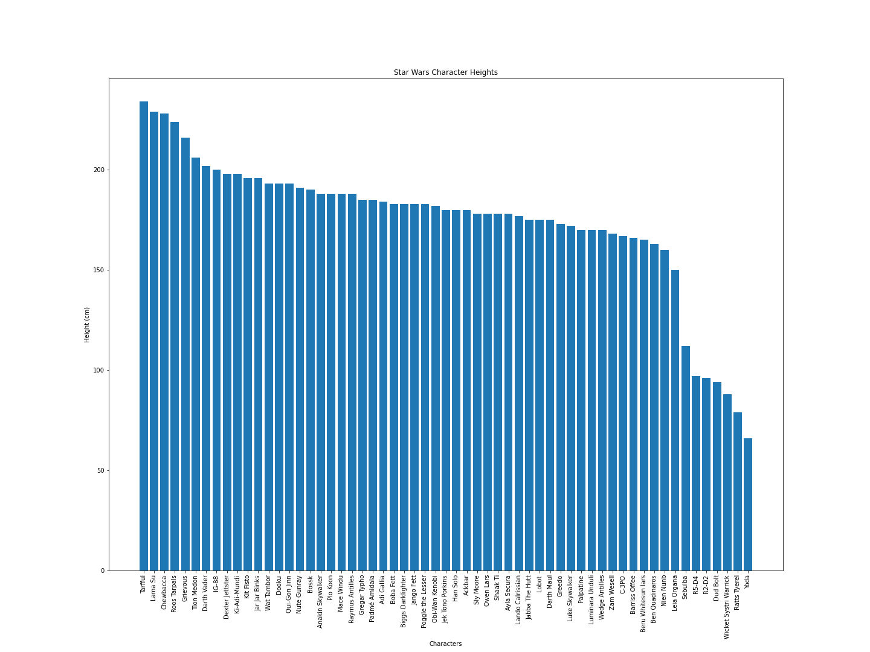
Character Heights
pvalue=0.00018438028390007074)
------------------------------------------
The sample standard deviation is 35.2
The sample variance is 1241.4
------------------------------------------
The mean height of Star Wars characters is 174.4 cm or 68.4 in
------------------------------------------
Roughly 68% of the data is between 139.1 and 209.6 cm
Roughly 95% of the data is between 103.9 and 244.8 cm
Roughly 99.7% of the data is between 68.7 and 280.1 cm

Slide 11
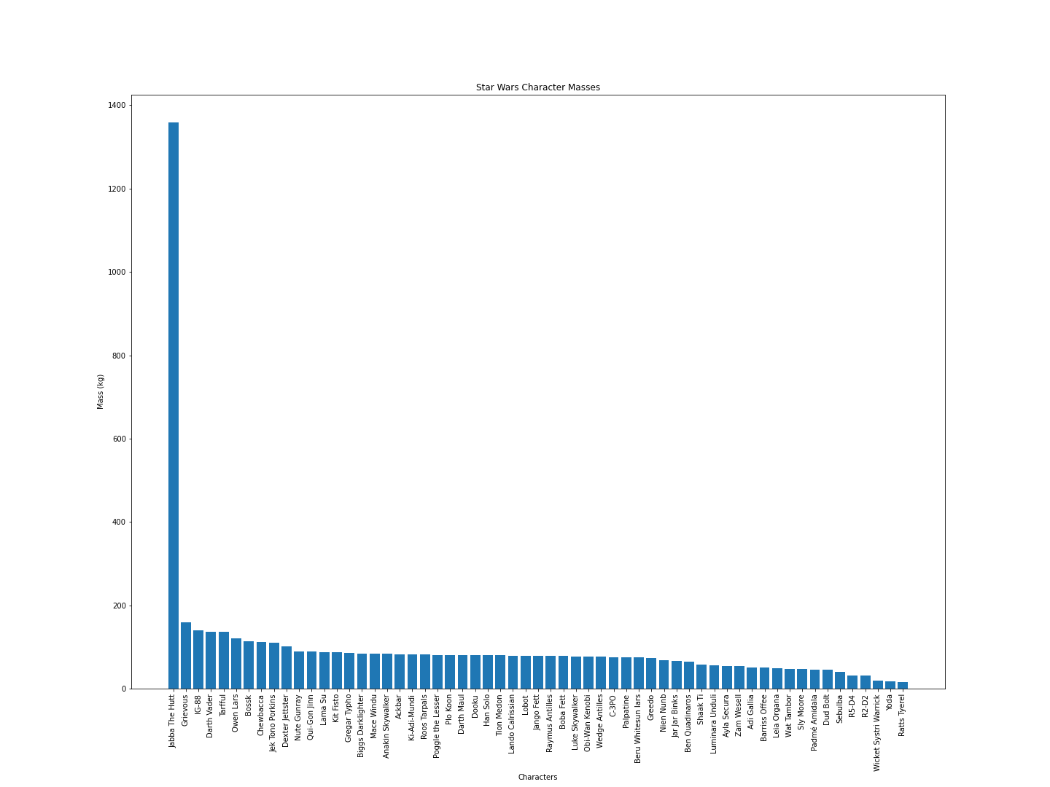
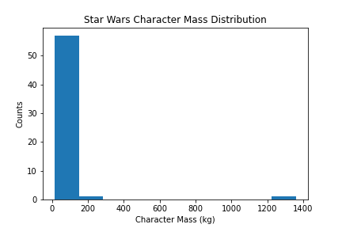
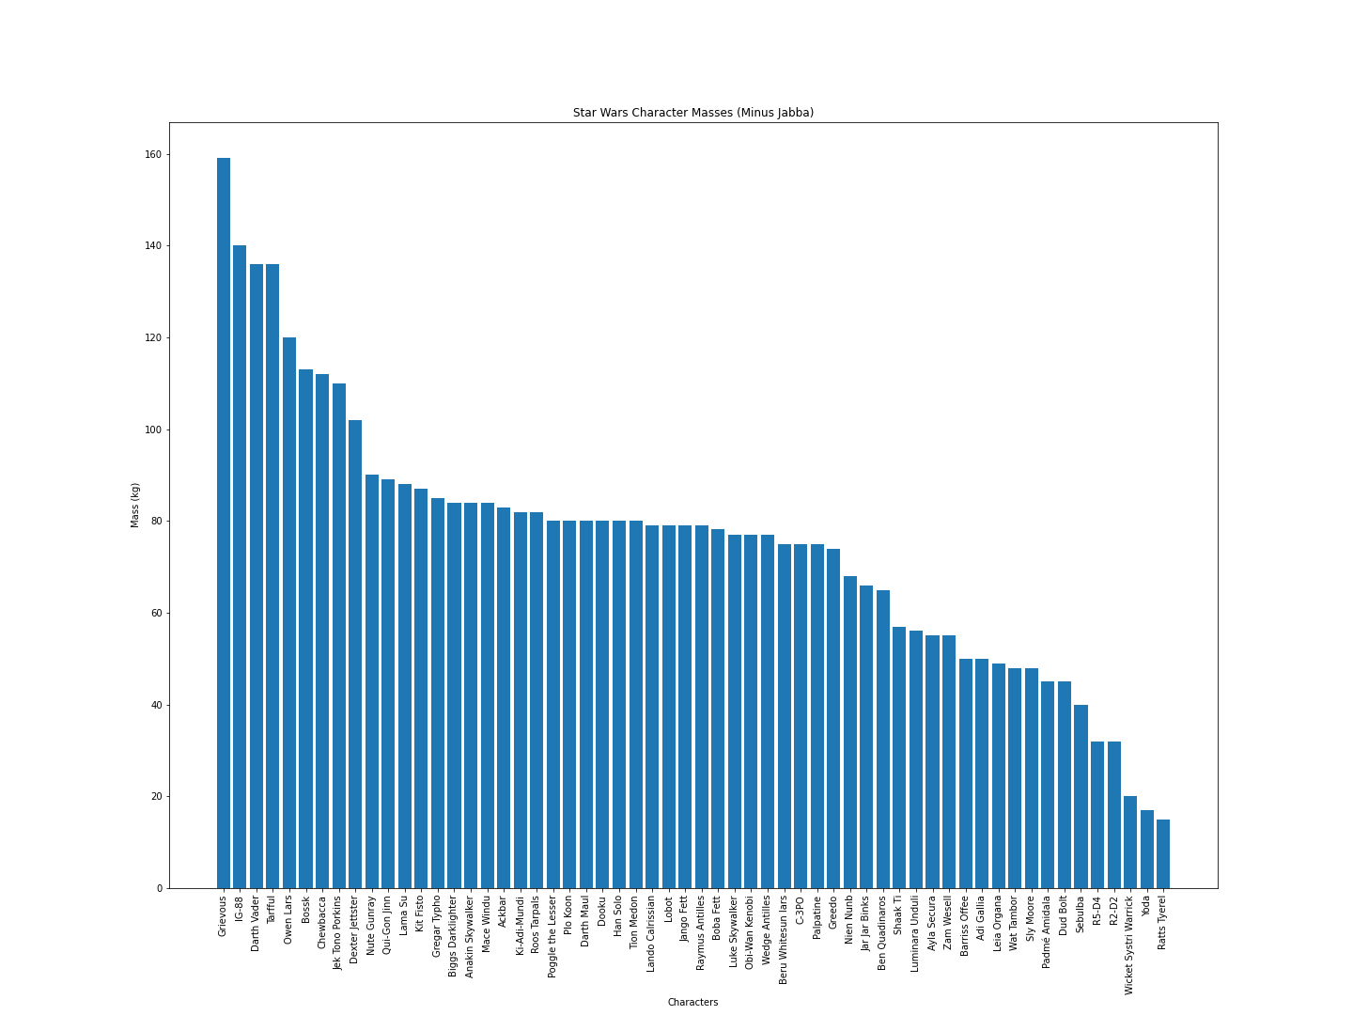
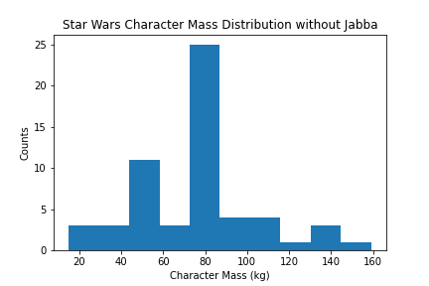
Can one person Hutt truly make a difference?
Masses with Jabba
pvalue=1.7377320722567525e-24)
---------------------------
The sample standard deviation is 168.0
The sample variance is 28229.0
---------------------------
The mean mass of Star Wars characters with Jabba is
97.3kg or 214.5lbs
Masses without Jabba
pvalue=0.09846414031271)
--------------------------The sample standard deviation is 29.0
The sample variance is 841.0
---------------------------The mean mass of Star Wars characters without Jabba is
75.6kg or 166.7lbs

Slide 12
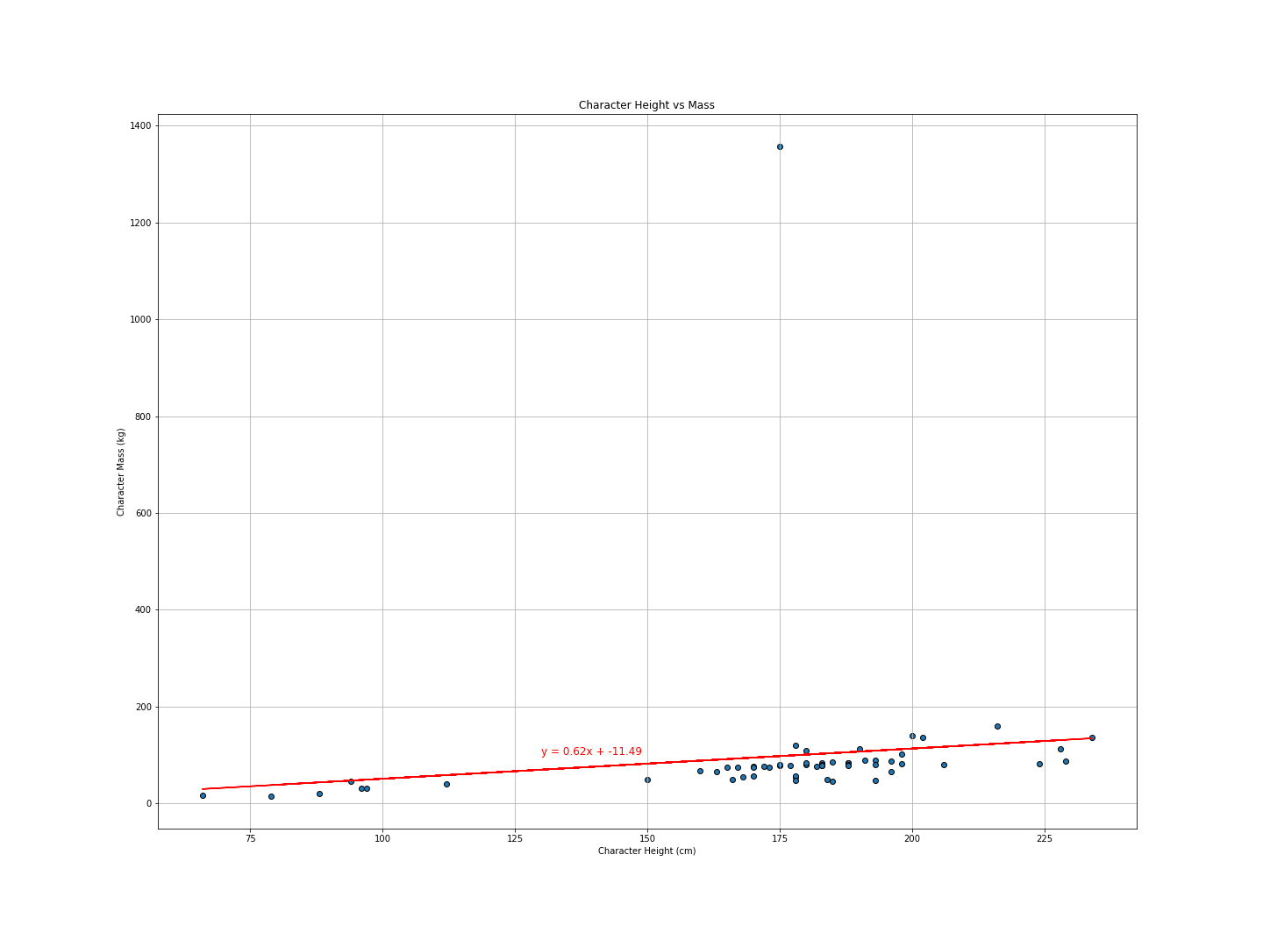
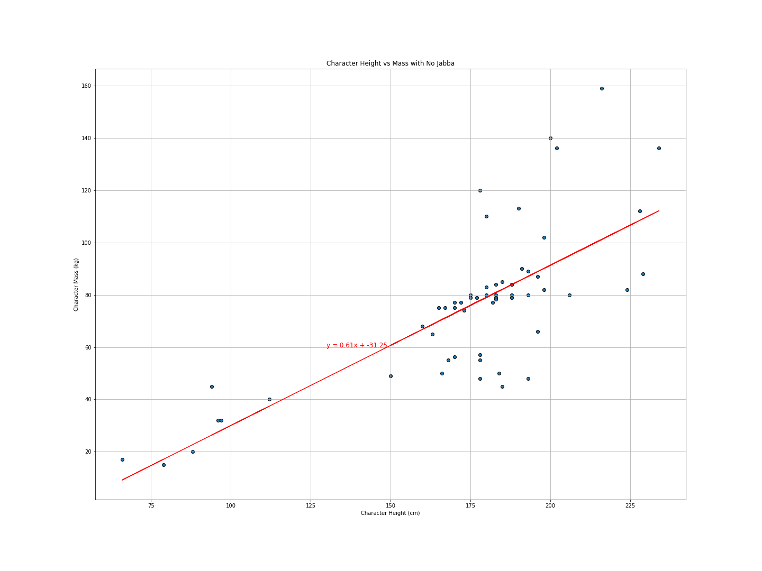
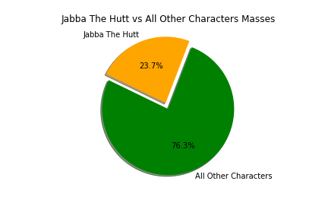
Apparently one Hutt can make a difference
With Jabba
Without Jabba
The r-squared is 0.01712
The r-squared is 0.56379

Slide 13
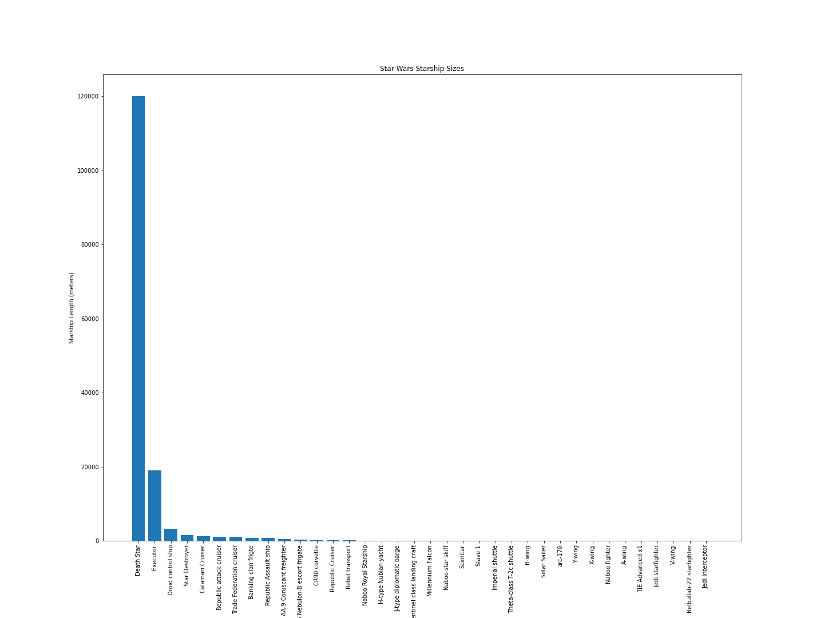
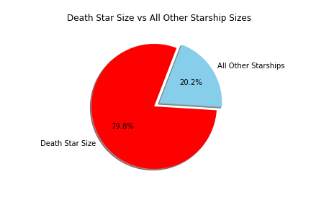

Slide 14
Discussion
Discuss your findings. Did you find what you expected to find? If not, why not? What inferences or general conclusions can
you draw from your analysis?

Slide 15
Post Mortem
Discuss any difficulties that arose, and how you dealt with them
Discuss any additional questions that came up, but which you didn't have time to answer: What would you research next, if you
had two more weeks?

Slide 16
Questions?

