Slide 1

Rakesh Jha

Slide 2
What to expect ahead
Introduction
JavaScript
NodeJs
Express framework
Social media backend (Node.js,express,mongodb)
Scalling Node.Js application

Slide 3
Background
V8 is an open source javascript engine developed by google,it's written in C++ and used in google chrome.
Node runs on V8
It was created by Ryan Dahl in 2009
It is an open source runs on well on linux and window system

Slide 4
Introduction:Basic
In simple words Node.js is 'server-side javascript'
Node.js is a high-performance network applications framework,well optimized for high concurrent environment
It's 40% javascript and 60% C++

Slide 5
Introduction:Advance(Confusing)
Node.js uses an event-driven,non-blocking I/O model ,which makes it lightweight.
It makes use of event-loop via javascript's callback functionality to implement the non-blocking I/O
Everything inside Node.js is single threaded

Slide 6
Why Node.js ?

Slide 7
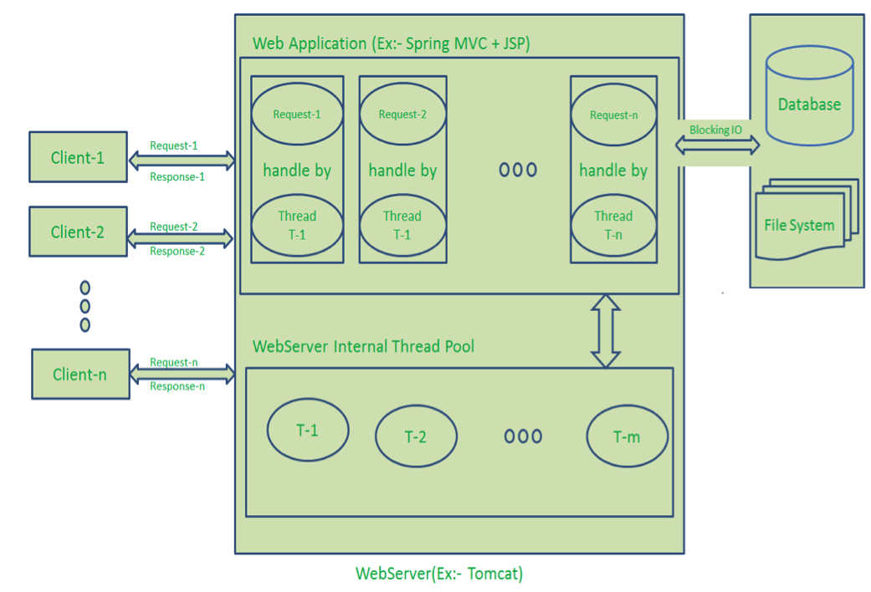
Multithreaded request response architecture

Slide 8
Drawbacks
Handling more and more concurrent client’s request is bit tough.
When Concurrent client requests increases, then it should use more and more threads, finally they eat up more memory.
Sometimes, Client’s Request should wait for available threads to process their requests.
Wastes time in processing Blocking IO Tasks.

Slide 9
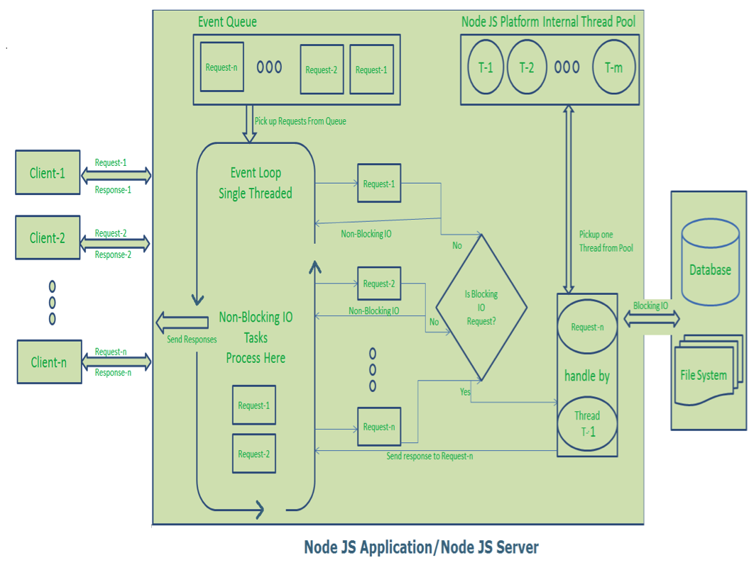
Node.Js Architecture-Single threaded event loop

Slide 10
Single threaded event loop architecture advantages
Handling more and more concurrent client’s request is very easy.
Even though our Node JS Application receives more and more Concurrent client requests, there is no need of creating more and more threads, because of Event loop.
Node JS application uses less Threads so that it can utilize only less resources or memory

Slide 11
Parallelism vs Concurrency

