Slide 1
UofT 3666 – Applied NLP Final Project
Group Members: Linda Peto and Rahim Jiwa

Slide 2
Purpose
The goal is to conduct a feasibility study to explore and demonstrate tools that be used to support your climate change application.
We focused on three different areas:
PDF extraction
LDA topic modelling
Identifying Actions.

Slide 3
Data
Data used were the Climate Change Docs and the Action CSV initially provided.
In addition, we self generated and obtained data to enrich provided data.
Added:
manually labelled 388 sentences from the Climate Change Docs as Non-Actions
Approximately 20 additional Climate Change PDFs.
Additional files can be found on GitHub.

Slide 4
PDF Extraction
Three different tools were explored: PdfMiner, PyPDF2, Tika.
We found that each tool provided a different outcome. We provided a notebook comparing each of the tools against each other on the same document.
Overall, each of the tools that we tested were easy to use and implement.
Tika was the best performing. PDF Miner was the best pure Python option.
There were a number of challenges that were faced:
PDFs formats can vary significantly from file to file. This increases the challenge of preprocessing the data for the various different cases.
There was a tendency to have poor transcriptions.
When batch converting PDFs there are cases that you need to be careful of: encryption, blank pages.

Slide 5
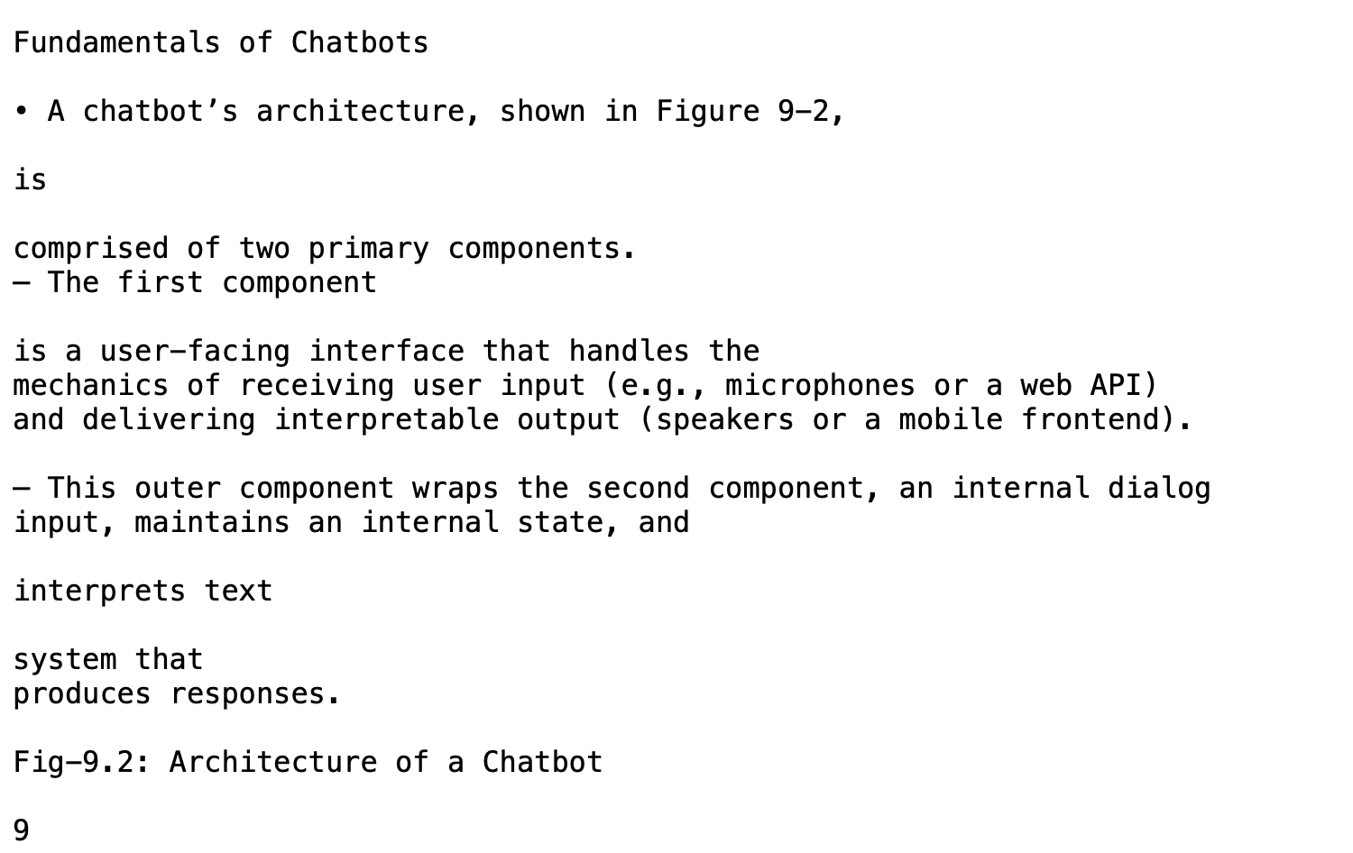
PDF Extraction - PDF Miner
Printed output of the text is fairly clean.
One issue with PDF Miner is that it can be sensitive to document names.
Another issue that can be seen is that some sentences are cut and split into two or three lines. This has the potential to be problematic depending on the context.

Slide 6
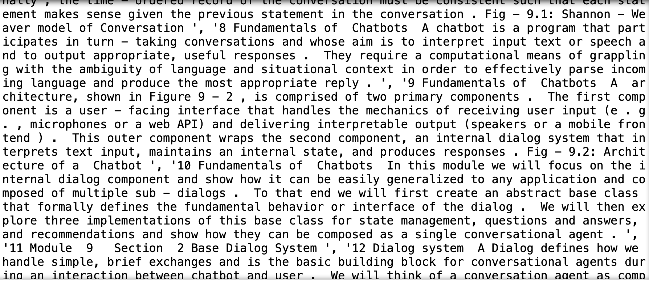
PDF Extraction - PyPDF2
The output is a list of pages.
When parsing the document, you end up having to go page by page.
The raw output initially was messy. There were new line characters in between every token.
Interesting aspect is dealing with encrypted files. For our purposes, we checked for encryption and skipped the encrypted documents.

Slide 7
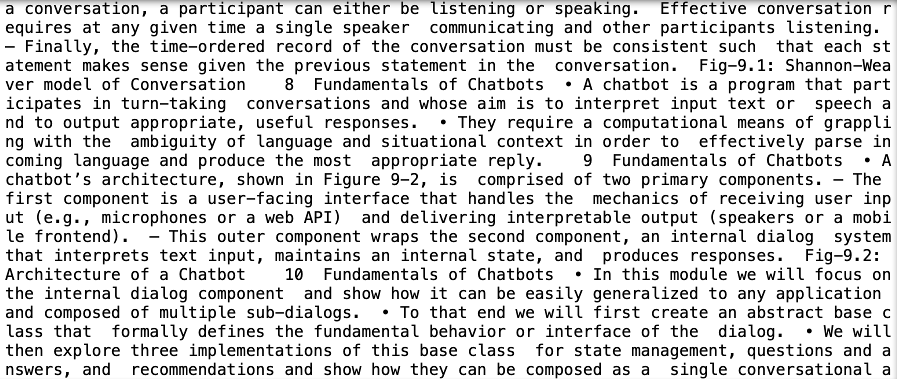
PDF Extraction - Tika
The output is a string.
Easy to use.
Output here has new lines and tab characters stripped out.
Requires an up to date Java Server.
Parses the whole document at once. This makes it easy to use, however, it can be problematic if you only need specific pages or have a pdf document with a blank page.

Slide 8
LDA Topic Modelling
LDA (Latent Dirichlet Allocation) is an unsupervised method of generating topics present among a set of documents.
The model takes a set of documents (which are made up of a collection of words), and examines the words within it, in order to determine the topics.
It also suggests that each document is made up of a distribution of small topics. The idea here, is that it is possible to have multiple topics within the same document. LDA looks to see how likely a topic can be seen within a document.

Slide 9
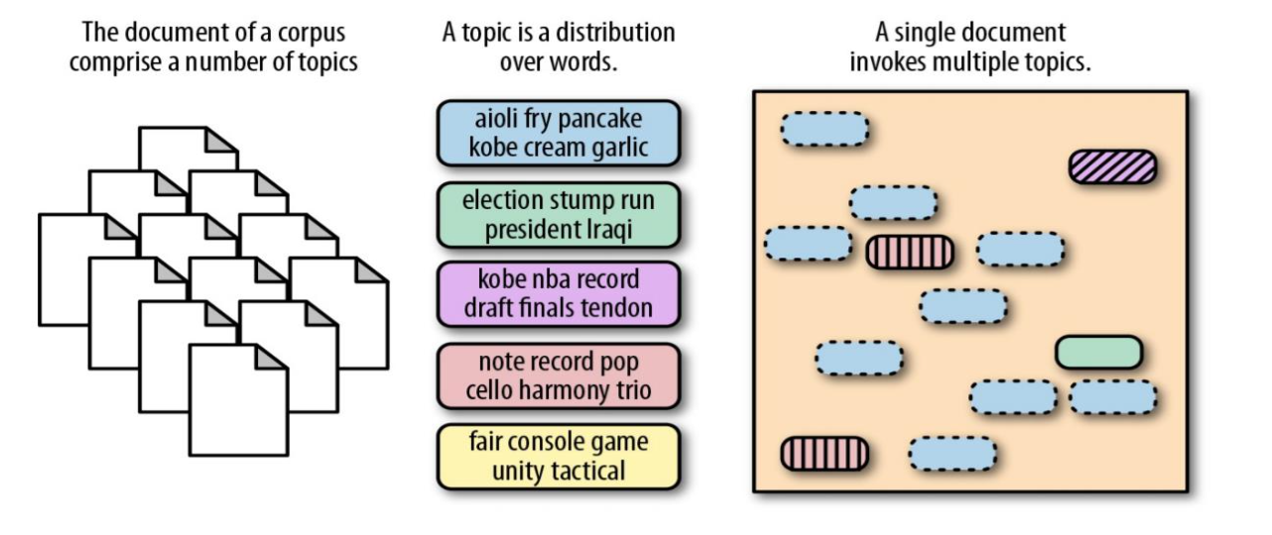
LDA Topic Modelling

Slide 10
LDA Topic Modelling
To perform LDA on this dataset, we tried using two different tools: sklearn and gensim.
Initially, we started with sklearn as it was the package our group was more familiar with.
We found that sklearn could implement LDA, however, it was not as robust as gensim.
An advantage of sklearn is that it is a popular package, with superb documentation and lots of available guidance.
Gensim is primarily focused on topic modelling, it provides greater functionality and is a better choice for a more focused NLP task.

Slide 11
LDA Topic Modelling
With the Gensim package
Implementing the LDA model
Calculating the coherence scores.
Testing a random document on with the model
Our best performing model had a Coherence Score of -0.13 utilizing the u_mass measure.
Upon inspection our topics also seemed to fit. The terms are related, however, within climate change, it is hard to discern specific subdomains. This could mean that the documents are fairly similar.

Slide 12
LDA - Evaluation
One method to evaluate the topics is to examine the top terms. The top terms will provide an idea of what the topic is supposed to represent.
Another method is to use the Coherence Score. The Coherence Score is used to determine the clarity of the topics.
There are a number of different measures that can be used to determine the Coherence Score. The two most prominent measures are C_UCI and U_Mass.
One challenge with the Coherence Score is that the different measures have different scales.
C_UCI is based on Pointwise Mutual Information and considers the probability of co-occurence between two terms, with the reference being an external corpus.
U_Mass is based on looking at the probability of co-occurances between top terms, with the reference being the internally used corpus.

Slide 13
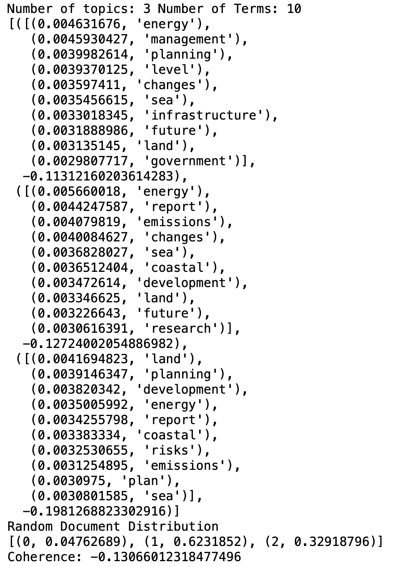
LDA - Results
The best result across all the iterations had a coherence score of -0.13.
It can be seen that the terms within the topics are close together and there are connections.
An issue is there is overlap between the topics. This might indicate that there is not enough diversity amongst the topics.

Slide 14
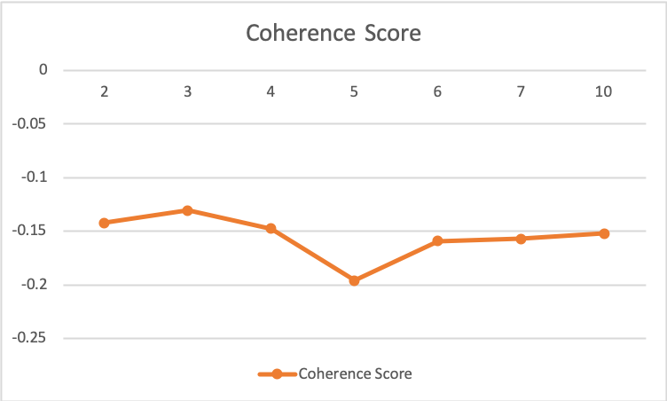
LDA - Results
Found that Coherence Score was better for a smaller number of topics, eventually score plateau.

Slide 15
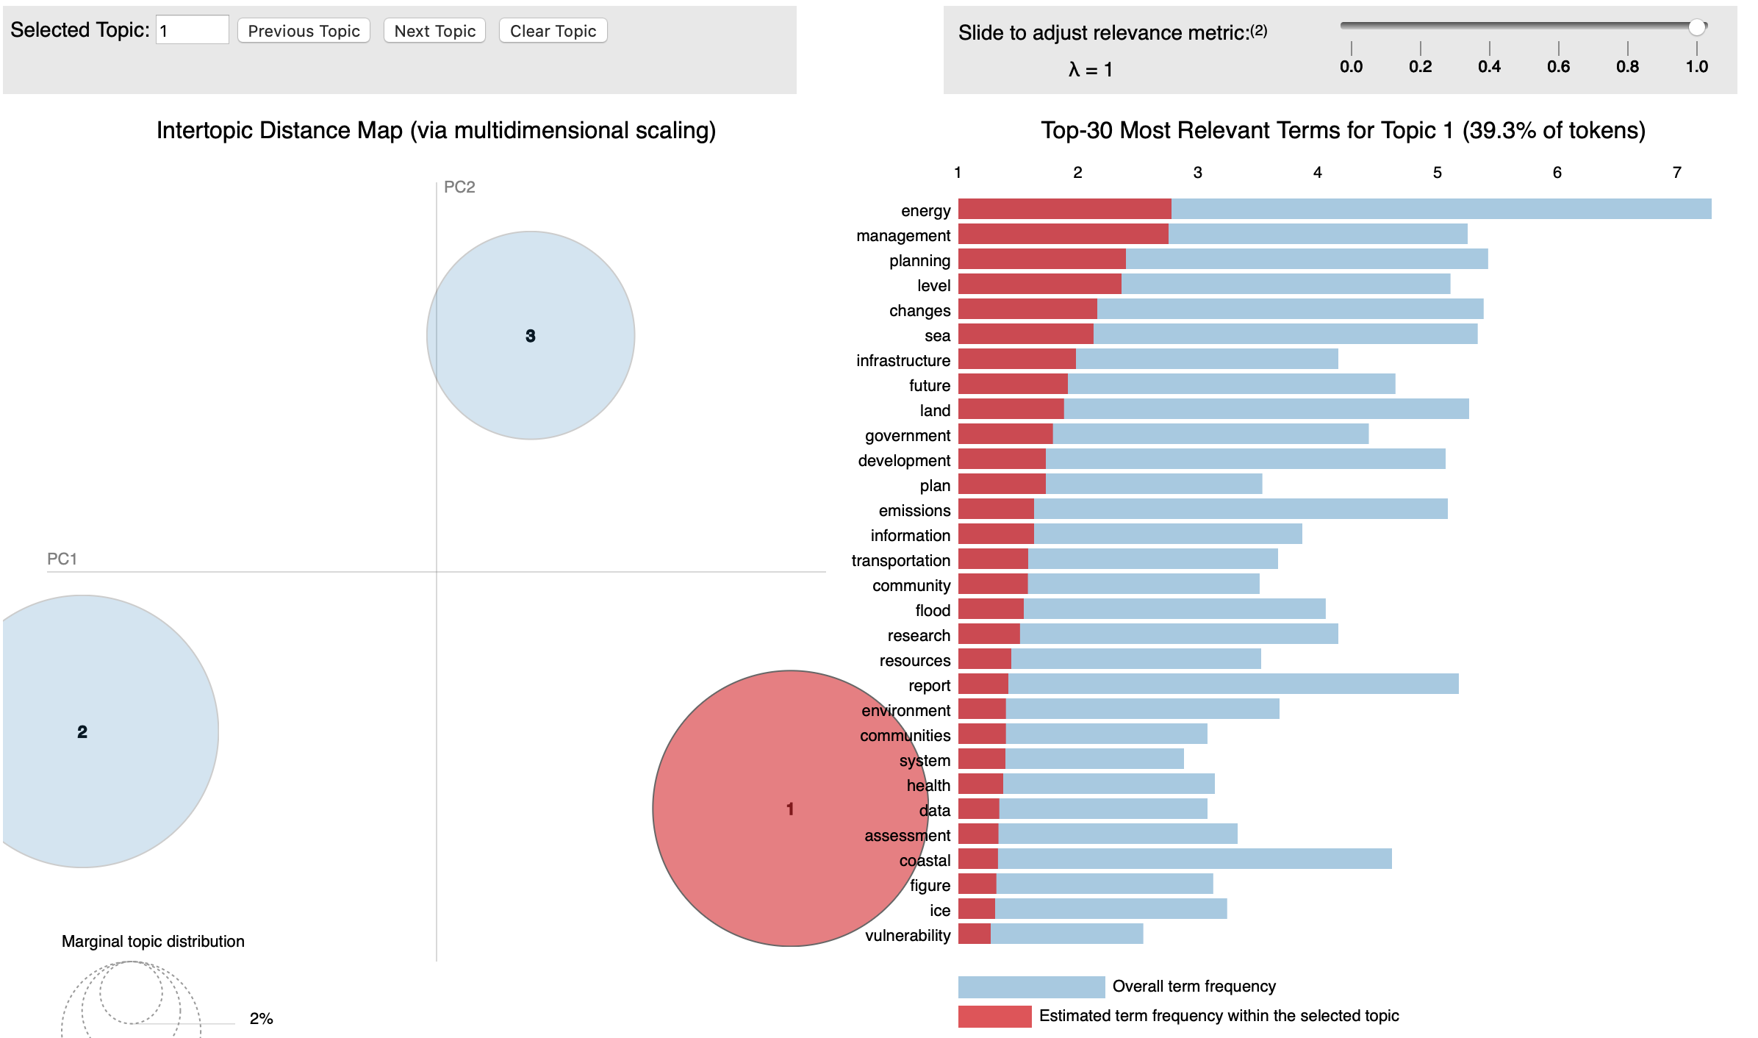
PyLDAvis - Topic 1

Slide 16
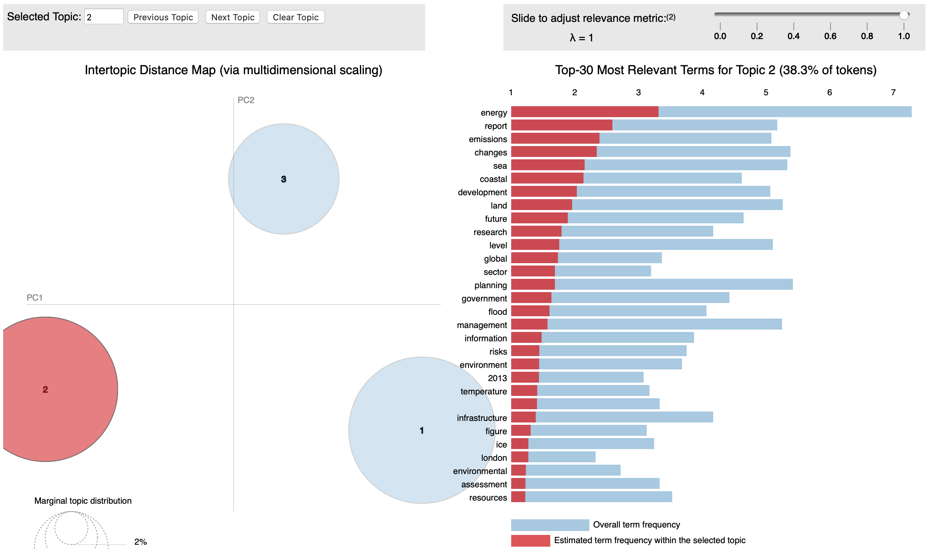
PyLDAvis - Topic 2

Slide 17
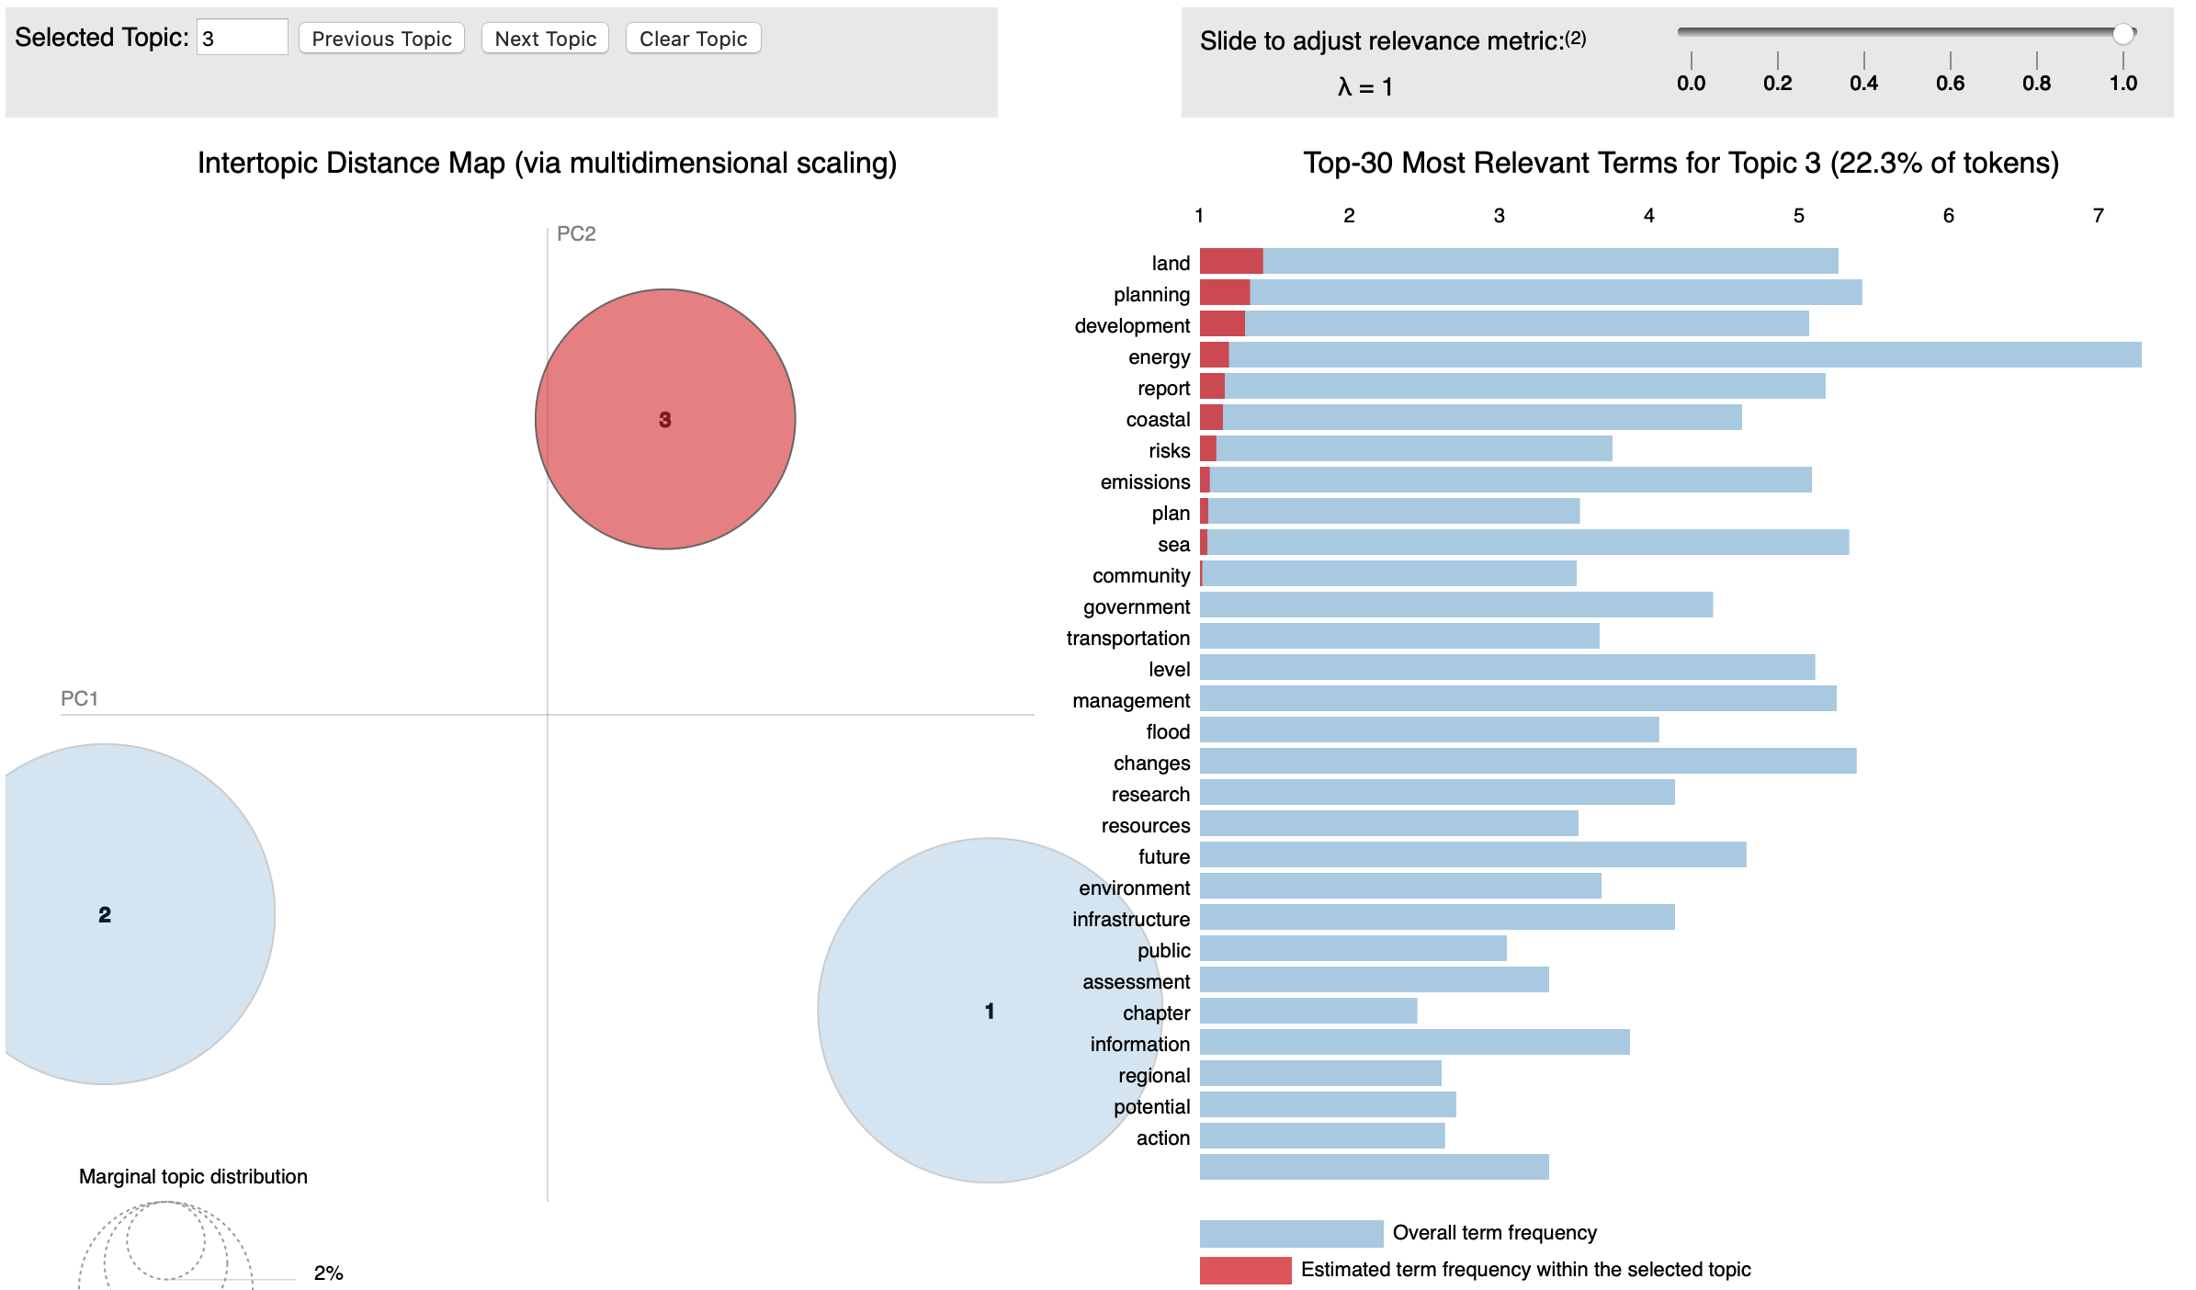
PyLDAvis - Topic 3

Slide 18
LDA Topic Model on Random Document
We previously discussed about determining whether or not an unseen document belongs within the topics.
To explore this, we utilized a pdf of one of our lectures, and fit it to the data.
The result we got was:
What the LDA model did here was assign it a probability of how it would fit within the topics that are already defined. Based off of our exploration, it does not indicate that the document does not belong.
It does not appear that Gensim has a built-in method to perform this action with the LDA class.
Methods of checking if the document fit include:
Implement heuristics in preprocessing. For example, check the name of the file of the document.
Examine most frequent words and compare to topic words.
A method that could be performed is called Doc2Vec. Here you would vectorize the entire document and then compare them to one another. The idea being that the vectorization forms of documents that are similar will be close together.

Slide 19
LDA Findings
One of the challenges that was faced was that NLTK stopwords were reducing the corpus down.
In order to stop this, a stopwords file was created and stopwords were defined based on examining the corpus tokens frequency distribution.
Stopwords file included: common punctuation, common terms (canada, climate, change, http, www, com, and, or, etc), meaningless unicode characters (\uf0b7).
In addition, a heuristic was applied in order to only include tokens whose length was greater than two.
Another challenge faced was the: volume, quality, and similarity of data.
Found that when we added new documents to our corpus, that our coherence score improved. However, this depends on the document added.

Slide 20
Identifying Actions
Overview
Principle Task:
From examples of ‘actions a citizen could do’, learn to automatically identify such actions.
Our Approach:
Look at the grammatical structure of the sentence instead of the words.
Consider both Machine Learning and Rule-Based algorithms.

Slide 21
Identifying Actions
Tools
To capture the grammatical structure of the sentence, we considered:
nltk POS tagging - doesn’t provide enough information for our purpose
CLiPS modality checker - buggy
Stanford CoreNLP - runs in Java, so more complicated to install
spaCy -
in Python
easy to use
produces dependency parses suitable for our purpose

Slide 22
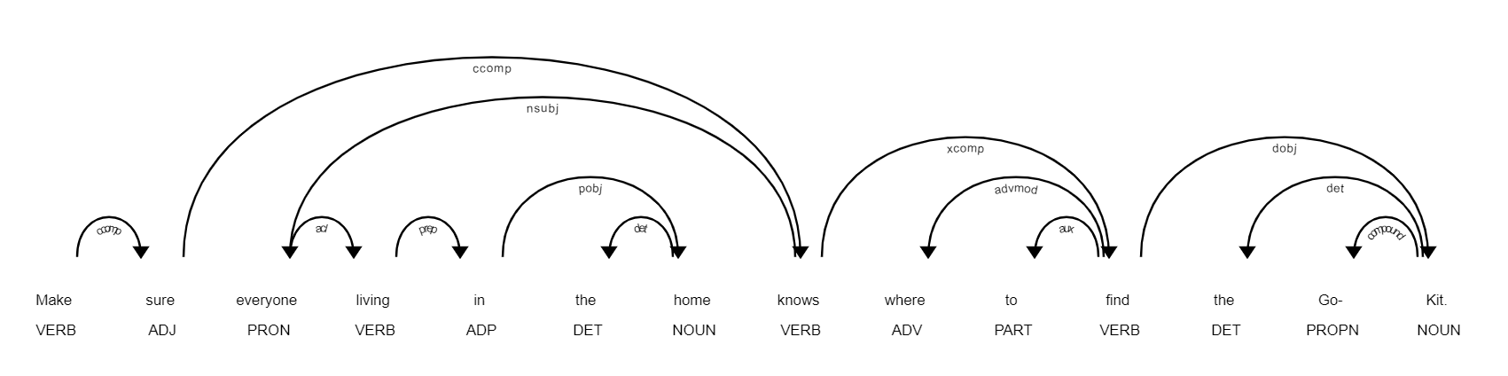
Identifying Actions
Text to Grammatical Tokens
Extract the sentences from the text file with nltk sentence_tokenizer.
Parse the sentences into dependency parse trees with spaCy.
Represent the top two levels of the trees as lists of grammatical tokens. ['ROOT_self_VBP', 'LEFT_nsubj_PRP', 'RIGHT_xcomp_VB', 'RIGHT_punct_.']
Use the grammatical tokens instead of words in your favourite algorithm.

Slide 23
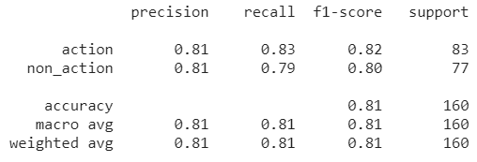
Identifying Actions
Logistic Regression Classifier
Vectorize the sequences of grammatical tokens with TF-IDF.
Apply varying degrees of feature reduction with TruncatedSVD.
Train and test Logistic Regression model with 10-fold cross-validation.
Typical fold scores:
Best results were obtained without Truncated SVD.
Retrain the model on the entire training data.
Test on the held-out test data.

Slide 24
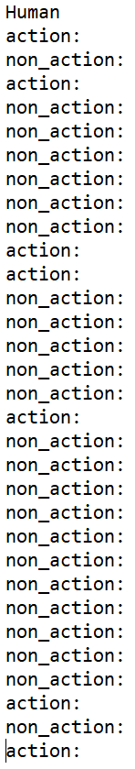
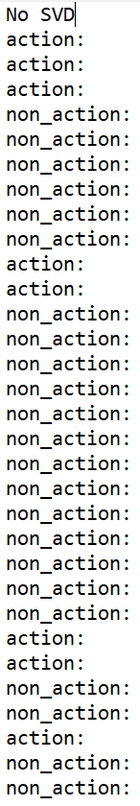
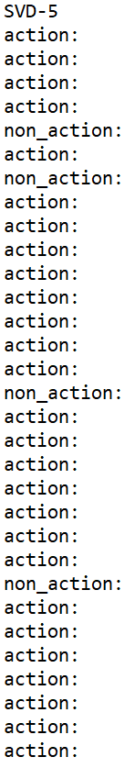
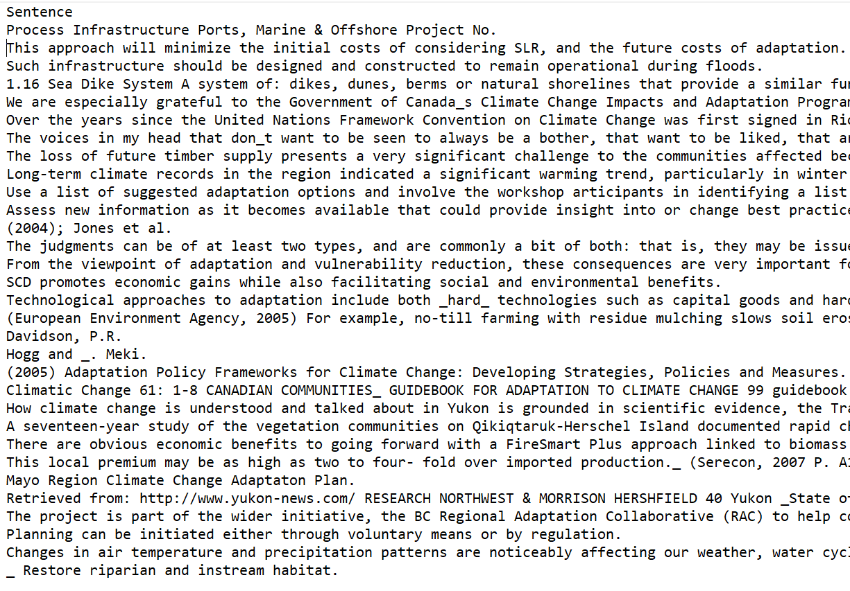
Identifying Actions
Manual Scoring of a Small Sample

Slide 25
Identifying Actions
Results on Held-Out Test Data
Logistic Regression without Feature Reduction
Logistic Regression with 5 Features
In general, the more we reduced the number of features, the more the algorithm labelled everything an ‘action’.
Metric | Score
Accuracy | 0.71
Precision | 0.67
Recall | 0.63
F1 | 0.67
Metric | Score
Accuracy | 0.35
Precision | 0.26
Recall | 1.0
F1 | 0.41

Slide 26
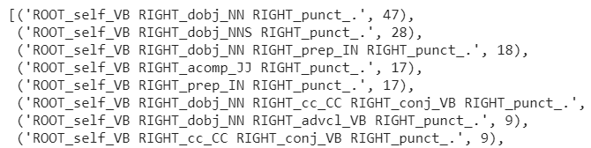
Identifying Actions
Rule-Based Solution
Obvious pattern visible in frequency
counts of grammatical tokens
for actions
Created simple hard-coded rule
Results on held-out test data
For this specific task, a one-line rule was the best performer.
Metric | Score
Accuracy | 0.85
Precision | 1.0
Recall | 0.77
F1 | 0.87

Slide 27
Challenges
Data Variability
PDF documents were not in consistent format.
PDF extraction and preprocessing is labour intensive.
PDF extraction tools themselves are fairly easy to use, dealing with the output and wrangling it to a useable format can be difficult and imprecise.
Amount of data
In order to deal with a smaller dataset, time was spent in order to enrich it.
Monolithic data
Many documents were large and covered many topics. This made it more difficult to distinguish individual topics from each other.
Human Scoring Bias
It was difficult to remain objective in the manual scoring of the test results at the end, after having worked with the data and models for a long time.

Slide 28
Lesson Learnt
Better to work with a larger dataset.
PDF extraction was a valuable exercise. PDFs can be difficult to work with and the results from the different tools will vary.
It is better to use fewer topics. Noticed that fewer topics had a better Coherence Score, eventually the score plateaus.
LDA is not a very good tool for small datasets.
Parsing sentences into grammatical structure can yield good results for some problems.
Sometimes a hard-coded rule can be the right tool for the job.

Slide 29
Next Steps
If we were to continue this project further:
Work on acquiring more data and observe impact on results.
Try other binary classifiers and compare results.
Test Doc2Vec and other solutions for identifying whether a document fits with the Climate Change theme and belongs within the Corpus.
Identify possible methods to leverage the metadata associated with the PDF documents.
Consider how these NLP solutions would fit into your workflow and system. What areas may require a Human Touchpoint?

