Slide 1
UofT 3666 – Applied NLP Final Project
Group Members: Linda Peto and Rahim Jiwa

Slide 2
Introduction
Project from Riipen, Deploy Software Solutions, Climate Change Study
Deploy Software Solutions was interested in learning about NLP.
In order to explore this, they are considering a situation that could have a positive impact and were interested in being able to automatically go through pdfs and extract wisdom that consumers could use.
Interested in developing a consumer app, ideally highlighting information that would be personalized for the consumer and actions they can take to make a difference.

Slide 3
Problem Statement and Objectives
The primary purpose of this project was to conduct a feasibility study.
In order to solve this problem, there were three areas of focus:
PDF Extraction
LDA Topic Modelling
Identifying Actions
Our objective were to:
Extract the data and explore various tools related to extraction.
Explore topic modelling and possible uses cases.
Explore and attempt to classify actions within the documents based on sentence structure.

Slide 4
Methodology
After the Project Kickoff and acquiring the data
Step 1: PDF Extraction
Step 2a: Action Parsing and Classification
Step 2b: LDA Modelling
Step 3: Combine and Synthesize.

Slide 5
PDF Extraction
Three different packages were tried: PyPDF2, PDFMiner, and Tika.
Out of the three, we found Tika to be the best overall. PDF Miner was the best pure Python option.
Objective was focused on implementation.
When utilizing the tools, heuristics were applied in order to eliminate Unicode new line characters and tabs.
Challenges and Issues:
PDFs can be formatted differently, this results in greater emphasis needed for preprocessing. For example, 1 column vs 2 columns.
The transcription can be poor and inaccurate.
Debugging. There were a variety of errors and challenges. Examples: Encrypted Files, Blank Pages.
Results vary across the different tools. Certain tools may work better on certain PDFs. This makes it difficult to standardize an approach.

Slide 6
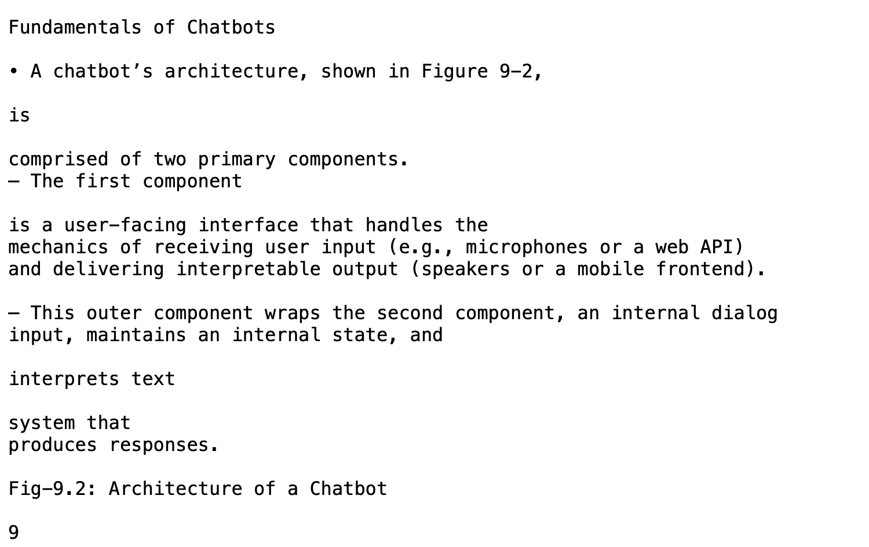
PDF Extraction - PDF Miner
Printed output of the text is fairly clean.
One issue with PDF Miner is that it can be sensitive to document names.
Another issue that can be seen is that some sentences are cut and split into two or three lines. This has the potential to be problematic depending on the context.

Slide 7
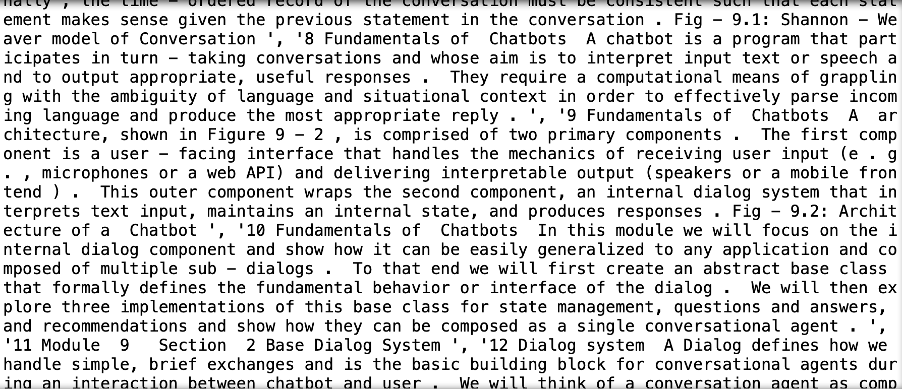
PDF Extraction - PyPDF2
The output is a list of pages.
When parsing the document, you end up having to go page by page.
The raw output initially was messy. There were new line characters in between every token.
Interesting aspect is dealing with encrypted files. For our purposes, we checked for encryption and skipped the encrypted documents.

Slide 8
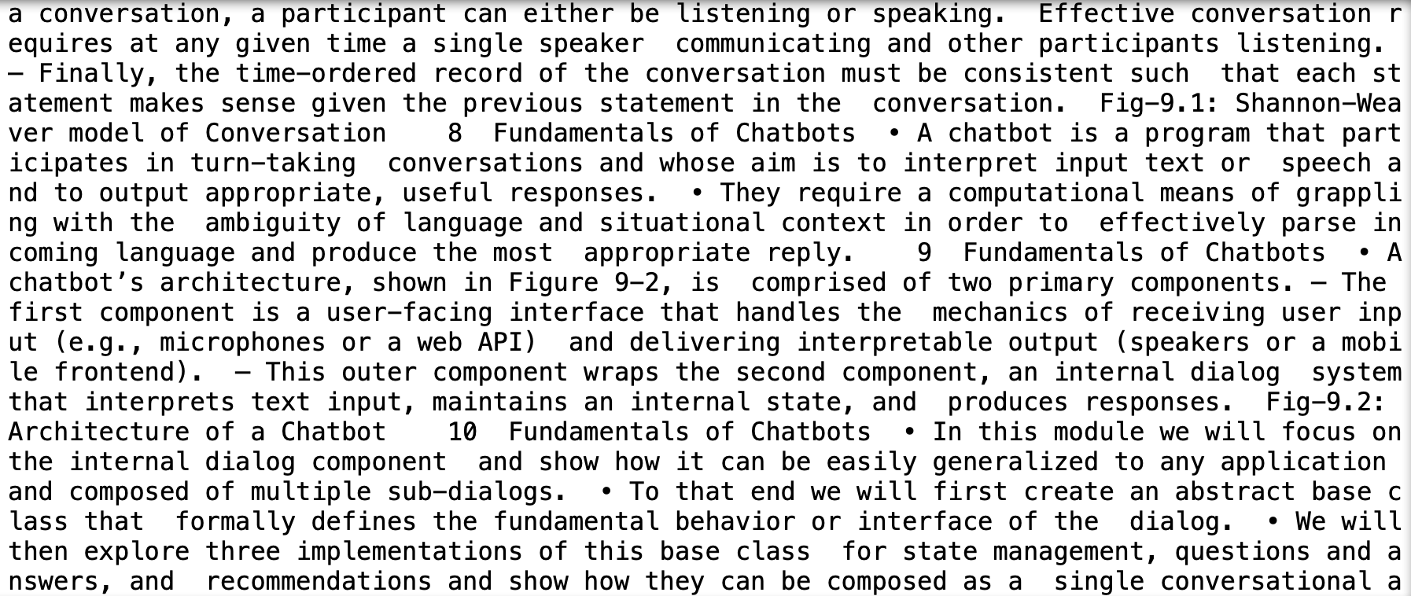
PDF Extraction - Tika
The output is a string.
Easy to use.
Output here has new lines and tab characters stripped out.
Requires an up to date Java Server.
Parses the whole document at once. This makes it easy to use, however, it can be problematic if you only need specific pages or have a PDF document with a blank page.

Slide 9
Data
There were two main components to our data.
A CSV containing a sample of the Action information.
PDFs containing Climate Change information.
CSVs containing a sample of Action information.
Had 12 fields: actions, action_type, disaster_type_title, disaster_type_detail, doc_page, doc_path, doc_title, doc_publisher, date_added, contet_geography, context_usertype, notes
Contained about 1000 observations, of which 820 were citizen actions
PDFs related to climate change
Approximately 50 pdfs.
30% of the documents had been manually examined to create the CSV

Slide 10
Data Continued
One of the challenges that we ended up facing was a small set of data.
This proved to be problematic when applying Classifier Models or when applying an LDA model.
One of the solution to this was to create additional data to enrich our dataset.
Approximately 20 additional Climate Change pdfs were added.
Another challenge was that we had examples of actions, but nothing to contrast them with. In order to have a balanced training set, we manually extracted 388 examples of non-actions from the PDFs, and then duplicated them, to approximately equal the number of action examples.

Slide 11
LDA
Approach:
Started by using Sklearn and performing the LDA topic modelling.
Based off of the results of our topics, tested various combinations of topics and number of terms.
Moved on to try Gensim to perform topic modelling and get coherence scores.
Iterated to improve topics and scores by refining stopwords and increasing the amount of data.
The best coherence score tested was with 3 topics and was -0.13 using the u_mass measure for coherence.

Slide 12
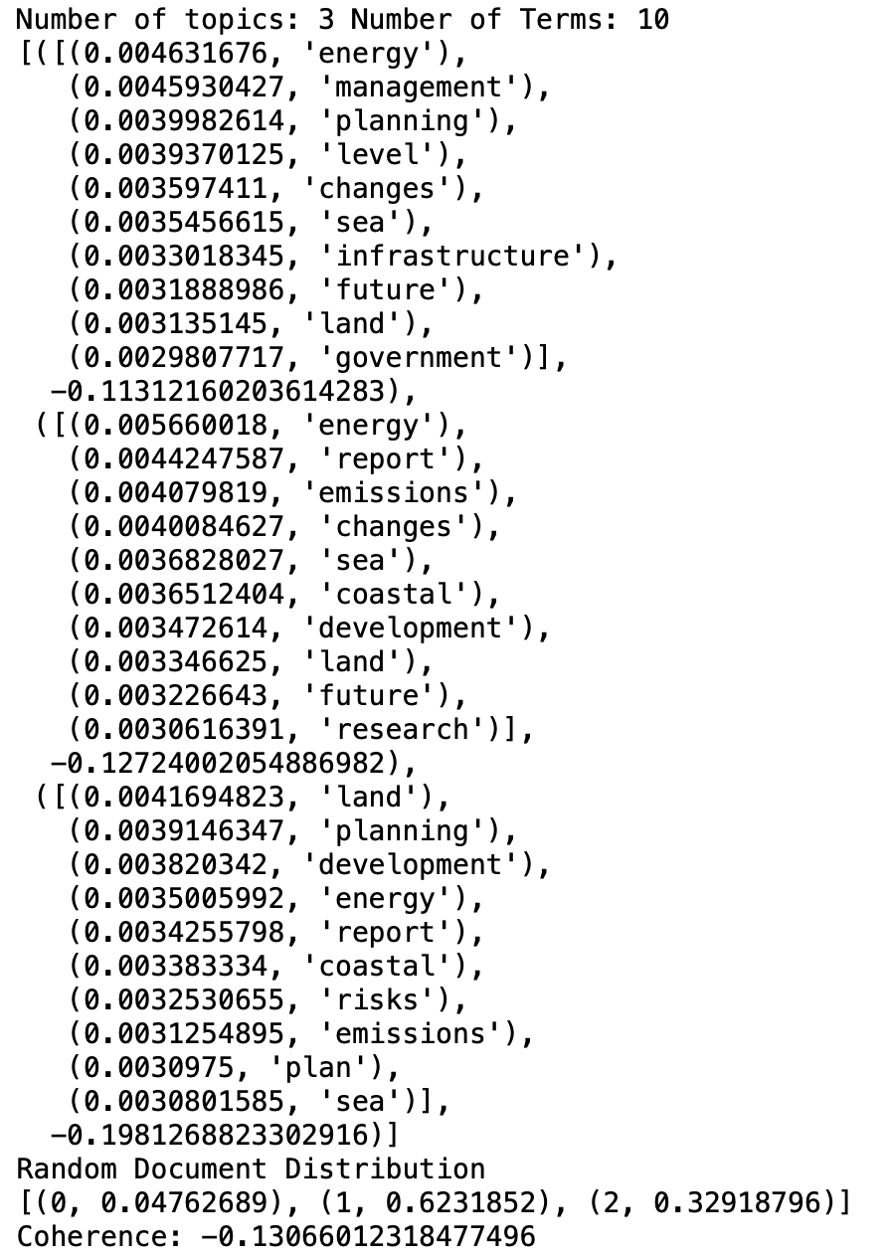
LDA
Our best result across all the iterations had a coherence score of -0.13.
It can be seen that the terms within the topics are close together and there are connections.
An issue is there is overlap between the topics. This might indicate that there is not enough diversity amongst the topics.

Slide 13
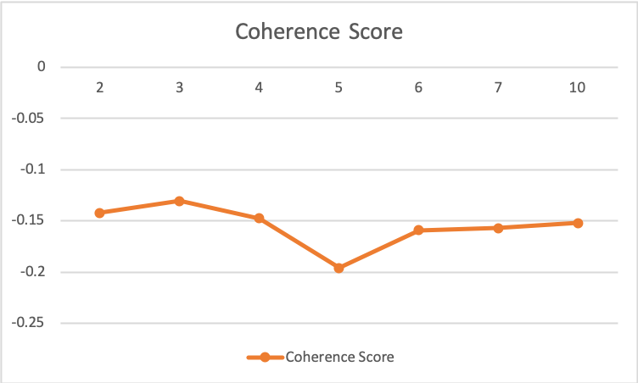
LDA - Results
Found that Coherence Score was better for a smaller number of topics, eventually score plateau.

Slide 14
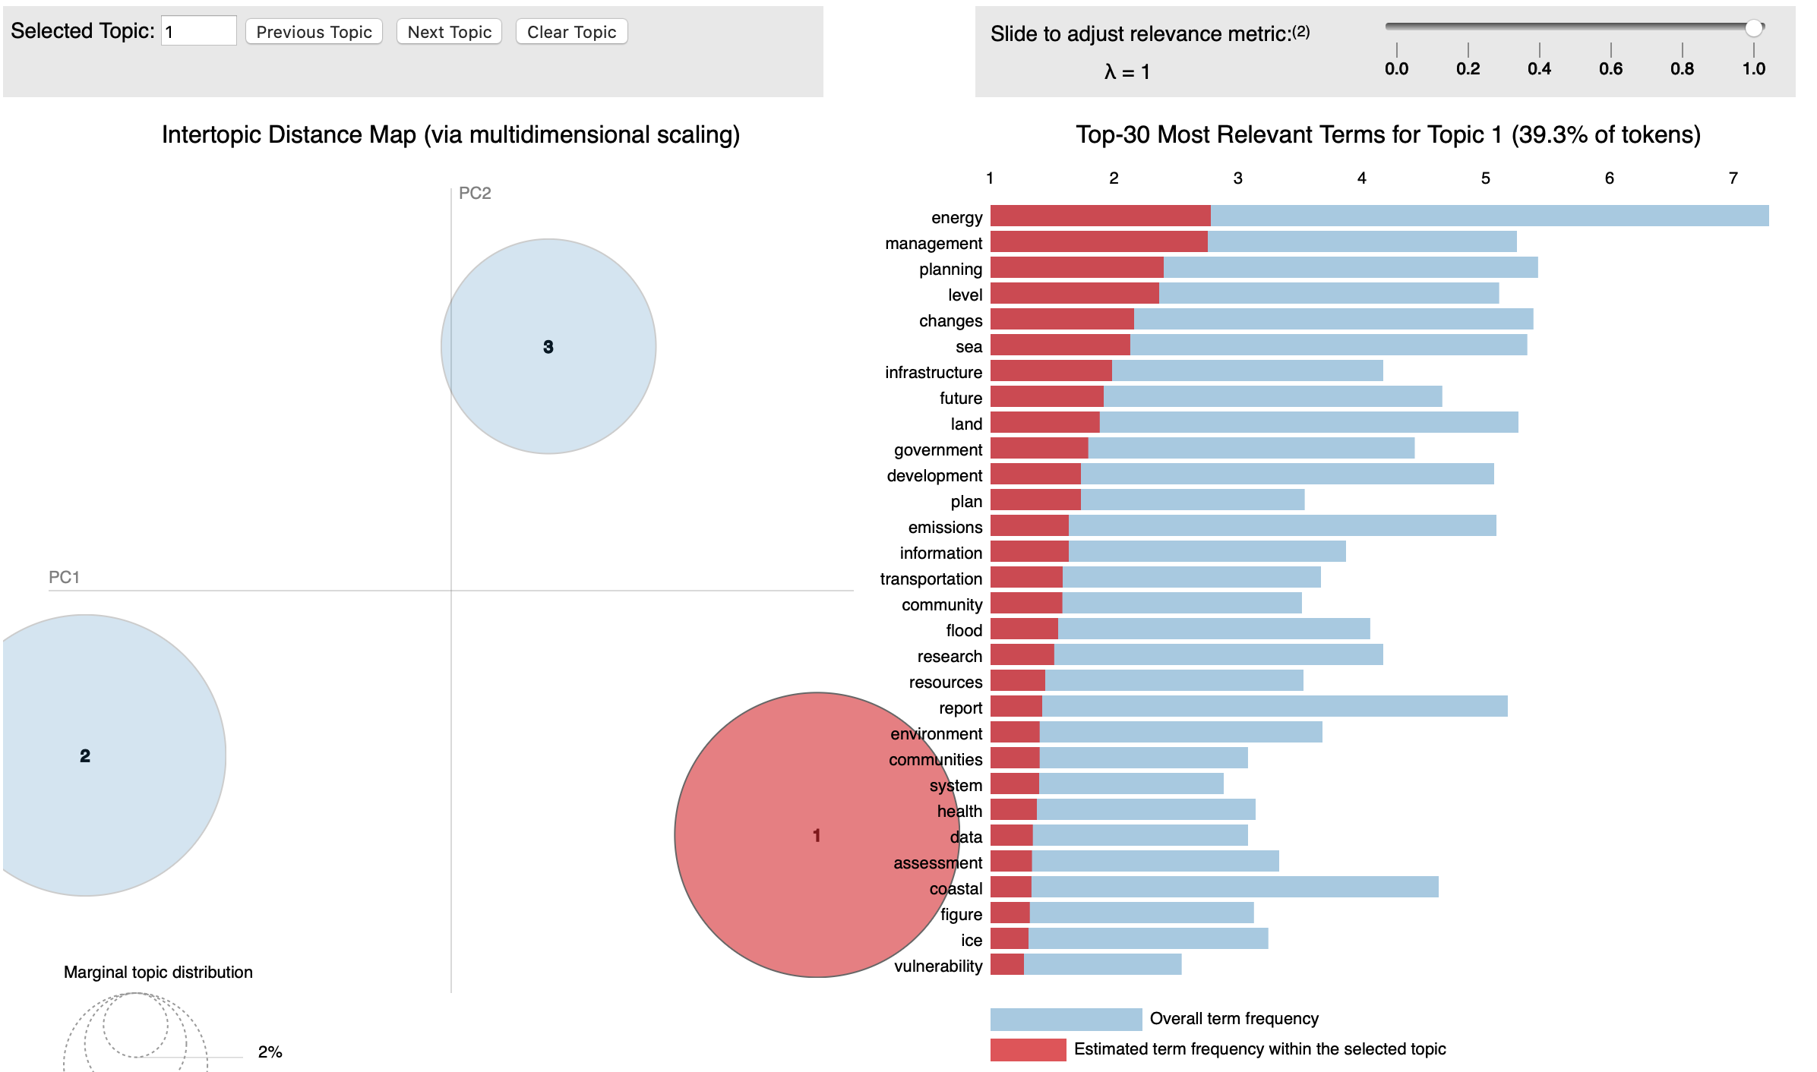
PyLDAvis - Topic 1

Slide 15
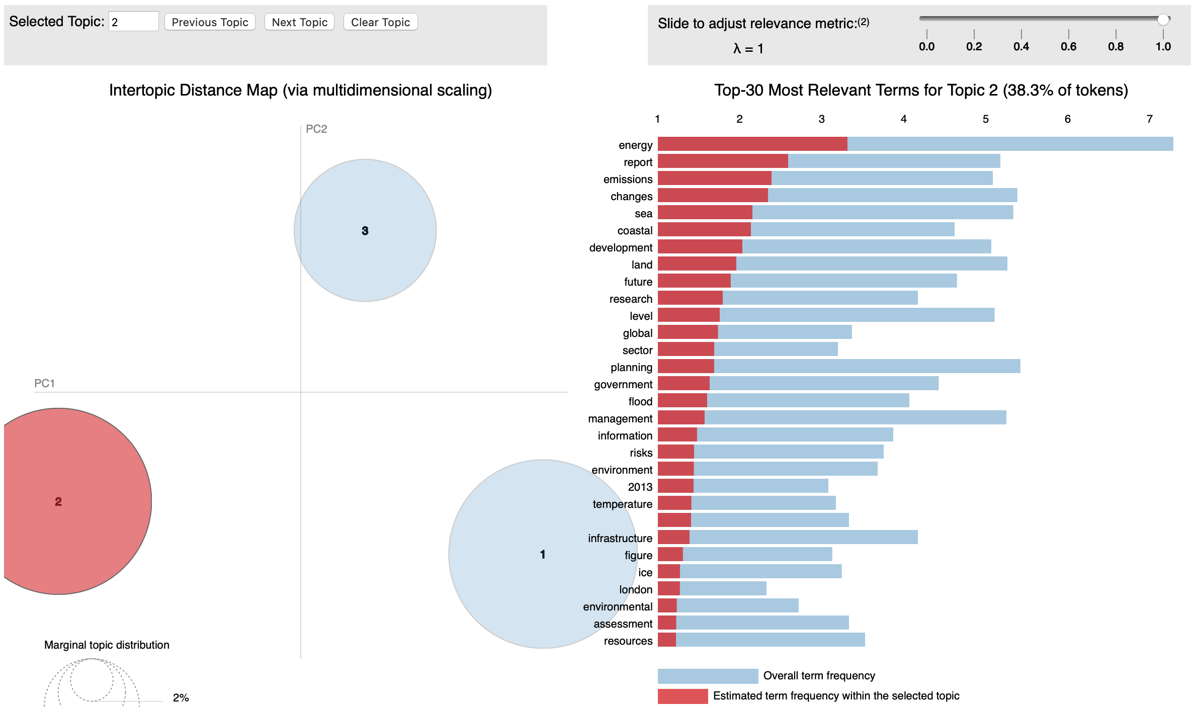
PyLDAvis - Topic 2

Slide 16
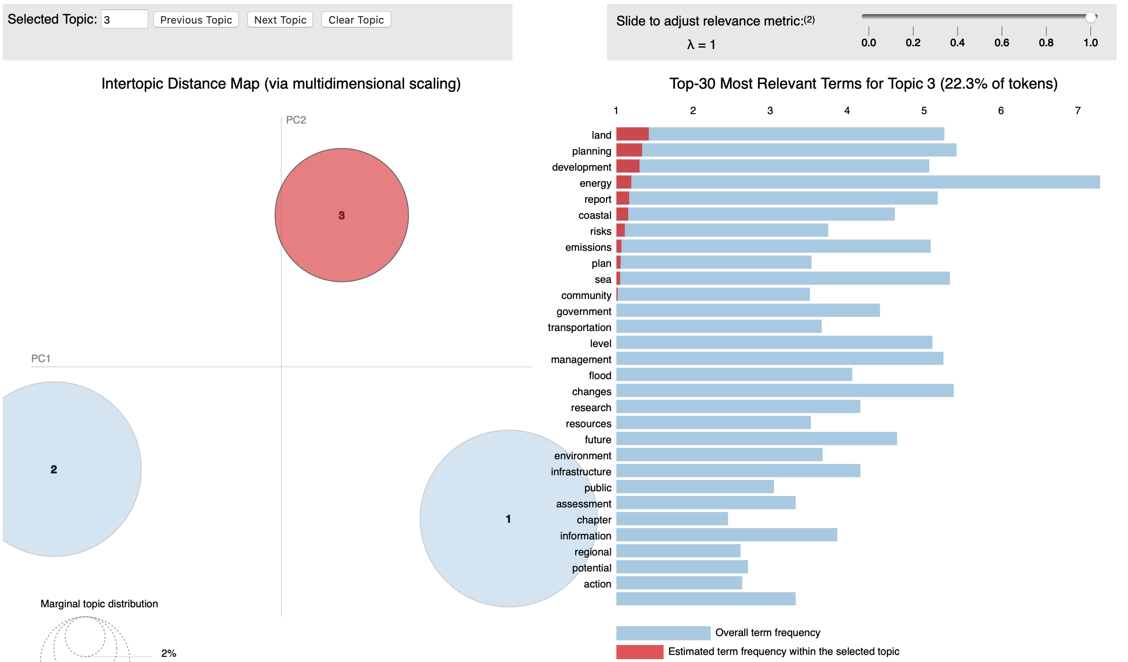
PyLDAvis - Topic 3

Slide 17
LDA Findings
One of the challenges that was faced was that NLTK stopwords were reducing the corpus down.
In order to stop this, a stopwords file was created and stopwords were defined based on examining the corpus tokens frequency distribution.
Stopwords file included: common punctuation, common terms (canada, climate, change, http, www, com, and, or, etc), meaningless unicode characters (\uf0b7).
In addition, a heuristic was applied in order to only include tokens whose length was greater than two.
Another challenge faced was the: volume, quality, and similarity of data.
There were documents that were similar, yielding closely related topics.
We also found that when we added new documents to our corpus, that our coherence score improved.

Slide 18
Identifying Actions
Overview
Principle Task:
From examples of ‘actions a citizen could do’, learn to automatically identify such actions.
Our Approach:
Look at the grammatical structure of the sentence instead of the words.
Consider both Machine Learning and Rule-Based algorithms.

Slide 19
Identifying Actions
Tools
To capture the grammatical structure of the sentence, we considered:
nltk POS tagging - doesn’t provide enough information for our purpose
CLiPS modality checker - buggy
Stanford CoreNLP - runs in Java, so more complicated to install
spaCy -
in Python
easy to use
produces dependency parses suitable for our purpose

Slide 20
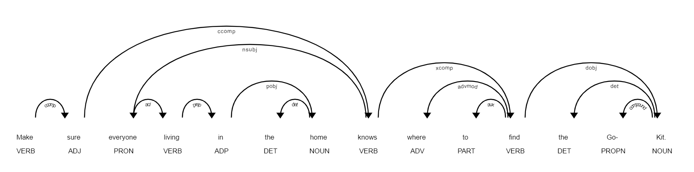
Identifying Actions
Text to Grammatical Tokens
Extract the sentences from the text file with nltk sentence_tokenizer.
Parse the sentences into dependency parse trees with spaCy.
Represent the top two levels of the trees as lists of grammatical tokens. ['ROOT_self_VBP', 'LEFT_nsubj_PRP', 'RIGHT_xcomp_VB', 'RIGHT_punct_.']
Use the grammatical tokens instead of words in your favourite algorithm.

Slide 21
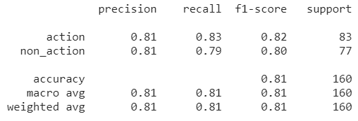
Identifying Actions
Logistic Regression Classifier
Vectorize the sequences of grammatical tokens with TF-IDF.
Apply varying degrees of feature reduction with TruncatedSVD.
Train and test Logistic Regression model with 10-fold cross-validation.
Typical fold scores:
Best results were obtained without Truncated SVD.
Retrain the model on the entire training data.
Test on the held-out test data.

Slide 22
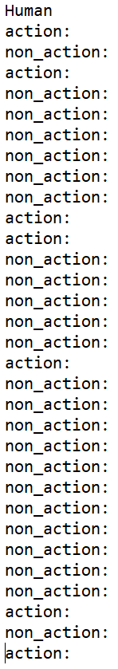
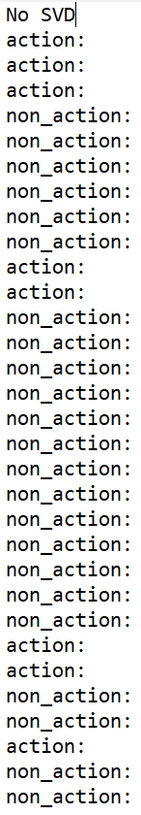
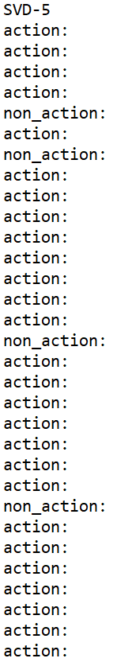
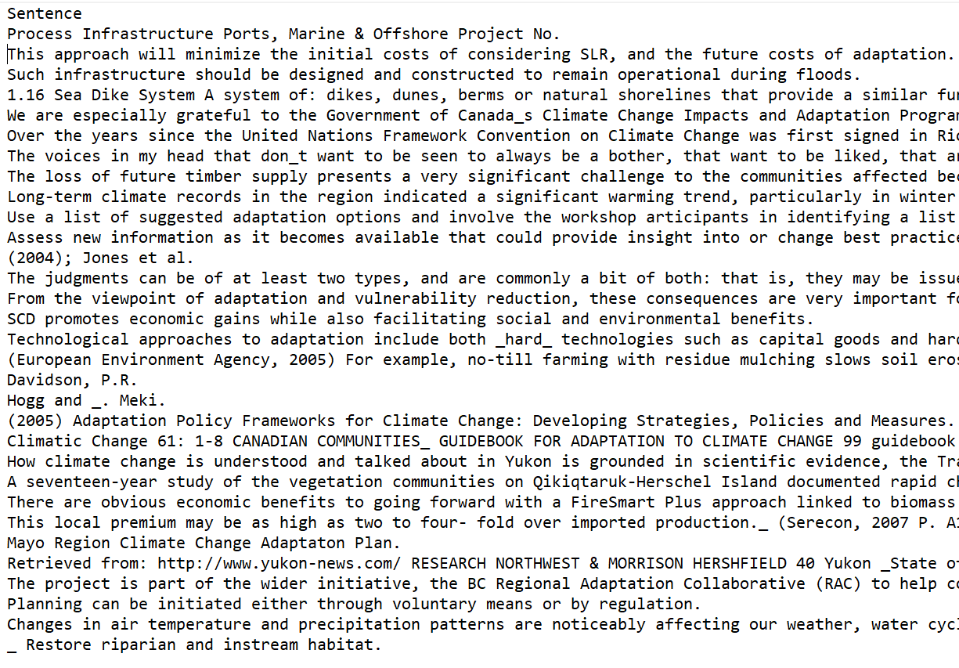
Identifying Actions
Manual Scoring of a Small Sample

Slide 23
Identifying Actions
Results on Held-Out Test Data
Logistic Regression without Feature Reduction
Logistic Regression with 5 Features
In general, the more we reduced the number of features, the more the algorithm labelled everything an ‘action’.
Metric | Score
Accuracy | 0.71
Precision | 0.67
Recall | 0.63
F1 | 0.67
Metric | Score
Accuracy | 0.35
Precision | 0.26
Recall | 1.0
F1 | 0.41

Slide 24
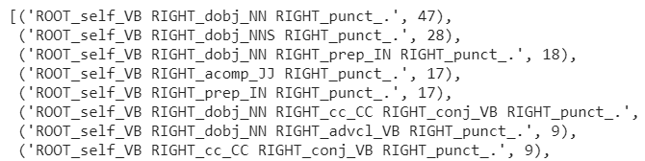
Identifying Actions
Rule-Based Solution
Obvious pattern visible in frequency
counts of grammatical tokens
for actions
Created simple hard-coded rule
Results on held-out test data
For this specific task, a one-line rule was the best performer.
Metric | Score
Accuracy | 0.85
Precision | 1.0
Recall | 0.77
F1 | 0.87

Slide 25
Challenges
Data Variability
PDF documents were not in consistent format.
PDF extraction and preprocessing is labour intensive.
PDF extraction tools themselves are fairly easy to use, dealing with the output and wrangling it to a useable format can be difficult and imprecise.
Amount of data
In order to deal with a smaller dataset, time was spent in order to enrich it.
Monolithic data
Many documents were large and covered many topics. This made it more difficult to distinguish individual topics from each other.
Human Scoring Bias
It was difficult to remain objective in the manual scoring of the test results at the end, after having worked with the data and models for a long time.

Slide 26
Lesson Learnt
Better to work with a larger dataset.
PDF extraction was a valuable exercise. PDFs can be difficult to work with and the results from the different tools will vary.
It is better to use fewer topics. Noticed that fewer topics had a better Coherence Score, eventually the score plateaus.
LDA is not a very good tool for small datasets.
Parsing sentences into grammatical structure can yield good results for some problems.
Sometimes a hard-coded rule can be the right tool for the job.

