Slide 1
SCS 3760 Term Project
Rahim Jiwa

Slide 2
Business Case
Classification Model in order to predict whether or not US Small Business Association (SBA) Loans will be paid back in full or charged off.
The SBA guarantees a portion of the loans, therefore, it is important to minimize risk. By including a prediction model to whether or not the loans are likely to be paid off, less time can be spent on cases where a loan is unlikely and help complement loan officer decision making.
Data included features like: geographic location, number of employees, $ of loan from bank, number of jobs created, term of loan etc.
Data set does not include other relevant factors: business financial information, credit history, etc.

Slide 3
Cloud VS On-Prem
In this situation, it is preferred to use the cloud.
Cloud is the cheaper solution:
No need to purchase or set up resources. No CAPEX.
Pay only for what you use.
Don’t need to hire or obtain skill to deal with hardware component.
Cloud solution is faster to adopt
Quick to get started and implement
Cloud is more secure than being on-prem.

Slide 4
Possible Security Risks
Since we have financial data, and are looking at loans, there will be sensitive information in the system.
Security provisions need to be implemented so that information cannot be hacked. By relying on cloud services, the risk of losing information, or dealing with hackers trying to break into the system is lowered.
Cloud provides resources in order to keep data secure when considering the security triad.
A risk that is present here would be giving permissions to the wrong people or accidentally exposing data. With cloud, availability is less or a concern, however you don’t want to potential open up the model and data to integrity or confidentiality concerns.

Slide 5
AWS vs GCP
For this project, GCP was the platform of choice.
GCP is the more familiar platform, and it was determined to be faster to develop on.
The business case does not require highly sophisticated tools and could be done on either platform.
GCP is a low cost option. For example, hosting on Google Cloud Storage is cheaper than hosting on S3.

Slide 6
Architecture – Key Technologies
Google Cloud Storage
Low-cost storage solution that can be used like a data lake and can store all the data needed with high availability.
Project data here is a basic .csv, only needs a bucket to store the data in.
Don’t require relational database capabilities, nor characteristics like multi-regional storage.
AI Platform Notebooks
Easy deployment of Jupyter Notebooks, unlike a VM does not require effort to set up or maintain instances. It’s easy to scale, comes with everything needed to create and deploy models.

Slide 7
Architecture – Key Technologies
BigQuery
Great for analytics, easy to load data in and query it using SQL-like language.
Low Cost
Provides risk-managers or loan officers to go in an perform analytics to consider situations like industry exposure or dig deeper than the straight classification.
Cloud Functions
Provides a serverless option to deploy prediction model.
Enables to create a single function which can take in data and provide a prediction.
This is useful for a situation, where applicants or loan officers at a bank want to see if a business would be eligible for a loan.

Slide 8
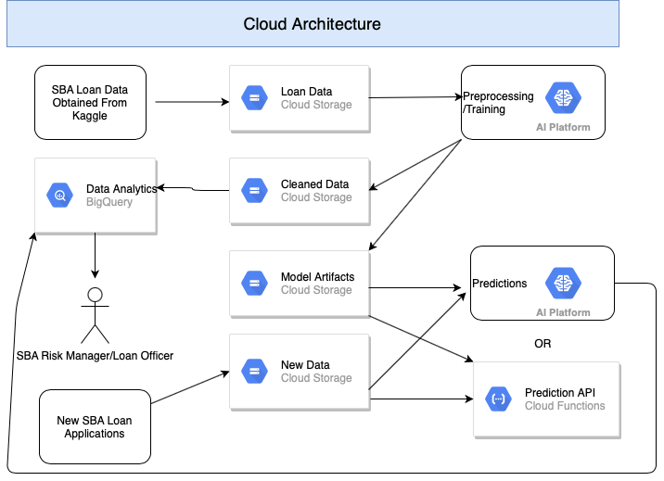
Architecture

Slide 9
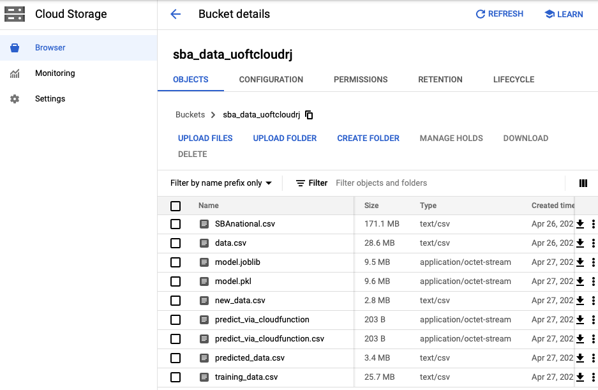
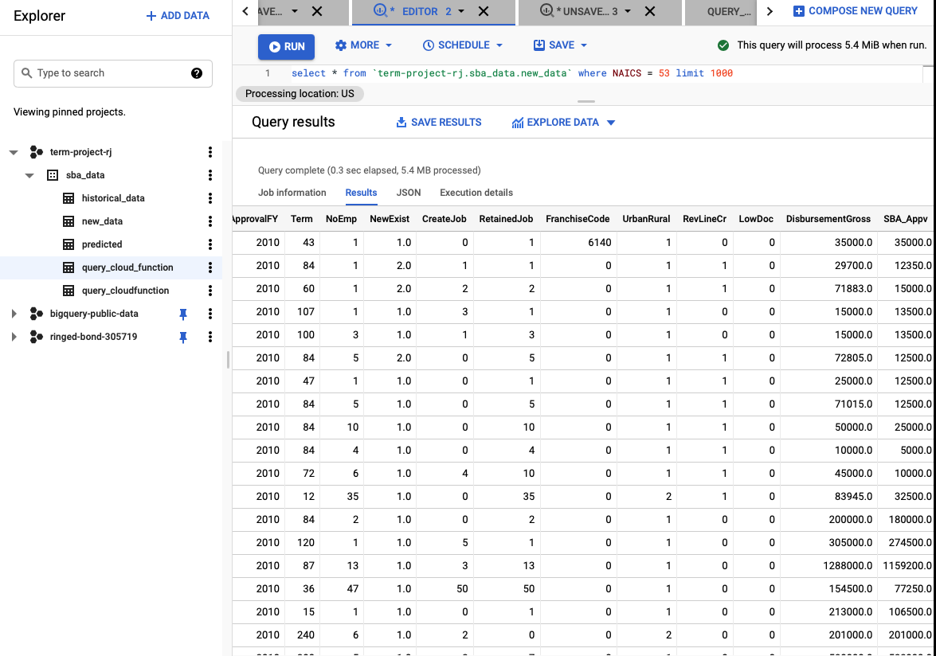
Screenshots

Slide 10
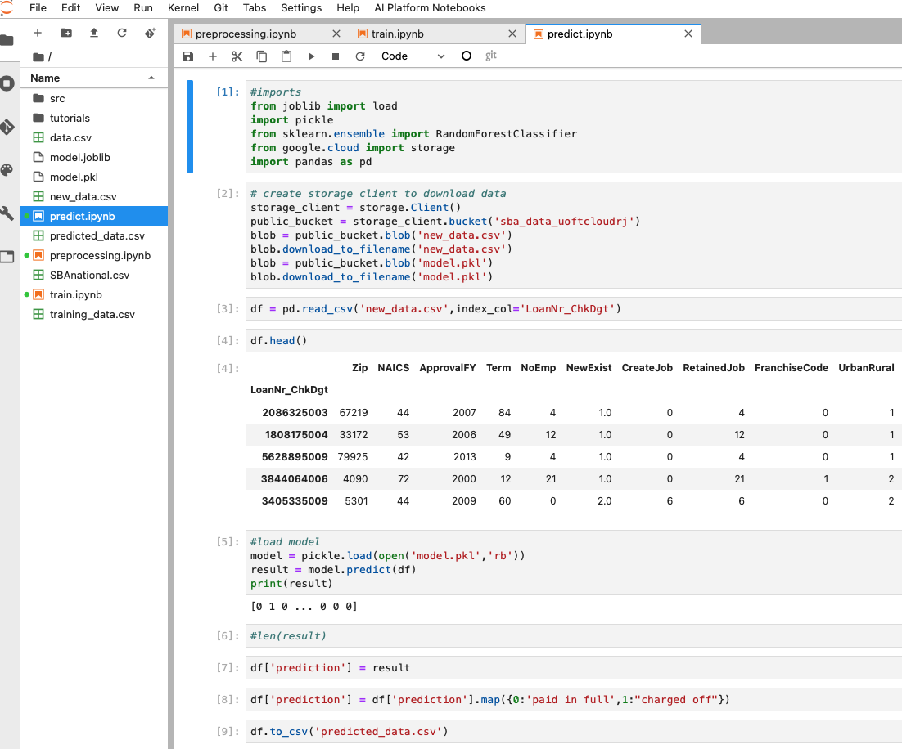
Screenshots

Slide 11
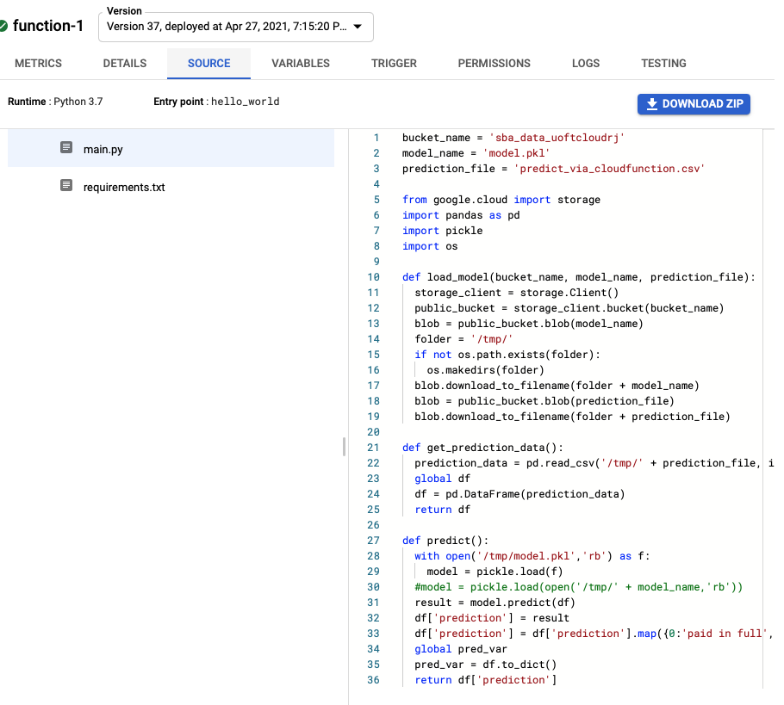
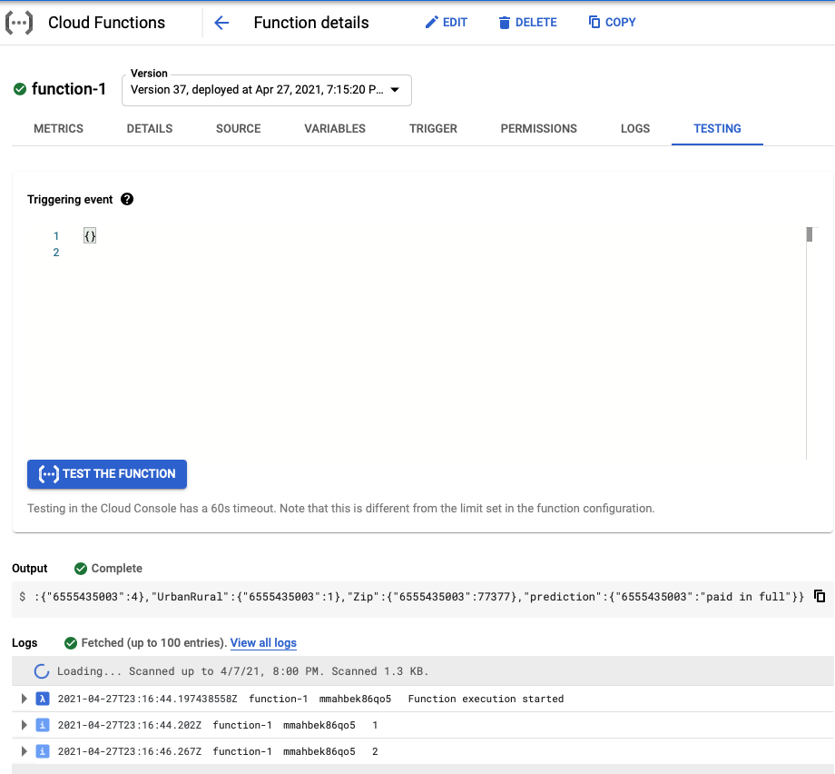
Screenshots

Slide 12
Challenges/Next Steps
Consider and implement a security scheme.
Look for more enriched data.
Work on improving cloud function deployment to allow to entry of data.
Consider queries and analytics for portfolio risk management.

