Slide 1
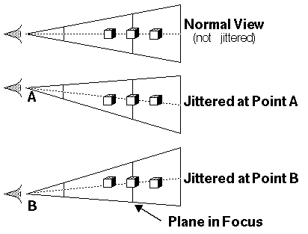

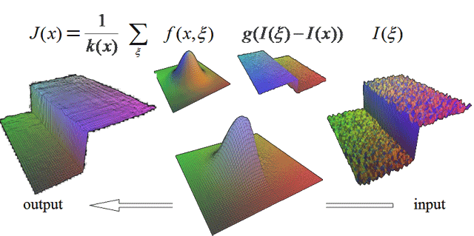

Comparison of Depth of Field Rendering Algorithms for VR
Robert Konrad
Department of Electrical Engineering, Stanford University
Motivation
Overview of Algorithms
Visual experience in VR is very different from natural viewing conditions (entire scene is in focus)
Representing 3D information in flat displays is important in creating realistic, immersive experiences
DoF rendering has shown to be an effective depth cue [1]
When stereoscopic disparity has been shown to reduce the fusion time of images [2]
Natural blurring is associated with reduced levels of visual fatigue [ 3]
Ray Tracing (Reference)
Bilateral Filtering
Non-linear Filter [4]
Aperture
Adaptive Recursive Filtering [5]
Related Work
Experimental Results
[1] Michael Mauderer, Simone Conte, Miguel A. Nacenta, and Dhanraj Vishwanath. 2014. Depth perception with gaze-contingent depth of field. In Proceedings of the SIGCHI Conference on Human Factors in Computing Systems.
[2] Maiello, G., Chessa, M., Solari, F., Bex, P.J. (July 2014). Simulated disparity and peripheral blur interact during binocular fusion. Journal of Vision, 14(8):13.
[3] Hoffman, D.M., Girshick, A.R., Akeley, K. & Banks, M.S. (2008). Vergence-accomodation conflicts hinder visual performance and cause visual fatigue. Journal of Vision, 8(3):33.
Graph of PSNR (different resolutions)
Graph of Time

