Slide 1
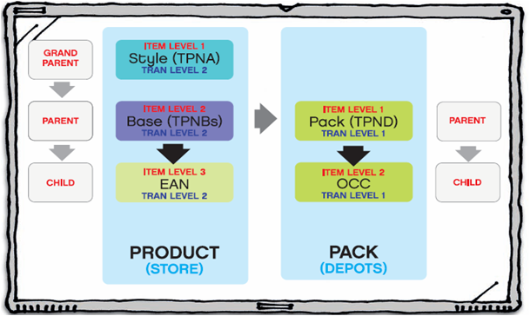









Product Setup
Price Change
Supplier Deals
Clearance
Security – OIM(NBS)
By –
Vipindas Thekke Purakkal
RadhaKrishnan Meiyappan

Slide 2
Agenda
1. What is OIM?
2. Managing users – Create, Modify, Delete
3. How RMS (NBS) security works with OIM?
4. Grant function roles to users
5. Grant data access to users
6. Batches related to security
7. How RPM(NBS) security works with OIM?
8. Q/A

Slide 3
What is OIM
Oracle Identity Manager is a powerful and flexible enterprise identity management system that is used to create and manage users
Multiple instances of Oracle Retail can be integrated to a single instance of OIM
This enables users of RPM and RMS to connect to either system via a single user account set-up in OIM .
User Administration of RMS and RPM to be performed solely within the GUI of OIM
Users perform password management via the web interface to OIM
Notes:
Talk about the Life cycle of a product and explain the below terms
Item
Supplier
Warehouse
Store
Price
Cost
Promotion

Slide 4
Managing users – Create, Modify, Delete
Create new users.
Modify the access to existing users
Remove the existing users

Slide 5
Managing users – Create, Modify, Delete
The following details needs to be provided for creating a new user
User general information (name, email, etc)
Application provisioning details
Application attributes (Functional, Data roles, etc)

Slide 6
How RMS (NBS) security works with OIM
When a user is provisioned in OIM to an Oracle Retail instance the integration always replicates the user’s details into BHMS (in RMS). The user is also provisioned into ORMS and ORSM/ORPM. The provisioning is implemented via an Application Provisioning Plug-in to OIM .
BHMS is responsible for providing a user access to the appropriate parts for the Oracle Retail Merchandise Hierarchy. A Pro*C batch interface is used to extract this assignment and allocate the user to the relevant data security group in ORMS and ORSM.

Slide 7
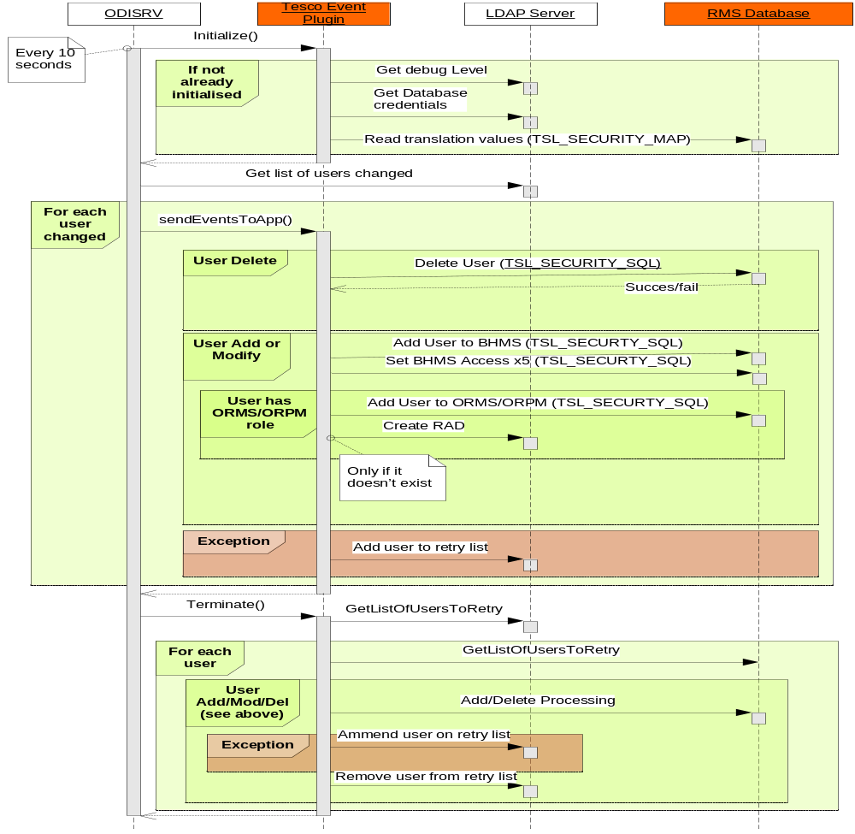
How RMS (NBS) security works with OIM

Slide 8
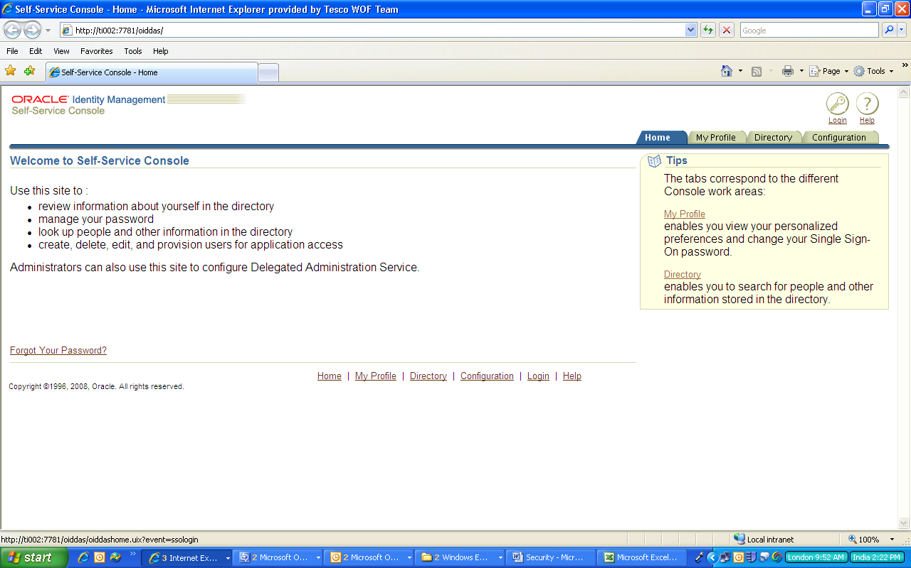
Managing users – Create, Modify, Delete
The OIM home page

Slide 9
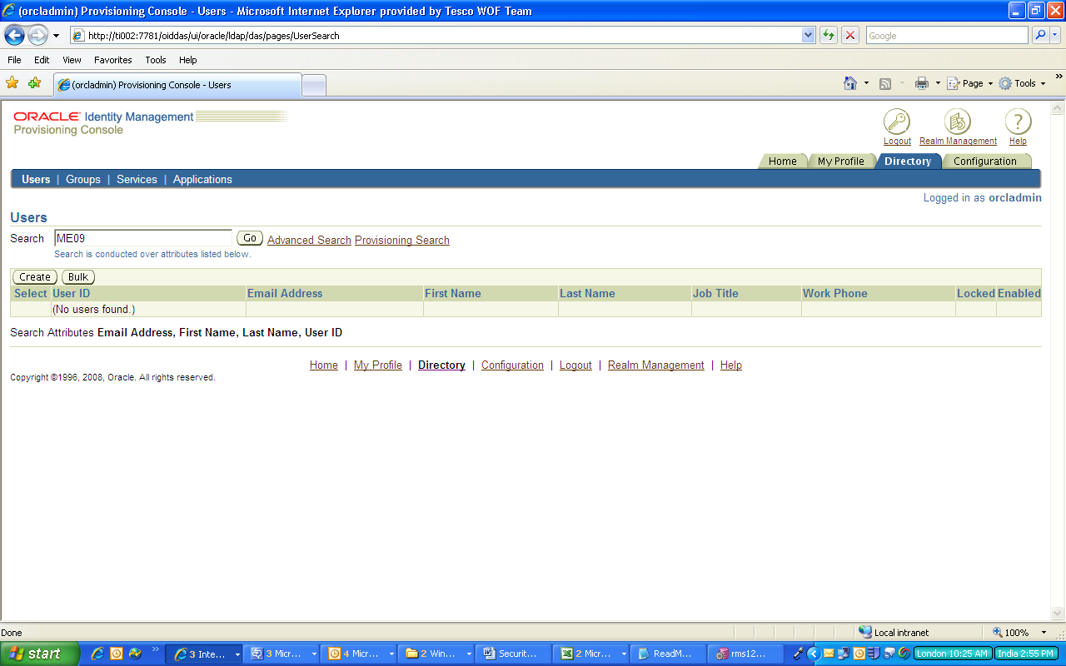
Managing users – Create, Modify, Delete
Users search and edit screen

Slide 10
Grant functional roles to users
The users can be granted a maximum of two functional roles and one data role. This needs to be done on the OIM interface

Slide 11
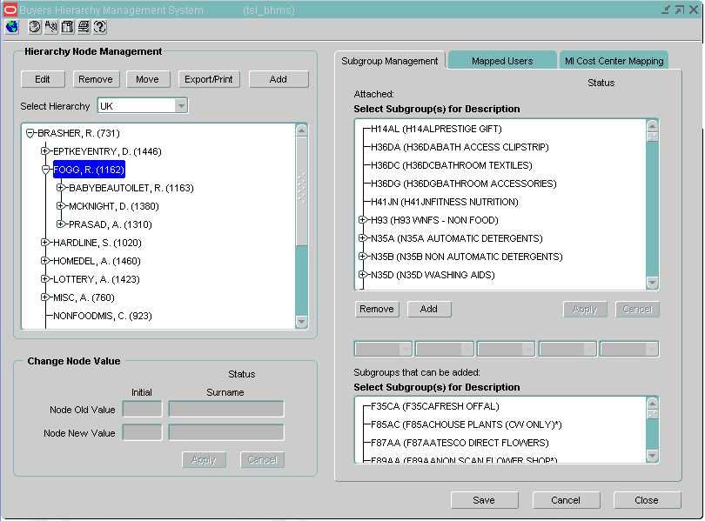
Grant data access to users
The grant of data access to users in maintained in BHMS screen. The relevant subgroups needs to be assigned to the users

Slide 12
Batches related to security
Once the users are created in OIM and configured in BHMS, the Pro*C batch “tsl_bhms_rms_rsm” should be run.
This batch translates the configuration available in BHMS into RMS and RSM/RPM to allocate the user with the relevant data access.

Slide 13
OIM – RMS Integration - Technical
  The following tables will be populated in the DB (Both RMS and RSM) once a user is created in OIM
    DBA_USERS
    DBA_ROLE_PRIVS
    TSL_BHMS_USERS
    TSL_BHMS_SYSTEM_ACCESS
    TSL_SECURITY_MAP
    USER_ATTRIB
    USER_ROLE (RSM)

Slide 14
OIM – RMS Integration - Technical
  The following tables will be populated/updated in the DB once a user is configured in BHMS
    TSL_BHMS_HIERARCHY
    TSL_BHMS_SUBCLASS
    TSL_BHMS_USERS

Slide 15
OIM – RMS Integration - Technical
  The following tables will be populated in the DB (Both RMS and RSM) once the Proc*C batch is executed
    SEC_GROUP
    SEC_USER_GROUP
    FILTER_GROUP_MERCH
    TSL_SECURITY_MAP(Bhms2RmsGroupId, Bhms2RsmRole)

Slide 16
How RPM (NBS) security works with OIM
Pro*C batch tsl_bhms_rms_rsm populates appropriate data into following RSM tables which will be used by RPM to validate user and controls based on security permissions.
RSM_ROLE
RSM_USER_ROLE
RSM_ROLE_NAMED_PERMISSION
RSM_HIERARCHY_PERMISSION
RSM_ROLE_HIERARCHY_PERMISSION
Based on assignment of Data permission role to user ORPM allows to access UK or ROI Zones and create Promotions in respective zones.

Slide 17
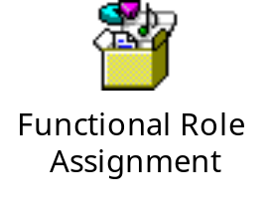
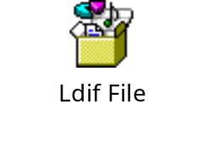
OIM – User Role Creation - Technical
  How to create New User role in OIM?
  Lightweight Directory Interchange format(LDIF) file will be created with appropriate role name.
  Assign Function roles to the new User role in SQL file format.

Slide 18

OIM – Functional Role Creation - Technical
  How to create New Functional role in OIM?
  Assign RSM named permissions to the new functional role in SQL file format.

Slide 19
OIM – Batch Run - Technical
  User roles can be changed in OIM and select ‘Resend’ option as Yes which will update appropriate tables. No need to run tsl_bhms_rms_rsm Pro*C batch.
  Change in Merchandize hierarchy in BHMS screen needs Pro*C batch run to reflect new data access.

Slide 20
Q/A
?
Questions

