Slide 1

iFeedBack
iFeedBack is a single sign-on, instant feedback survey tool designed
for college students.
Continue …

Slide 2
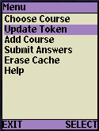
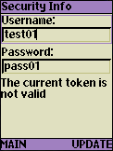

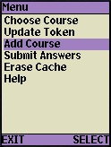
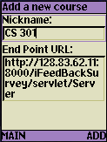
Configure and Setup
Obtain a token from the single sign-on Web Service to access class survey sites.
Under the “Add Course” menu, click ADD to add the URL of a class survey site. You can repeat this process multiple times to add more classes.
Continue …

Slide 3

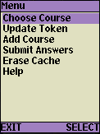

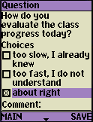
Fill Out a Survey
Choose a class site by its nickname iFeedBack fetches the currently active question Answer the question
click SAVE to save it in on-device cache.
NOTE: Use arrow key to move among choices
Use Send/Call key to mark selections
Continue …

Slide 4
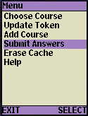
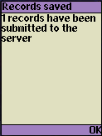
Submit Answers
When the cache grows big, we can send all saved answers with their timestamps to their respective servers as a batch.
Continue …

Slide 5
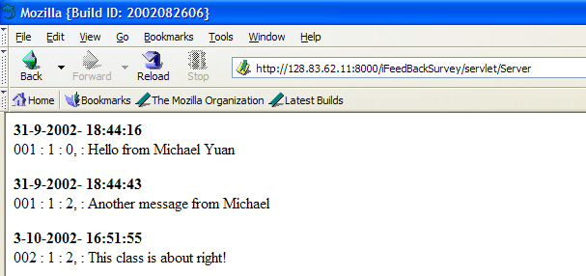
Administration
Point your browser to the class survey URL to see current submitted answers.
Finished

