Slide 1
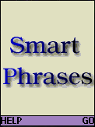
Smart Phrases is
a complete dictionary and thesaurus,
a smart spell checker with suggestions and
a real world language usage statistics checker.
Continue …

Slide 2
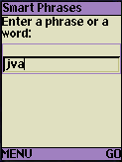
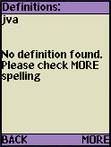
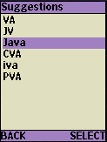
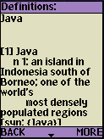
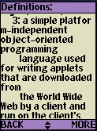
Dictionary Mode
Enter a single word and click GO, it automatically enters the “Dictionary Mode”.
You can force it into “Usage Statistics Mode” search using the MENU (see last slide).
Try the same query again to see how cache improves performance.
“java” is mis-spelled
Suggestions based on pronunciations
Gives up-to-date modern definitions
Continue …

Slide 3
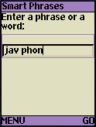
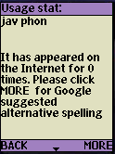
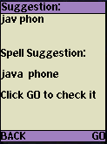
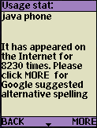
The Usage Statistics mode
Enter a phrase and click GO, SmartPhrases automatically enters the “Usage Statistics” mode.
You can force “Dictionary Mode” search on a phrase using MENU (see last slide). But the dictionary probably does not contain most phrases.
Try this search again to see the cache in action.
“java phone” is mis-spelled
found nothing
Google smart spell suggestion corrects both words.
Continue …

Slide 4
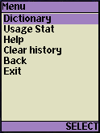
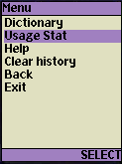
Forced search mode
To force dictionary search on phrases or usage statistics search on single words, you can enter your search string first and then select from the menu list for actions.
OR
Finished

