Slide 1
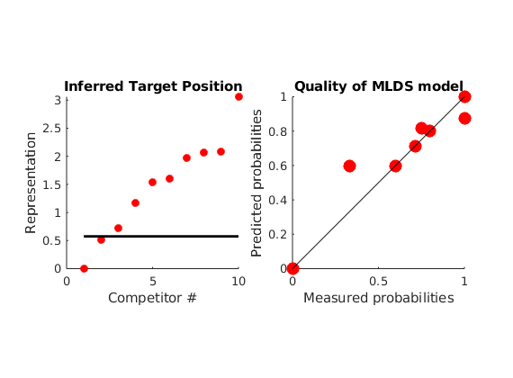
10 competitors, for each of which (-1) one parameters is fitted. The target is also fitted
For each comparison, each position is given by the fitted parameters plus the error coming from a normal distribution, mean zero and sigma fixed to 0.1
Then fitted positions would predict responses for each of the pairs (not all 45 are shown because of overlap)

Slide 2
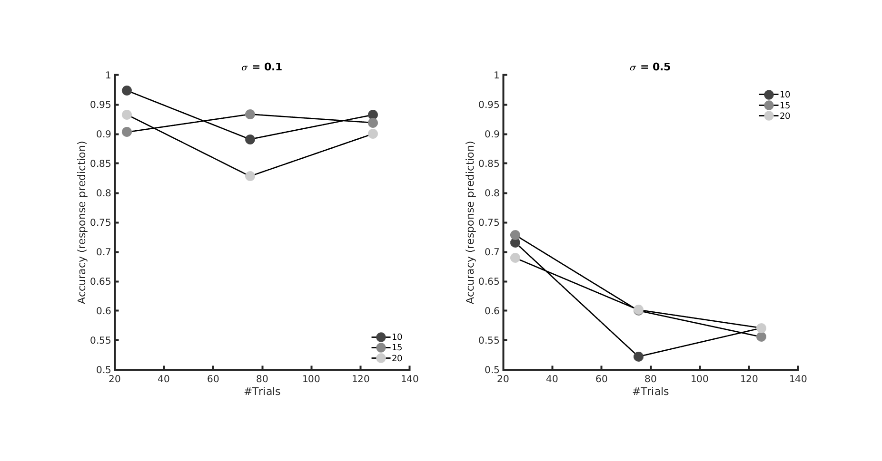
Here I randomly sampled a number of comparisons ( 10, 15, 20) and generated observers’ responses by adding to the comparison values perceptual noise at 2 sigma levels (0.1, 0.2, left and right). The simulated observers completed 25, 80 or 125 trials. Then I computed accuracy as the agreement between predicted proportions (rounded to 0 or 1).
For low sigma is quite high and much lower for higher sigma. However, the negative depedence on the number of trials is suspicious and I need to check better.

