Slide 1




Advances Towards Preferred Order for CNN (Deriving Natural Order in a Non-Natural World)
Randy Klepetko
Department of Electrical and Computer Engineering
University of Texas at San Antonio, San Antonio, Texas, USA
randy.klepetko@my.utsa.edu
Dissertation Committee:
Ram Krishnan, Ph.D.
Artyom Grigoryan, Ph.D.
Yanmin Gong, Ph.D.
Jeff Prevost, Ph.D.

Slide 2
Intro and Motivation
CNNs classify images
Also classify non-image data
Sound, genes, etc.
Sensors, security
CNN input format: vectors/matrices/tensors
Natural sources have natural vector order
CNNs leverage this to learn local and global patterns
Organizing non-natural data when using CNN
Does the order matter?

Slide 3
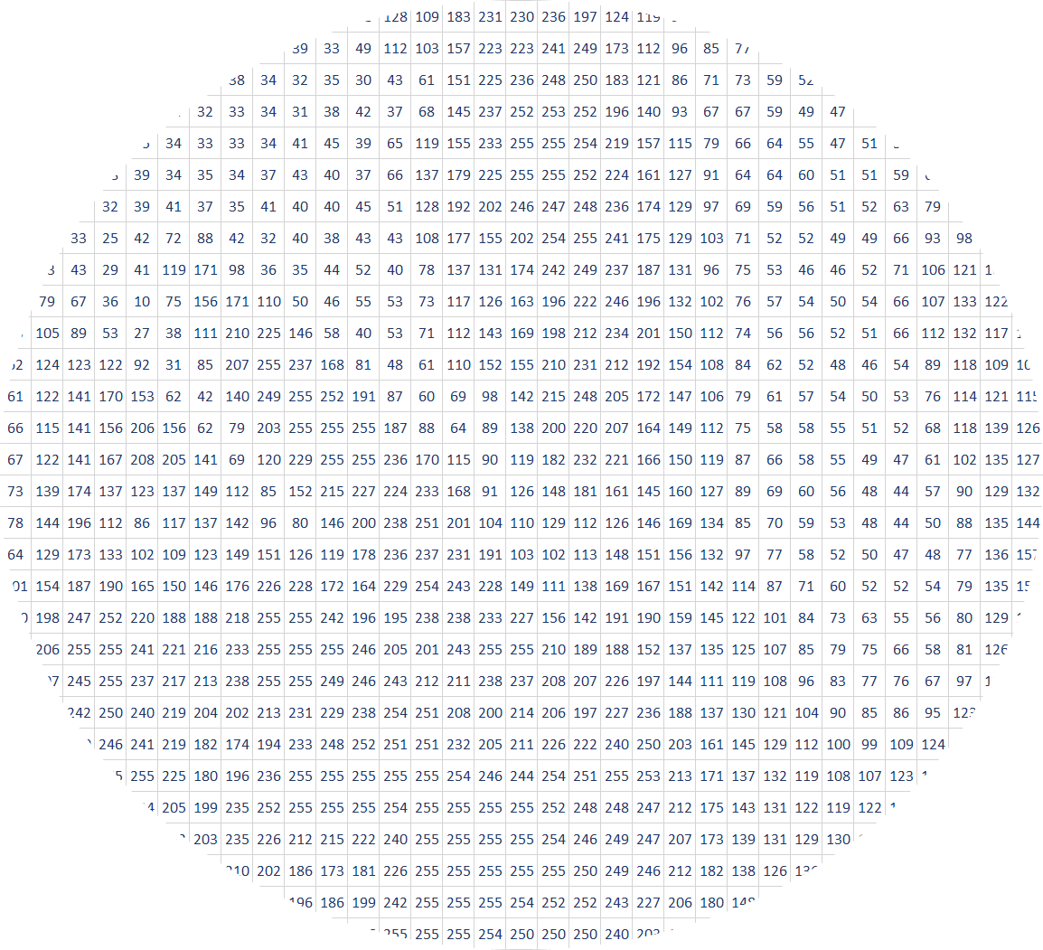
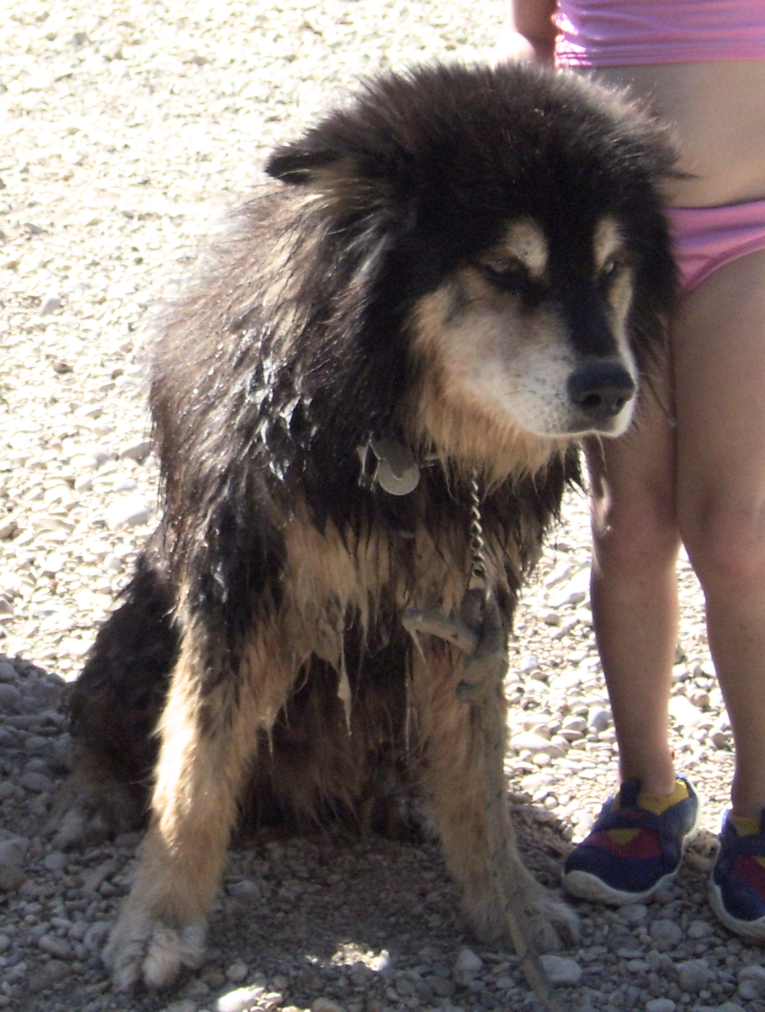



What is an Image?
Notes:
What is an image, and what makes up an object.
Pixel Correlation – high positive within background and object. High negative on the edges.
Hypothesize:
- By using statistical correlation we can create artificial objects in non-natural data and improve performance.

Slide 4

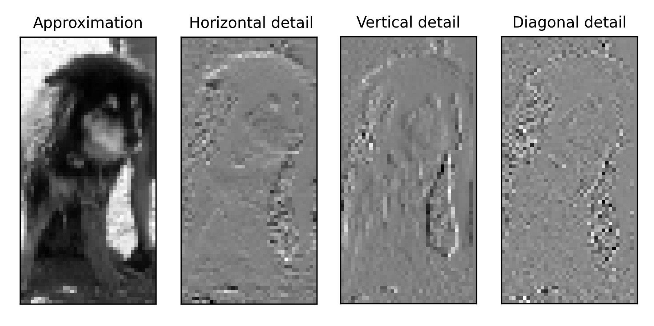
What is a Convolution?
Filter Pair (Digital Haar Wavelets)
Notes:
Convolutions: simple wavelet filter set processed on an image in two dimensions.

Slide 5
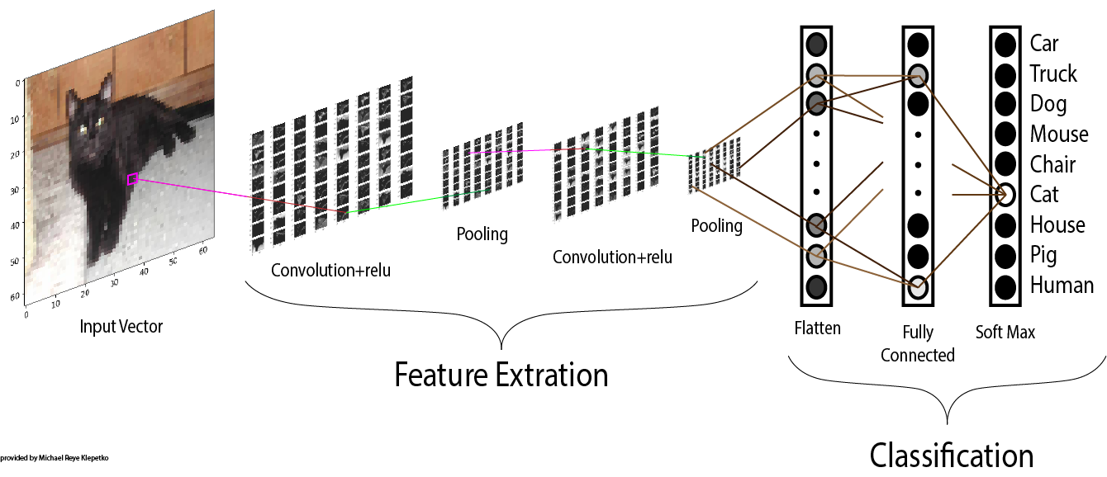
Convolutional Neural Networks
Notes:
CNN use convolutional layers to extract features from the image pixels, and each following layer pooling and extracting these features into an identifiable object.

Slide 6
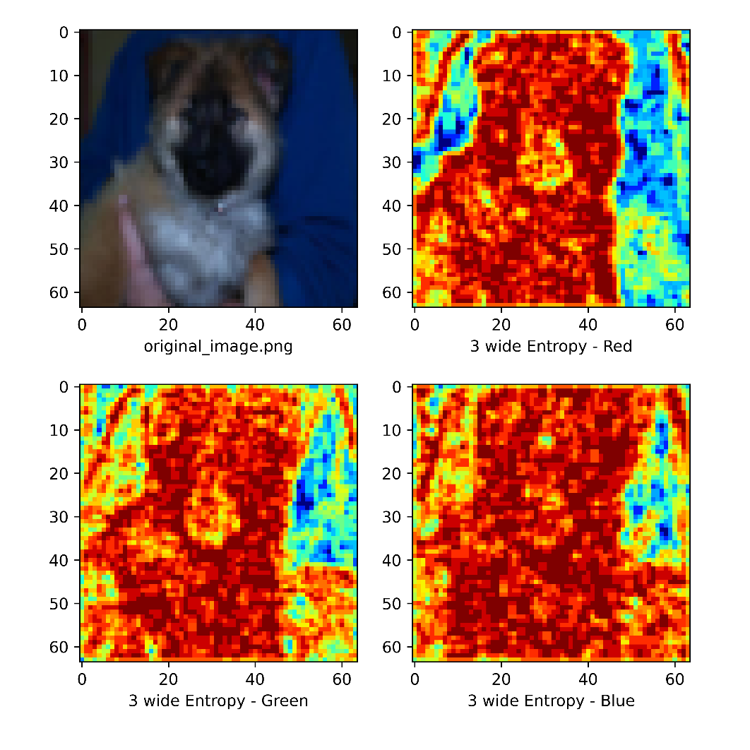
3-Wide Entropy of Dog Image
Layer of CNN Activation of Dog Image
Notes:
Compare CNN convolutional layer activation plot to entropy plot of the same image.
Hypothesize:
- CNN are picking up novel patterns within the entropy.

Slide 7
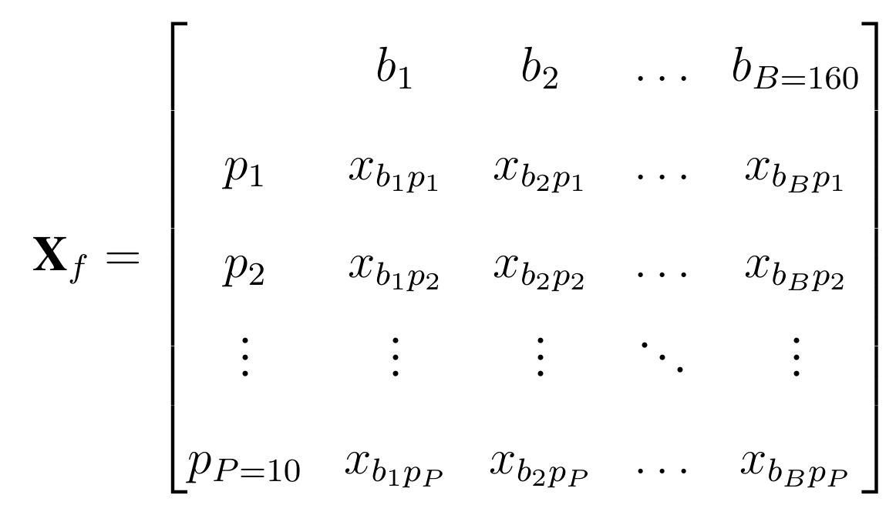
Non-Natural Datasets – IP Flows
Truncate and Remove Physical Layer
First 160 Bytes Remaining
First 10 packets of Flow
Missing Data Padded with Zeros
CIC-IDS-2017
Public Dataset
Raw IP-Packets
Notes:
Our non-natural data are computer process metrics.

Slide 8
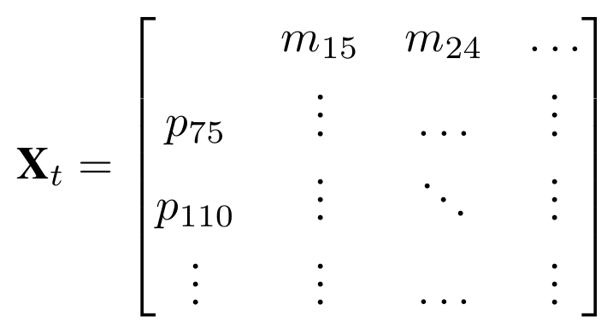
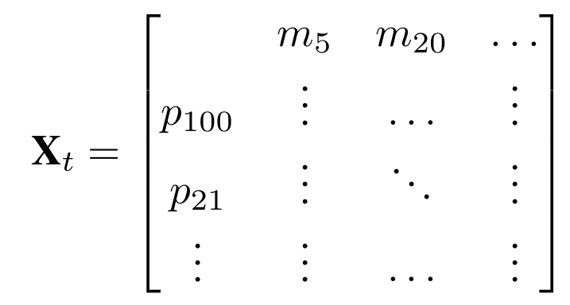
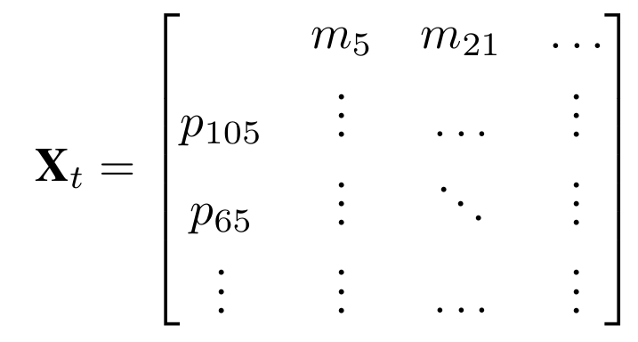
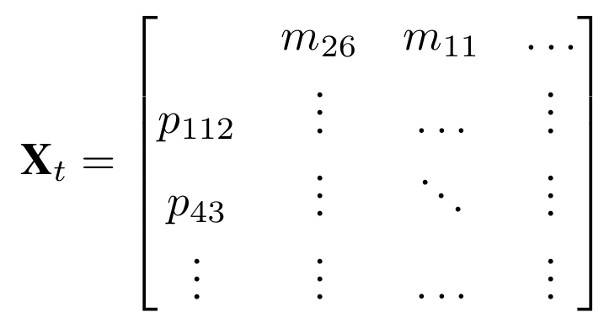
What Order Is Best?
Hypothesis:
Order Matters
Images Offer Insight On Proper Order
Using Correlation as a Basis Performs Better Than Average
Problem applies to many types of datasets beyond security
Notes:
Our question is, does order matter? Is there one that is best?

Slide 9
Approach
Identify Datasets.
Defined strategies for row and column orderings
Randomly Determined – 100 random (10 per axis)
Structural Relationships – Logs, Specs, etc.
Image Mathematical Relationships – Statistical Correlation
Conducted extensive experimentation using above strategies
Run the process on multiple CNN models
Run the process on multiple data sets
Compared the results

Slide 10
Current Work - Publications:
Randy Klepetko and Ram Krishnan. "Analyzing CNN Model Performance Sensitivity to the Ordering of Non-Natural Data", 4th International Conference on Computing, Communications and Security (ICCCS). IEEE Rome, Italy, 2019.
Randy Klepetko and Ram Krishnan. "Analyzing CNN Models’ Sensitivity to the Ordering of Non-Natural Data", International Conference on Secure Knowledge Management in the Artificial Intelligence Era. Springer, San Antonio, Texas, 2021

Slide 11
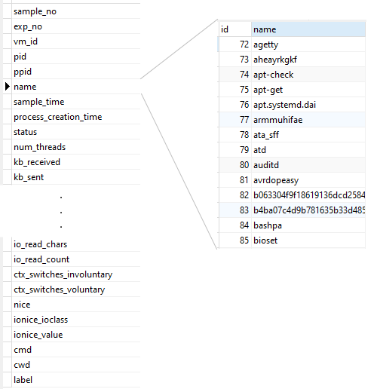
Non-Natural Datasets – Process Metrics
Detect Malware Infections
Computer Metrics
Sampled by Process
Sampled over Time
From Linux Virtual Machines
Cloud SaaS Environment
Some Machines are Infected with Malware
Notes:
First data set is from Dr. Abdelsalem’s work here at UTSA.

Slide 12
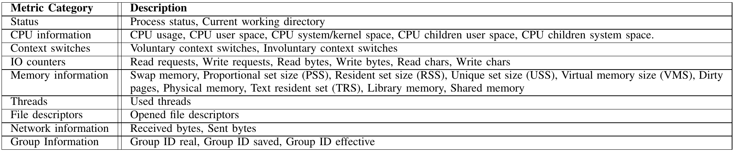
Metrics Captured per Process
Non-Natural Datasets – Process Metrics

Slide 13
Non-Natural Datasets – Process Metrics
Tier 1
Tier 2
Tier 3
LOAD BALANCED
FIREWALL
Web Server
Application Server
Database
Clients
...
Web Server
. . .
. . .
Web Server
Application Server
Clients
...
Web Server
Notes:
Sampled from an Virtual Machines in a cloud environment, where one of the machines was infected with a malware script.

Slide 14
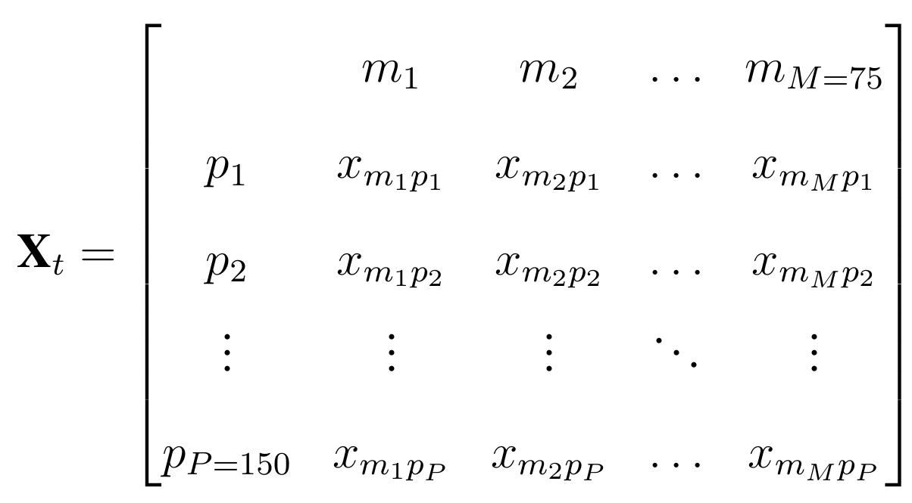
Non-Natural Datasets – Process Metrics
Benign Phase
Malicious Phase
Inject and Execute Malware
Samples taken every 10 second for 30 minutes.
15 minute mark malware is injected into an application server.
Grids made of process metric time samples from infected VM, half labeled positive.
Notes:
We compiled these samples per time slice into a matrix where one axis was the metrics while the other axis represented the processes.

Slide 15
Stabilize Grid Ordering (Process Rows)
Needed to stabilize grid ordering between samples.
Identified “Non-Unique” axis labels.
Used these axis labels as the ordered group in front.
“Non-Unique” axis labels missing in an experiment sample are padded with zeros.
Empty slots for “Unique” axis labels are extra bottom rows, supplied with non-zero values as they appear.
Notes:
Sample grids should be stabilized before processing.
This means that the features along an axis don’t change.
This was our process for doing that.

Slide 16
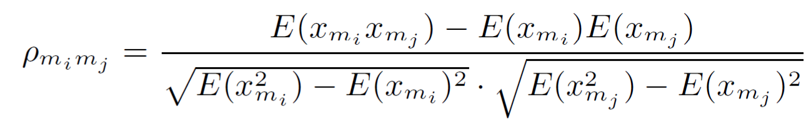
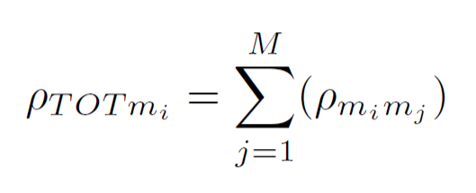


Ordering By Statistics – Independent Axis
When all data points along the axis (metric/byte) are include in every sample.
Statistical Correlation Function per Metric/Byte Pair:
Total Correlation:
ABS-Correlation:
Anti-Correlation:
Notes:
Use this function to find a correlation between every feature along an independent axis.
It was possible because every sample packet contained data for all the axis feature (metric/byte).
- Used ABS to try to make object edges.
- Used Anti to test counter hypothesis by breaking up object.
Our algorithm, also needs to order which features are most correlated with the other features on this axis, total correlation.

Slide 17
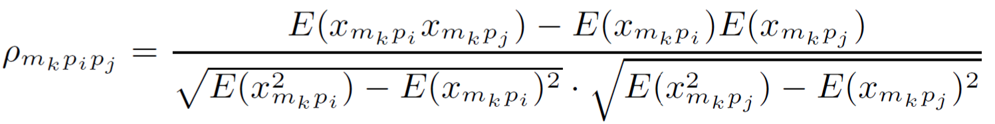
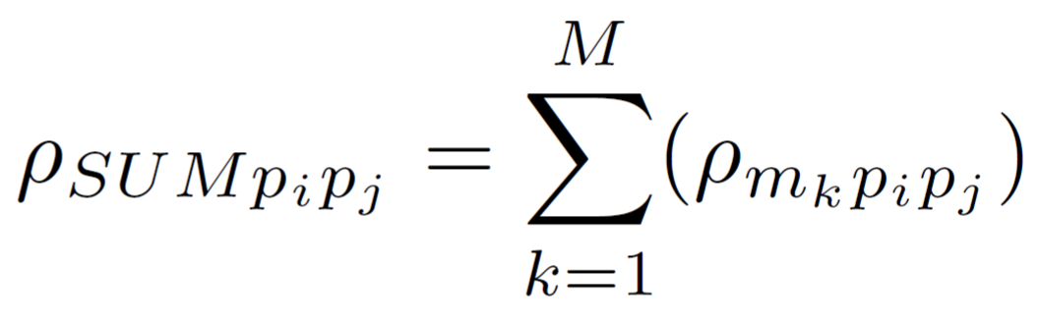
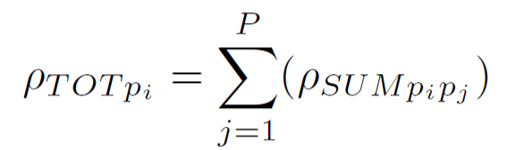

Ordering By Statistics – Dependent Axis
When one data points along the axis (process) are include in every sample.
Statistical Correlation per Process Pair for every Metric:
Correlated Sum Function:
ABS-Correlation Sum:
Anti-Correlation Sum:
Total Correlation Sum:
Notes:
Use this function to find a correlation between every feature along an dependent axis.
It was because every sample packet contained data on only a single feature along this axis.
You’ll note that the correlation function has a dependency on the other access
To strip out the dependence on the the other axis, we sum them to gain a Correlated Sum per Feature Pair.
We also test a ABS to build object edges, and a Anti to disperse the objects in a counter hypothesis.
We also generate a total we use in the ordering algorithm.

Slide 18
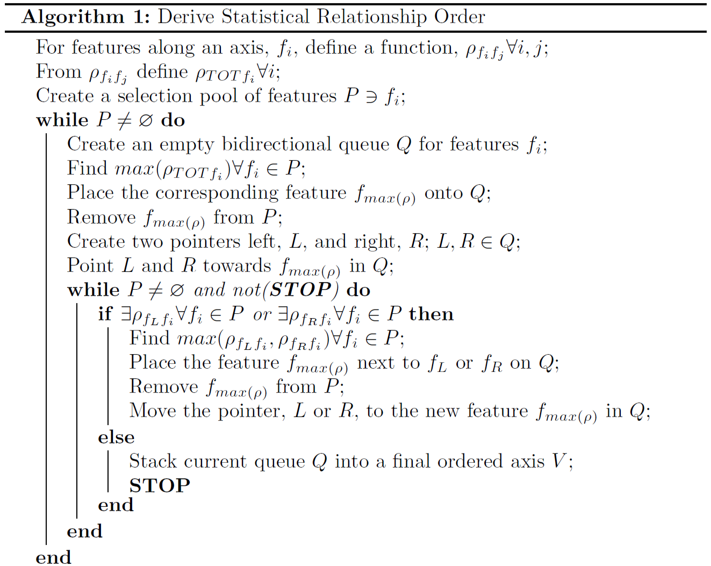
Ordering Algorithm:
Axis Feature: f_{i}
Metric axis: m_{i}
Process axis: p_{i}
Byte axis: b_{i}
Function: ρ_{fifj}
Per feature pair: f_{i} f_{j}
Independent of other axis feature

Slide 19
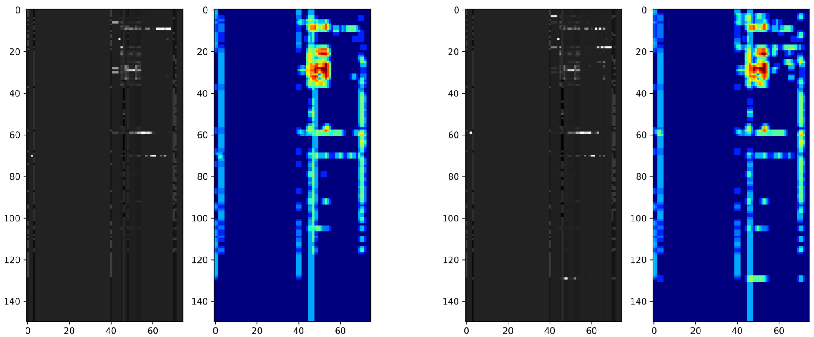
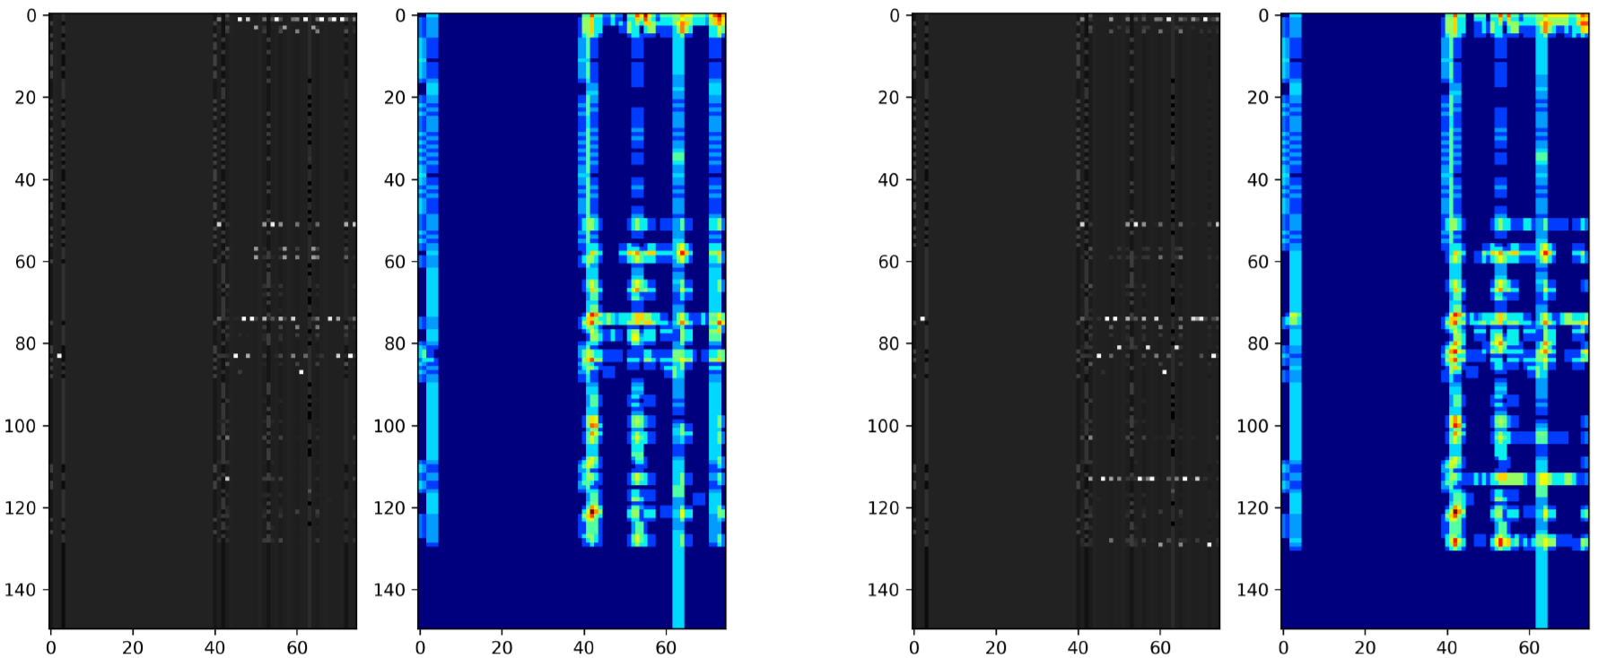
Visual Example:
Correlated Rows and Columns
Plots of Process/Metric Matrices with 3-wide Entropy
Benign
Infected
Anti-Correlated Rows and Columns
Notes:
Here are plots of two samples, one benign and the other infected, with a 3-wide entropy filter.
Correlated rows and columns concentrates groups of data points into objects while the anti-correlated disperses them.

Slide 20
CNN Models Analyzed:
Notes:
First paper used lenet-5, but it took awhile.
Decided to use the latest fastest models.
Performed testing with about 20 models and found three that saturate training within 3 epochs.

Slide 21
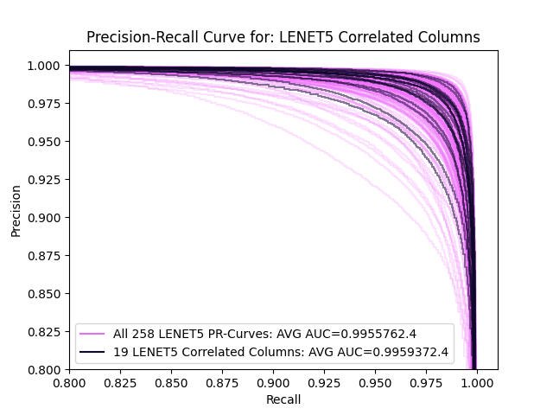
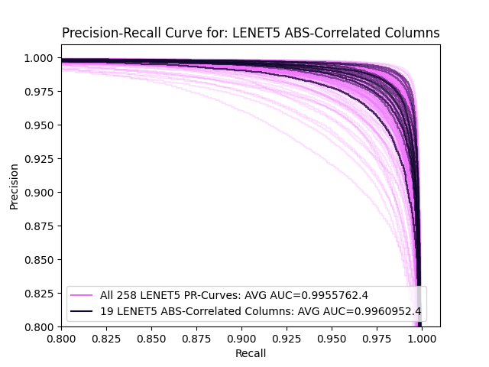
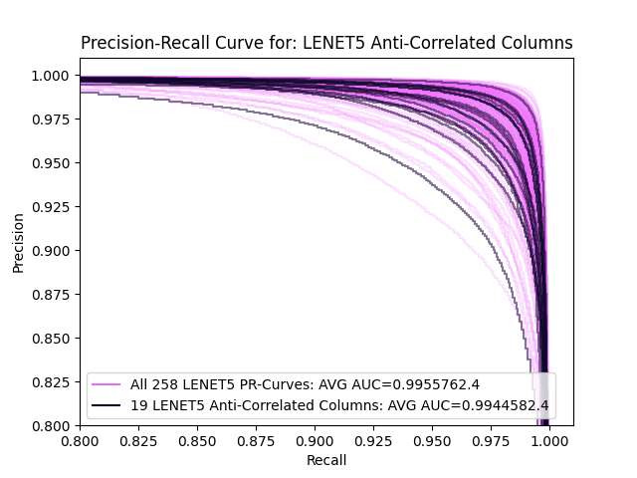
Results: Lenet-5 (20 epoch) PR-Curves
Column Ordering Options

Slide 22
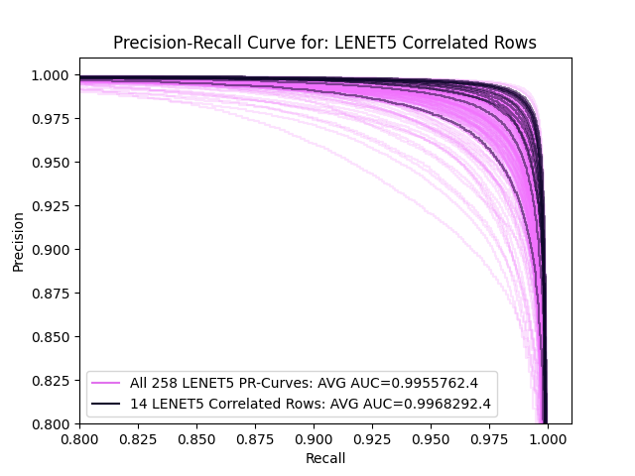

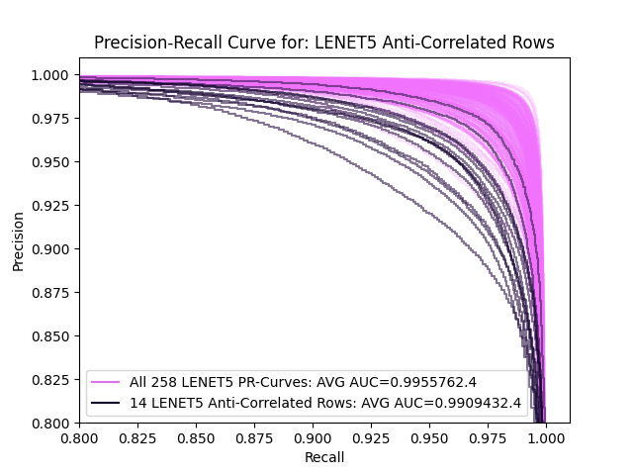
Results: Lenet-5 (20 epoch) PR-Curves
Row Ordering Options

Slide 23
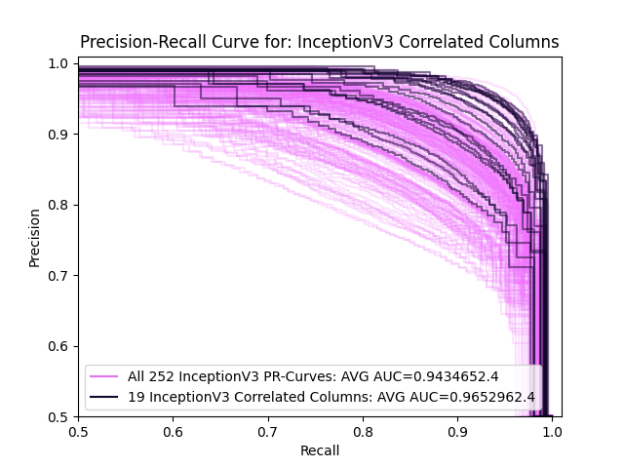
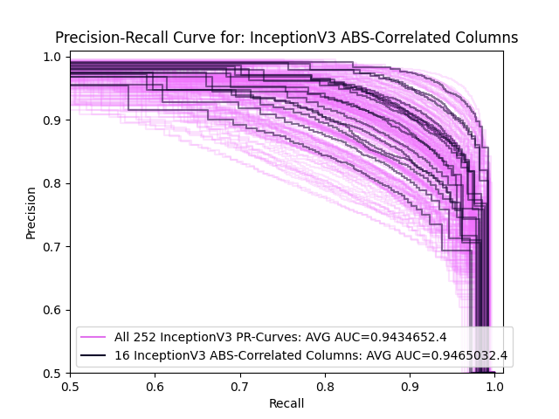
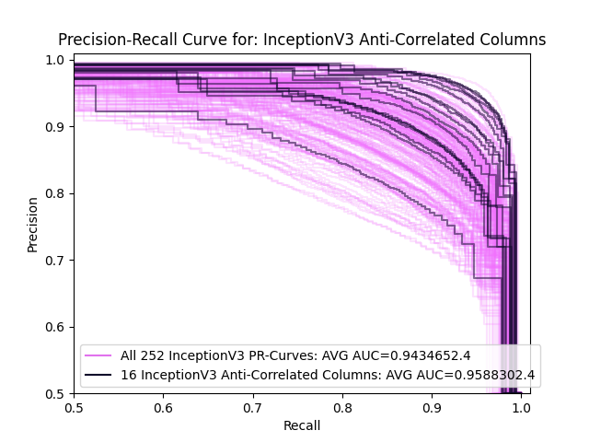
Results: Inception-V3 PR-Curves
Column Ordering Options

Slide 24
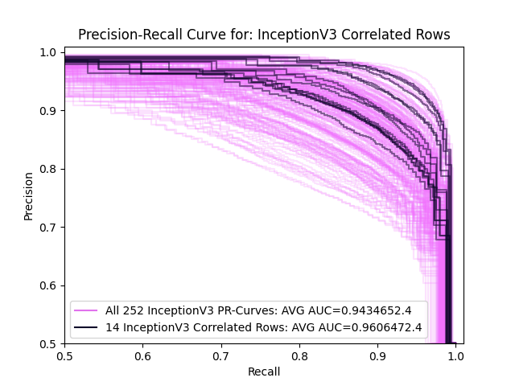

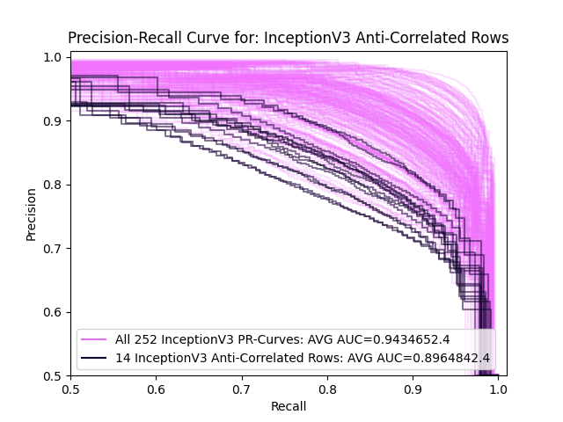
Results: Inception-V3 PR-Curves
Row Ordering Options

Slide 25
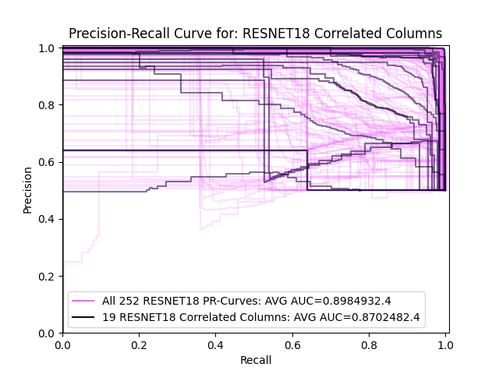
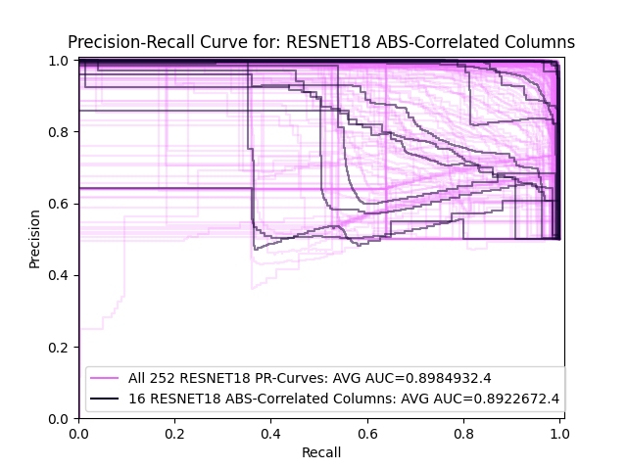
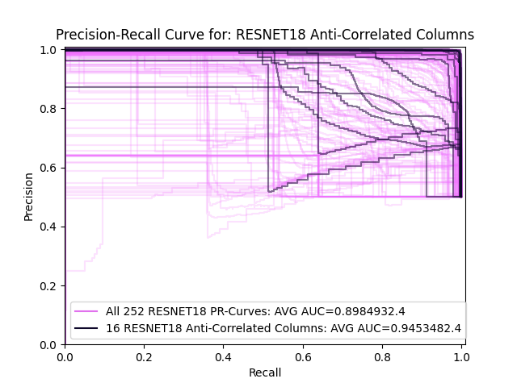
Results: RESNET-18 PR-Curves
Column Ordering Options

Slide 26
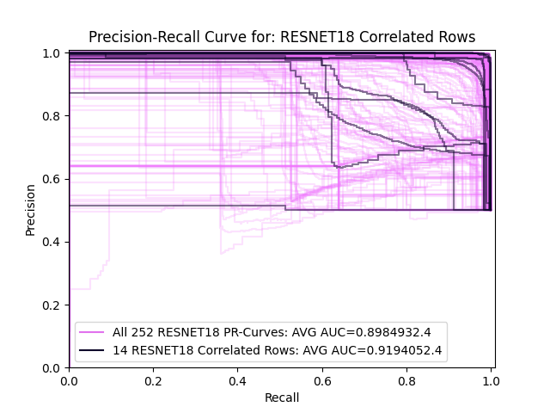
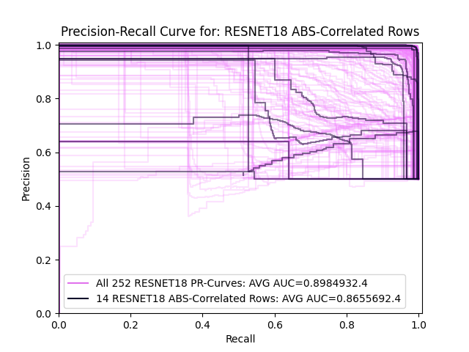

Results: RESNET-18 PR-Curves
Row Ordering Options

Slide 27
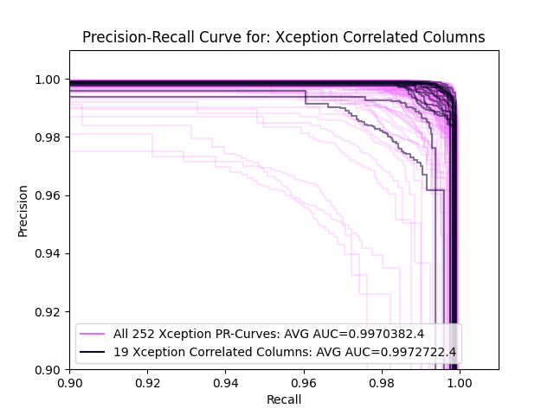

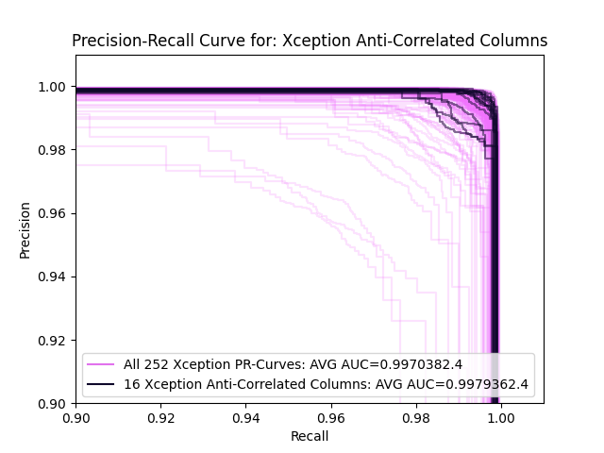
Results: Xception PR-Curves
Column Ordering Options

Slide 28
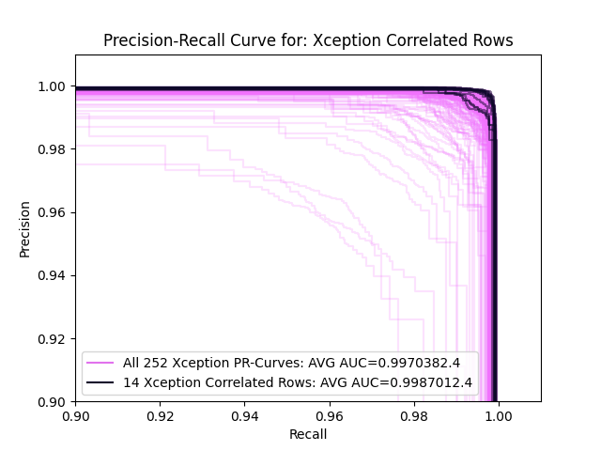
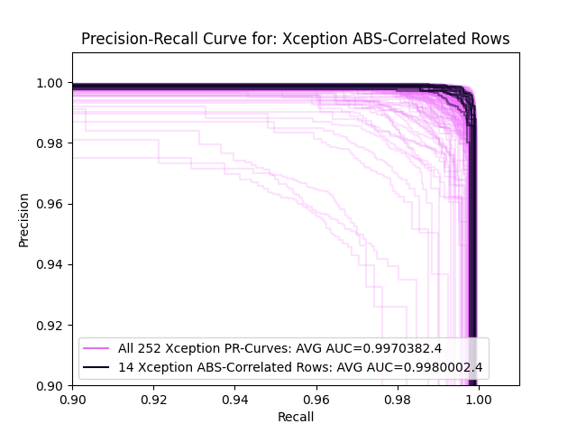
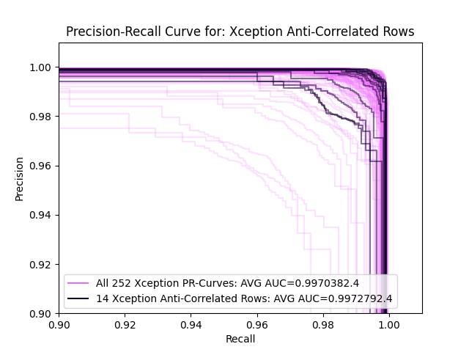
Results: Xception PR-Curves
Row Ordering Options

Slide 29
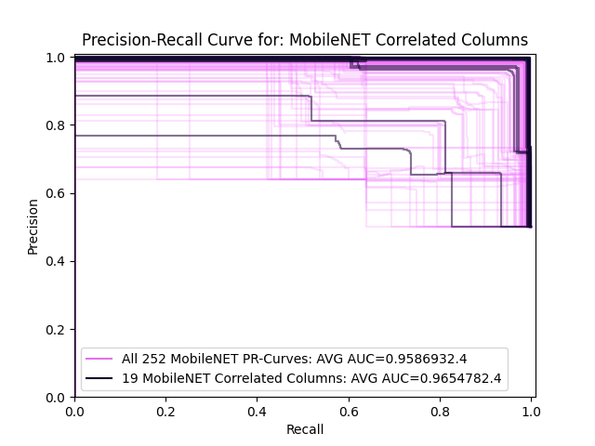
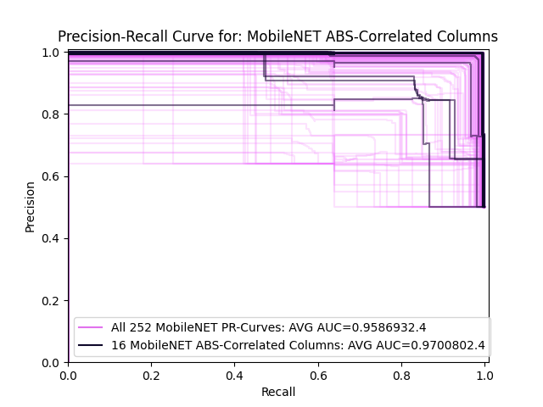
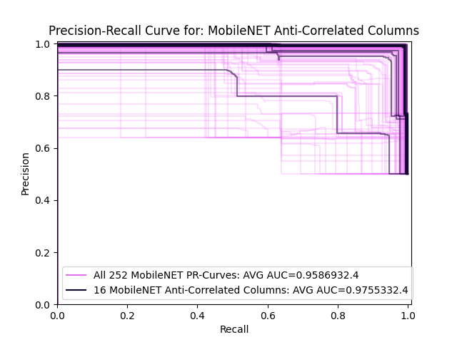
Results: MobileNet PR-Curves
Column Ordering Options

Slide 30
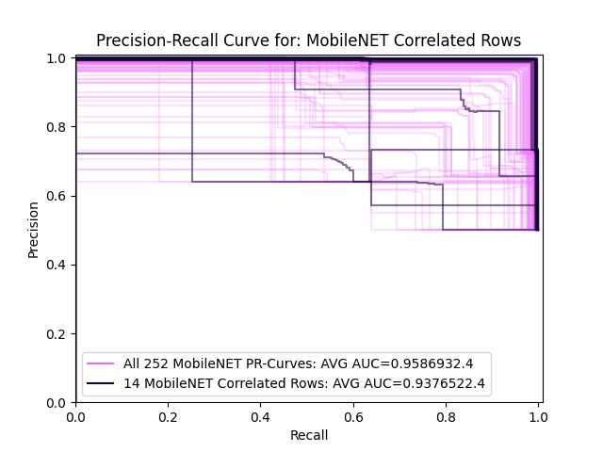
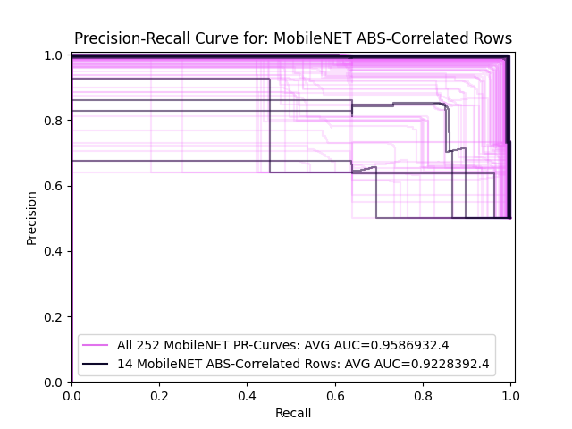
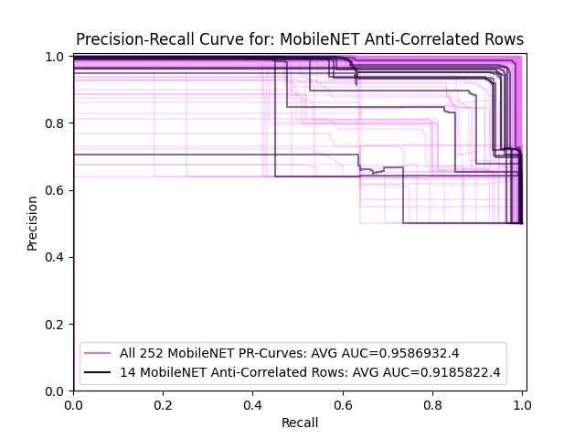
Results: MobileNet PR-Curves
Row Ordering Options

Slide 31
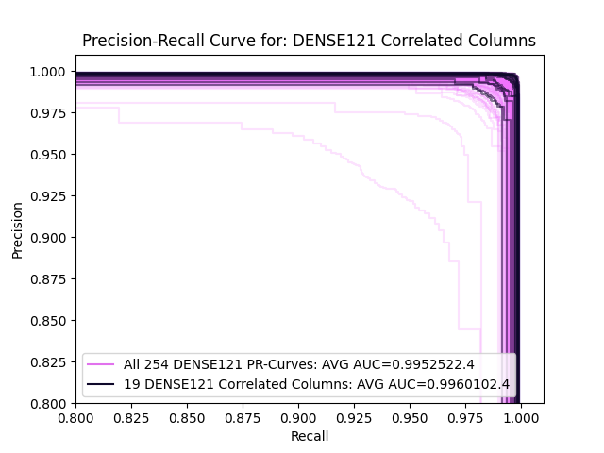
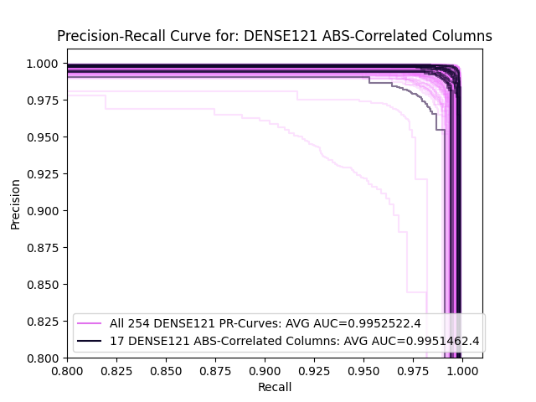
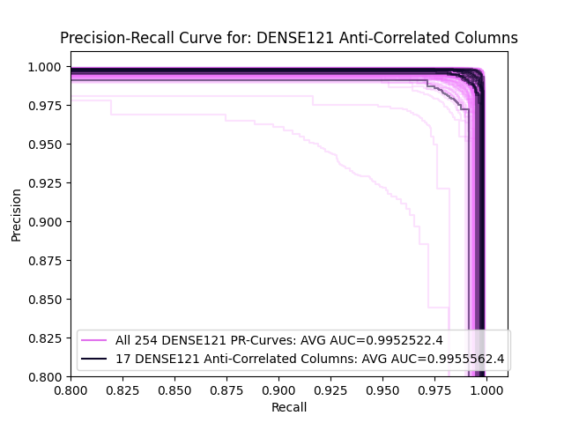
Results: DenseNet-121 PR-Curves
Column Ordering Options

Slide 32



Results: DenseNet-121 PR-Curves
Row Ordering Options

Slide 33
Performance Results:
Improvement over Mean AUC of Precision Recall Curves
Columns: Shorter Independent Axis
Rows: Longer Dependent Axis
Notes:
In general all of our models performed better than average when we used correlation to ordered the independent axis.
Four of six performed better than average when using correlation to order the dependent longer axis, and four of six performed much worst than average when ordering the same axis using anti-correlated ordering.
Lenet-5 and DenseNet followed our hypothesis almost exactly, followed by Inception and Xception. The later two also appreciate abs-correlated on the Independent axis
Resnet behaved the worst overall and against the hypothesis, performed better using anti-correlated over the other options.
MobileNet did not like any of the ordering schemes we presented for the longer, dependent axis, but did well with all of the schemes with the shorter independent axis.

Slide 34
Non-Natural Datasets – IP Flows
CIC-IDS-2017
Multiple Label Types
Grid Shape Different
One Non-Natural Axis
Hypothesis:
Performance of CNN will improve when using mathematical relationships as a basis for ordering, but that improvement will match by CNN model, most along the independent axis within the process/metric data set results.
MobileNet may behave following the comparative axis length (long).
Notes:
Our non-natural data are computer process metrics.

Slide 35
Anticipated Timeline
Chap 1-3 (15%) - Research more image pixel relationships (Jan ’02)
Chap 4 (40%) - Prepare CIC-IDS data set (Jan ’02)
Chap 5 (40%) - Perform CNN processing on CIC-IDS data set (Mar ‘02)
Chap 6 (90%) - Prepare and publish results (Apr ‘02)
Finish Dissertation (Aug ‘02)
Anticipated Publications:
Journal Publication Adding CIC-IDS Dataset to Publication.

Slide 36
Additional Slides

Slide 37
Process Metric - Sample Statistics
114 different Linux malwares injected.
Samples from 912 machines.
29 million process samples, 2.9 million from infected machines.
323 different process names, 129 are “non-unique” and ordered.
34 numerical metrics, ordered; 2 strings hot-coded to 41 unordered.
Grid size was 150 process rows by 75 metric columns.
31,064 Sample Grids using 252 Ordering Schemes

Slide 38
IP Data- Sample Statistics

Slide 39
Training Machine:
Central Processor Unit: IntelCore i7-9700K CPU @ 3.6 GHz x 8
Memory: 15.5 GB
Graphical Processor Unit: NVIDIA GK210GL (Tesla K80)
OS: 64-bit Ubuntu 20.10 LTS (Gnome 3.38.3)
CUDA: 11.2
Python: 3.6 using Tensorflow and Tensorboard

Slide 40
Performance Results:
Mean AUC for Precision Recall Curves
CNN | All | Correlated | ABS-Corr | Anti-Corr
Architecture | Options | Columns | Columns | Columns
Inception-V3 | 94.35% | 96.53% | 94.65% | 95.88%
ResNet-18 | 89.85% | 91.24% | 89.23% | 95.13%
Xception | 99.70% | 99.97% | 99.64% | 99.79%
MobileNet | 95.87% | 96.55% | 97.01% | 97.55%
DenseNet-121 | 99.53% | 99.60% | 99.52% | 99.56%
Correlated | ABS-Corr | Anti-Corr
Rows | Rows | Rows
96.06% | 96.60% | 89.65%
87.02% | 86.56% | 94.53%
99.73% | 99.80% | 99.73%
93.76% | 92.29% | 91.86%
99.70% | 99.43% | 99.20%
Color Code:
AUC ≥ +2% & Best | +2% > AUC ≥ 0% & Best | AUC ≥ +1% & Not Best | +1% > AUC > -1% | -1% ≥ AUC > -3% | -3% ≥ AUC
Notes:
Inception behaved like Lenet-5 liking correlation and not liking anti-correlation.
Resnet behaved the worst, and surprising liked anticorrelated over the other options.
MobileNet did not like any of the ordering schemes we presented for the longer, summed axis, but did well with the shorter independent axis.
Xception and Dense both were order performance independent, but noticed a slight improvement when correlation was used to derive the ordering scheme.

