Slide 1



The Effect of Homophily on Co-Offending Outcomes Ruslan Klymentiev, Luis Enrique Correa Rocha, Christophe Vandeviver Social Simulation Conference 2024 - Kraków - 19/09/2024

Slide 2
Research Question
How does similarity-based partner selection affect co-offending outcomes?

Slide 3
Research Question
How does similarity-based partner selection affect co-offending outcomes?
Structure of the criminal network
Information diffusion

Slide 4
Outline
Background
Proposed ABM model
Results & Discussion

Slide 5
Background
Co-offending acts as a means of achieving material and immaterial goods (Weerman, 2003):
Services
Catch
Payment
Appreciation
Acceptance
Information
Pros of co-offending
Cons of co-offending
Partner selection
Homophily
Skills exchange

Slide 6
Background
Group crime can increase the risk of getting caught (Morselli, 2009)
As the number of offenders per offense increases the profit per individual offender decreases (Tillyer and Tillyer, 2015)
Non-trivial problem of partner search and selection (McCuish et al., 2015; Tremblay, 2017; Van Mastrigt, 2017; Weerman, 2003)
Pros of co-offending
Cons of co-offending
Partner selection
Homophily
Skills exchange

Slide 7
Background
According to Tremblay (2017), ideally, offenders want to find partners who are trustful and useful.
Trustful connections ensure long-lasting relationships with low chances of failure or betrayal (Grund and Morselli, 2017)
Useful connections provide important information to expand one’s criminal opportunities (Becker and McCorkel, 2011)
Pros of co-offending
Cons of co-offending
Partner selection
Homophily
Skills exchange

Slide 8
Background
Scholars have found similarity preference in co-offending networks in terms of the following:
age (Bright and Whelan, 2020; Di Meo, 2023; Van Mastrigt and Carrington, 2013)
sex (Di Meo, 2023; Van Mastrigt and Carrington, 2013)
ethnicity (Grund and Densley, 2015)
marital status (Di Meo, 2023)
spatial proximity (Schwarzenbach and Jensen, 2024)
socio-cultural background (Schwarzenbach and Jensen, 2024)
violence level (Geeraert et al., 2024)
Pros of co-offending
Cons of co-offending
Partner selection
Homophily
Skills exchange

Slide 9
Background
Co-offenders commit a wider variety of crimes than solo offenders (Conway and McCord, 2002)
Co-offending often involves a combination of offenders with varying skills (Bright et al., 2024)
Co-offending might help with committing sophisticated crimes (Felson, 2003)
Pros of co-offending
Cons of co-offending
Partner selection
Homophily
Skills exchange

Slide 10
Proposed Model
Overview
Hypotheses
Model algorithm
Parameters
Outcomes
Similarity preference in the environment
Network structure
Information diffusion (Skill sharing)

Slide 11
Proposed Model
1a. As the similarity preference increases, the co-offending network becomes sparser.
1b. As the similarity preference increases, the co-offending network becomes more clustered.
2. As the similarity preference increases, the number of skills per offender decreases.
3. Offenders that have a lower density (less redundancy) of the ego-centric network learn more skills.
Overview
Hypotheses
Model algorithm
Parameters
Outcomes
Notes:
Less redundant = higher variety
Less redundant = lower density
Higher variety = more skills
low

Slide 12
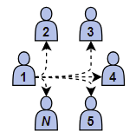
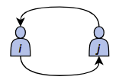
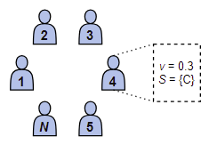
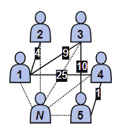

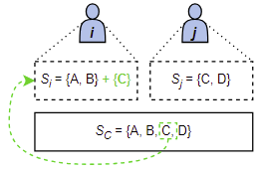

Proposed Model
Overview
Hypotheses
Model algorithm
Parameters
Outcomes
Notes:
Can also be a logistic function with a probability? Can run as a sensitivity analysis

Slide 13
Proposed Model
Overview
Hypotheses
Model algorithm
Parameters
Outcomes
Notes:
Can also be a logistic function with a probability? Can run as a sensitivity analysis

Slide 14
Proposed Model
Overview
Hypotheses
Model algorithm
Parameters
Outcomes
Notes:
Can also be a logistic function with a probability? Can run as a sensitivity analysis

Slide 15
Proposed Model
Overview
Hypotheses
Model algorithm
Parameters
Outcomes
Notes:
Can also be a logistic function with a probability? Can run as a sensitivity analysis

Slide 16
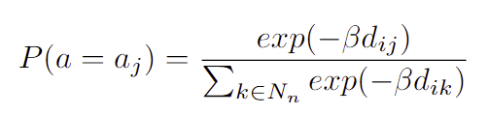

Proposed Model
Overview
Hypotheses
Model algorithm
Parameters
Outcomes
$d_{ij}=\left|v_{i}−v_{j}\right|$, dissimilarity between agents i and j
Six arbitrary values of $β$: 0, 20, 40, 60, 80, 100
When $β=0$agents do not have any similarity preferences and choose the partner at random.
The higher values of $β$ represent a stronger preference for similar partners.

Slide 17

Proposed Model
Network structure:
Density (D)
Transitivity (C)
Average degree ($\overline{k}$)
Average tie weight ($\overline{w}$)
Information diffusion:
Average skill level (ASL)
Overview
Hypotheses
Model algorithm
Parameters
Outcomes

Slide 18
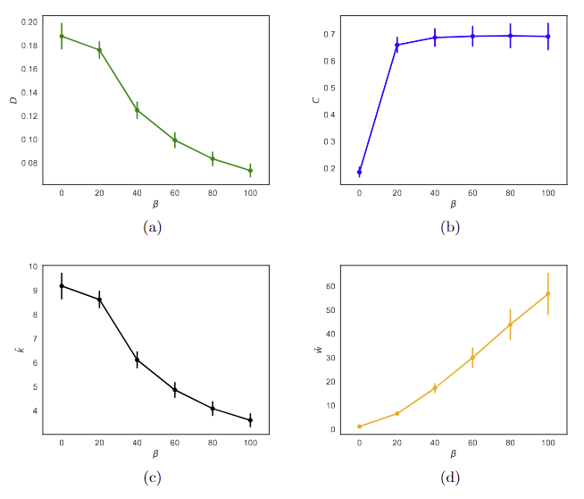
Results
Network structure
Information diffusion
Individual-level results
✅ H1a & H1b: As the similarity preference increases, the co-offending network becomes sparser but more clustered, which results in more stable connections.

Slide 19
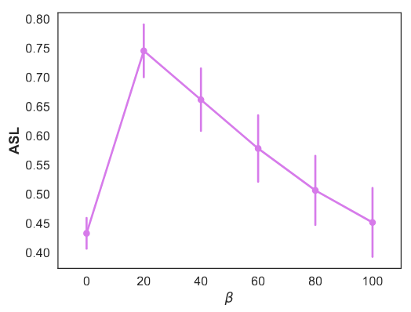
Results
Network structure
Information diffusion
Individual-level results
✅* H2: As the similarity preference increases, the number of skills per offender decreases.
Notes:
Change to the average number of crimes per offender
Talk more about the case beta=0?

Slide 20
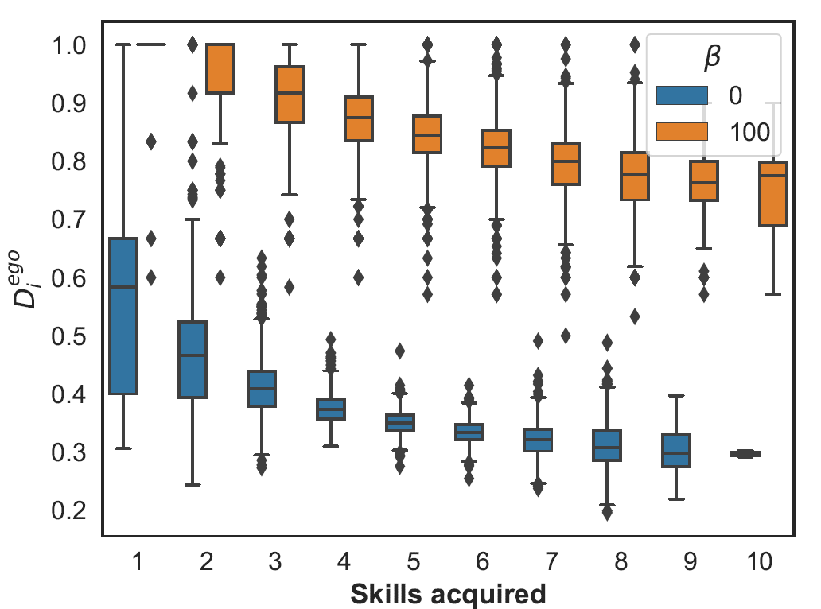
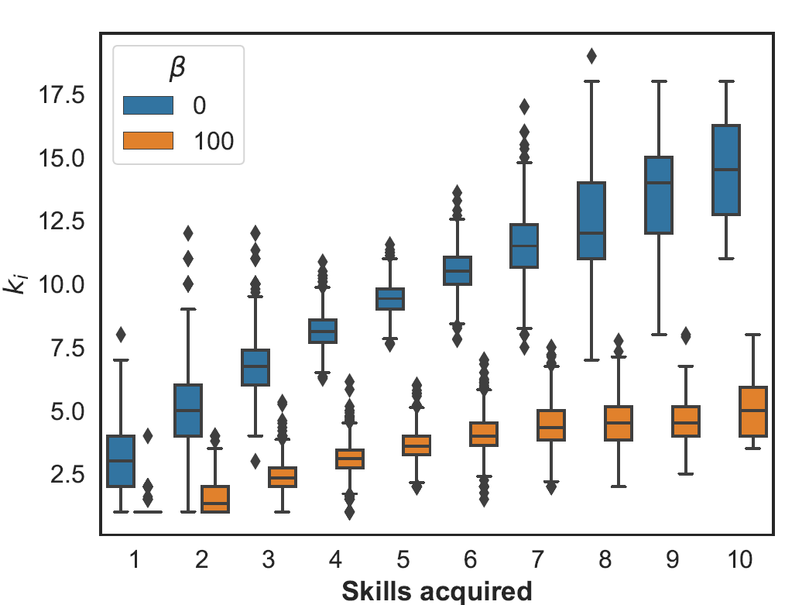
Results
Network structure
Information diffusion
Individual-level results
✅ H3: Offenders that have a lower density (less redundancy) of the ego-centric network learn more skills.
Notes:
- Agents that have a lot of connections are more important for network disruption?

Slide 21
Discussion
When offenders are exclusive during the partner selection process, they develop stable partnerships (strong ties). This in turn results in a low number of skills acquired by offenders
When offenders are more inclusive, they learn new skills from each other to a greater extent. However, this comes with the consequences of having fewer stable connections (weak ties)
Long-term criminal partners tend to specialize (Grund and Morselli, 2017)
Make the model more complex (e.g., different attributes, triadic closure, degree assortativity?)
By identifying how homophily drives network formation and skills exchange, policymakers can design more targeted interventions that disrupt these processes (Diviak, 2023)

Slide 22
Ruslan Klymentiev PhD Researcher Department of Criminology, Criminal Law and Social Law Institute for International Research on Criminal Policy Campus Aula, Universiteitstraat 4, 9000 Ghent, Belgium email: Ruslan.Klymentiev@UGent.be

Slide 23
References
Becker, S., & McCorkel, J. A. (2011). The Gender of Criminal Opportunity: The Impact of Male Co-Offenders on Women’s Crime. Feminist Criminology, 6 (2), 79–110. https://doi.org/10.1177/1557085110396501
Bright, D., Lerner, J., Putra Sadewo, G. R., & Whelan, C. (2024). Offence versatility among co-offenders: A dynamic network analysis. Social Networks, 78, 1–11. https://doi.org/10.1016/j.socnet.2023.10.003
Di Meo, G. (2023). Historical Co-offending Networks: A Social Network Analysis Approach. The British Journal of Criminology, 63 (6), 1591–1611. https://doi.org/10.1093/bjc/azad00516
Diviak, T. (2023). Structural resilience and recovery of a criminal network after disruption: A simulation study. Journal of Experimental Criminology. https://doi.org/10.1007/s11292-023-09563-z
Felson, M. (2003). The process of co-offending. Crime prevention studies, 16, 149–168.
Furutani, S., Shibahara, T., Akiyama, M., & Aida, M. (2023). Analysis of Homophily Effects on Information Diffusion on Social Networks. IEEE Access, 11, 79974–79983. https://doi.org/10.1109/ACCESS.2023.3299854
Geeraert, J., Rocha, L. E., & Vandeviver, C. (2024). The impact of violent behavior on co-offender selection: Evidence of behavioral homophily. Journal of Criminal Justice, 94, 102259. https://doi.org/10.1016/j.jcrimjus.2024.102259
Grund, T. U., & Densley, J. A. (2015). Ethnic Homophily and Triad Closure: Mapping Internal Gang Structure Using Exponential Random Graph Models. Journal of Contemporary Criminal Justice, 31 (3), 354–370. https://doi.org/10.1177/1043986214553377
Grund, T. U., & Morselli, C. (2017). Overlapping crime: Stability and specialization of co-offending relationships. Social Networks, 51, 14–22. https://doi.org/10.1016/j.socnet.2017.03.008
Morselli, C. (2009). Inside Criminal Networks (Vol. 8). Springer New York. https://doi.org/10.1007/978-0-387-09526-4
Tillyer, M. S., & Tillyer, R. (2015). Maybe I Should Do This Alone: A Comparison of Solo and Co-offending Robbery Outcomes. Justice Quarterly, 32 (6), 1064–1088. https://doi.org/10.1080/07418825.2014.883422
McCuish, E. C., Bouchard, M., & Corrado, R. R. (2015). The Search for Suitable Homicide Co-Offenders Among Gang Members. Journal of Contemporary Criminal Justice, 31 (3), 319–336. https://doi.org/10.1177/1043986214553375
Schwarzenbach, A., & Jensen, M. (2024). Extremists of a feather flock together? Community structures, transitivity, and patterns of homophily in the US Islamist co-offending network (K. L. Warren, Ed.). PLOS ONE, 19 (6), e0298273. https://doi.org/10.1371/journal.pone.0298273
Talaga, S., & Nowak, A. (2020). Homophily as a Process Generating Social Networks: Insights from Social Distance Attachment Model. Journal of Artificial Societies and Social Simulation, 23 (2), 6. https://doi.org/10.18564/jasss.4252
Tremblay, P. (2017, October). Searching for Suitable Co-offenders. In R. V. Clarke & M. Felson(Eds.), Routine Activity and Rational Choice (1st ed., pp. 17–36). Routledge. https://doi.org/10.4324/9781315128788-2
Van Mastrigt, S. B. (2017, June). Co-offending and Co-offender Selection (W. Bernasco, J.-L. Van Gelder, & H. Elffers, Eds.; Vol. 1). Oxford University Press. https://doi.org/10.1093/oxfordhb/9780199338801.013.21
Van Mastrigt, S. B., & Carrington, P. J. (2013, October). Sex and Age Homophily in Co-offending Networks: Opportunity or Preference? In Crime and Networks (pp. 40–63).
Weerman, F. M. (2003). Co-offending as Social Exchange. Explaining Characteristics of Co-offending. British Journal of Criminology, 43 (2), 398–416. https://doi.org/10.1093/bjc/43.2.398

Slide 24
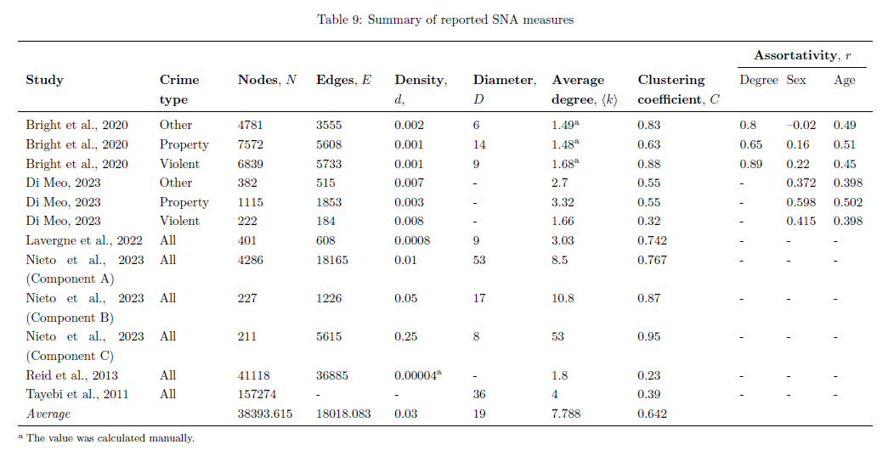
Backup Slides

Slide 25
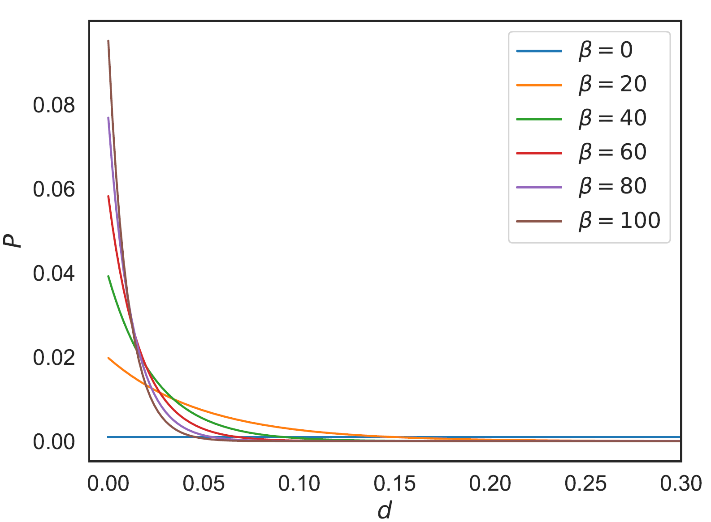
Backup Slides

Slide 26
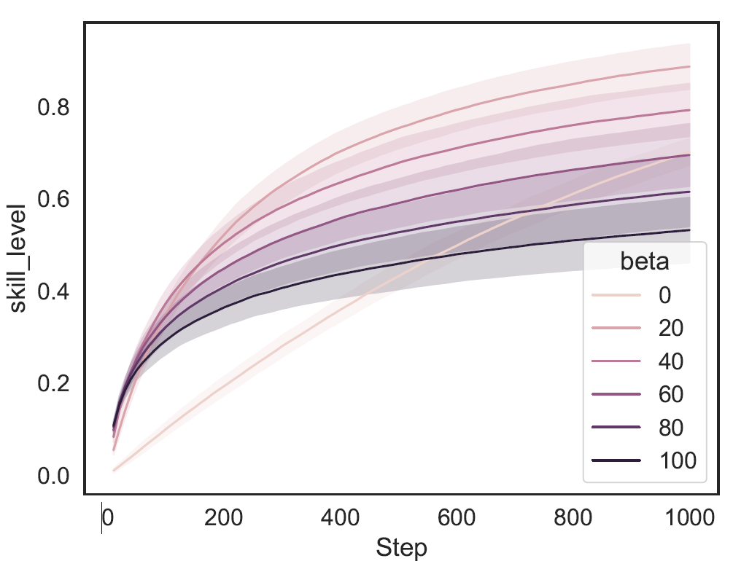
Backup Slides

Slide 27
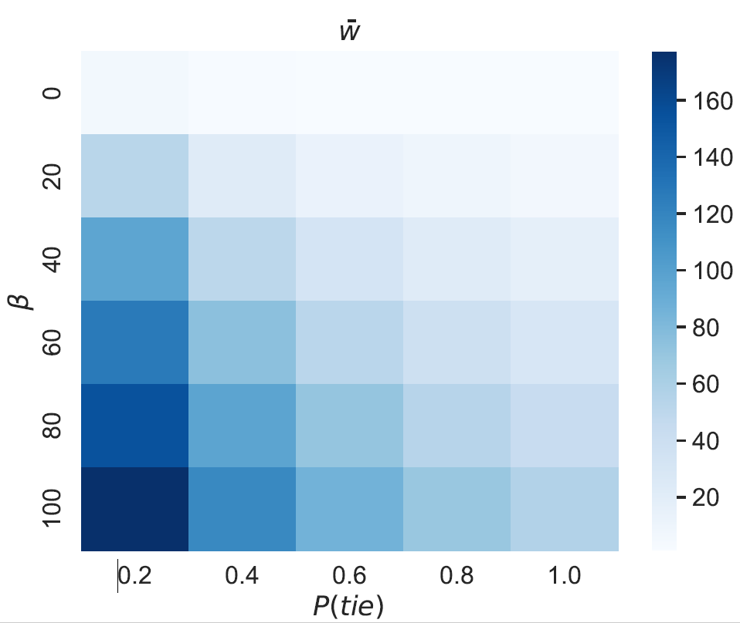
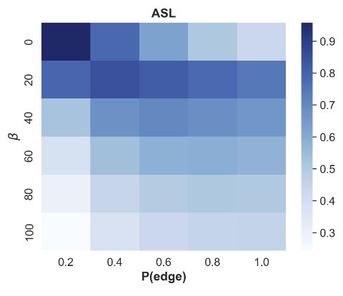
Backup Slides

Slide 28
Background
Homophily plays an important role in:
network formation (Alraddadi et al., 2020; Talaga and Nowak, 2020)
information diffusion (Furutani et al., 2023; Golub and Jackson, 2012; Sun et al., 2022)
opinion formation (Alraddadi et al., 2020; Gargiulo and Gandica, 2017)
innovations in networks (Yousaf and Palazzo, 2023)
Pros of co-offending
Cons of co-offending
Partner selection
Homophily
Skills exchange

