Slide 1
Evaluating Countries based on Environmental Conditions

Slide 2
Introduction
Data: Measurements of environment conditions in Countries
Rows: There are 137 observations, 1 for each country
Columns: Total 137 variables.
Qualitative: Happiness, measured as Ordinal
Quantitative: Aspect, Slope; Crop Land, Tree Canopy; Wind; Cloud & Multiple variables for Temp, Rain
Country Happiness_Rank accessibility_to_cities elevation aspect 1 Afghanistan 153 317.71575 1831.7444 201.4298 2 Albania 95 73.83086 651.8155 192.1303 3 Algeria 68 1212.79982 556.7583 184.9747 4 Angola 137 378.20239 1061.4790 174.2569 5 Argentina 30 209.21958 682.7993 145.0314 6 Armenia 127 97.29452 1850.4830 183.5375 slope cropland_cover tree_canopy_cover isothermality 1 1.5156001 9.511846 0.3746726 35.90442 2 1.8900753 23.346087 12.8046289 33.16941 3 0.1708615 3.690864 0.1766562 40.29895 4 0.1926286 2.794476 19.8701092 64.33239 5 0.6238553 21.962504 8.8336096 49.85147 6 2.3188956 21.338266 6.9929146 32.42359 rain_coldestQuart rain_driestMonth rain_driestQuart rain_mean_annual 1 128.718360 1.7224832 8.300540 311.32914 2 392.508789 40.0884801 138.154620 1151.09747 3 25.290778 0.9349921 6.088662 79.45607 4 8.054832 0.2601221 4.430197 1023.37470 5 79.087675 17.1832114 60.486305 539.87247 6 69.674299 20.0054896 67.223098 501.65877 rain_seasonailty rain_warmestQuart rain_wettestMonth rain_wettestQuart 1 91.62876 12.689584 67.83925 175.8160 2 38.54663 138.334670 159.04607 435.8747 3 67.08149 9.508621 13.36623 33.2941 4 91.53816 318.535618 202.19713 524.2807 5 48.32124 183.138160 79.21689 211.7121 6 46.50160 127.161681 86.25816 213.7846 temp_annual_range temp_coldestQuart temp_diurnal_range temp_driestQuart 1 40.26161 -0.2613516 14.724698 21.1203287 2 27.08155 3.5798958 9.114174 19.5732059 3 36.49031 13.1515534 14.872674 26.9210724 4 21.48916 18.7935162 13.845249 18.8668818 5 26.77336 8.0238906 13.461877 11.0949601 6 34.82843 -4.5577218 11.433959 -0.5852048 temp_max_warmestMonth temp_mean_annual temp_min_coldestMonth 1 31.95010 11.53331 -8.3115067 2 26.27564 11.46749 -0.8059126 3 41.54823 22.96395 5.0579265 4 31.03791 21.61187 9.5487517 5 28.21619 14.20719 1.4428340 6 24.35806 6.16530 -10.4703703 temp_seasonality temp_warmestQuart temp_wettestQuart wind cloudiness 1 88.15351 22.67524 3.947660 3.432747 114.22898 2 62.66852 19.57742 5.267450 2.472694 181.13111 3 75.11026 32.45083 20.813229 4.025770 90.67439 4 18.53582 23.28857 22.758982 2.164405 187.51704 5 47.56007 20.17117 16.477629 4.270904 159.00653 6 81.33372 16.19944 9.369816 1.968253 191.76167
Research Question How do the 137 countries differ on these variables?
## Country Happiness_Rank accessibility_to_cities ## Afghanistan: 1 Min. : 1.00 Min. : 0.969 ## Albania : 1 1st Qu.: 41.00 1st Qu.: 55.216 ## Algeria : 1 Median : 77.00 Median : 122.848 ## Angola : 1 Mean : 79.06 Mean : 321.889 ## Argentina : 1 3rd Qu.:118.00 3rd Qu.: 338.201 ## Armenia : 1 Max. :158.00 Max. :3220.715 ## (Other) :131 ## elevation aspect slope cropland_cover ## Min. : 8.319 Min. : 94.24 Min. :0.0000 Min. : 0.00553 ## 1st Qu.: 251.926 1st Qu.:168.27 1st Qu.:0.1592 1st Qu.: 6.18871 ## Median : 425.131 Median :176.14 Median :0.5200 Median :19.97215 ## Mean : 603.987 Mean :177.11 Mean :0.7470 Mean :24.28494 ## 3rd Qu.: 814.622 3rd Qu.:186.50 3rd Qu.:1.1985 3rd Qu.:36.14503 ## Max. :2962.817 Max. :245.34 Max. :3.6984 Max. :77.52802 ## ## tree_canopy_cover isothermality rain_coldestQuart rain_driestMonth ## Min. : 0.000 Min. :19.35 Min. : 0.0312 Min. : 0.000 ## 1st Qu.: 4.926 1st Qu.:31.83 1st Qu.: 69.6743 1st Qu.: 2.611 ## Median :16.579 Median :44.35 Median : 144.7110 Median : 16.807 ## Mean :19.109 Mean :48.64 Mean : 217.7677 Mean : 27.408 ## 3rd Qu.:31.197 3rd Qu.:65.48 3rd Qu.: 271.8047 3rd Qu.: 40.790 ## Max. :60.085 Max. :87.00 Max. :1271.9904 Max. :157.769 ## ## rain_driestQuart rain_mean_annual rain_seasonailty rain_warmestQuart ## Min. : 0.00 Min. : 14.16 Min. : 11.16 Min. : 0.00 ## 1st Qu.: 14.01 1st Qu.: 501.66 1st Qu.: 35.77 1st Qu.: 99.63 ## Median : 67.22 Median : 847.35 Median : 59.71 Median : 217.20 ## Mean : 97.34 Mean :1033.53 Mean : 62.51 Mean : 267.52 ## 3rd Qu.:141.79 3rd Qu.:1486.49 3rd Qu.: 87.52 3rd Qu.: 366.79 ## Max. :537.83 Max. :2972.14 Max. :144.51 Max. :1195.09 ## ## rain_wettestMonth rain_wettestQuart temp_annual_range temp_coldestQuart ## Min. : 3.757 Min. : 8.929 Min. : 9.275 Min. :-24.7437 ## 1st Qu.: 79.354 1st Qu.: 213.785 1st Qu.:16.848 1st Qu.: 0.4906 ## Median :124.978 Median : 338.736 Median :25.775 Median : 13.0249 ## Mean :173.078 Mean : 454.883 Mean :25.110 Mean : 10.7980 ## 3rd Qu.:270.387 3rd Qu.: 716.121 3rd Qu.:30.863 3rd Qu.: 21.5560 ## Max. :537.011 Max. :1441.200 Max. :50.631 Max. : 26.2576 ## ## temp_diurnal_range temp_driestQuart temp_max_warmestMonth ## Min. : 6.154 Min. :-19.847 Min. :16.43 ## 1st Qu.: 9.114 1st Qu.: 8.557 1st Qu.:25.50 ## Median :10.622 Median : 19.985 Median :30.72 ## Mean :10.927 Mean : 16.240 Mean :29.98 ## 3rd Qu.:12.612 3rd Qu.: 24.828 3rd Qu.:34.05 ## Max. :16.269 Max. : 35.217 Max. :43.84 ## ## temp_mean_annual temp_min_coldestMonth temp_seasonality ## Min. :-6.832 Min. :-30.679 Min. : 3.001 ## 1st Qu.: 9.789 1st Qu.: -4.007 1st Qu.: 16.811 ## Median :19.845 Median : 5.713 Median : 48.591 ## Mean :17.215 Mean : 4.872 Mean : 48.573 ## 3rd Qu.:24.395 3rd Qu.: 15.195 3rd Qu.: 71.384 ## Max. :28.250 Max. : 22.202 Max. :145.221 ## ## temp_warmestQuart temp_wettestQuart wind cloudiness ## Min. : 9.504 Min. : 1.567 Min. :1.203 Min. : 50.36 ## 1st Qu.:18.643 1st Qu.:11.657 1st Qu.:2.202 1st Qu.:154.88 ## Median :24.352 Median :19.084 Median :2.796 Median :199.37 ## Mean :23.185 Mean :18.198 Mean :2.927 Mean :190.10 ## 3rd Qu.:27.270 3rd Qu.:24.748 3rd Qu.:3.586 3rd Qu.:234.12 ## Max. :35.217 Max. :31.853 Max. :4.724 Max. :322.19 ##
Domain of Data represented with type of measurement:
Qualitative Happiness -> Ordinal
Quantitative Variables Aspect -> Interval Temp -> Interval Wind -> Interval Cloud -> Interval
Accessibility -> Ratio Elevation -> Ratio Slope -> Ratio Cropland -> Ratio Tree Canopy -> Ratio Rain -> Ratio
Subseting Data by Domain
There are multiple variables representing rain and Temp, for analysis purposes, lets choose annual mean for Rain and Temp.
## Happiness_Rank accessibility_to_cities elevation aspect ## Afghanistan 153 317.71575 1831.7444 201.4298 ## Albania 95 73.83086 651.8155 192.1303 ## Algeria 68 1212.79982 556.7583 184.9747 ## Angola 137 378.20239 1061.4790 174.2569 ## Argentina 30 209.21958 682.7993 145.0314 ## Armenia 127 97.29452 1850.4830 183.5375 ## slope cropland_cover tree_canopy_cover isothermality ## Afghanistan 1.5156001 9.511846 0.3746726 35.90442 ## Albania 1.8900753 23.346087 12.8046289 33.16941 ## Algeria 0.1708615 3.690864 0.1766562 40.29895 ## Angola 0.1926286 2.794476 19.8701092 64.33239 ## Argentina 0.6238553 21.962504 8.8336096 49.85147 ## Armenia 2.3188956 21.338266 6.9929146 32.42359 ## rain_mean_annual temp_mean_annual wind cloudiness ## Afghanistan 311.32914 11.53331 3.432747 114.22898 ## Albania 1151.09747 11.46749 2.472694 181.13111 ## Algeria 79.45607 22.96395 4.025770 90.67439 ## Angola 1023.37470 21.61187 2.164405 187.51704 ## Argentina 539.87247 14.20719 4.270904 159.00653 ## Armenia 501.65877 6.16530 1.968253 191.76167
Research Question:

Slide 3
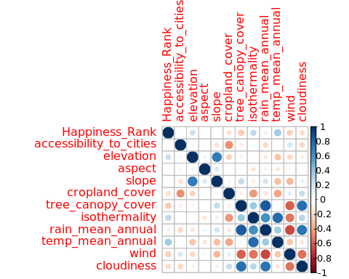

Slide 4
## Loading required package: prettyGraphs
Scree Plot

Slide 5
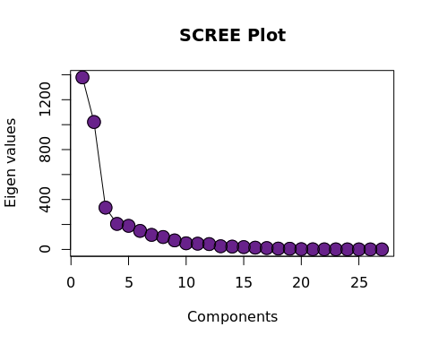

Slide 6
Factor Scores
Since there are 137 observations / Countries, hence let’s pick top 50 contributing countries.
## [1] TRUE

Slide 7
Animation

Slide 8
Loadings
## [1] "First 20"
## [1] "Next 20"
## [1] "Next 20"
## [1] "Next 20"
## [1] "Next 20"
## [1] "All"
## [1] TRUE

Slide 9
Animation

