Slide 1
Untitled

Slide 2
## Loading required package: animation
## corrplot 0.84 loaded

Slide 3
Introduction

Slide 4
Data
Read the data csv
Explore the Data
## 'data.frame': 137 obs. of 29 variables: ## $ Country : Factor w/ 137 levels "Afghanistan",..: 1 2 3 4 5 6 7 8 9 10 ... ## $ Happiness_Rank : int 153 95 68 137 30 127 10 13 80 109 ... ## $ accessibility_to_cities: num 317.7 73.8 1212.8 378.2 209.2 ... ## $ elevation : num 1832 652 557 1061 683 ... ## $ aspect : num 201 192 185 174 145 ... ## $ slope : num 1.516 1.89 0.171 0.193 0.624 ... ## $ cropland_cover : num 9.51 23.35 3.69 2.79 21.96 ... ## $ tree_canopy_cover : num 0.375 12.805 0.177 19.87 8.834 ... ## $ isothermality : num 35.9 33.2 40.3 64.3 49.9 ... ## $ rain_coldestQuart : num 128.72 392.51 25.29 8.05 79.09 ... ## $ rain_driestMonth : num 1.722 40.088 0.935 0.26 17.183 ... ## $ rain_driestQuart : num 8.3 138.15 6.09 4.43 60.49 ... ## $ rain_mean_annual : num 311.3 1151.1 79.5 1023.4 539.9 ... ## $ rain_seasonailty : num 91.6 38.5 67.1 91.5 48.3 ... ## $ rain_warmestQuart : num 12.69 138.33 9.51 318.54 183.14 ... ## $ rain_wettestMonth : num 67.8 159 13.4 202.2 79.2 ... ## $ rain_wettestQuart : num 175.8 435.9 33.3 524.3 211.7 ... ## $ temp_annual_range : num 40.3 27.1 36.5 21.5 26.8 ... ## $ temp_coldestQuart : num -0.261 3.58 13.152 18.794 8.024 ... ## $ temp_diurnal_range : num 14.72 9.11 14.87 13.85 13.46 ... ## $ temp_driestQuart : num 21.1 19.6 26.9 18.9 11.1 ... ## $ temp_max_warmestMonth : num 32 26.3 41.5 31 28.2 ... ## $ temp_mean_annual : num 11.5 11.5 23 21.6 14.2 ... ## $ temp_min_coldestMonth : num -8.312 -0.806 5.058 9.549 1.443 ... ## $ temp_seasonality : num 88.2 62.7 75.1 18.5 47.6 ... ## $ temp_warmestQuart : num 22.7 19.6 32.5 23.3 20.2 ... ## $ temp_wettestQuart : num 3.95 5.27 20.81 22.76 16.48 ... ## $ wind : num 3.43 2.47 4.03 2.16 4.27 ... ## $ cloudiness : num 114.2 181.1 90.7 187.5 159 ...
## Country Happiness_Rank accessibility_to_cities ## Afghanistan: 1 Min. : 1.00 Min. : 0.969 ## Albania : 1 1st Qu.: 41.00 1st Qu.: 55.216 ## Algeria : 1 Median : 77.00 Median : 122.848 ## Angola : 1 Mean : 79.06 Mean : 321.889 ## Argentina : 1 3rd Qu.:118.00 3rd Qu.: 338.201 ## Armenia : 1 Max. :158.00 Max. :3220.715 ## (Other) :131 ## elevation aspect slope cropland_cover ## Min. : 8.319 Min. : 94.24 Min. :0.0000 Min. : 0.00553 ## 1st Qu.: 251.926 1st Qu.:168.27 1st Qu.:0.1592 1st Qu.: 6.18871 ## Median : 425.131 Median :176.14 Median :0.5200 Median :19.97215 ## Mean : 603.987 Mean :177.11 Mean :0.7470 Mean :24.28494 ## 3rd Qu.: 814.622 3rd Qu.:186.50 3rd Qu.:1.1985 3rd Qu.:36.14503 ## Max. :2962.817 Max. :245.34 Max. :3.6984 Max. :77.52802 ## ## tree_canopy_cover isothermality rain_coldestQuart rain_driestMonth ## Min. : 0.000 Min. :19.35 Min. : 0.0312 Min. : 0.000 ## 1st Qu.: 4.926 1st Qu.:31.83 1st Qu.: 69.6743 1st Qu.: 2.611 ## Median :16.579 Median :44.35 Median : 144.7110 Median : 16.807 ## Mean :19.109 Mean :48.64 Mean : 217.7677 Mean : 27.408 ## 3rd Qu.:31.197 3rd Qu.:65.48 3rd Qu.: 271.8047 3rd Qu.: 40.790 ## Max. :60.085 Max. :87.00 Max. :1271.9904 Max. :157.769 ## ## rain_driestQuart rain_mean_annual rain_seasonailty rain_warmestQuart ## Min. : 0.00 Min. : 14.16 Min. : 11.16 Min. : 0.00 ## 1st Qu.: 14.01 1st Qu.: 501.66 1st Qu.: 35.77 1st Qu.: 99.63 ## Median : 67.22 Median : 847.35 Median : 59.71 Median : 217.20 ## Mean : 97.34 Mean :1033.53 Mean : 62.51 Mean : 267.52 ## 3rd Qu.:141.79 3rd Qu.:1486.49 3rd Qu.: 87.52 3rd Qu.: 366.79 ## Max. :537.83 Max. :2972.14 Max. :144.51 Max. :1195.09 ## ## rain_wettestMonth rain_wettestQuart temp_annual_range temp_coldestQuart ## Min. : 3.757 Min. : 8.929 Min. : 9.275 Min. :-24.7437 ## 1st Qu.: 79.354 1st Qu.: 213.785 1st Qu.:16.848 1st Qu.: 0.4906 ## Median :124.978 Median : 338.736 Median :25.775 Median : 13.0249 ## Mean :173.078 Mean : 454.883 Mean :25.110 Mean : 10.7980 ## 3rd Qu.:270.387 3rd Qu.: 716.121 3rd Qu.:30.863 3rd Qu.: 21.5560 ## Max. :537.011 Max. :1441.200 Max. :50.631 Max. : 26.2576 ## ## temp_diurnal_range temp_driestQuart temp_max_warmestMonth ## Min. : 6.154 Min. :-19.847 Min. :16.43 ## 1st Qu.: 9.114 1st Qu.: 8.557 1st Qu.:25.50 ## Median :10.622 Median : 19.985 Median :30.72 ## Mean :10.927 Mean : 16.240 Mean :29.98 ## 3rd Qu.:12.612 3rd Qu.: 24.828 3rd Qu.:34.05 ## Max. :16.269 Max. : 35.217 Max. :43.84 ## ## temp_mean_annual temp_min_coldestMonth temp_seasonality ## Min. :-6.832 Min. :-30.679 Min. : 3.001 ## 1st Qu.: 9.789 1st Qu.: -4.007 1st Qu.: 16.811 ## Median :19.845 Median : 5.713 Median : 48.591 ## Mean :17.215 Mean : 4.872 Mean : 48.573 ## 3rd Qu.:24.395 3rd Qu.: 15.195 3rd Qu.: 71.384 ## Max. :28.250 Max. : 22.202 Max. :145.221 ## ## temp_warmestQuart temp_wettestQuart wind cloudiness ## Min. : 9.504 Min. : 1.567 Min. :1.203 Min. : 50.36 ## 1st Qu.:18.643 1st Qu.:11.657 1st Qu.:2.202 1st Qu.:154.88 ## Median :24.352 Median :19.084 Median :2.796 Median :199.37 ## Mean :23.185 Mean :18.198 Mean :2.927 Mean :190.10 ## 3rd Qu.:27.270 3rd Qu.:24.748 3rd Qu.:3.586 3rd Qu.:234.12 ## Max. :35.217 Max. :31.853 Max. :4.724 Max. :322.19 ##
Domain of Data represented with type of measurement:
Qualitative Happiness -> Ordinal
Quantitative Variables Aspect -> Interval Temp -> Interval Wind -> Interval Cloud -> Interval
Accessibility -> Ratio Elevation -> Ratio Slope -> Ratio Cropland -> Ratio Tree Canopy -> Ratio Rain -> Ratio

Slide 5
Subseting Data by Domain
There are multiple variables representing rain and Temp, for analysis purposes, lets choose annual mean for Rain and Temp.
## Happiness_Rank accessibility_to_cities elevation aspect ## Afghanistan 153 317.71575 1831.7444 201.4298 ## Albania 95 73.83086 651.8155 192.1303 ## Algeria 68 1212.79982 556.7583 184.9747 ## Angola 137 378.20239 1061.4790 174.2569 ## Argentina 30 209.21958 682.7993 145.0314 ## Armenia 127 97.29452 1850.4830 183.5375 ## slope cropland_cover tree_canopy_cover isothermality ## Afghanistan 1.5156001 9.511846 0.3746726 35.90442 ## Albania 1.8900753 23.346087 12.8046289 33.16941 ## Algeria 0.1708615 3.690864 0.1766562 40.29895 ## Angola 0.1926286 2.794476 19.8701092 64.33239 ## Argentina 0.6238553 21.962504 8.8336096 49.85147 ## Armenia 2.3188956 21.338266 6.9929146 32.42359 ## rain_mean_annual temp_mean_annual wind cloudiness ## Afghanistan 311.32914 11.53331 3.432747 114.22898 ## Albania 1151.09747 11.46749 2.472694 181.13111 ## Algeria 79.45607 22.96395 4.025770 90.67439 ## Angola 1023.37470 21.61187 2.164405 187.51704 ## Argentina 539.87247 14.20719 4.270904 159.00653 ## Armenia 501.65877 6.16530 1.968253 191.76167

Slide 6
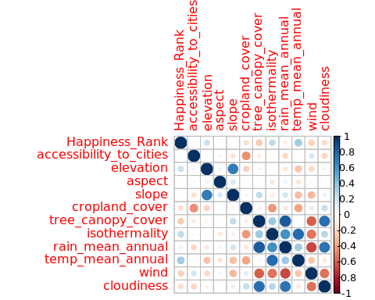
Research Question:

Slide 7
## Loading required package: prettyGraphs

Slide 8
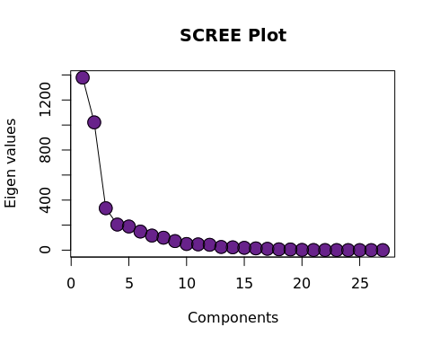
Scree Plot

Slide 9
Factor Scores
Since there are 137 observations / Countries, hence let’s pick top 50 contributing countries.
## [1] TRUE

Slide 10
Animation

Slide 11
Loadings
## [1] "First 20"
## [1] "Next 20"
## [1] "Next 20"
## [1] "Next 20"
## [1] "Next 20"
## [1] "All"
## [1] TRUE

Slide 12
Animation

