Slide 1
Multi Variate Analysis
Data set: Environmental Readings per Country
Ritesh Malaiya
2018.12.03

Slide 2
Overview
Data
Measurements of environment factors for 137 countries
Research Question
Which of the factors contribute most towards Happiness?
Methods
Quantitative
PCA
Qualitative
MCA
DiCA
Grouping variables to observe relative effect among groups
PLS-C
MFA
Cluster Analysis (DiSTATIS)

Slide 3
Dataset

Slide 4
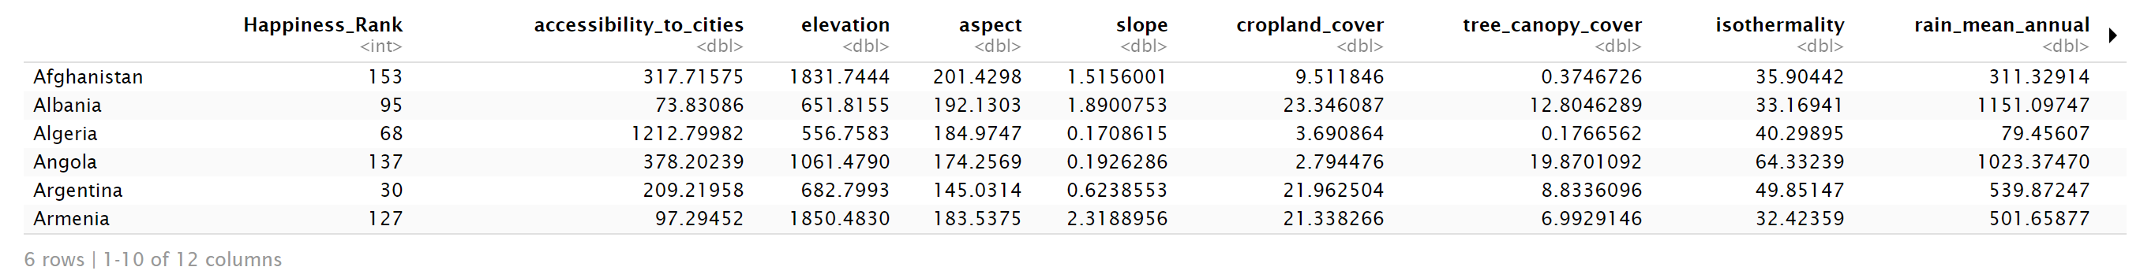
Dataset
Data: Measurements of environment conditions in Countries
Rows: There are 137 observations, 1 for each country.
Columns: Total 29 variables
Qualitative: Country (nominal), Happiness (Ordinal).
Quantitative: Aspect, Slope Crop Land, Tree Canopy Wind Cloud & Multiple variables for Temp & Rain

Slide 5
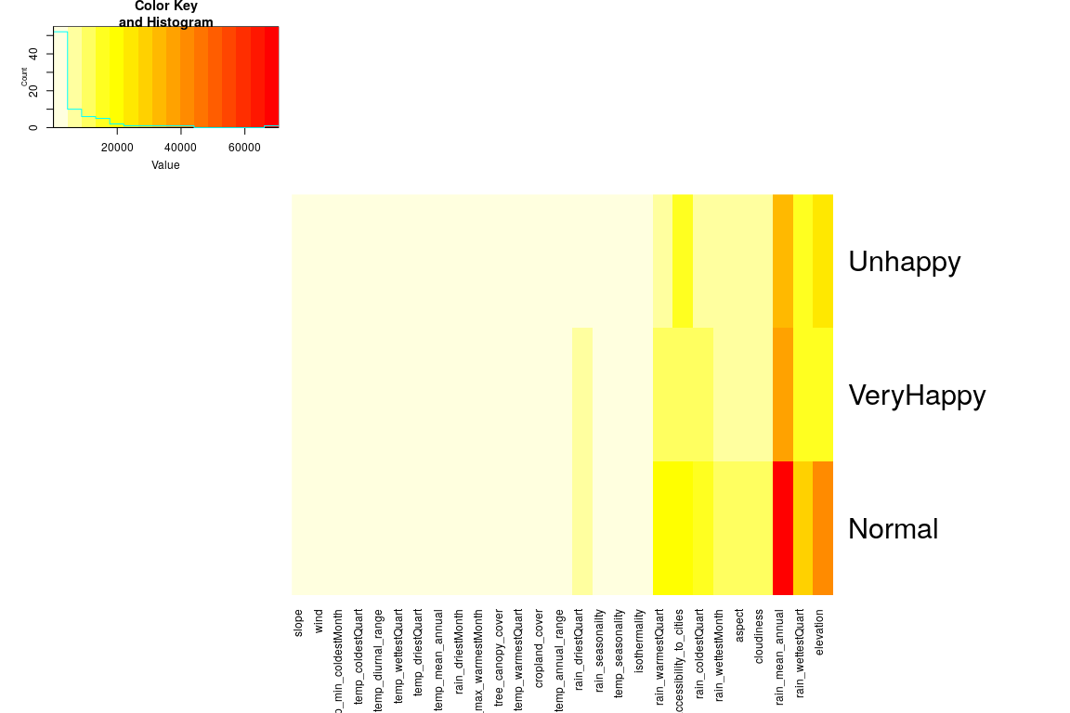
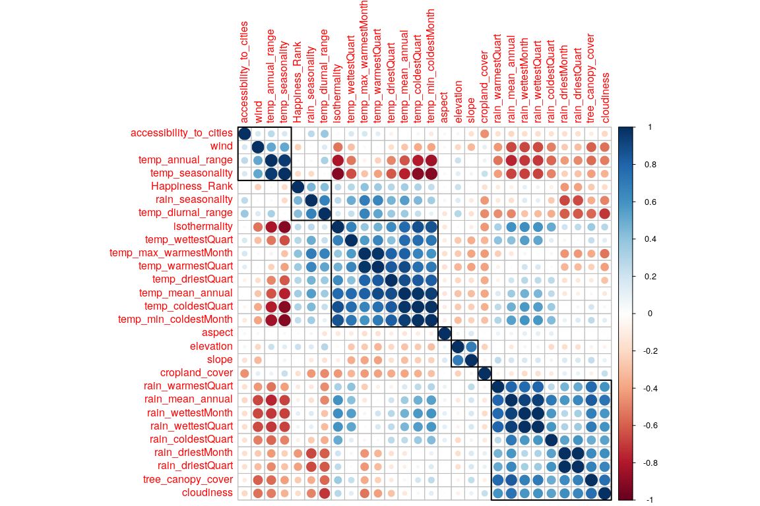
Correlation and Heat plot

Slide 6
Quantitative Analysis

Slide 7
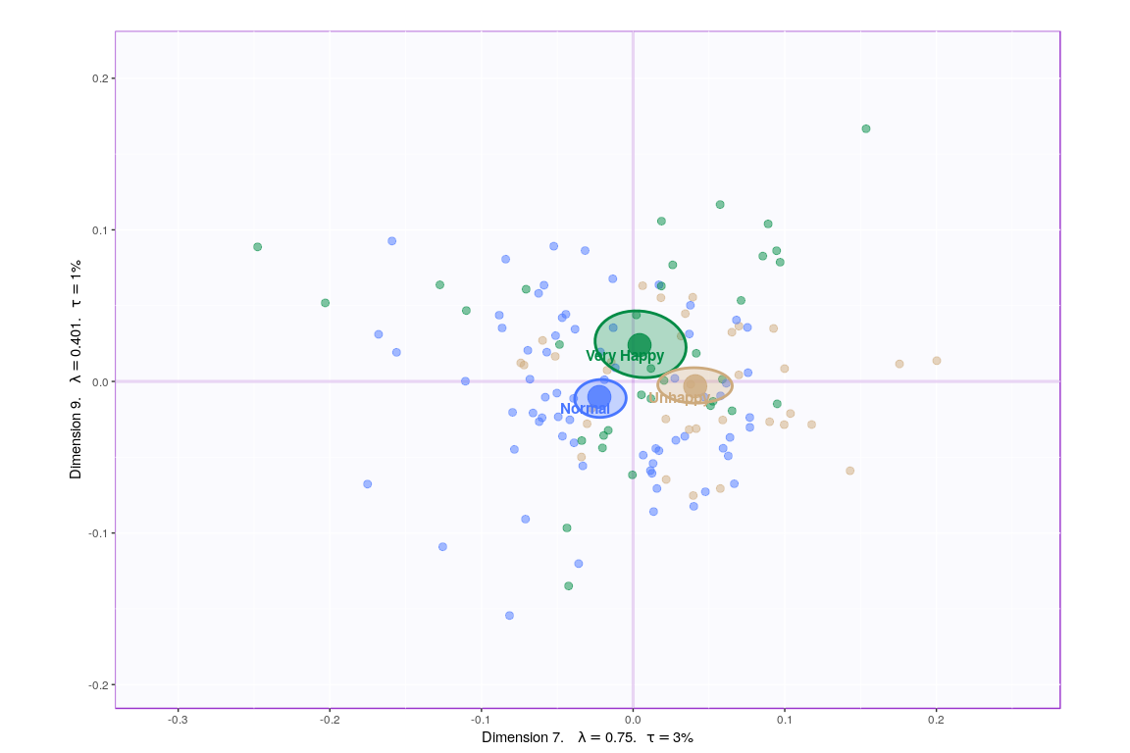
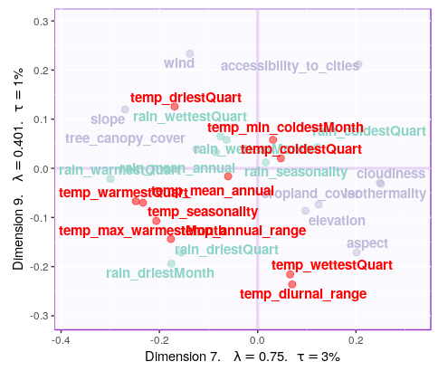
PCA

Slide 8
PCA
Methods | Unhappy | Normal | Very Happy | Reliability
PCA | Others | Temp & Rain | N/A | Components have significant contribution

Slide 9
Qualitative Analysis

Slide 10
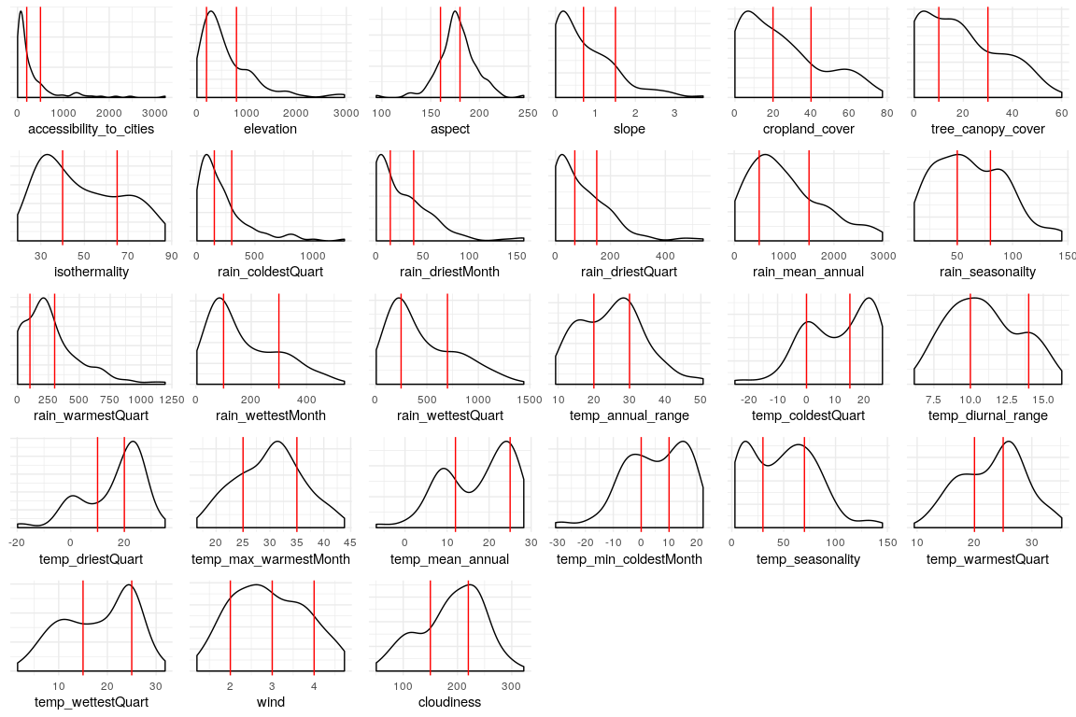



Data Binning

Slide 11
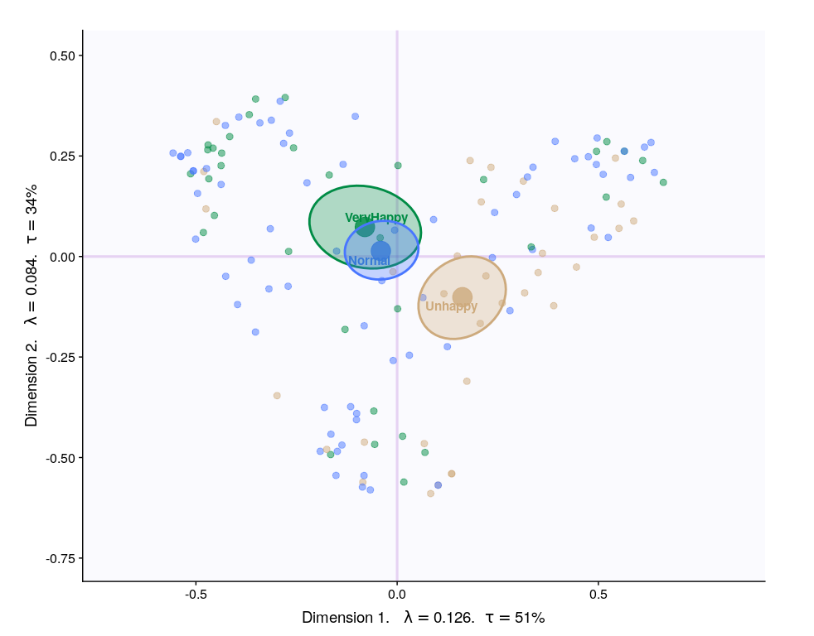
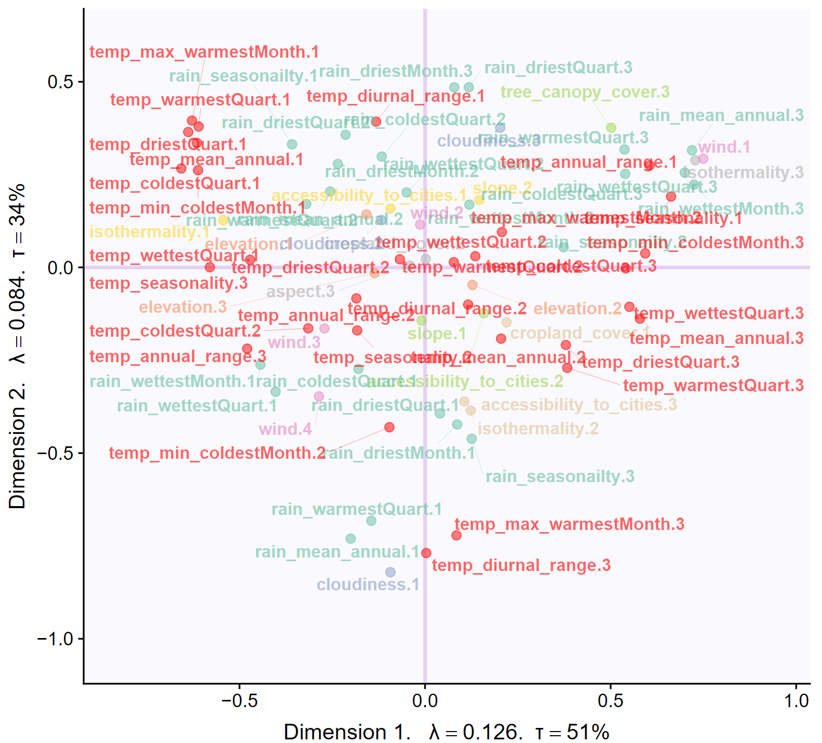

MCA

Slide 12
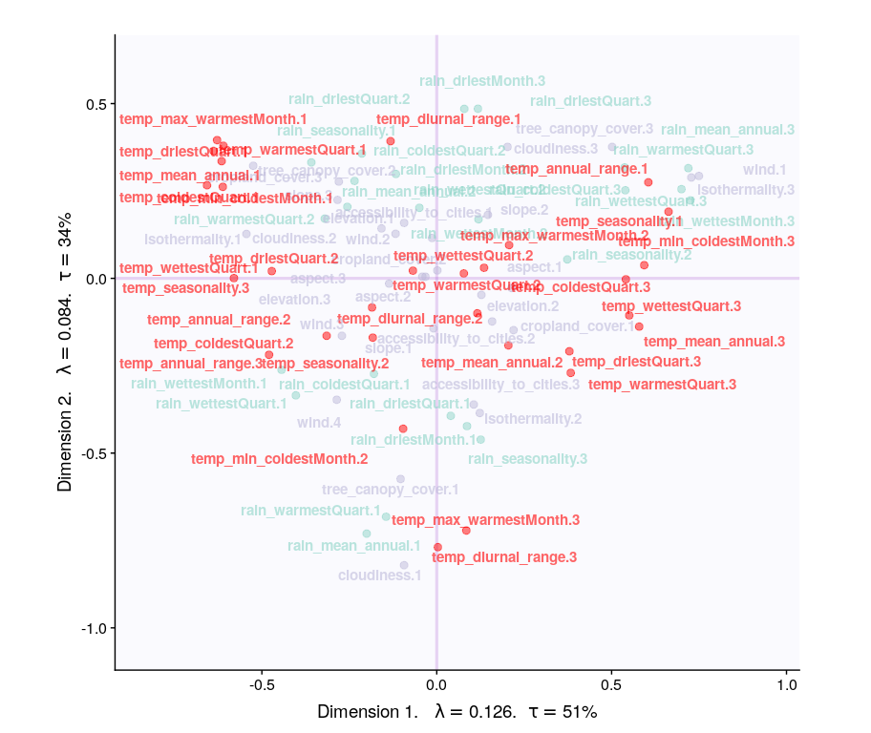
MCA
Methods | Unhappy | Normal | Very Happy | Reliability
PCA | Others | Temp & Rain | N/A | Components have significant contribution
MCA | High summers, warmer winters, high rain | N/A | Colder summers, warmer winters, moderate rain, windy | Components have significant contribution.

Slide 13
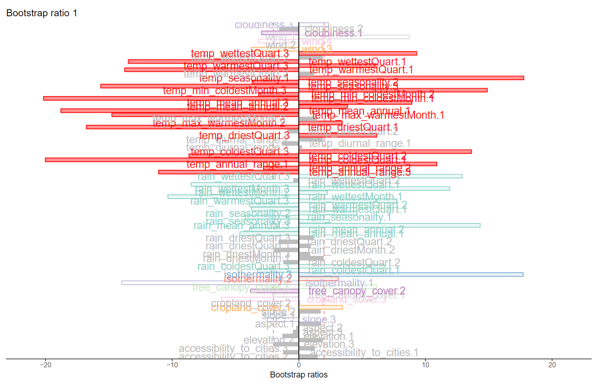
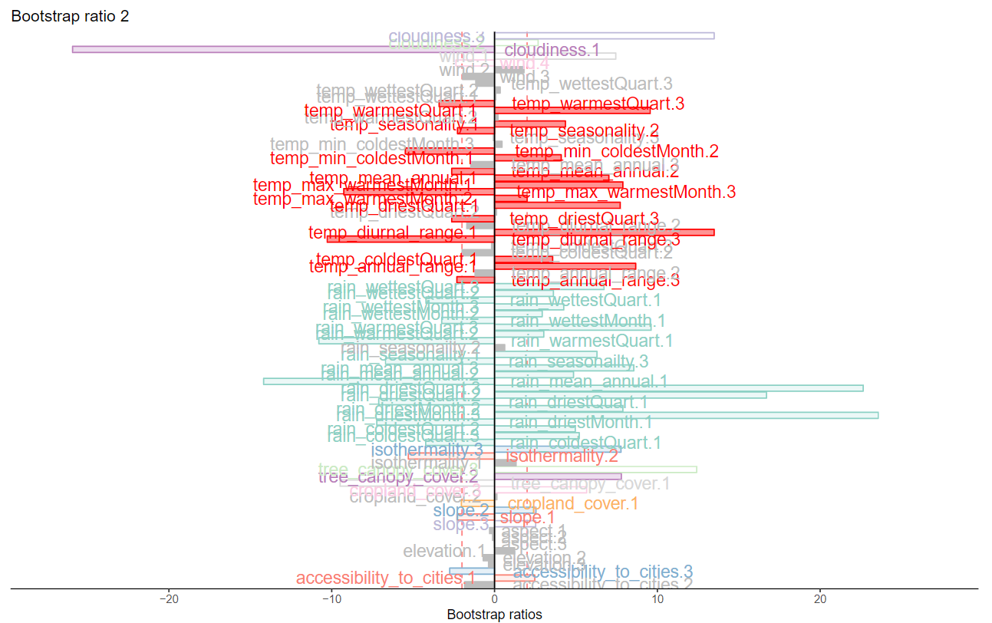
MCA - Inference

Slide 14
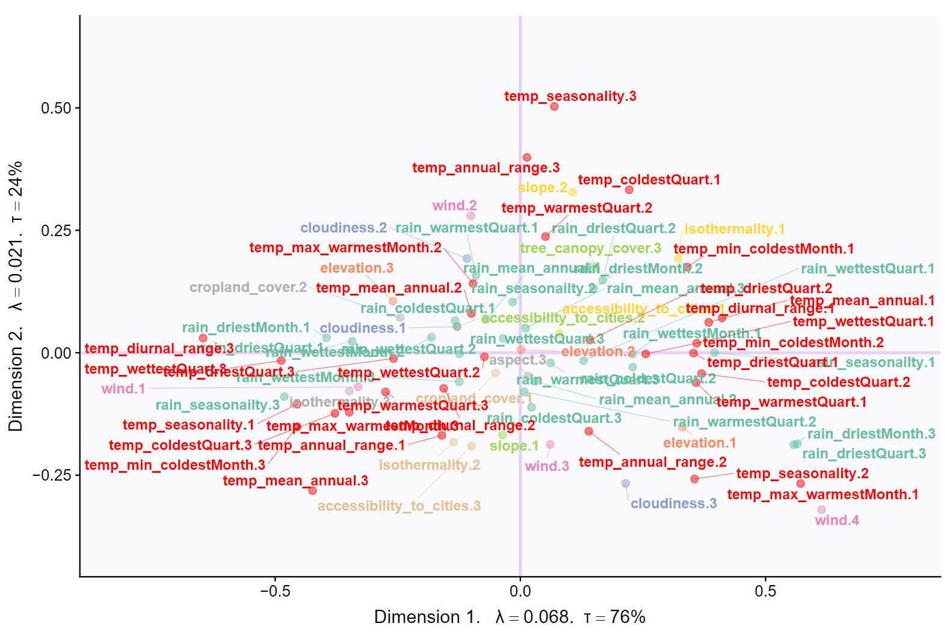
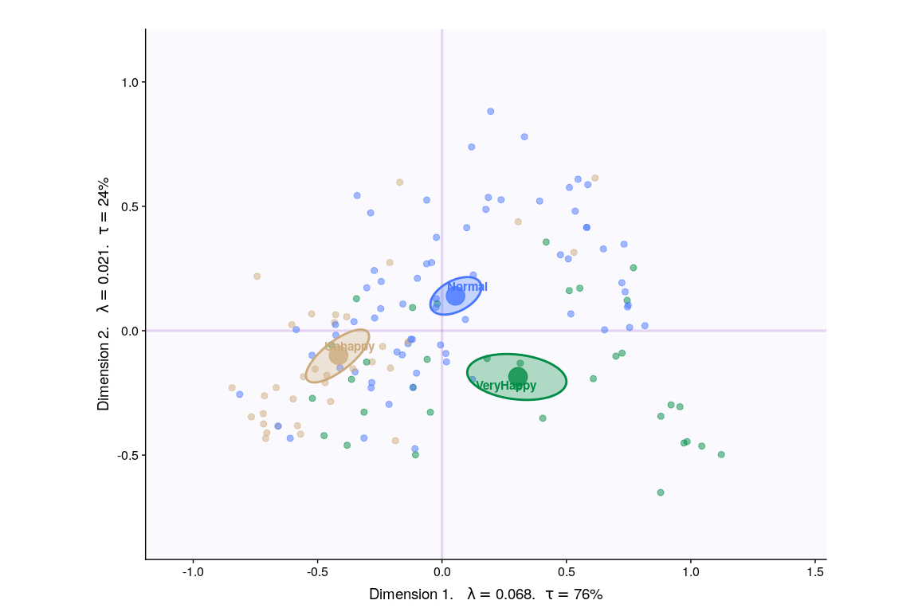
DiCA
Notes:
Temperature Seasonality. (Standard Deviation) • Definition: The amount oftemperature variation over. a given year (or averaged years) based on the standard. deviation (variation) of monthly temperature averages

Slide 15
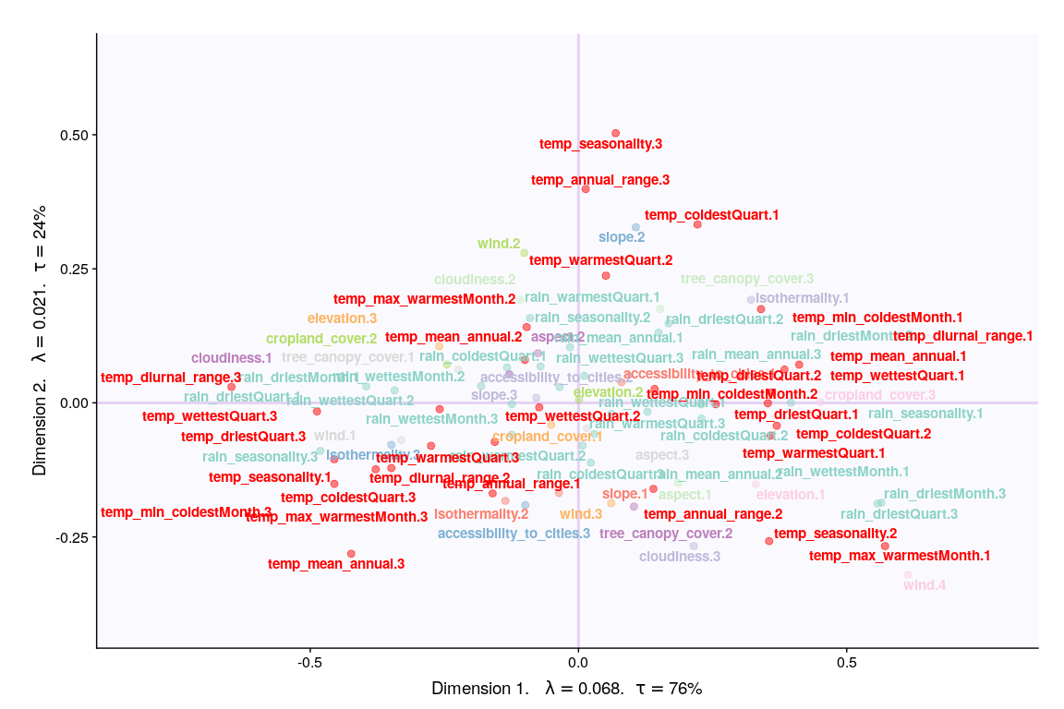
DiCA
Methods | Unhappy | Normal | Very Happy | Reliability
PCA | Others | Temp & Rain | N/A | Components have significant contribution
MCA | warm summers, cold winters, high rain | N/A | Warm winter, cold summer, low rain | Components have significant contribution
DiCA | warm summers, cold winters, high rain | Higher variation in temperature is correlated with lower happiness | Warm winter, cold summer, low rain, windy | Convex hulls are separated but second component only has temp variables as significant

Slide 16
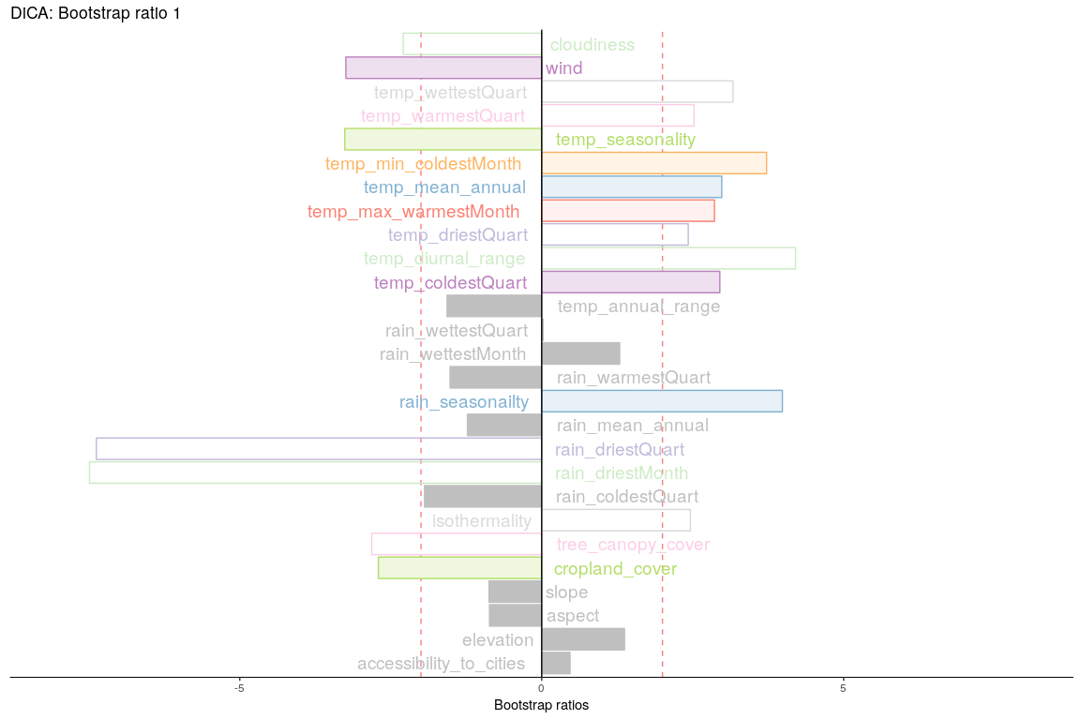
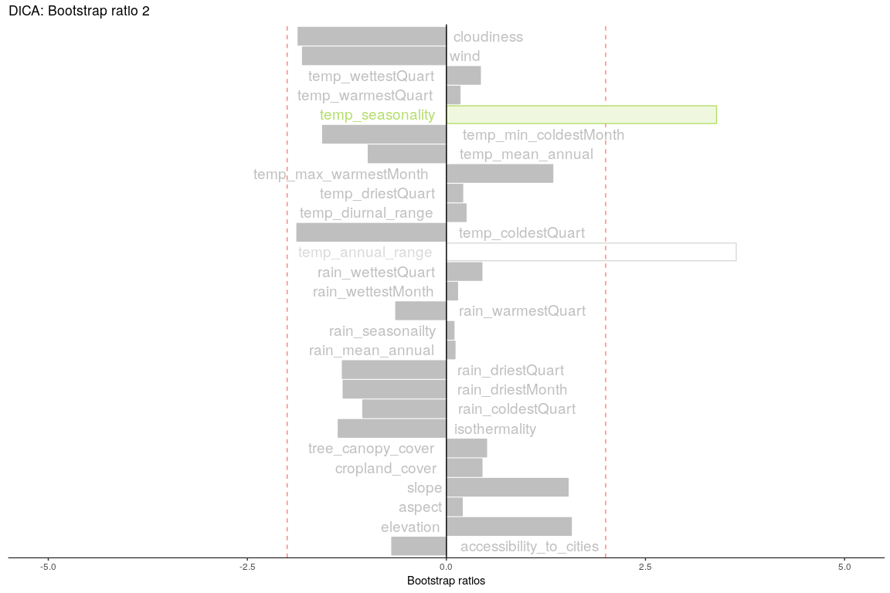
DiCA - Inference

Slide 17
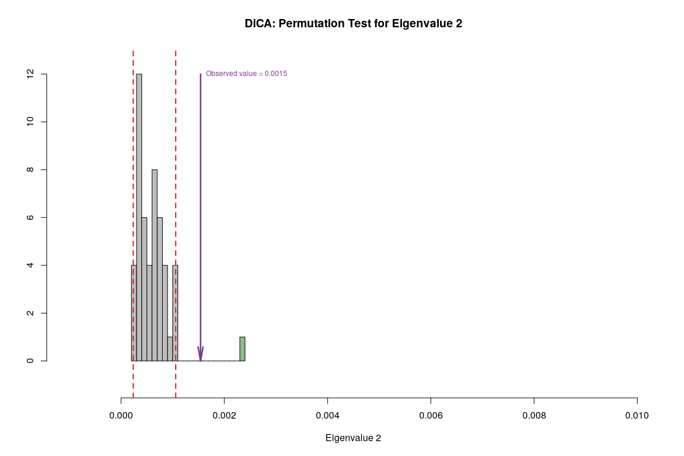
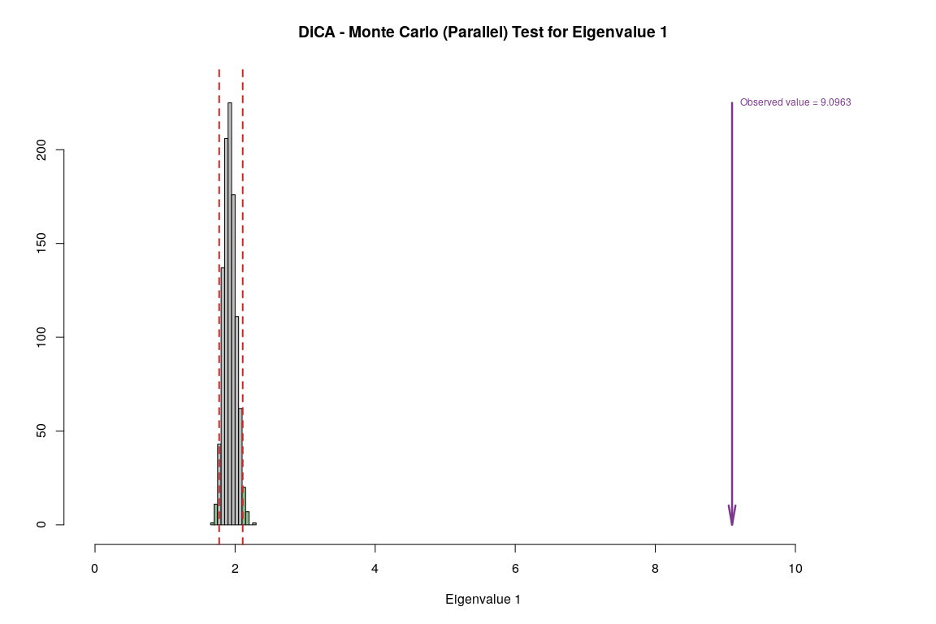
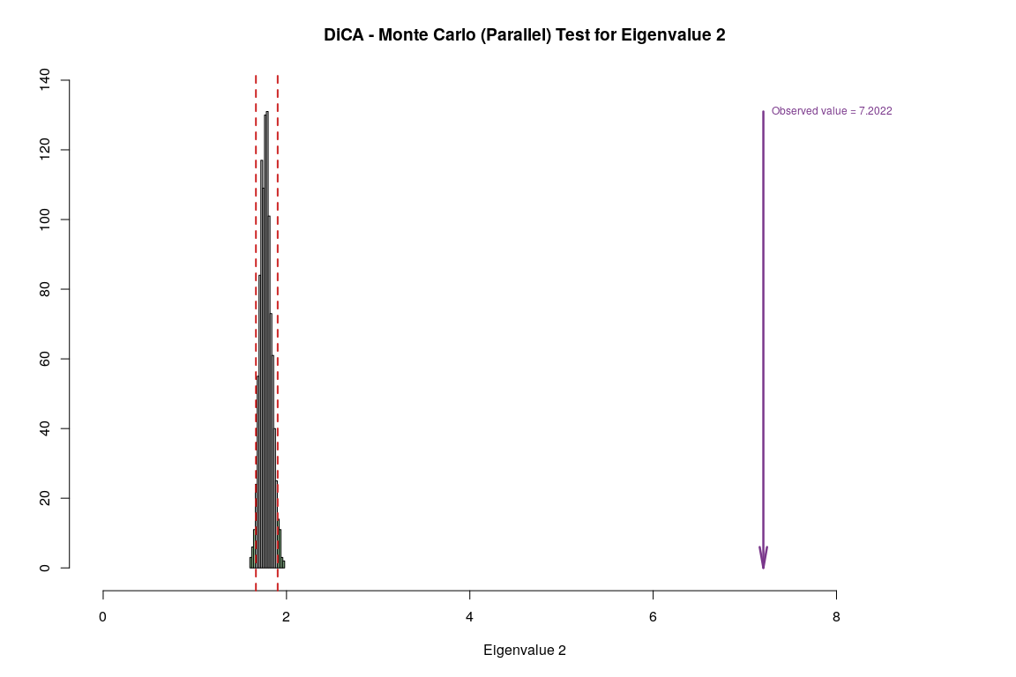
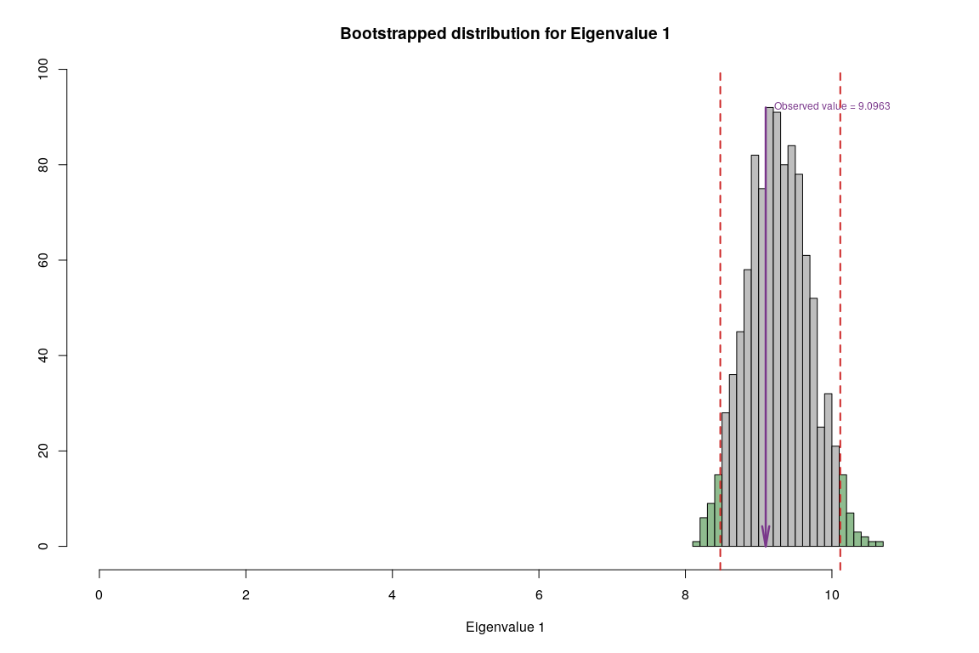
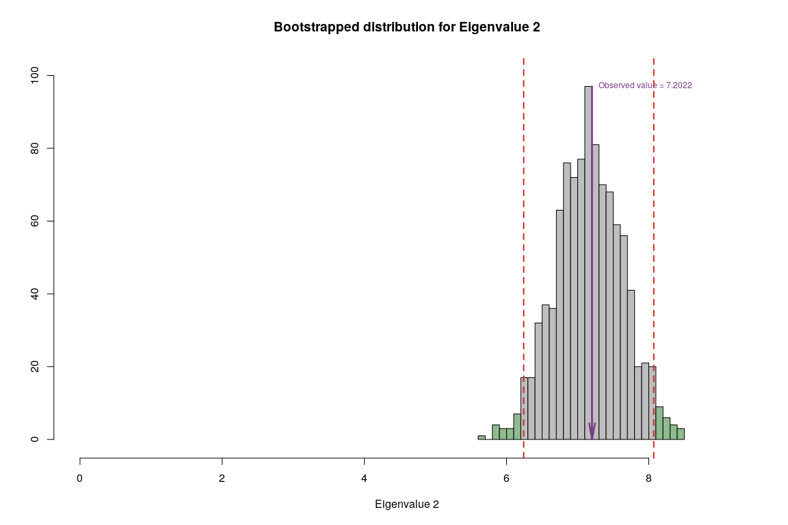
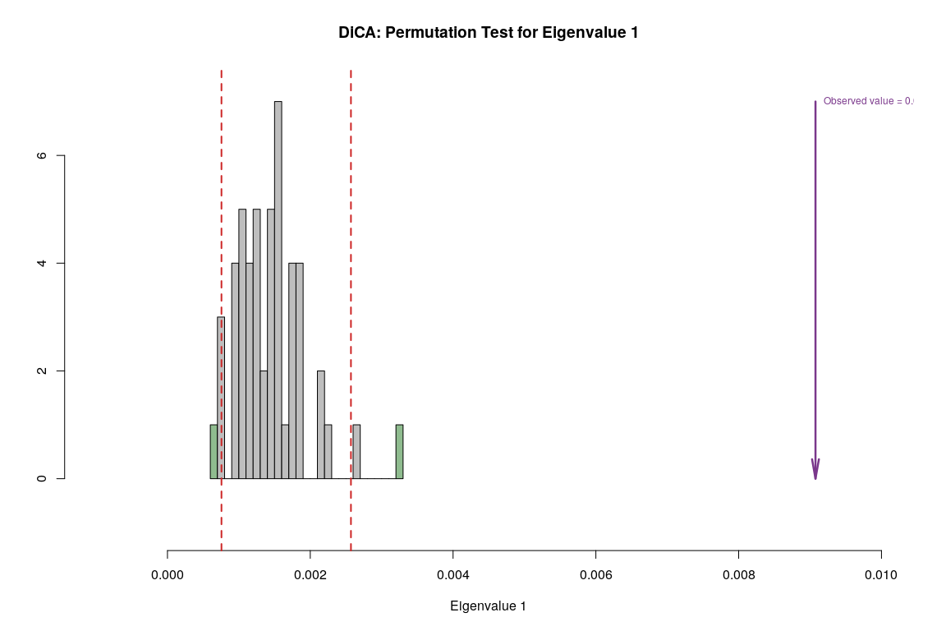
DiCA - Inference

Slide 18
Conclusion
MCA and DiCA agrees:
Warmer winter, colder summer, low rain, windy cities makes people happy
Colder Winter, warmer summers, high rain, less windy makes people unhappy
However,
Even though MCA shows that most the variables has high contribution for the strongest signal in the data - DiCA shows that temp, rain and wind variables contributes significantly.
Hence,
Happiness doesn’t seem to be highly dependent on environmental conditions
Temp, rain and wind seem to be slightly correlated with happiness.

Slide 19
Grouping variables to observe relative effect among variables

Slide 20
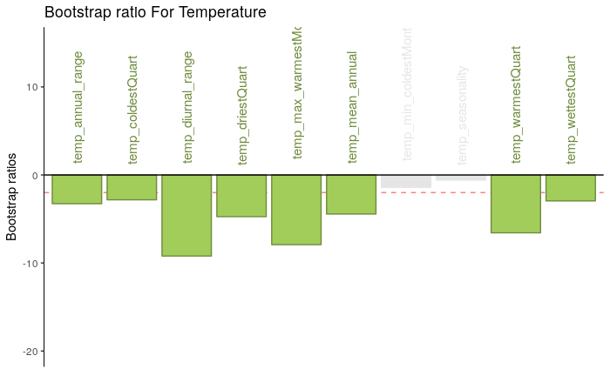
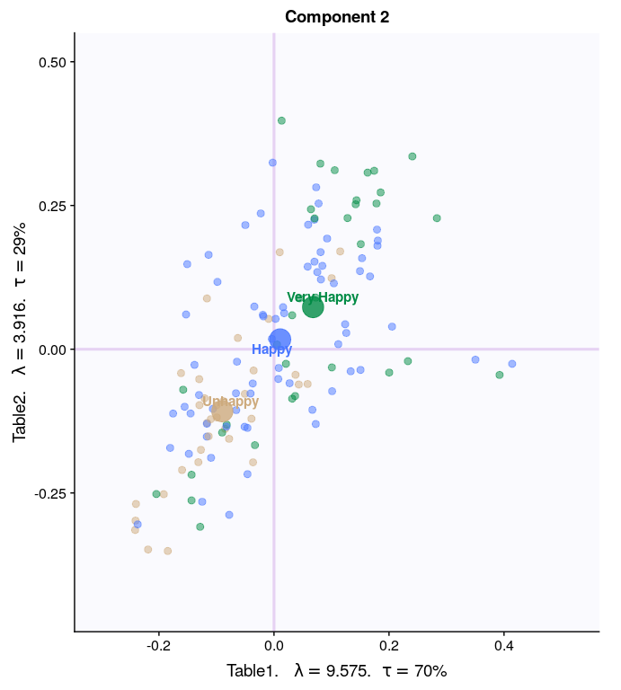
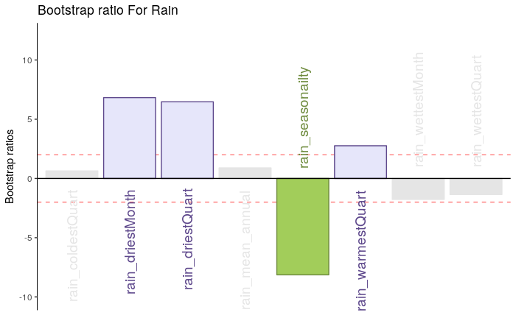
PLS-C
Component 2
Rain
Temperature

Slide 21
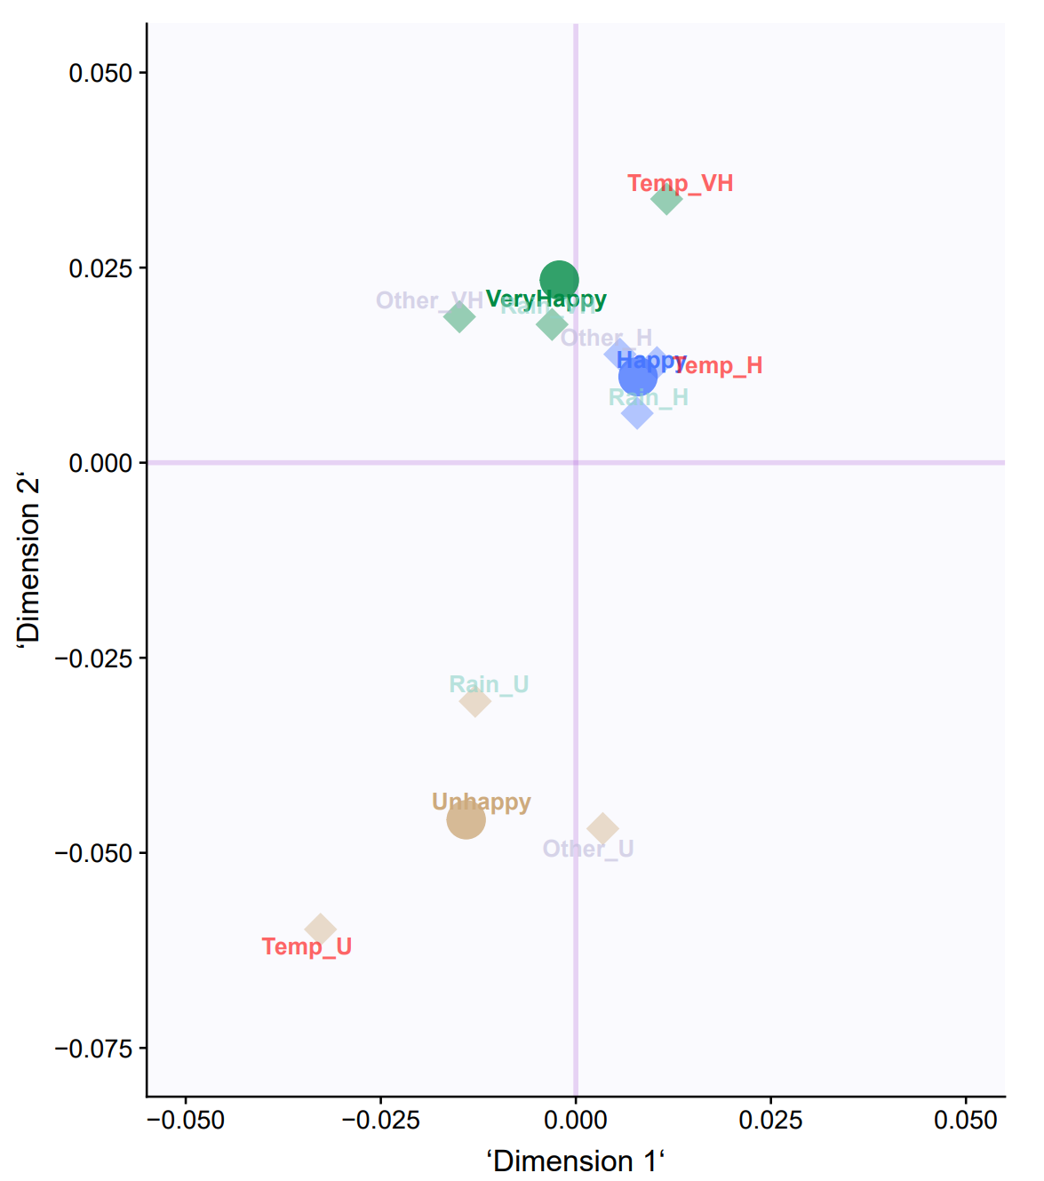
MFA

Slide 22
Cluster Analysis
DiSTATIS

Slide 23
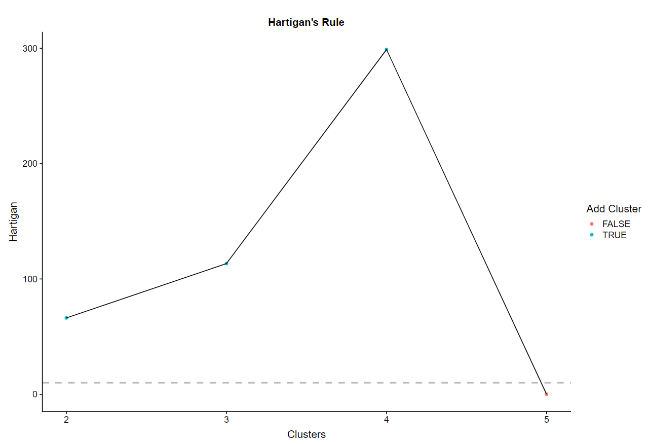
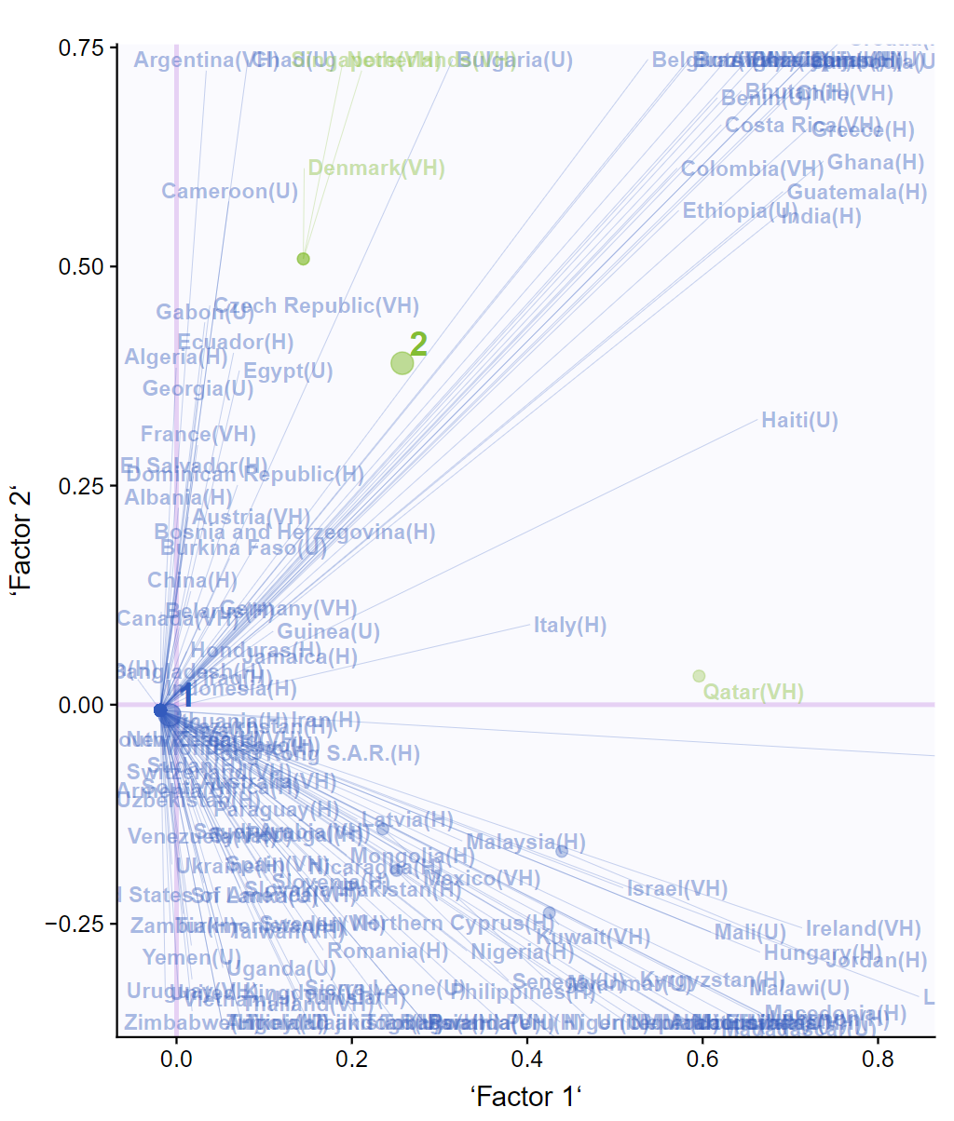
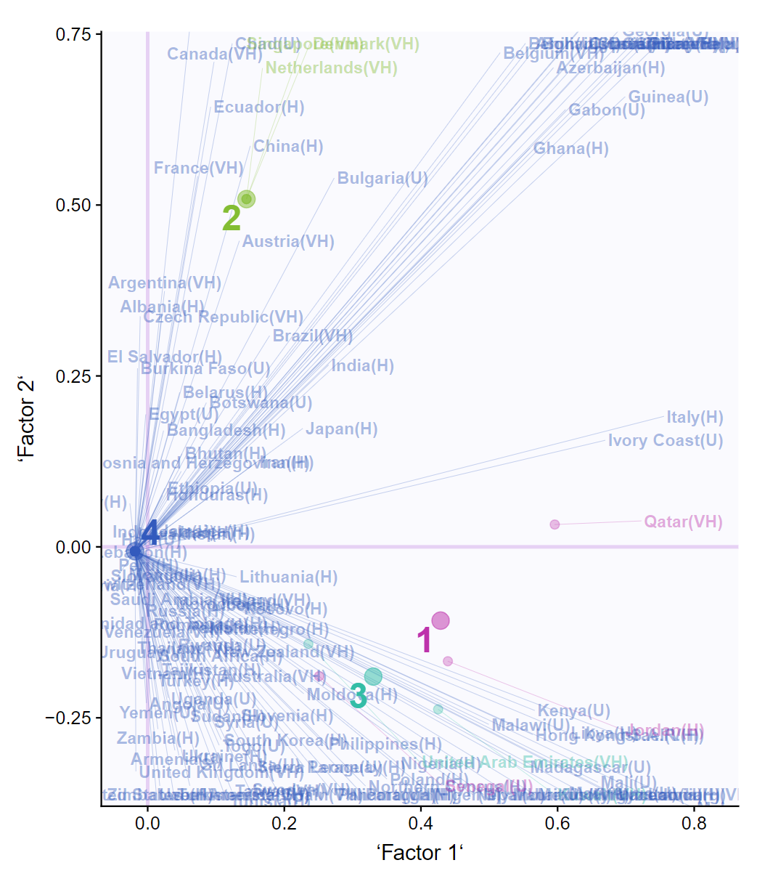
K-Means

Slide 24
Conclusion
Happiness doesn’t seem to be highly correlated to environmental conditions
Temperature, rain and wind seem to be slightly correlated with happiness.
Cluster Analysis doesn’t seem to show any patterns in the data.

Slide 25
Questions or comments?
Multi-variate Analysis - Environmental Readings per Country

