Slide 1

Logo clear

Slide 2

Logo white

Slide 3
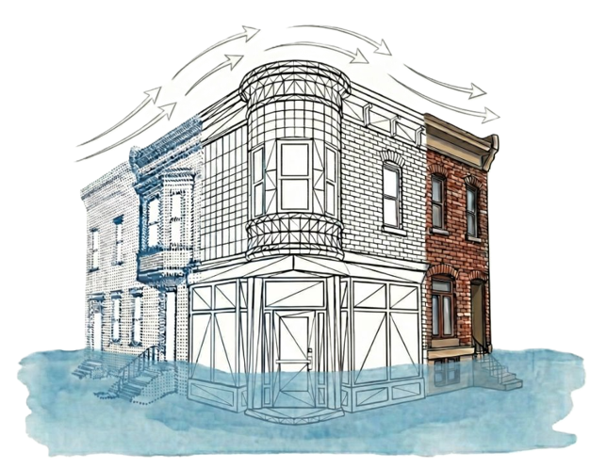

Becca signature –I just updated the text and screen grabbed it for my signature FYI you can do whatever you wish
 | Dr. Rebecca Napolitano | nap@psu.edu | Assistant Professor ​ Leader of the Heritage 3D Lab | Penn State Architectural Engineering ​ Co-lead | APTI Disaster Response Initiative (DRI)

Slide 4


Students sig
STUDENT NAME | student email@psu.edu | PhD Student
Heritage 3D Lab | Penn State Architectural Engineering
Lab website: https://rkn2.github.io/heritage3d-lab/
FYI to get this in your signature in line you will want to use an invisible table.
You can prob copy from my email or just ask me to send it to you

