Slide 1

Computer Modeling of Transient Stability Analysis
for a Multi-machine system
Presented by,
Rakesh Nair
Srinivasa Varma

Slide 2
Overview
Introduction
Power System Stability Analysis
Swing Equation
Power-angle equation
Equal Area Criterion
Stability Analysis of a Multi-machine System
Numerical Integration Method
Runge Kutta
Case Study on IEEE-39 Bus System
Computer Modeling of the System
Results and Simulation
Future Scope
Conclusion
References

Slide 3
Introduction
Power system subjected to wide range of disturbances
Small disturbances
Large disturbances
Faults can result to
Loss of synchronism or unstable operating condition-out of step
Fault clearance time is the most important criteria to determine system stability
Power Swing: Oscillation in active and reactive power flow on a transmission line caused by a large disturbance like a fault.
Effect of power swing may lead to nuisance tripping
The study of power swing for a large bus system requires enormous simulation
Power system is a highly non linear system involving non linear dynamics of a large equation

Slide 4
Power System Stability Analysis
Power system stability categorized into:
Steady State Stability
Transient Stability
Dynamic Stability
Assumptions made for stability analysis
DC offset currents and harmonics are neglected
Symmetrical components
Constant generated voltage

Slide 5
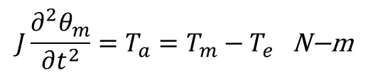
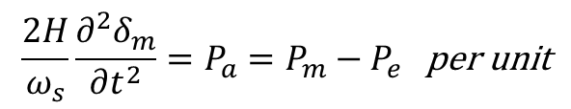


Power System Stability Analysis
Swing-Equation
Describes the behaviour of rotor dynamics during disturbances in the system
The differential equation governing the rotor dynamics of a synchronous machine is given by
So it is more convenient to measure rotor angle with respect to synchronously rotating frame of reference so
This equation is used to determine the stability of a machine with a power system.
Solving this equation we obtain δ as function of time called swing curves.
$$J\frac{∂^{2}θ_{m}}{∂t^{2}}=T_{a}=T_{m}−T_{e}\text{​​​ }\text{N}\text{−}\text{m}$$
$$θ_{m}=ω_{s}t+δ_{m}$$
$$\frac{d^{2}θ_{m}}{dt^{2}}=\frac{d^{2}δ_{m}}{dt^{2}}$$
$$\frac{2H}{ω_{s}}\frac{∂^{2}δ_{m}}{∂t^{2}}=P_{a}=P_{m}−P_{e}\text{​​​ }\text{per} \text{unit}$$

Slide 6



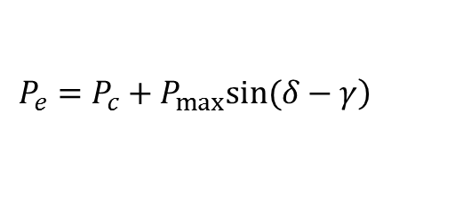


Power System Stability Analysis
Power-Angle Equation
In swing equation we consider mechanical power to be constant.
During a fault there will be a change in electrical power , which determines the stability of system.
Change in Pe is obtained by performing power flow equations to electrical network and the machine model chosen.
We can represent
For a lossless line
where,
$$\left.P_{1}={|E_{1}^{′}|}^{2}G_{11}+|E_{1}^{′}||E_{2}^{′}||Y_{12}|cos(δ_{1}−δ_{2}−θ_{12}\right)$$
$$δ=δ_{1}−δ_{2}$$
$$γ=θ_{12}−\frac{π}{2}$$
$$\left.P_{e}=P_{c}+P_{max}sin(δ−γ\right)$$
$$P_{e}=P_{max}sinδ$$
$$P_{max}=\frac{|E_{1}^{′}||E_{2}^{′}|}{X}$$

Slide 7
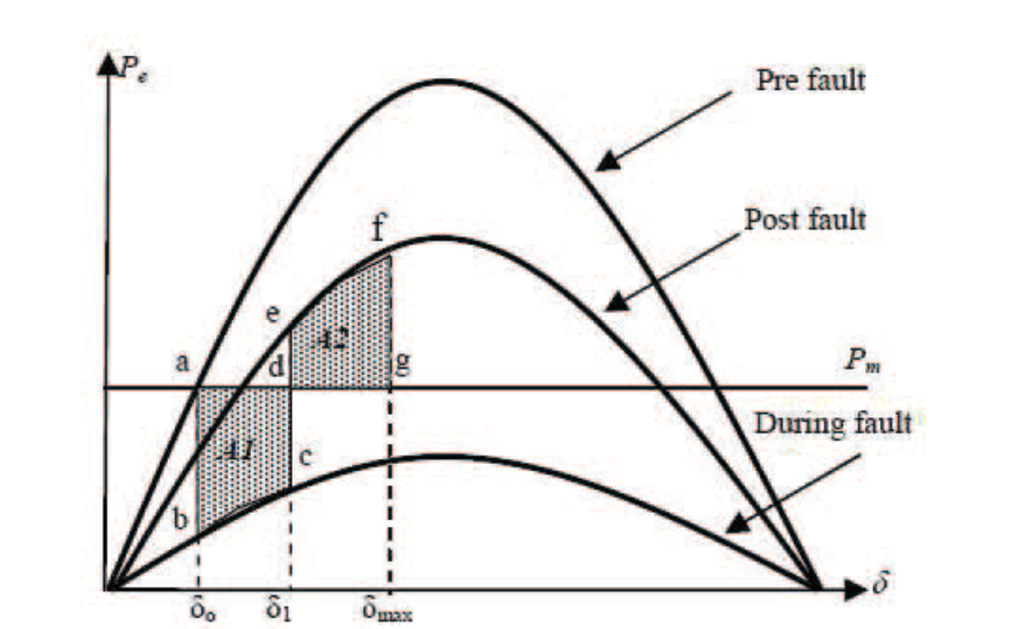
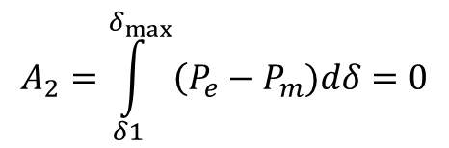
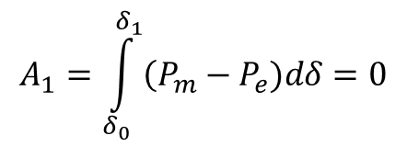
Power System Stability Analysis
Equal Area Criterion
$$A_{1}=\int_{δ_{0}}^{δ_{1}}{\left(P_{m}−P_{e})dδ\right.}=0$$
$$A_{2}=\int_{δ1}^{δ_{max}}{\left(P_{e}−P_{m})dδ\right.}=0$$

Slide 8
Stability Analysis of a Multi-Machine System
A multi-machine can be represented as a single machine system connected to an infinite bus.
classical model
Mechanical Power is constant
Damping is ignored.
Machine is represented by its internal voltage in series with transient reactance.
Rotor angle coincides with δ
All loads converted to equivalent admittances.

Slide 9
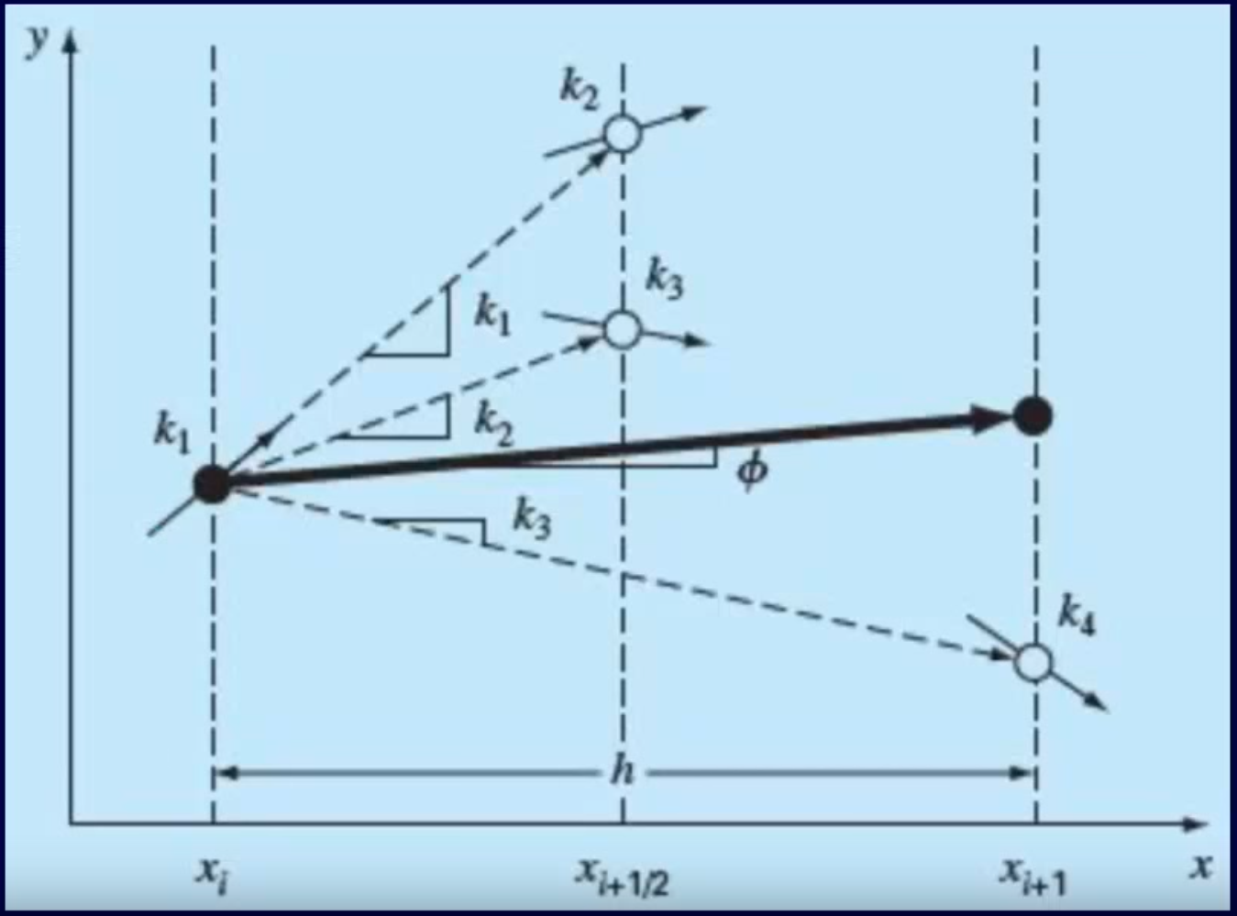
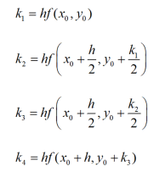
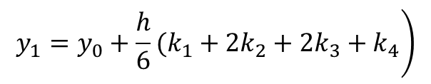
Numerical Integration Methods [5]
4th order Runge-Kutta method
$$\left.y_{1}=y_{0}+\frac{h}{6}(k_{1}+2k_{2}+2k_{3}+k_{4}\right)$$

Slide 10
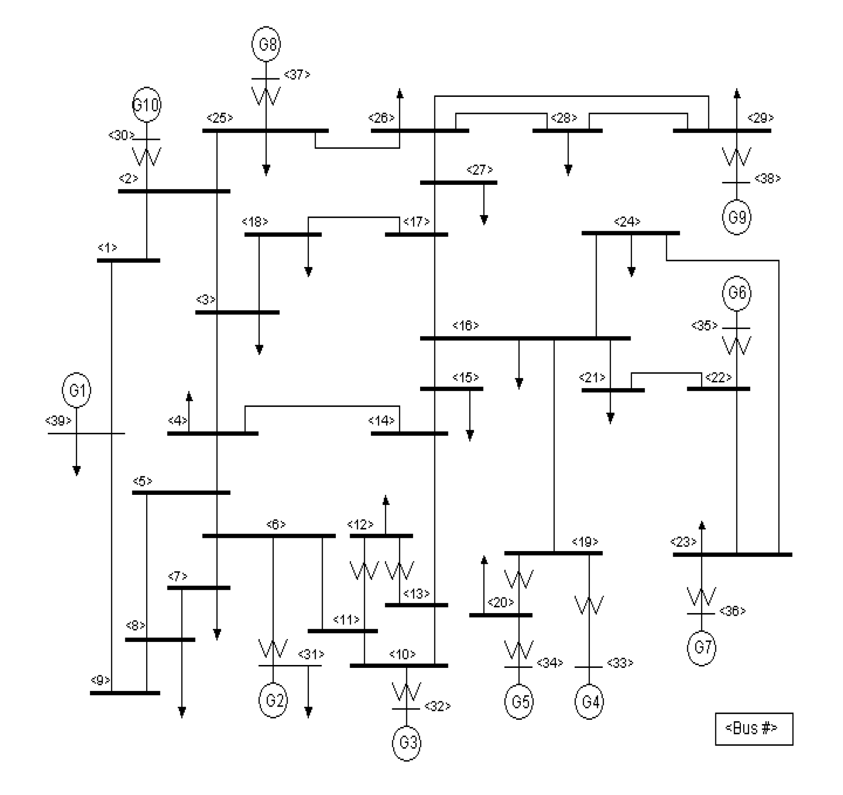
Case Study on IEEE 39 bus system [6]

Slide 11
Computer Modeling Of The System
MATLAB® program flow chart for transient stability analysis

Slide 12
Computer Modeling Of The System
MATLAB® program flow chart for determining the critical clearing time for faults.

Slide 13
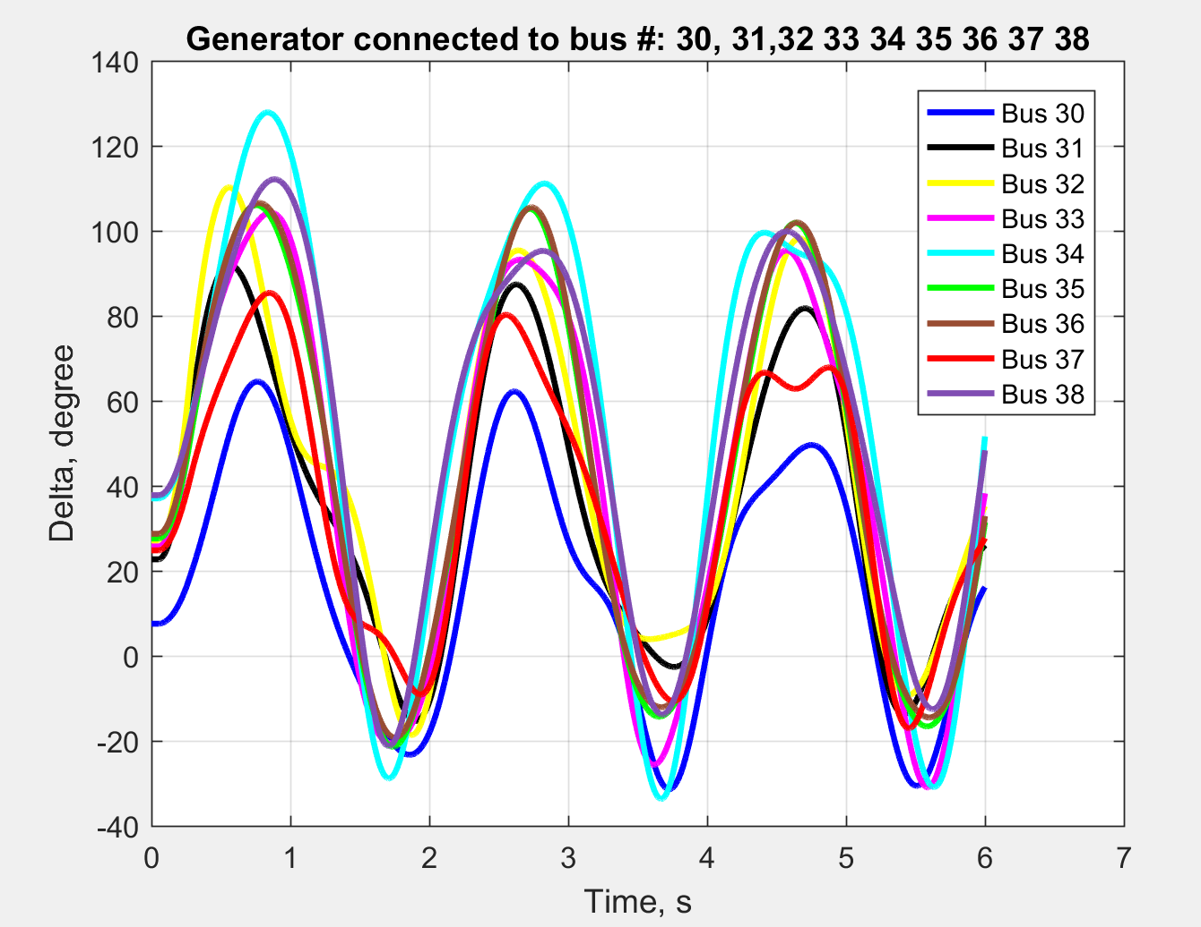
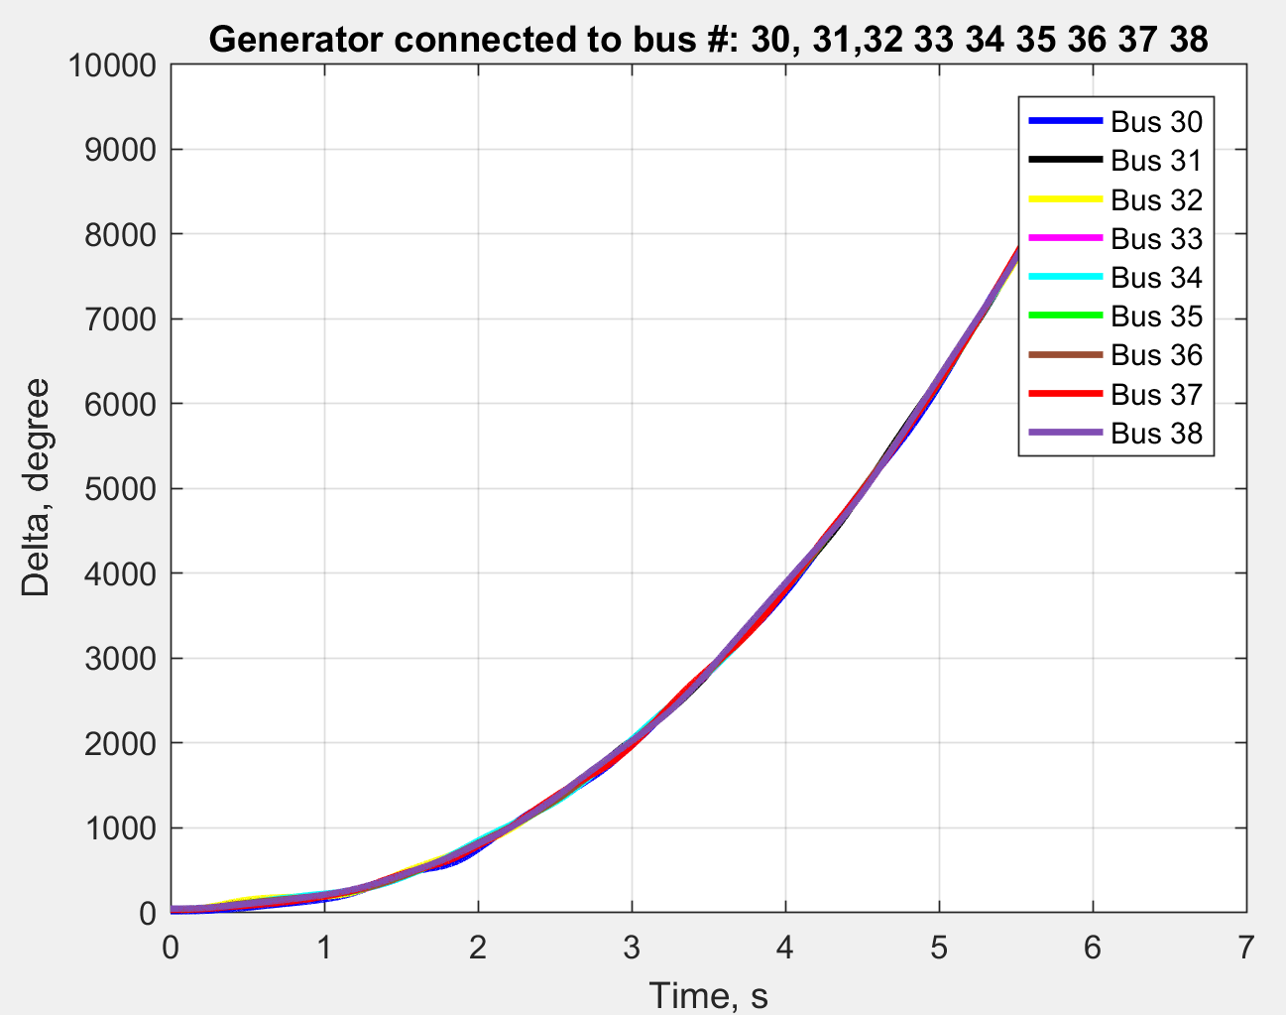
Results and Simulations
Case-1: Fault on bus#14 w/ stable swing curve(undamped) for clearing time (tcl) =0.22s
Case-2: Fault on bus#14 causing OOS (undamped) tcl=0.3s

Slide 14
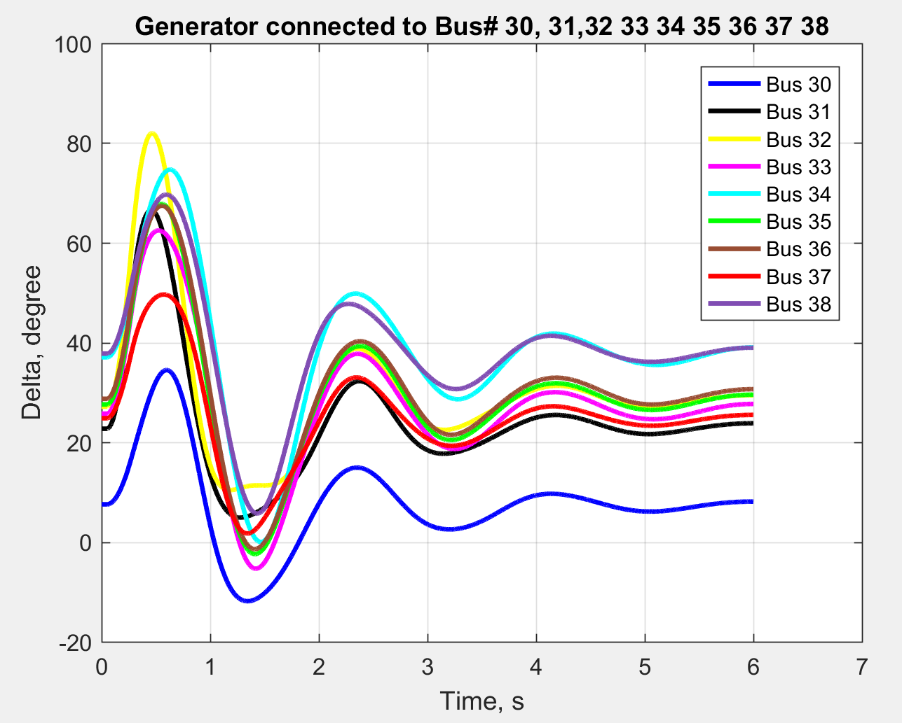
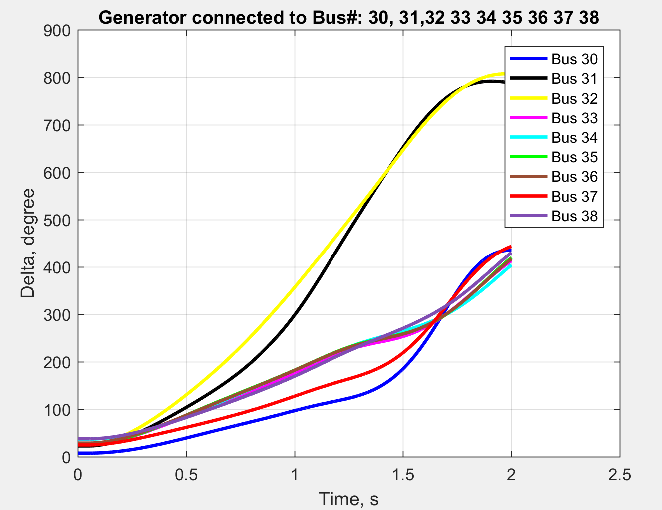
Results and Simulations
Case-3: Fault on bus#14 causing swing curve(damped) for tcl=0.22s
Case-4: Fault on bus#14 causing OOS (damped) tcl=0.8s

Slide 15
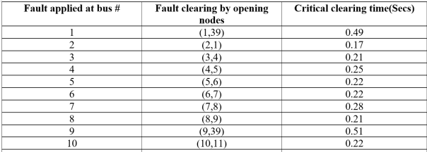
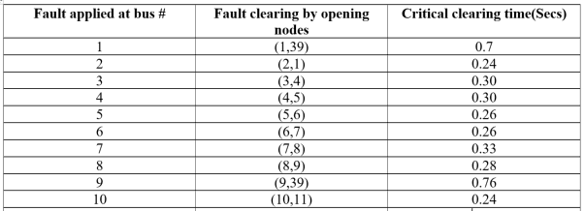
Results and Simulations
Case-5: Critical clearing time for fault on each node(w/o generator damping)
Case-6: Critical clearing time for fault on each node(w/ generator damping)

Slide 16
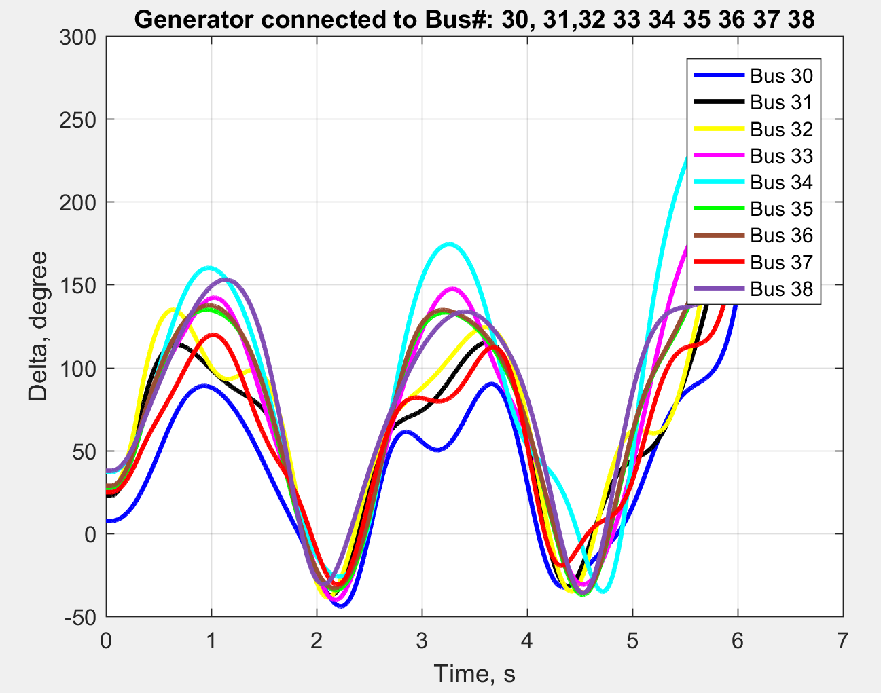
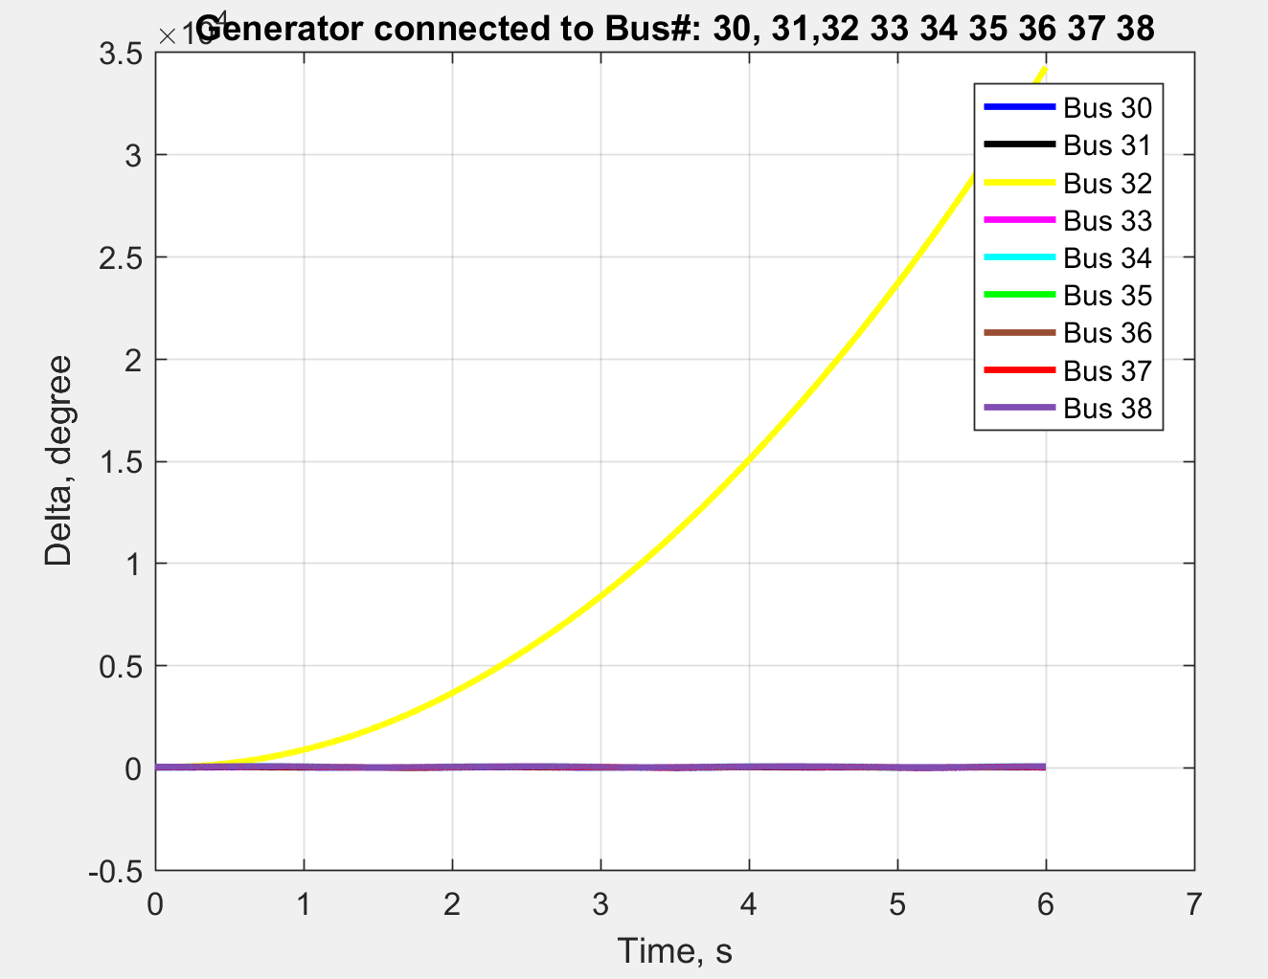
Results and Simulations
Case-7:OOS for clearing time (tcl) just after critical clearance (tcr) time for fault at bus#14
Case-8: Generator connected to a faulted bus going OOS

Slide 17
Future Scope
In our simulation, we obtained critical clearance time by noting δmax of swing curve. For various simulations we observed that the generator that first reaches beyond =150⁰ makes the system go unstable. However, this method doesn’t clear the fault exactly at 90⁰ which is the criteria for determining the critical clearance time.
We have not considered the dynamic response of an Automatic Voltage Regulator(AVR) and the turbine-governor characteristics in our simulations. So, this can be an improvement for future work.
We have considered the fault to be occurring on the tie line near the bus. In real world, fault may occur on any segment of the tie line. Hence the simulation should consider the fault location on the tie line.

Slide 18
Conclusion
Classical model of transient stability analysis was considered for developing a method to compute the swing curves for a three phase fault on various buses of the IEEE 39 bus system.
We also developed a method to calculate the critical clearance time based on the maximum delta angle in the swing curve which was determined by analyzing the swing curves for fault on various buses.
For simulating the swing curves, we used RK-4 numerical integration method.
We have compared the cases of damped and undamped generators in computing the critical clearance time for fault on each of the buses.

Slide 19
References
[1] “NPTEL.” [Online]. Available: http://nptel.ac.in/courses/Webcourse-contents/IIT-KANPUR/power- system/chapter_9/9_1.html.
[2] J. J. Grainger, Power System Analysis. .
[3] A. Sauhats, A. Utans, D. Antonovs, and E. Biela-dalidovicha, “Out-of-Step Protection Using Equal Area Criterion in Time Domain,” 2016.
[4] S. Paudyal, G. Ramakrishna, and M. S. Sachdev, “Out-of-step protection using the equal area criterion in time domain - SMIB and 3-machine case studies,” IEEE Reg. 10 Annu. Int. Conf. Proceedings/TENCON, no. i, 2008.
[5] H. Q. M. and H. D. L. Huynh Chau Duy, “Transient Stability Analysis,” vol. 15, pp. 256–260, 2002.
[6] M. L. Crow, Computational Methods for Electric Power Systems, Third. .
[7] T. Expansions, “Euler ’ s Method , Taylor Series Method , Runge Kutta Methods , Multi-Step Methods and Stability .,” no. 0, pp. 1–6.
[8] G. Outline, “IEEE 10 Generator 39 Bus System,” Network.

