Slide 1


PresIt
keep all your presentations with you
Richard Knoll
Florian Nairz
github.com/rknoll/presit

Slide 2
Architecture Overview
github.com/rknoll/presit

Slide 3

WCF Server
[OperationContract]
void AuthenticateId(string clientId, string sessionId);
[OperationContract]
Presentation CreatePresentation(string clientId, string name);
[OperationContract]
bool UpdateSlide(string clientId, string presentationId, Slide slide);
[OperationContract]
void NextSlide(string clientId);
github.com/rknoll/presit

Slide 4

Presentation Client
Login via QR Code on any PC
Create / Edit Presentations by importing
Images ( bmp, png, … )
PowerPoint Presentation
Present It !
github.com/rknoll/presit

Slide 5

Private Client
Holds Private ID
Authenticates Presentation Client via QR
Control Presentation ( Next, Prev )
Custom Control Devices
e.g. via Bluetooth
github.com/rknoll/presit

Slide 6
Control Device
Internet
STM32F4Discovery
Bluetooth
Gesture
Transport Bluetooth
Gesture Recognition (Android)
UART
SPI
MEMS-Sensor
github.com/rknoll/presit

Slide 7
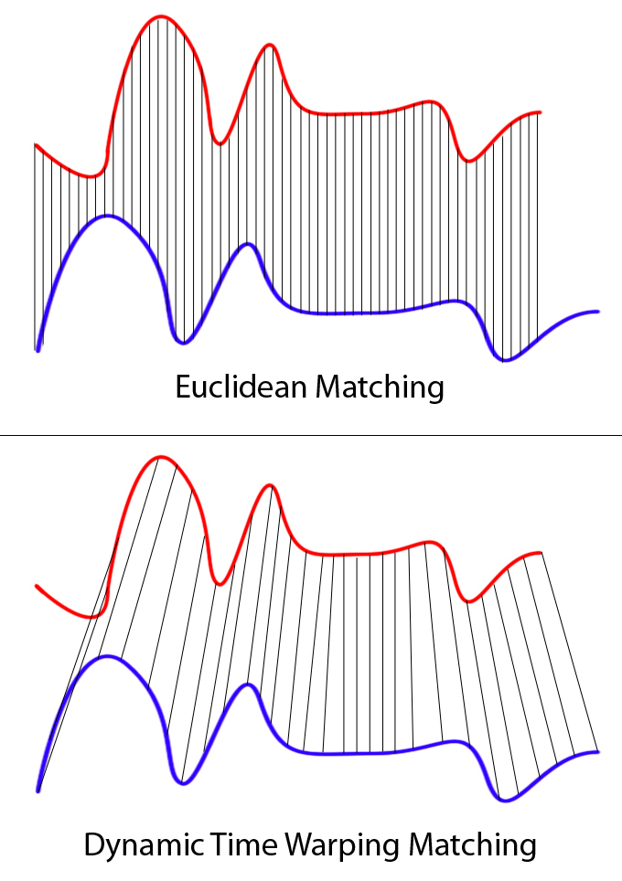
Gesture Recognition
Algorithm: Dynamic Time Warping
Problems:
Signals are time shifted and data points are measured continuously
Signals have different amplitudes
Goal:
Find matching pattern within a continuous data stream
Define a cost threshold
github.com/rknoll/presit

Slide 8
PresIt
keep all your presentations with you
github.com/rknoll/presit

