Slide 1
PROFIT ANALYSIS FOR RESTAURANT
Presented By:-
Ram Krishna Srivastava

Slide 2
PROBLEM
At what location in a city one can open a restaurant, so that he can make maximum profit according to his budget?

Slide 3
SOLUTION
So I prepared a dataset of restaurants at various locations in Delhi NCR with the cost for two persons for having one meal, and several other parameters.
This dataset is used to predict profit at which place, what kind of restaurants must be started to get the maximum of profit.

Slide 4
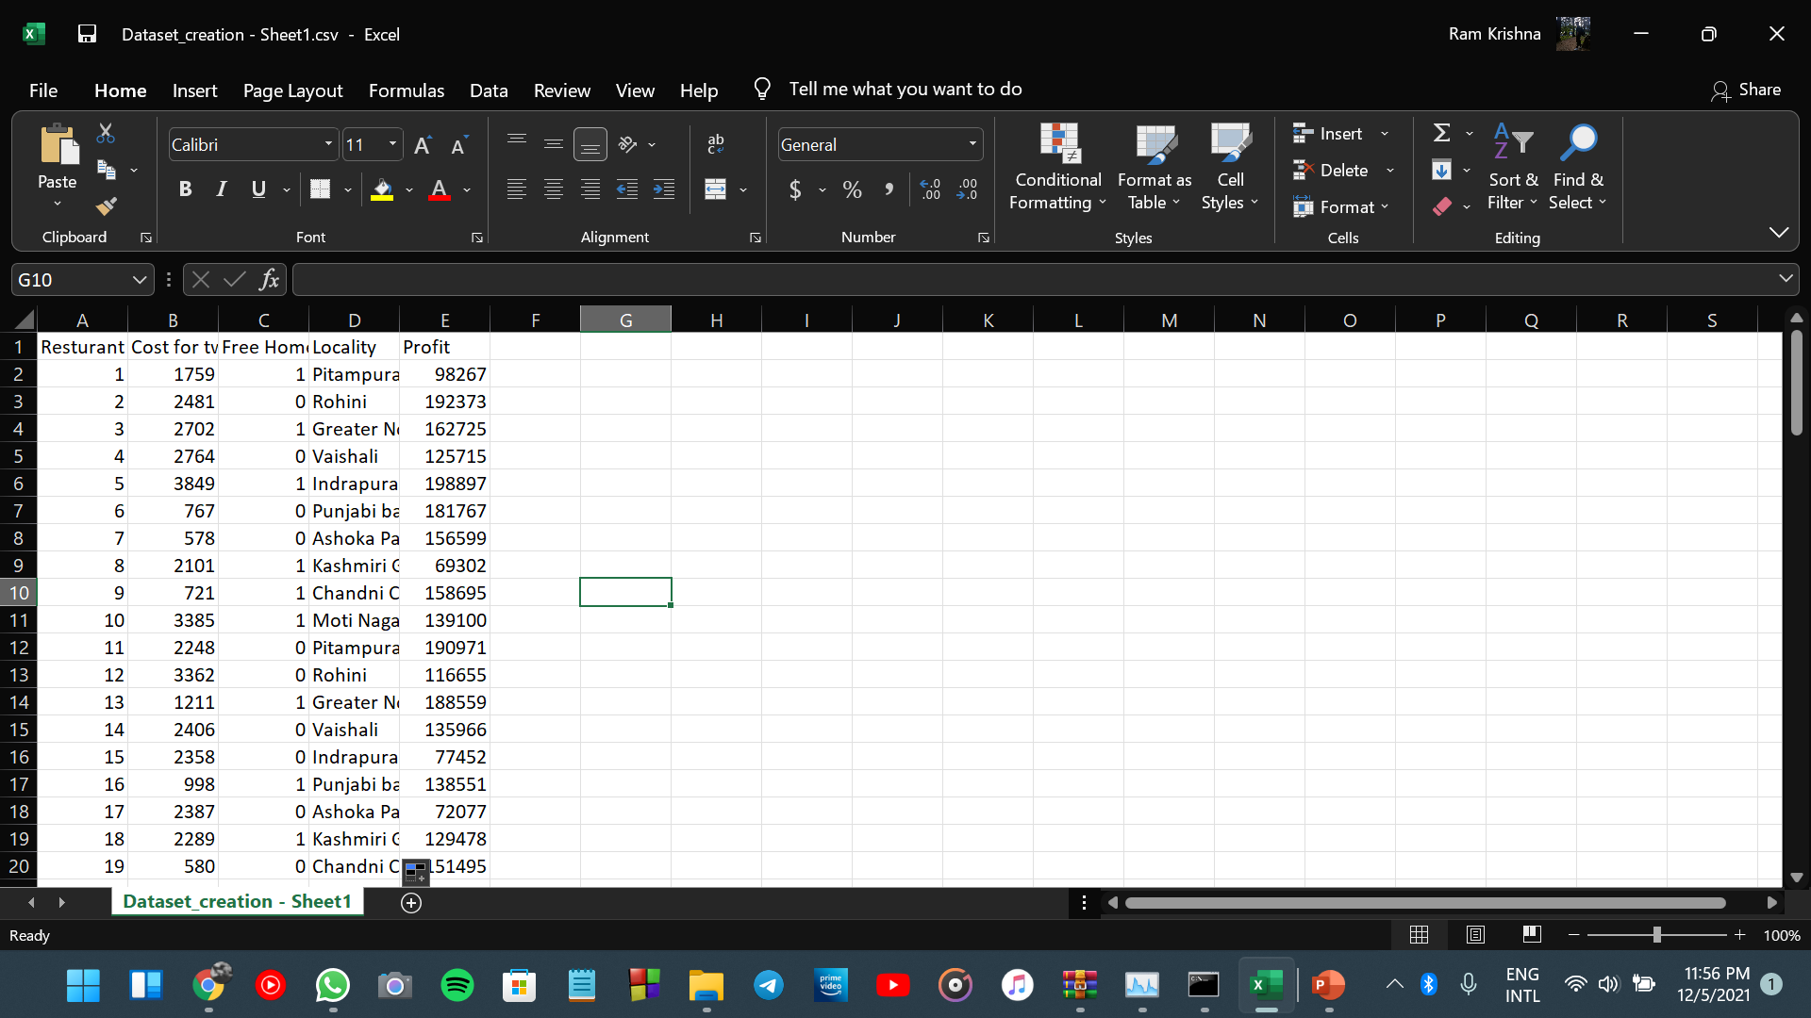
MY DATASET

Slide 5
TECHNOLOGIES USED
Machine Learning (Multi Linear Regression)

Slide 6
INPUT
ML
(Multi-Linear Regression)
PREDICTION OF DATA
ANALYSIS OF DATA
OUTPUT

Slide 7
FUTURE ASPECTS
My future aspect is to make my model feasible for other cities too.

