Slide 1

Machine Learning TERM PROJECT
Faculty : Dr. Sowmya V
ABHISHEK LAXMAN JOSHI
CB.EN.P2DSC21033

Slide 2
Predicting Success of Bank Telemarketing Calls using Machine Learning Algorithsm
https://archive.ics.uci.edu/ml/datasets/Bank+Marketing#

Slide 3
INTRODUCTION
In today’s world, data is the king. Use it in an effective way and it can create a huge impact on your business, don’t leverage it and you will be left behind in this fast paced world in no time. And one of the ways that a organisation can improve it’s performance in the market is to capture and analyse customer data in an efficient way to improve the customer experience.
One of the industries that is being transformed the most by the recent Machine learning advances is the finance industry. Be it predicting stock prices, or in our case predicting if a customer will subscribe to a term deposit Machine learning can be an incredibly useful tool for providing better profitability

Slide 4
DATASET
Dataset consists of direct marketing campaigns data of a banking institution. The dataset was picked from UCI Machine Learning Repository which is an amazing source for publicly available datasets. There were four variants of the datasets out of which we chose “ bank-additional-full.csv” which consists of 41188 data points with 20 independent variables out of which 10 are numeric features and 10 are categorical features

Slide 5
Features
age (numeric)
job : type of job (categorical: ‘admin.’,’blue-collar’,’entrepreneur’,’housemaid’,’management’,’retired’,’self-employed’,’services’,’student’,’technician’,’unemployed’,’unknown’)
marital : marital status (categorical: ‘divorced’,’married’,’single’,’unknown’; note: ‘divorced’ means divorced or widowed)
education (categorical: ‘basic.4y’,’basic.6y’,’basic.9y’,’high.school’,’illiterate’,’professional.course’,’university.degree’,’unknown’)
default: has credit in default? (categorical: ‘no’,’yes’,’unknown’)
housing: has housing loan? (categorical: ‘no’,’yes’,’unknown’)
loan: has personal loan? (categorical: ‘no’,’yes’,’unknown’)

Slide 6
Features
contact: contact communication type (categorical: ‘cellular’,’telephone’)
month: last contact month of year (categorical: ‘jan’, ‘feb’, ‘mar’, …, ‘nov’, ‘dec’)
day_of_week: last contact day of the week (categorical: ‘mon’,’tue’,’wed’,’thu’,’fri’)
duration: last contact duration, in seconds (numeric). Important note: this attribute highly affects the output target (e.g., if duration=0 then y=’no’). Yet, the duration is not known before a call is performed
campaign: number of contacts performed during this campaign and for this client (numeric, includes last contact)
pdays: number of days that passed by after the client was last contacted from a previous campaign (numeric; 999 means client was not previously contacted)

Slide 7
Features
previous: number of contacts performed before this campaign and for this client (numeric)
poutcome: outcome of the previous marketing campaign (categorical: ‘failure’,’nonexistent’,’success’)
emp.var.rate: employment variation rate — quarterly indicator (numeric)
cons.price.idx: consumer price index — monthly indicator (numeric)
cons.conf.idx: consumer confidence index — monthly indicator (numeric)
euribor3m: euribor 3 month rate — daily indicator (numeric)
nr.employed: number of employees — quarterly indicator (numeric)

Slide 8
Univariate Analysis
We take one feature at a time and check how well it can distinguish between the two classes. For example, one of the features in our dataset is “Job” of the customer. We will see the distribution to find out if there is any specific category for this feature which subscribes to a term deposit more than other categories.
We will look into the Count Plots of each feature to find out the class distribution for each feature
We will look into the box plot and the distribution for all the numerical features.

Slide 9
Correlation Matrix of the numerical features:
Correlation is a statistical measure that indicates the extent to which two or more variables fluctuate together. A positive correlation indicates the extent to which those variables increase or decrease in parallel; a negative correlation indicates the extent to which one variable increases as the other decreases. This can be a very useful tool to quickly check which features are more correlated and which pair of features are not.

Slide 10
DATA PRE-PROCESSING
As our dataset has 10 categorical features we will need to encode these features into a numerical representation to apply the machine learning models
We do it using lambda function
Dealing with Missing values
Dealing with Duplicate values
Splitting the Data
We split the data as 80% for training and 20% for testing

Slide 11
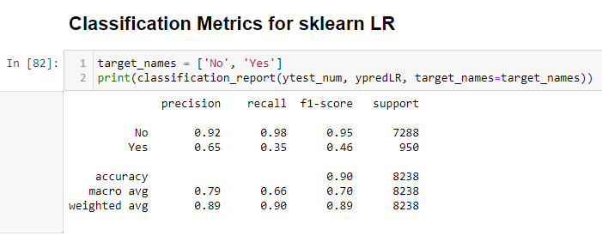
MODEL FITTING : Logistic Regression
Logistic regression is a supervised machine learning algorithm which is a process of modeling the probability of a discrete outcome given an input variable or a number of input variables.

Slide 12
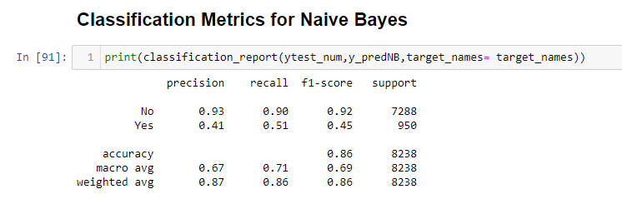
MODEL FITTING : Naïve Bayes
It is a classification algorithm based on Bayes Theorem which assumes that the features are independent.
Bayes theorem provides a way of calculating posterior probability P(c|x) from P(c), P(x) and P(x|c)

Slide 13
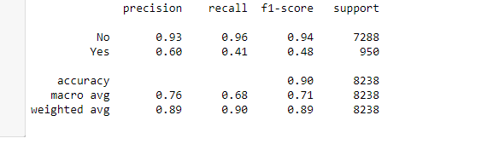
MODEL FITTING : KNN
KNN is one of the simplest supervised learning machine learning technique.
It first assumes similarity between the new data point and the currently available data points and puts the new data point into the class that is most similar to the available classes

Slide 14
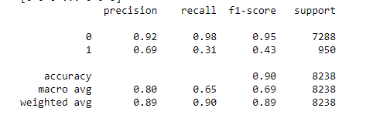
MODEL FITTING : SVM
SVM is also a supervised ML algorithm that can be used for both regression and classification problems. In SVM, we plot each of the data point in n-dimensional space with the value of each feature being the value of a particular coordinate (n is number of features) [8]. Then we classify by finding the hyper-plane that differentiates the two classes very well. Support vectors are the coordinates of individual observation

Slide 15
MODEL FITTING : SVM with Kernel
SVM is also a supervised ML algorithm that can be used for both regression and classification problems. In SVM, we plot each of the data point in n-dimensional space with the value of each feature being the value of a particular coordinate (n is number of features) [8]. Then we classify by finding the hyper-plane that differentiates the two classes very well. Support vectors are the coordinates of individual observation

Slide 16
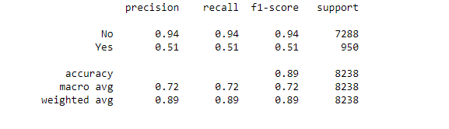
MODEL FITTING : Decision Tree
It is a tool used for both regression and classification problems. As per the name , it uses flowchart like a tree structure to show the predictions that result from a series of feature-based splits. It starts with a root node and ends with a decision made by leaves [9]. The amount of uncertainty is calculated using Entropy

Slide 17
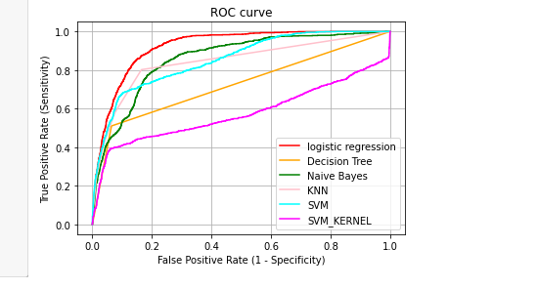
RESULTS

Slide 18
RESULTS
ALGORITHM | AUC Score | Avg_ CV_Score
Logistic Regression | 0.9224 | 0.9057
KNN | 0.8429 | 0.8993
Naïve Bayes | 0.8588 | 0.8534
SVM | 0.8567 | 0.9037
SVM with Kernel | 0.6478 | 0.9017
Decision Tree | 0.7231 | 0.8872

Slide 19
Conclusion
This study investigates the application of various ML algorithms for predicting the output or to know whether the customer is willing to subscribe to the term deposit or not. The models applied to predict this output are logistic regression, KNN, Naïve Bayes Classifier, SVM, Decision trees. The data applied is Portuguese retail bank data. On applying the mentioned models on the dataset, the task of classifying is done. Then the simulation experiment takes place under several measures like precision, recall, accuracy, f1-score, support, AUC. We get fair amount of scores for each of the model, the best being for logistic regression which shows the model can have used for real-time predictions.

Slide 20
THANK YOU

