Slide 1
Skullduggery
Encrypted Cell phone Communication
Team Members:
Greg Baker
Robert Koeninger
Advisor:
Dr. Wilsey

Slide 2

Problem Description
Most popular cell phone communication standard is GSM
GSM encryption is very weak
Calls can be decrypted with free software and cheap equipment
“I remember seeing somewhere that the encryption was based on three shift registers, which immediately says oh, goodness. And now I know exactly how bad it is, and we're going to talk about it today. Basically I'm glad I'm over on Verizon with - and not using GSM. It's completely cracked. It's completely broken.”
– Steve Gibson, “Security Now!”

Slide 3

Preliminary Solution
TLS/SSL is encryption standard used for online transactions
Still considered secure
Voice data to be encrypted using TLS and sent through GSM/CDMA channel

Slide 4
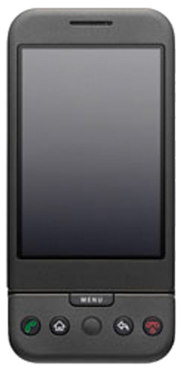
Approach
Google makes a phone that can run custom Android build
Costs $25 + $400 a piece

Slide 5
Sub goals
Config app for android
Transparent implementation, silent notification icons
Load software onto phone
Google makes dev phone

Slide 6
Questions?
Does you have them?

