Slide 1

Skullduggery
Encrypted Cell phone Communication
Team Members:
Greg Baker
Robert Koeninger
Advisor:
Dr. Philip Wilsey

Slide 2

Problem Description
Most popular cell phone communication standard is GSM
GSM encryption is very weak
Calls can be decrypted with free software and cheap equipment
“I remember seeing somewhere that the encryption was based on three shift registers, which immediately says oh, goodness. And now I know exactly how bad it is, and we're going to talk about it today. Basically I'm glad I'm over on Verizon with - and not using GSM. It's completely cracked. It's completely broken.”
– Steve Gibson, “Security Now!”

Slide 3

Preliminary Solution
TLS/SSL is encryption standard used for online transactions
Still considered secure
Voice data to be encrypted using TLS and sent through GSM/CDMA channel

Slide 4
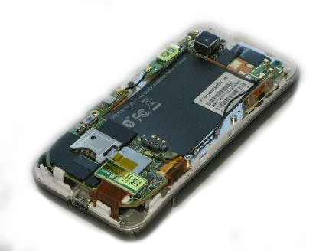
Approach
To encrypt we will need to modify modem control code
User application will be used to edit encrypt configuration
Phones will attempt to “handshake” at beginning of call, default to normal call if fail

Slide 5
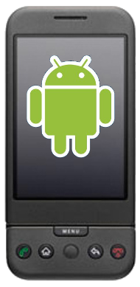
Approach (cont.)
Developed using Android, because its open-source
Modem control is accessible from with OS; platform portable
Google makes phone that accepts custom builds ($425)

