Slide 1
Skullduggery
Greg Baker
Robert Koeninger
Cellular Phone Encryption System

Slide 2
Goals
Develop a voice encryption system for the Android Operating System.
Encryption system will be more secure than standard GSM encryption.
Should be fast enough to not interfere with conversations

Slide 3
Design
The hard work will be modifications to phone firmware:
Voice data will be “caught” after the compression step in voice communication
Voice data will be encrypted after compression
Voice data will be encrypted with AES 128 or 192
Also included will be an Android application to make debugging and options easier

Slide 4
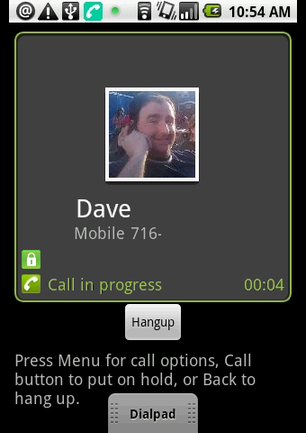
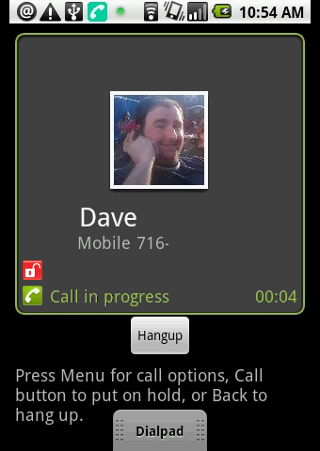

Slide 5
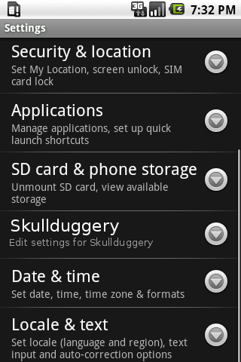

Slide 6
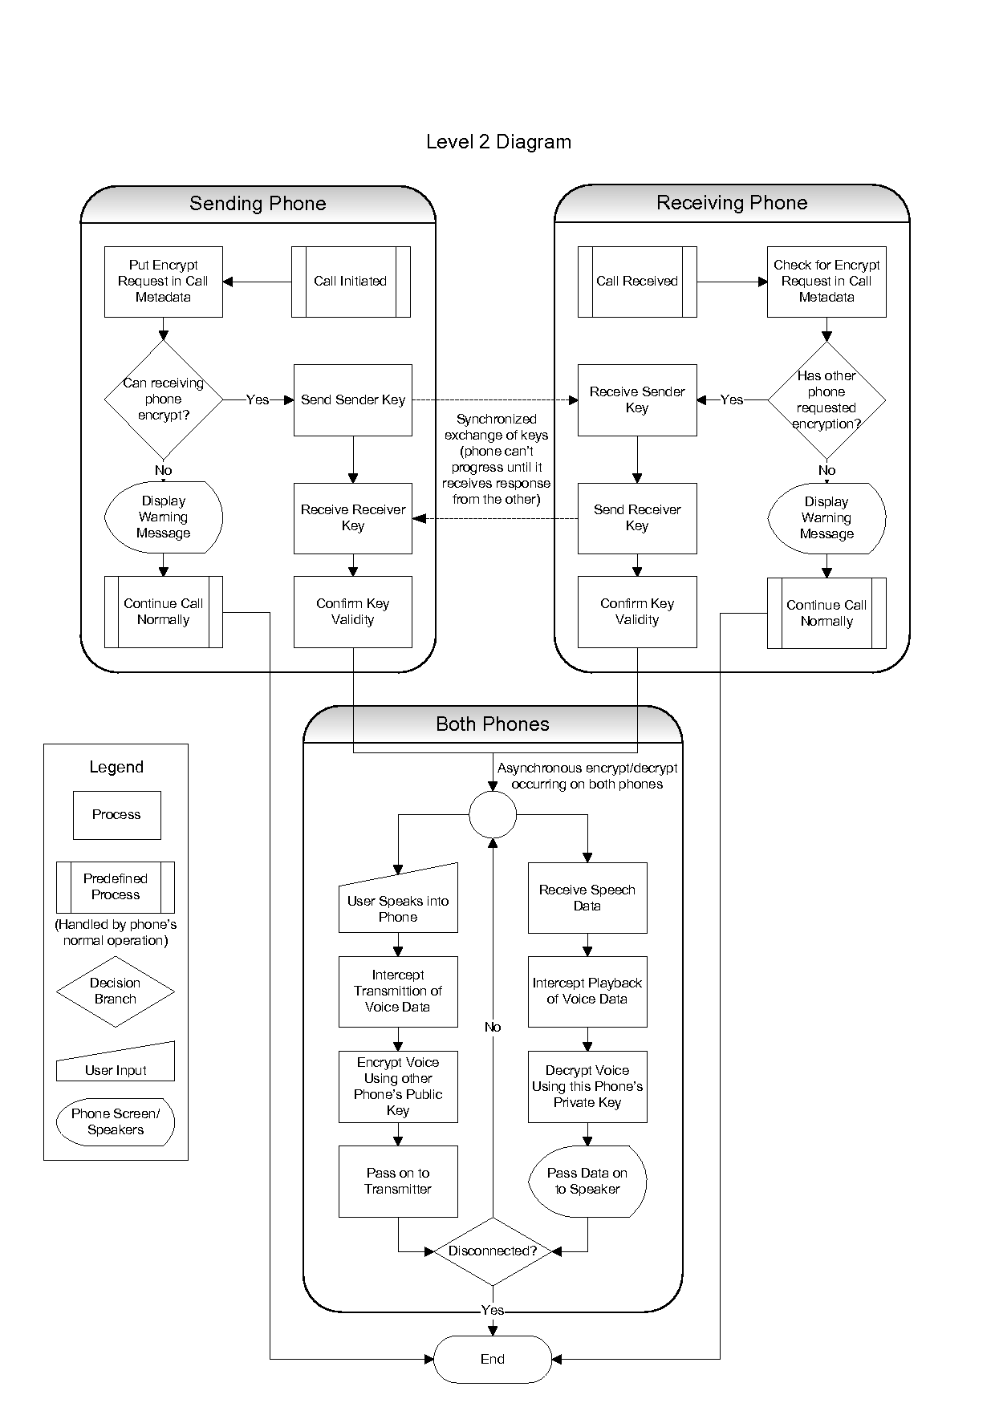

Slide 7
Schedule

Slide 8
Progress
Android Dev Phone is likely candidate for on-phone encryption testing.
Android Development Kit is best candidate for full testing of phone
Libraries for AES & Public-key encryption methods are widely available
Source-control, Development Environment set up.

Slide 9
Results
Few deliverables so far
We know a lot about the phone call state and events methods

