Slide 1

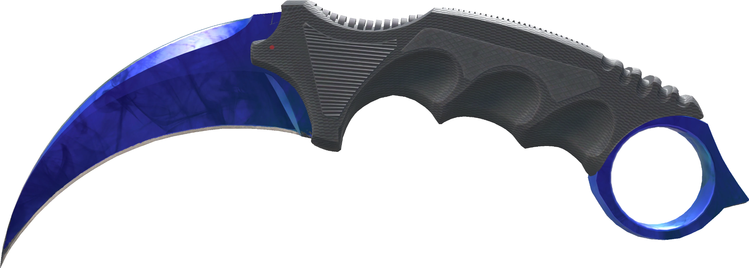

MTH-319 Cumulative Presentation
Robert Kohn
Dr. Russell’s Class

Slide 2
Overview
Topics Covered within this Presentation
Predicting One’s Kill Death Ratio Category Based On Other Performances
Analyzing and Forecasting “Karambits” using Google Trends Data
Using Classification Trees to Predict a Round’s Outcome in Counter-Strike
KNN Project
Time Series Project
Decision Tree Project

Slide 3
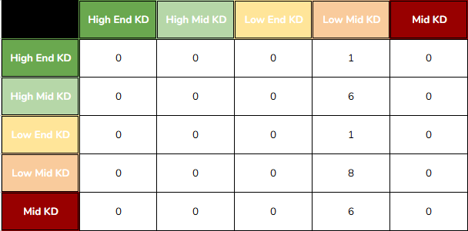
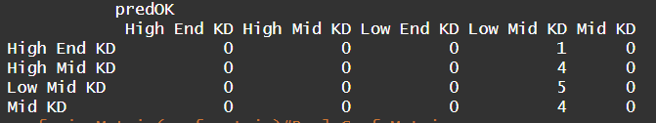
Predicting One’s Kill Death Ratio Category Based On Other Performances
KNN Project
Attempted to Establish Connection between KD Ratio and Other Statistics
Opening Kills 46.7% Accuracy
  Highest
Low Mid KD Dominates Dataset
  Misclassification Common
  Never predicts others
KNN Simplicity not Ideal for This Problem

Slide 4
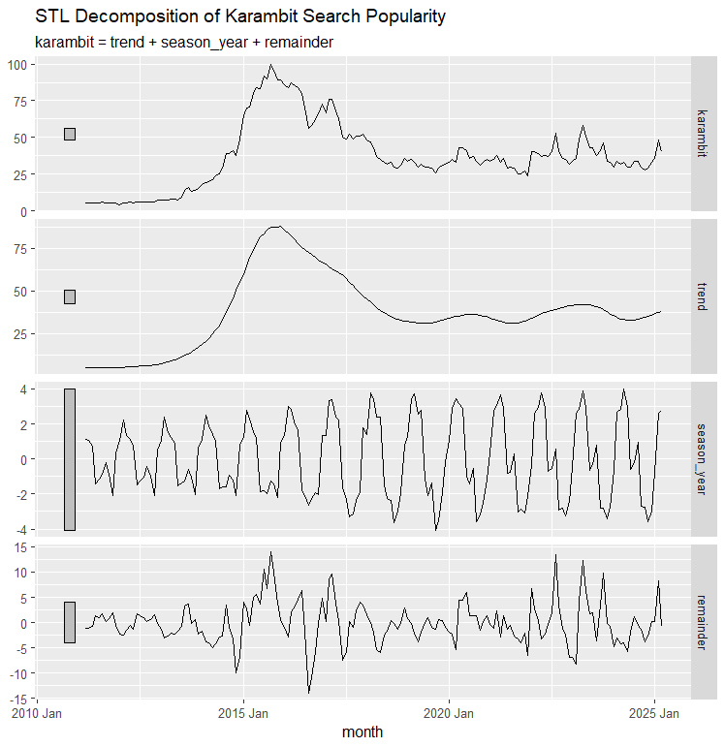
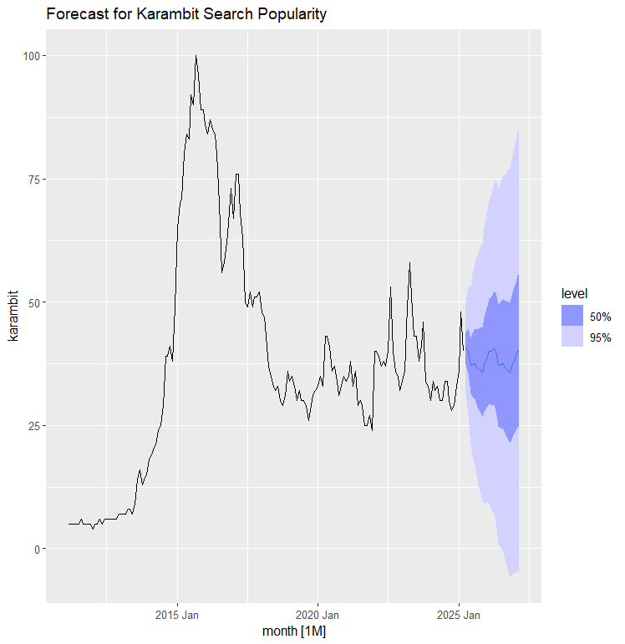
Analyzing and Forecasting “Karambits” using Google Trends Data
Time Series Project
Data from 2011-2025
  Pre-Release and Post-Release in Counter-Strike
Peak popularity 2014-2016
Major Cycle 2015-2020
Minor Cycle 2022-2025
Seasonal Exponential Smoothing Model
April Peaks, October Lows

Slide 5
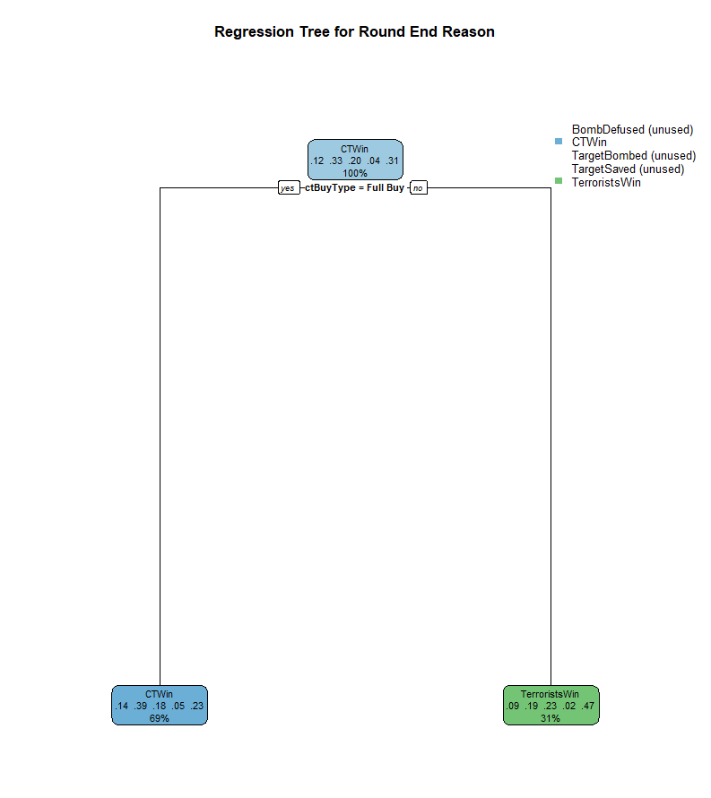
Using Classification Trees to Predict a Round’s Outcome in Counter-Strike
Decision Tree Project
Classification Tree
CT Buy Type
Bagged Tree
CT+T Round Spend
Random Forest
CT+T Round Spend

Slide 6
Any Questions?

