Slide 1
Prescription Pain Reliever Misuse Analysis of the US 2017 National Survey on Drug Use and Health https://public.tableau.com/profile/rosiekeogh#!/vizhome/PainRelieverMisuse_NSDUH2017/StoryHome
File created on: 21/05/2019 19:07:53 from Tableau

Slide 2
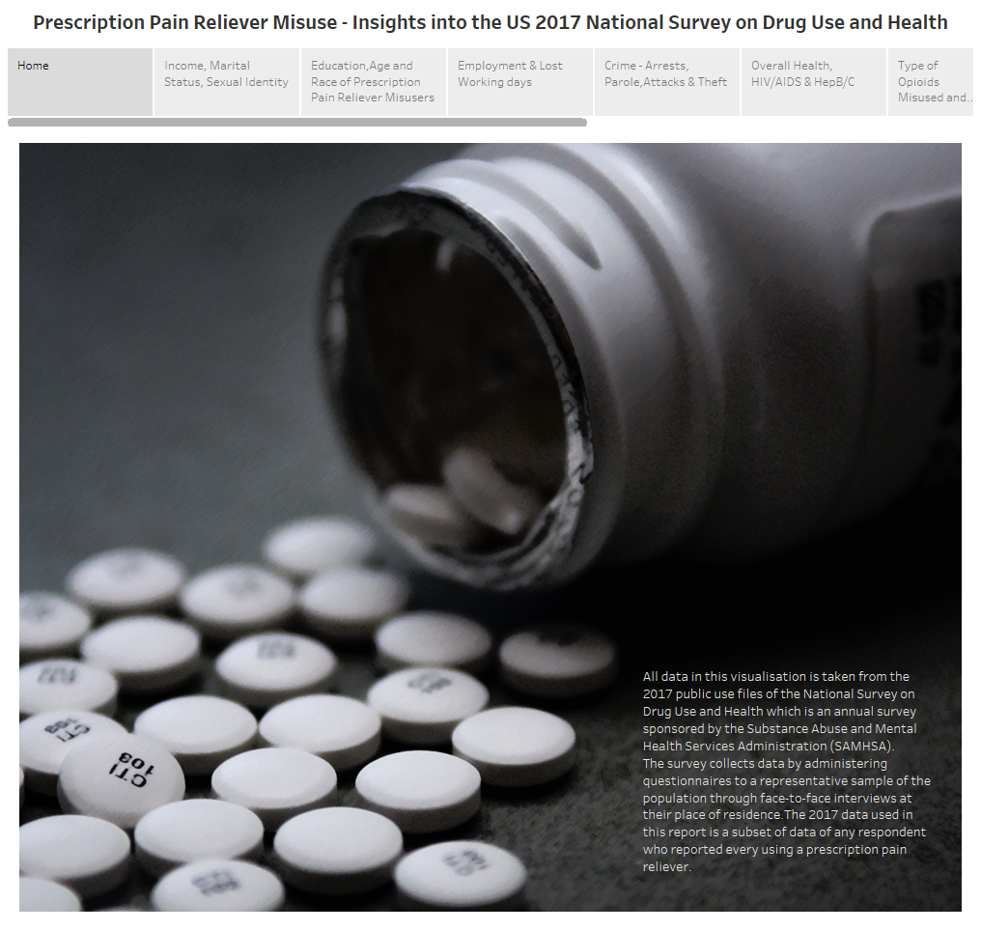

Slide 3
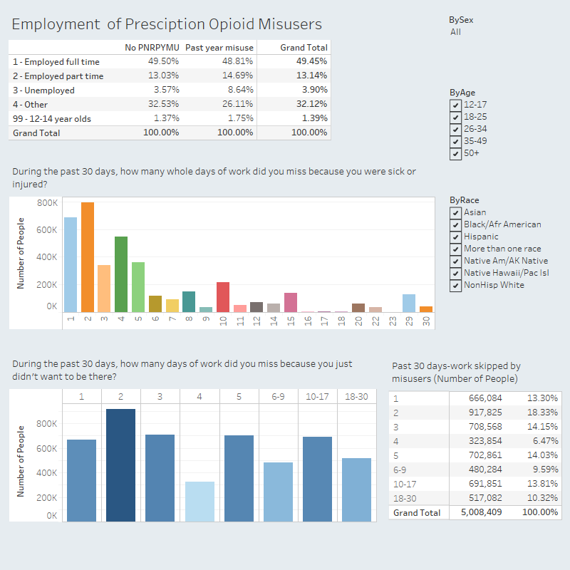

Slide 4
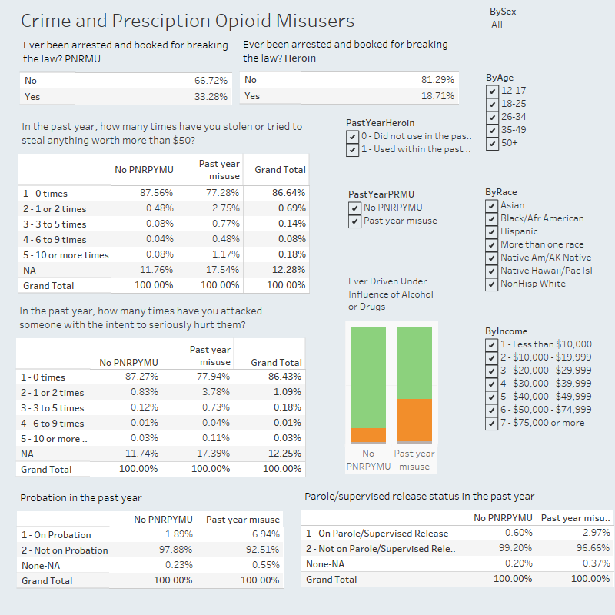

Slide 5
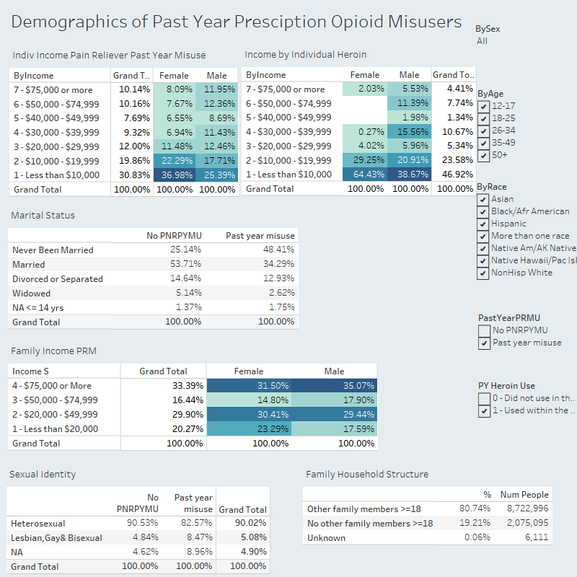

Slide 6
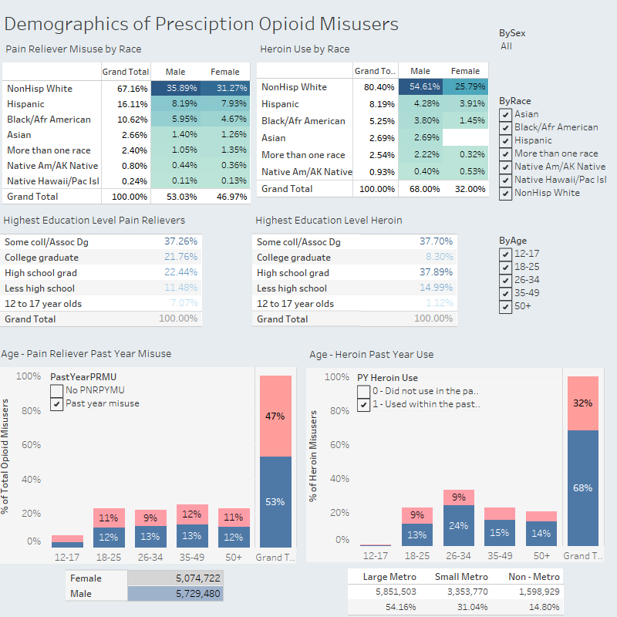

Slide 7
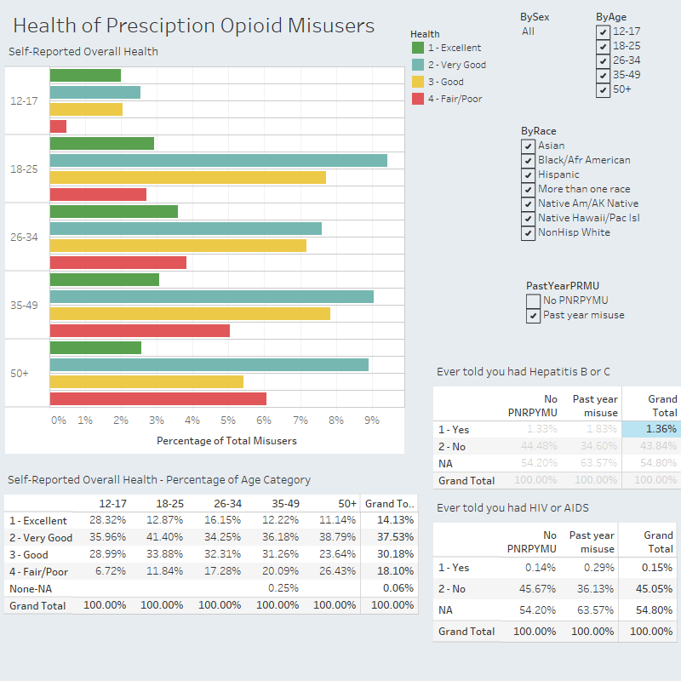

Slide 8
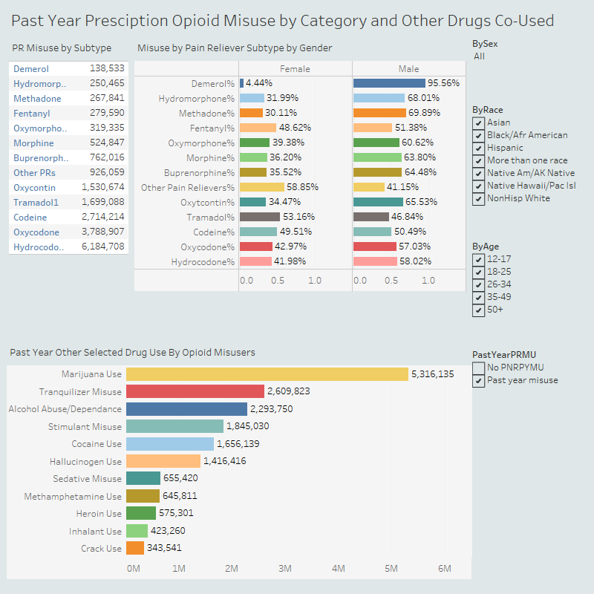

Slide 9
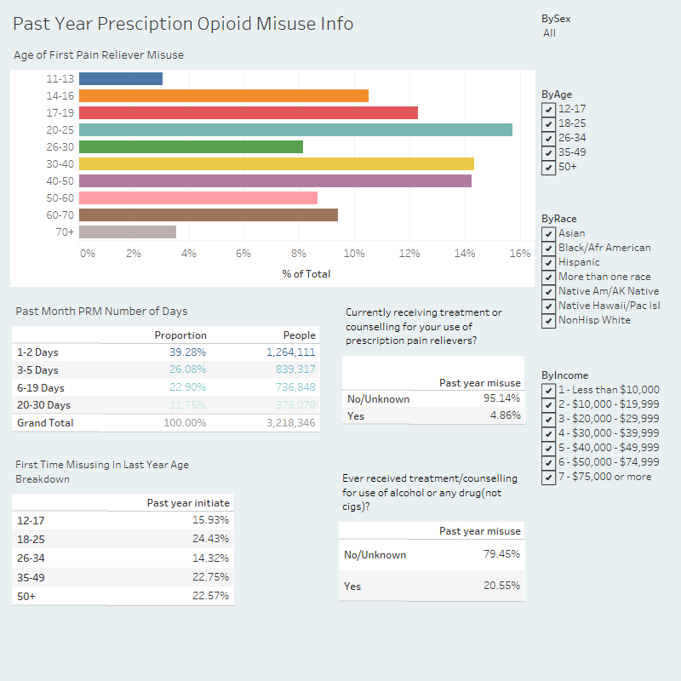

Slide 10
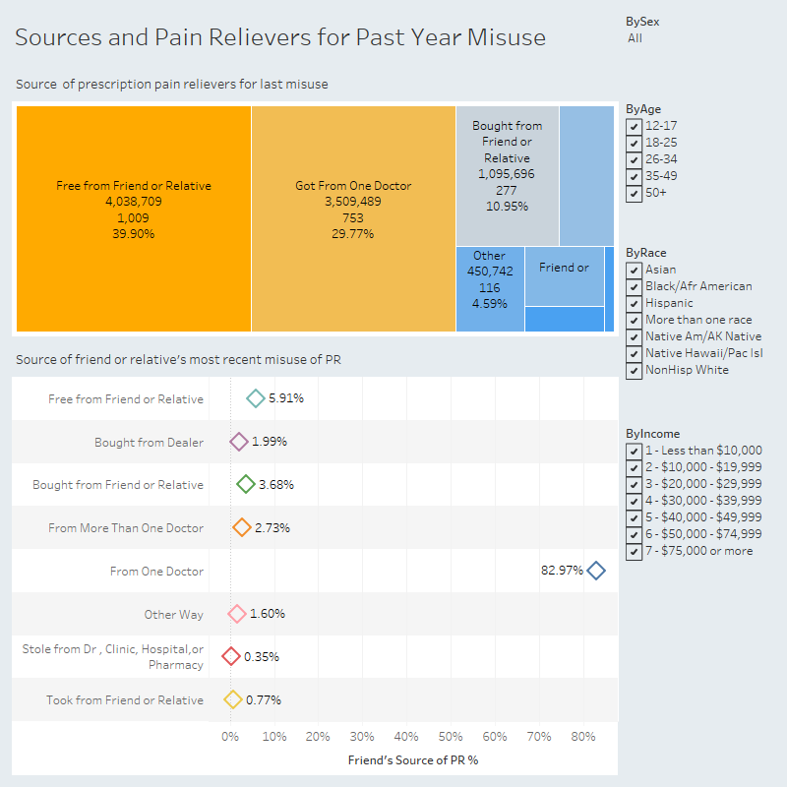

Slide 11
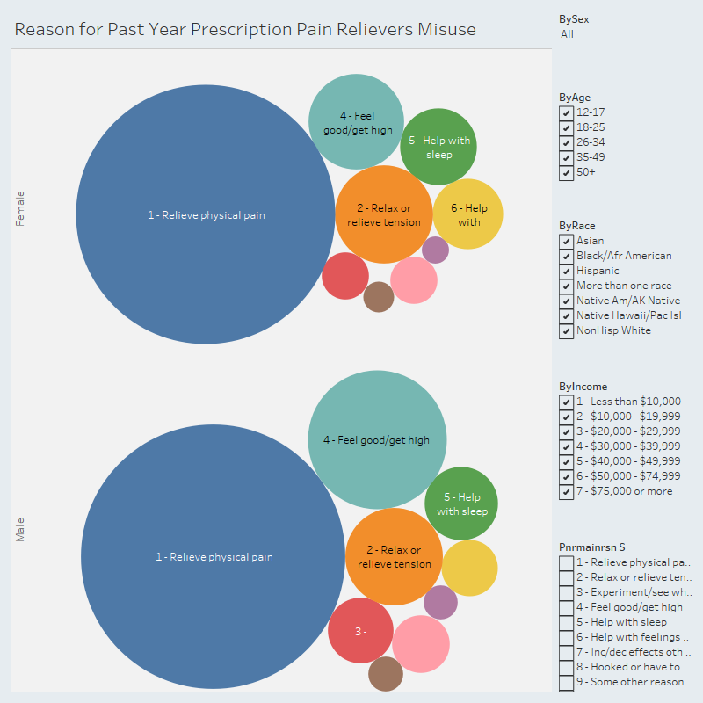

Slide 12
