Slide 1
Detecting the number of zzp’ers in the Netherlands
Group 03: Wout, Karim, Roy

Slide 2
Project Idea
Research question: Can social media be used to identify and determine the number of freelancers/independent contractors (ZZPers) in the Netherlands?

Slide 3
Project Idea
Analyze the number of Tweets containing key words per day:
“ZZP”, “@StZZPNederland”, “@ZPnetwerk”
Possibly extend using data from the KvK

Slide 4
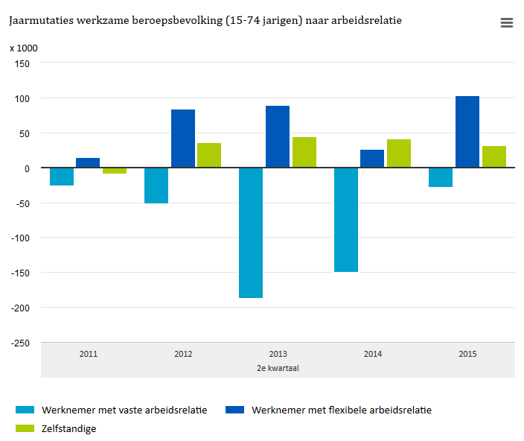
Preliminary Results
Source: CBS

Slide 5
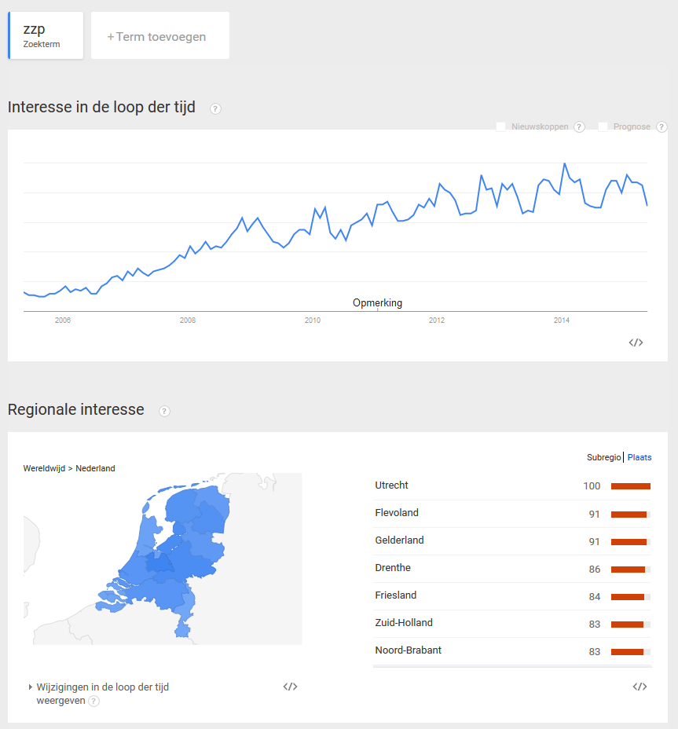
Preliminary Results

Slide 6
Questions?

