Slide 1
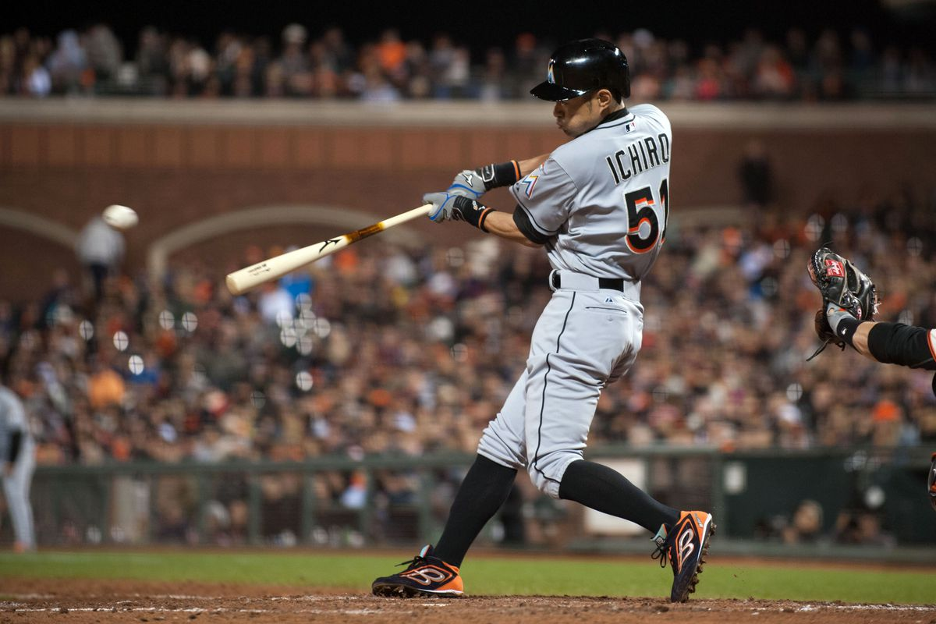
Optimizing the Swing from Peak Launch Angle
Riku Komatani, Advisor: Alan M. Nathan
University of Illinois

Slide 2
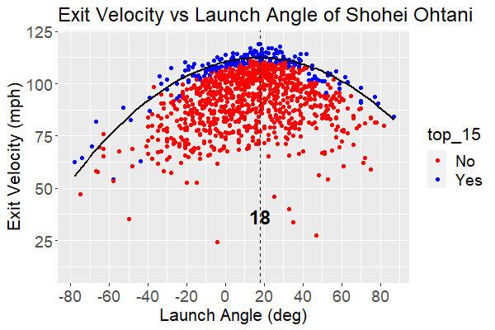
Peak Launch Angle
Launch Angle that Maximizes Exit Velocity of a Batter
Using Statcast data from 2017 ~ 2023 season (excluding 2020)
Obtaining the Peak Launch Angle
Divide all BIP data into 5-degree launch angle bins
Select the top 15% by exit velocity for each bin
Fit a quadratic regression on EV vs LA on the selected data
Find LA that corresponds to the peak of that fit

Slide 3
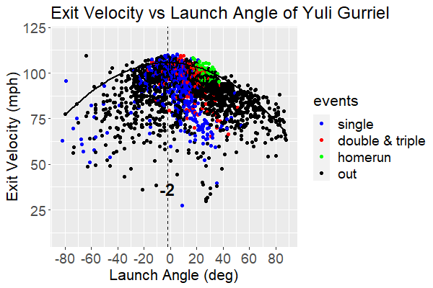
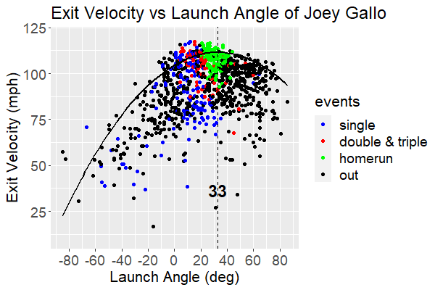
Exploring the Differences between Low and High Peak Launch Angle Batters
Yuli Gurriel
Lowest peak launch angle batter ~ –2˚
Balls hit at peak LA with high EV -> Single
Joey Gallo
Highest peak launch angle batter ~ 33˚
Balls hit at peak LA with high EV -> HR

Slide 4
Comparing the Swings of Yuli Gurriel and Joey Gallo
Yuli Gurriel
Leveled swing
Low attack angle
Joey Gallo
Non-leveled uppercut swing
High attack angle

Slide 5
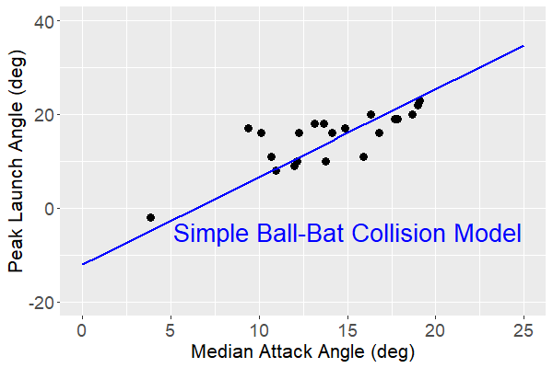
Correlation between Peak Launch Angle and Attack Angle
Using AA from bat-tracking data, provided by the MLB
Each point representing a batter
The relationship is approximately linear as predicted by the Simple Ball-Bat Collision Model

Slide 6
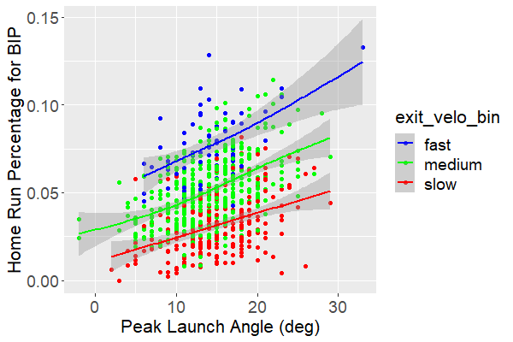
Observation 1: Home Run Percentage
Three EV Groups
Fast: EV ≥ 110 mph
Medium: 105 mph ≤ EV < 110 mph
Slow: EV < 105 mph
Each point representing a batter
Each group fitted with GAM
Note
HR% for BIP increases with higher EV
All three fits have a positive slope
Higher peak LA -> Higher HR% for BIP

Slide 7
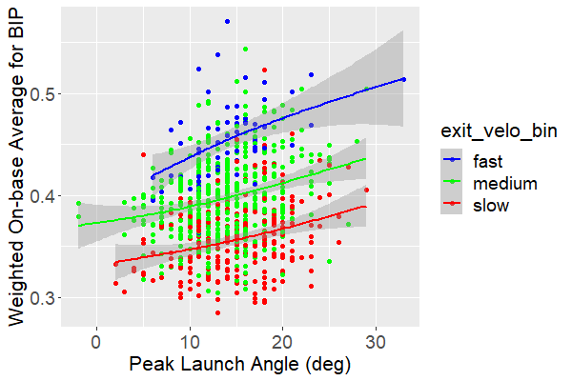
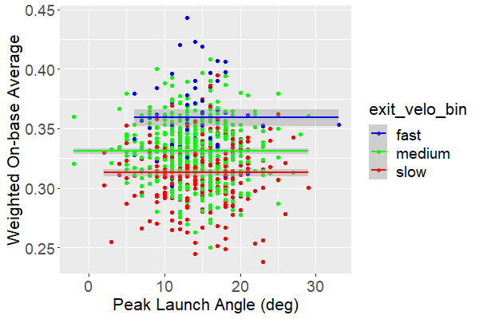
Observation 2: wOBA
wOBA for BIP
wOBA increases with higher EV
wOBA increases with higher peak LA
wOBA for All Events
wOBA increases with higher EV
wOBA doesn’t vary with respect to peak LA

Slide 8
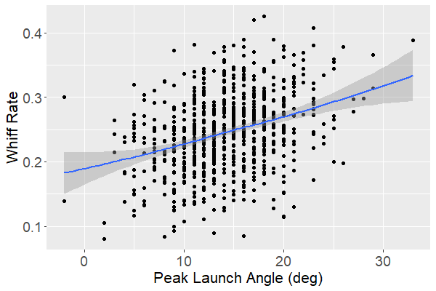
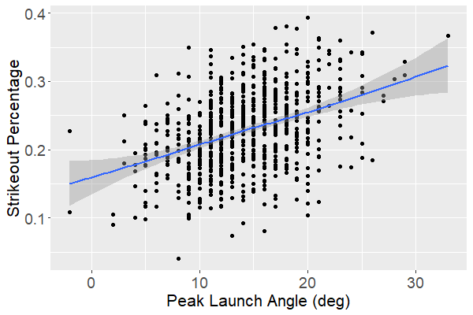
Observation 3: Whiff Rate & Strikeout Percentage
Both whiff rate and strikeout % increases with respect to peak LA
Why?
Low peak LA -> leveled swing -> longer duration of time to make contact
High peak LA -> uppercut swing -> shorter duration of time to make contact

Slide 9
Summary
Peak LA varies among batters, ranging from –2˚ to 33˚
Peak LA is strongly correlated to AA as predicted by the Simple Ball-Bat Collision Model
Batters with higher peak LA have higher HR % and Whiff Rate
wOBA for all events is independent of the peak LA
The optimal AA for a batter depends on their desired batting style

