Slide 1
The J2ME Development Environment
Renaissance Softlabs

Slide 2
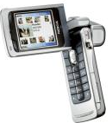
Introduction
Personalized and intelligent information appliances are necessities in our life today.
Such appliances can be:
  cell phones
  two-way pagers
  smart cards
  personal organizers
  palmtops
These appliances tend to be special-purpose, limited-resource, network-connected devices.

Slide 3
Environment requirements
We need an environment which is adapted for constrained devices - devices that have limitations on what they can do when compared to standard desktop or server computers.
The constraints are:
  extremely limited memory
  small screen sizes
  alternative input methods
  slow processors

Slide 4
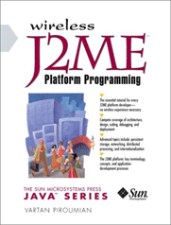
So – what’s the solution?
Because of the vast need, Sun has decided to develop a special edition of Java -
J2ME (Java 2 Micro Edition).
What is J2ME
Java platform for small devices
Introduced by sun in 1999 for mobile devices
A subset of Java 2 Standard Edition
For programming the mobile device (e.g mobile phones or WinCE…)

Slide 5
Why J2ME?
Effective than Brew and Symbian
Garbage Collector
Platform Independent
Security
Very simple
OTA

Slide 6
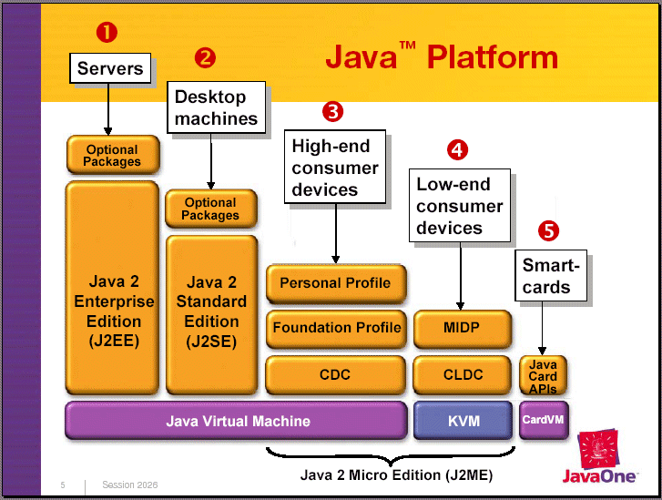
Java Platform

Slide 7
Configurations Layer
A configuration defines the minimum set of libraries and VM capabilities
Devices have similar processing and power and memory constraints
EX: CDC (Connected Device Configuration)
CLDC (Connected Limited Device Configuration)

Slide 8
Configurations
Configuration
CLDC
CDC
Connected Limited Device Configuration
Connected Device Configuration

Slide 9
CLDC vs. CDC
CLDC
  For very constrained devices
  160 - 512 KB of total memory
  16-bit or 32-bit processor
  Low power consumption and often operating with battery power
  Connectivity with limited bandwidth
CDC
  2 MB or more memory for Java platform
  32-bit processor
  High bandwidth network connection, most often using TCP/IP

Slide 10
CLDC
(Connected Limited Device Configuration)
Addresses
  Java language and virtual machine features
  Core Java Libraries
  Input/Output
  Networking
  Security
Not Addresses (but in MIDP)
  User Interface functionality
  Event handling
  High-Level application model
  Application life-cycle management

Slide 11
Profiles Layer
A profiles layer is a set of Java Based API that extend the J2ME definition
UI and presentation capabilities are generally defined at this layer
EX: CLDC => MIDP (Mobile Information Device Profile)
CDC => Personal Profile
CDC => Foundation Profile
MIDP provides the core application functionality for
mobile devices

Slide 12
Profile Layer
Profile
MIDP
PDAP
FP
PBP
PP
Mobile Information Device Profile
Personal Digital Assistant Profile
Foundation Profile
Personal Basis Profile
Personal Profile

Slide 13
MIDP – MID Profile
MIDP is targeted at a class of devices known as
mobile information devices (MIDs).
Minimal characteristics of MIDs:
  Enough memory to run MIDP applications
  Display of at least 96 X 56 pixels, either monochrome or color
  A keypad, keyboard, or touch screen
  Two-way wireless networking capability

Slide 14
J2ME Applications
A J2ME app is called a Midlet
MIDlets – The heart of J2ME…
MIDP does not support the running of applications that use a static main method as their entry point, nor calling the System.exit method in order to terminate.
Instead, we use a MIDlet, which is a MID Profile application.

Slide 15
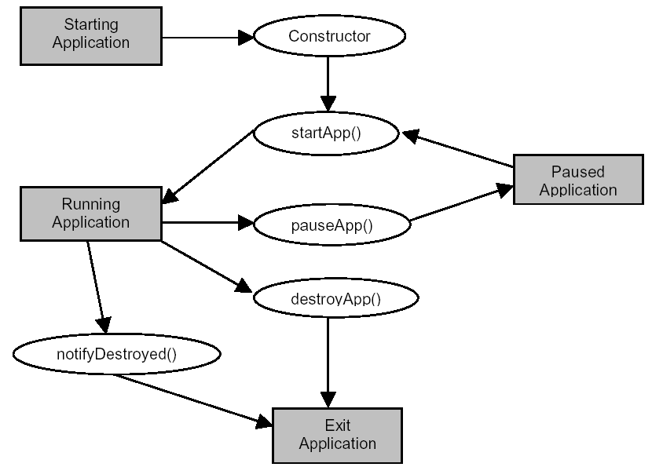
Midlet life cycle

Slide 16
MIDlet Suite
One or more MIDlets are packaged together into a MIDlet suite, composed of:
  JAR (Java archive) file
  JAD (Java Application Descriptor) file
All the user-defined classes and resources required by the suite's MIDlets must be in the JAR file.
The JAR file must also include a manifest that describe the MIDlets in the suite.
The application descriptor (JAD) contains similar information, and is used by devices to obtain information about a MIDlet suite without having to download and install the MIDlet suite first.

Slide 17
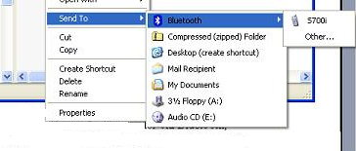
How To Install
There are 3 ways to download the application from your desktop ..
  via USB Wire
  via Infrared
  via Bluetooth

Slide 18
How to Install from a Remote place
Using OTA (Over The Air)
Steps to follow in OTA
(for example, if you are using Apache Tomcat as server)
  Create a .html file in Root dir with a link
to the .jad file
  .jad file has the URL of .jar file
  .jar file consists of total classes and resources
  From the handled device call the .html file and click
  on the link; which will call the .jad file which downloads the application.

