Slide 1


WiFi
Renaissance Softlabs
vg136b7

Slide 2
Wi-Fi Introduction
Simple, cheap , flexible and mobility
Great solution for
  Home LAN
  Office LAN
  Periodic Event LAN, conferences, trade shows
When applied to a large area Internet service business, challenges arise:
  Access Points get very large in number.
  Build-out, Management & Maintenance become exponentially complex.

Slide 3
WiFi History
Late 1980’s Motorola developed the first commercial WLAN
1990 – IEEE initiated the 802.11 project
1997 - IEEE approves the 802.11 international interoperability standard
1999 – IEEE ratifies the 802.11a & 802.11b wireless network communication standard
802.11b is the current, most used standard
  Frequency 2.4GHz – 2.5GHz Industrial, Scientific, and Medical (ISM)
  Maximum transmission speed 11Mbits per second
802.11a is soon to be released
  5 GHz frequency
  54 Mbps

Slide 4
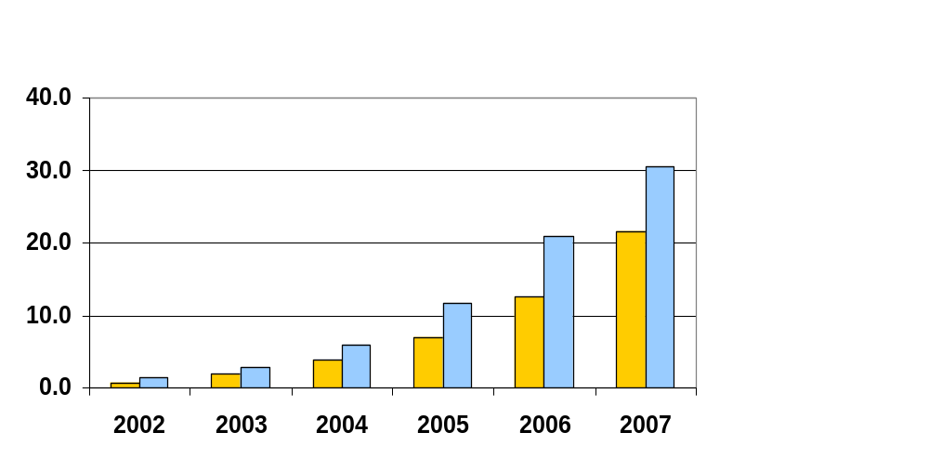
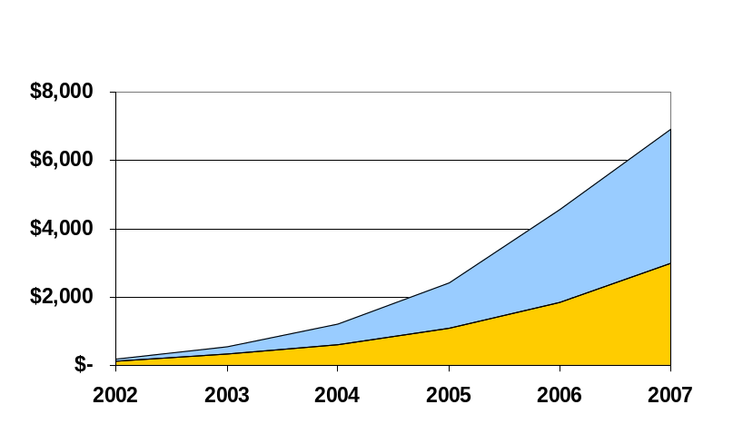
Wi-Fi Market Size
U.S.
Europe
Number of Users (millions)
Revenue ($ millions)
Users growing from 600K to 21.5M in US
Revenue growing from $134M to $3B in US
Strong User Base Translates into Strong Revenue Growth
The Analysys Group, 2002; Europe 2007 is Harris Estimate

Slide 5


WLAN Vision
Airport
Local Area
W-LAN datacom
Hotel &
Conference
Roaming
Office
Public
space
Wide area
Cellular datacom
Office meeting
spot

Slide 6
Wireless Technologies
802.11a (Wi-Fi)
802.11b (Wi-Fi)
802.11g (Wi-Fi)
802.11i (Security)
802.16 (Wi-Max)
Bluetooth (802.15)
GSM (Global System for Mobile Communications)
3GSM
GPRS (General Packet Radio Service)
CDMA (Code Division Multiple Access)
CDMA2000
CDPD (Cellular Digital Packet Data)
TDMA (Time Division Multiple Access)

Slide 7

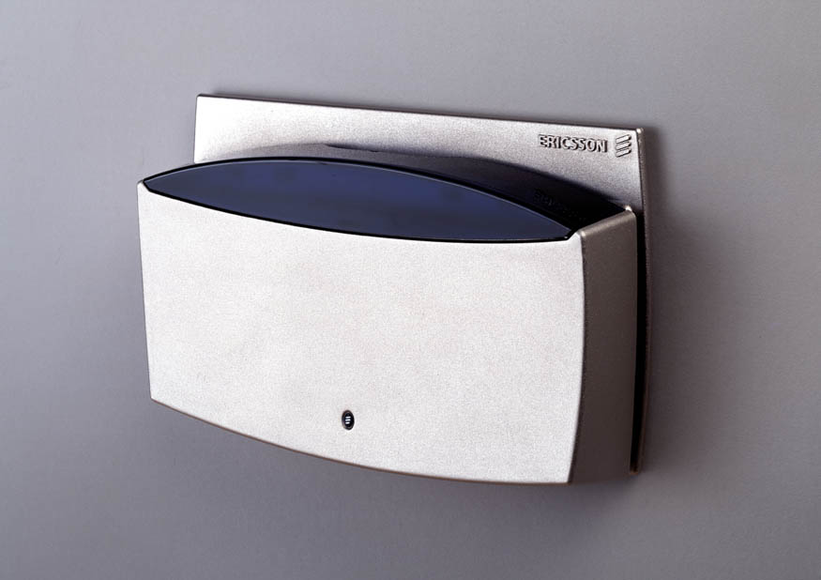
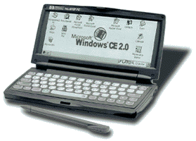

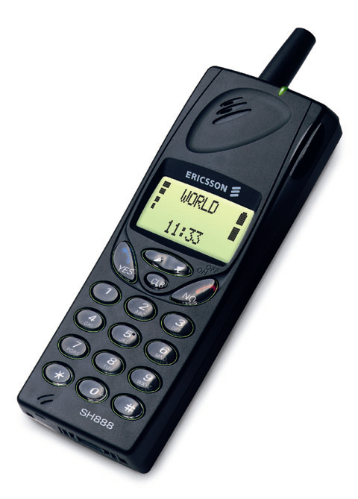
Wireless Interworking Technologies
Hand-over
Wireless Local Area Network
Wireless Wide Area Network
Wireless Personal Area Network

Slide 8
Wireless Technologies
Technology | Purpose | Frequency | Range | Speed | Devices | Compatibility
802.11a | Wireless Internet Access | 5GHz | 25 to 75 feet indoors; range can be affected by building materials | Up to 54Mbps | Laptop computers, PDAs, cell phones | Not compatible with 802.11b, 802.11g

Slide 9
Wireless Technologies
Technology | Purpose | Frequency | Range | Speed | Devices | Compatibility
802.11b | Wireless Internet Access | 2.4GHz | Up to 300 feet indoors; range can be affected by building materials | Up to 11Mbps | Laptop computers, PDAs, cell phones | Other 2.4GHz devices, like cordless phones, may disrupt connection

Slide 10
Wireless Technologies
Technology | Purpose | Frequency | Range | Speed | Devices | Compatibility
802.11g | Wireless Internet Access | 2.4GHz | Up to 150 feet indoors; range can be affected by building materials | Up to 54Mbps | Laptop computers | Other 2.4GHz devices, like cordless phones, may disrupt connection

Slide 11
Wireless Technologies
Technology | Purpose | Frequency | Range | Speed | Devices | Compatibility
820.16 (Wi-Max) | Wireless metro-politan area networks | 10 and 66 GHz | Several miles | Emerging | Emerging | Current Vendor resistance; mass adoption potential by 2006

Slide 12
Wireless Technologies
Technology | Purpose | Frequency | Range | Speed | Devices | Compatibility
Bluetooth | Wirelessly connect computer peripherals, such as printers, PDAs, cameras | 2.4GHz | Up to 33 feet (10 meters); range can be affected by building materials | 720Kbps | Printers, cameras, cell phones, PDAs, other peripherals | Other 2.4GHz devices, like cordless phones, may disrupt connection

Slide 13
WiFi vs Bluetooth
Parameter | WiFi | Bluetooth
Standard | 802.11a | 802.15
Frequency | 2.4GHz | 2.5GHz
Data Rate | 11Mbps | 720Kbps
Range | 300 feet | 100 feet
Called as | WLAN | WPAN
Power | 1W | 1mW
Address | SSID | UUID

Slide 14
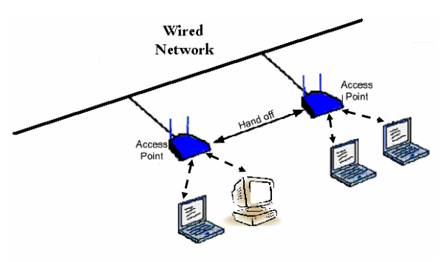
Concept

Slide 15
Different Markets & Roles
Bluetooth
  Designed for quick, seamless, short-range networks
  Features low power consumption, small protocol stack,robust data & voice transfer
  Cheap price
  Good choice for WPAN
  (Wireless Personal Area Networks)
802.11
  Designed for infrequent mobility, IP-based data transmission
  Medium range and high data rate
  Good choice for WLAN
medium power & medium range
low power & short range
WPAN
BT
HomeRF
x0M
xKM
x00M
IEEE 802.11
GSM, CDMA, GPRS, etc.
high power & long range

Slide 16
WiFi
IEEE 802.11b is based on a cellular architecture where
  The system is subdivided into cells
  Each cell is called Basic Service Set (BSS) which is identified by the SSID (Service Set ID) and each is controlled by Base Station called Access point (AP).
The whole interconnected Wireless LAN including the cells and their different AP is called Extended Service Set (ESS).

Slide 17
802.11 LAN
Distributed Systems
AP
AP
BSS
BSS
ESS

Slide 18


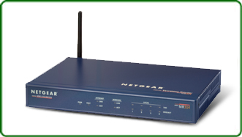
SSID Broadcasting
SSID = Company A
SSID
SSID
SSID = Company A

Slide 19
WiFi Architecture Layers
MAC Layer
Physical Layer

Slide 20
Phycical Layer
Frequency Hopping Spread Spectrum
Direct Sequence Spread Spectrum

Slide 21
MAC Layer
Controlling Multiple Access
Fragmentation
Reassembly

Slide 22
Carrier Sense Multiple Access with Collision Avoidance mechanism (CSMA/CA).
A CSMA works as: A station desires to transmit, senses the medium, if the medium is busy, then the station will defer its transmission to a later time, if the medium is sensed free then the station is allowed to transmit.
Collision may occur
But we can’t use it in Wireless LAN, because
  the implementation of full duplex radio
  all the stations should know each other

Slide 23
802.11 uses the Collision Avoidance scheme as:
A station willing to transmit senses the medium, if it is busy it defers. If it is free for specified time (called DIFS, Distributed Inter Frame Space) then the station is allowed to transmit. At receiving side, it will check the CRC and send the ACK back to the Sender. It indicates that the Collision is not occurred.
Virtual Carrier Sense:
  In order to avoid the Collision between two unknown devices
  A station willing to transmit sends a short control packet called RTS (Request to Send) which includes source, destination and duration of the following transaction. Then the receiver will send a response control packet, CTS (Clear To Send) which consists the same information.

Slide 24
The Data flow
Source
RTS
Data
Destination
CTS
ACK

Slide 25
Inter Frame Spaces
SIFS-Short Inter Frame Space: used to separate transmission belonging to a single dialog( fragment –ACK) and the value is 25 milli seconds.
PIFS Point Coordination IFS: used by AP to gain access to the medium before any other station and the value is 78 milli sec.
DIFS Distributed IFS: used by a station willing to start a new transaction and the value is 128 milli sec.
EIFS Extended IFS: used by a station that has received a packet that could not understand, that is needed to prevent the station to avoid the Collision in future packet belonging to that dialog.

Slide 26
How does the station join an existing Cell?
When a station wants to join the Cell, it can know the synchronization information from the Access Point in two ways
Passive scanning – waits to receive Beacon Frames from the AP
Active scanning – transmits the Probe request to find the AP and waiting for the Probe response from AP

Slide 27
Authentication Process
interchanging the information where each side proves the knowledge of a given password.
Two approaches to authenticate, those are:
  Open system authentication: without verifying the identity
  Shared key authentication: based on WEP and requires that both devices implement the WEP

Slide 28
Authentication Process
BS
Station
Request for authentication
Challenge from BS: random number
Response from Station: signed number
Success or Failure
Two – way traffic

Slide 29
Association Process
exchanging the information between stations and the AP capabilities, to know the current position of station
After the association, a station is capable of transmitting and receiving the information.
System
BS
Request for Association
Response with association ID
Two way traffic

Slide 30
Reassocaition
the process of moving an association from old BS to new BS in an ESS
Over the air, the process is same as the association
on the back bone BS s are interact with each other to move frames
this reassociation procedure is initiated when the System detects that another BS has the stronger signal.

Slide 31
Reassocaition
System
New BS
Old BS
Reassociation Request
Send Security block
Ack Security Block
Send Notify
Move Response
Reassociation Response
Inter Access Point Protocol
(IEEE 802.11f)

Slide 32
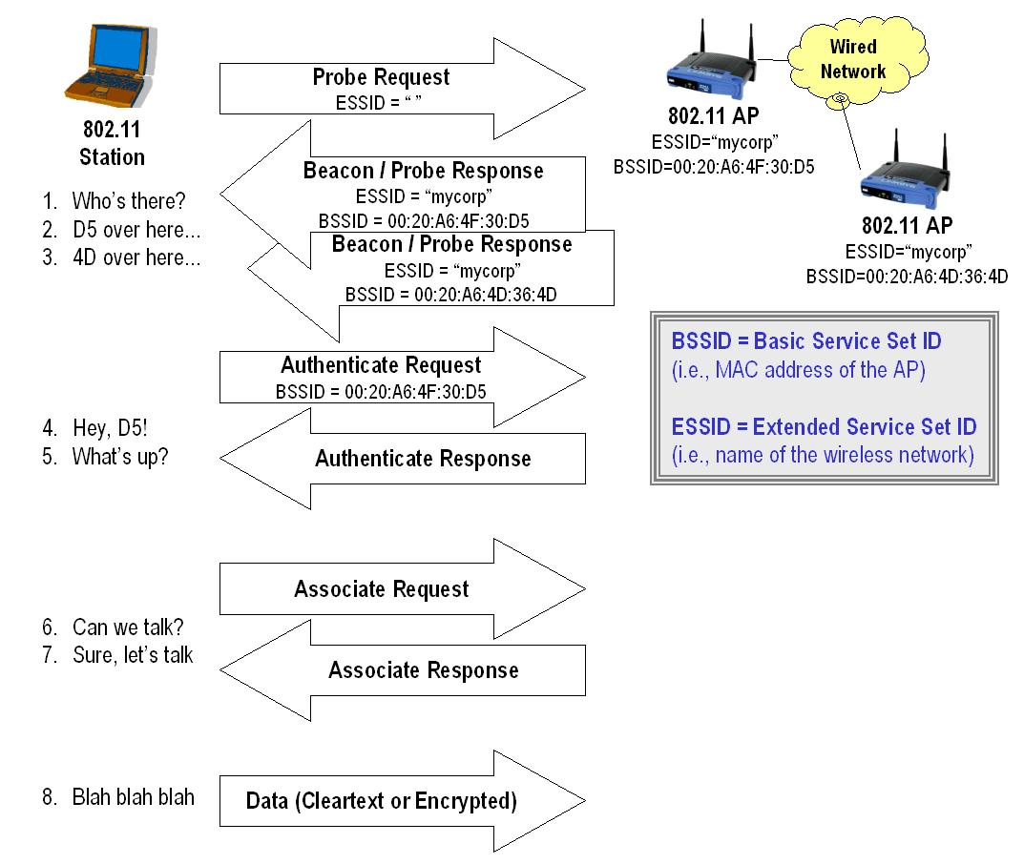

Slide 33
WLAN Routers vs. APs
Access points allow wireless clients access to a single network
WLAN routers allow clients to browse a number of different networks.
The router always takes the IP address into account to make decisions on how to forward (i.e., route) the packet; whereas, access points generally ignore the IP address and forward all packets.

Slide 34
WiFi Network Topologies
Ad Hoc Network
This is a peer to peer network.
Infrastructure Network
This network allows to access various wired networks.This requires a base station called Access Point

