Slide 1
Pre-training and fine-tuning approach for detecting route information failures in IP core networks
team mlab 2020/12/15

Slide 2
Background ― Difficulty of failure detection in BGP network
Target network
Failure: BGP injection
Other ISPs’ networks
IntGW-01
TR-01
5G core network
IntGW-02
TR-02
Failure:
BGP hijack
Failure:
Router failure
RR-01
Conventional rule-based approach is NOT applicable because BGP does not have a mechanism to authenticate each router configuration
Difficulty
Notes:
To begin with, I’d like to introduce the background of our solution. To offer a high-quality 5G network service, autonomous failure detection in the network is quite important.
In this challenge, we worked on detecting failures in a BGP network such as BGP injection and BGP hijacking due to router failures, route setting errors, and so on. However, the BGP network is not a centralized mechanism and it does not have a mechanism to authenticate each router configuration. Therefore, the conventional rule-based approach is NOT applicable.
BGPインジェクションやBGPハイジャック等の設定ミスによる障害：BGPに各ルータ設定を認証する仕組みがないためルールベースでは発見することが難しい

Slide 3
Problem Description ― Failure Detection in BGP Network
Objective: Detect the failures in the BGP network from the network status information
Input: Time series data obtained from the border gateway routers
Time series labeled training data
Time series input data
Time series prediction result
TIME | feature1 （Rx packet） | feature2 （Tx @scket） | feature3 （CPU usage）
2020/07/07 10:21 | 0.87 | 0.32 | 0.23
2020/07/07 10:22 | 0.67 | 0.23 | 0.45
2020/07/07 10:23 | 0.67 | 0.49 | 0.78
TIME | predicted isFailure
2020/07/07 10:21 | false
2020/07/07 10:22 | true
2020/07/07 10:23 | true
TIME | truth isFailure
2020/07/07 10:21 | false
2020/07/07 10:22 | true
2020/07/07 10:23 | false
predict
compare
・・・
predict
compare
predict
compare
・・・
・・・
・・・
Notes:
Here, I will introduce our problem description. The objective is to detect the BGP network failures from the network status information obtained from the border gateway routers.
The dataset has a time-series structure. We predicted failures at each time using the time series data, then compared the prediction results with the labeled training data.
Finally, we evaluated the effectiveness of the prediction using the F1 score, which is an index considering False-negative and False-Positive.

Slide 4
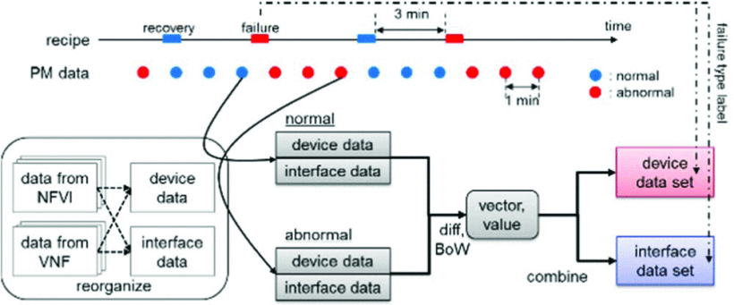
Related Work - Fault classification using machine learning in an NFV environment [Kawasaki+20]
Failure Scenario:
Node-down, Interface-down, and CPU overload
Preprocessor: Bag-of-Words (Bow) using labeled training data
Fault Classifier: MLP, RF, and SVM
Pre-processing Steps
Failure Scenario does NOT include failures peculiar to BGP network (injection, hijack, etc…)
Only labeled data (normal/abnormal) are used as the training data
In the case of failure detection in the BGP network,
Overfitting to one domain caused by lack of context should occur
Additional dataset is required to apply the model to other networks
Problem
Notes:
Regarding failure detection in an NFV environment, KDDI, the host of this theme, has previously proposed a machine learning-based method. This contains three failure scenarios: Node-down, Interface-down, and CPU overload.
To apply ML models, preprocess for the dataset is conducted by Bag-of-Words using labeled training data, which is a method that converts texts to a vector of word weights.
The preprocessed data is put into three ML-based fault classifiers: MLP, RF, and SVM, respectively.
In this work, the failure scenarios do not include failures peculiar to the BGP network like injection and hijack. Moreover, only labeled data (normal/abnormal) are used as the training data.
Therefore, only applying this method is insufficient to detect failures in the BGP network. To be more specific, overfitting to one domain should occur, and an additional dataset is required to apply the model to other networks.

Slide 5
01
Methodology

Slide 6


Pre-training and fine-tuning approach
Unsupervised learning
BGP Path Logs
Pre-training phase
We pre-train a general BGP path embedding model to understand BGP context.
General Path
Embedding model
Supervised learning
Fine-tuning phase
We train a model to predict labels on specific task such as BGP network failure detection.
A
A
The size of labeled data is small.
Supervised model
specific label data
Advantage
Since the model learning to understand the context does not require specific label data in pre-training, a large amount of BGP path data generated by real network is available.
Notes:
関連研究に対して
BGP Path embedding
関連研究との差分
Pre-traingとFine-tuningパラダイムは，様々な分野で大きな成果を出しています．
以上の問題に対して，我々はPre-traingとFine-tuningアプローチを用いました．
この２段階の学習によって，実際の運用で，ラベルデータを用いずに精度向上が可能となります．
実際のインターネットコアネットワークの運用では，大量のBGP経路データが毎日生成されていますが，特定のラベルをアノテーションしたデータは僅かです．
そのため，BGPネットワークのコンテキストを理解するための学習には教師なし学習を用いたPre-traingを行い，豊富なデータを使って汎用的なPath Embedding modelを作ります．
次に，この汎用モデルを付けた既存の判別機を，限られたラベルを用いてFinetuningを行います．

Slide 7
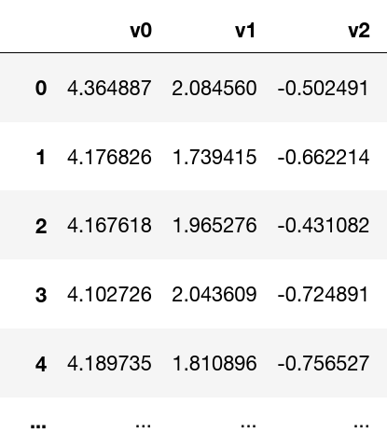
BGP path embedding
Unsupervised learning
BGP path has
an ordered structure.
We address the ordered structure as a language model.
We developed a general path model which transforms objects on BGP to vectors.
ある時刻のnetwork-deviceのjson
IntGW-01のpath-entries document
1.0.0.0/2410 4608 13335 10 4608 13335 p10 p30 p2 p2
1.0.4.0/2410 4608 4826 38803 56203 10 4608 4826 38803 56203 p10 p30 p2 p2
1.0.4.0/2210 4608 4826 38803 56203 10 4608 4826 38803 56203 p10 p30 p2 p2
1.0.5.0/2410 4608 4826 38803 56203 10 4608 4826 38803 56203 p10 p30 p2 p2
IntGW-01
IntGW-02
...
bgp-path-entry
"prefix": "1.187.50.0/23",
"nexthop":"10.30.2.2",
"as-path": "10 4608 7575 2914 9498 55644 55644 55644 55644 55644 55644 45271"
IntGW-02のpath-entries document
TR-01
...
...
・・・
TR-01のpath-entries document
TR-02
...
...
・・・
TR-02のpath-entries document
RR-02
...
...
RR-01のpath-entries document
...
Notes:
・実際のデータでもできる
ラベル付がコストがかかるが，これはいらない
この枠組みであれば実際のデータで精度を上げることができる
・ベクトルを，実際のタスクにチューニングすることで高い精度が得られるっていう，最近の言語モデルっぽい使い方ができる
・この前に全体像を話したほうが良い
・

Slide 8
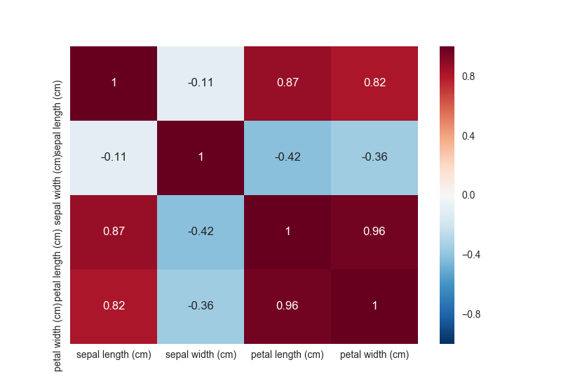

Dimensionality Reduction
Example Image of Correlation Matrix
https://blog.amedama.jp/entry/2017/04/18/230431
To cope with the Curse of Dimensionality
Because there are too many columns in the dataframe we need to delete redundant columns. ex. 238 columns ( physical infrastructure )
Method
Delete repetitive columns in each row
Delete the column with correlation coef. == 1
Generated correlation coef. matrix (Left)
Pearson product-moment correlation coefficient
Delete the column with correlation coef. == 1
https://jp.mathworks.com/help/stats/corr.html#mw_1b19e0d5-7906-4577-a0a5-b20311da7faf
Notes:
その他の工夫

Slide 9
02
Evaluation

Slide 10
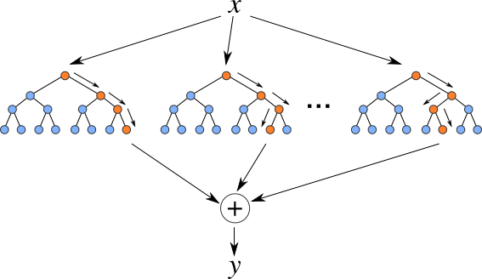
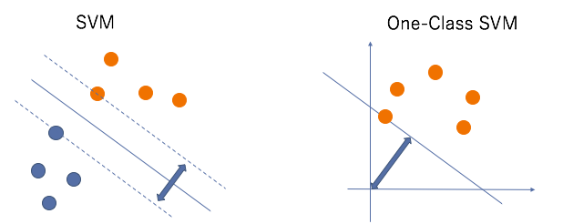
For the Evaluation
Failure Prediction Baseline :
Failure detection by tree-based classifiers AdaBoost, Bagging, ExtraTrees, GradientBoosting, Random Forest
Regression analysis for the failure indicating column of each failure types
Less failure examples problem : oversampling by SMOTE
One Class SVM：Unsupervised Learning
Learn normal state to detect anomaly status as outlier
Useful for unknown datasets
Support Vector Machine : Supervised Learning
Example Image of Random Forest
http://kazoo04.hatenablog.com/entry/2013/12/04/175402
Support Vector Machine and One Class SVM
https://www.smartbowwow.com/2018/12/anomaly-detection-using-one-class.html

Slide 11
Evaluation ― Tap Loss & Tap Delay
Tap Loss
Method | AdaBoost | Bagging | ExtraTrees | Gradient Boosting | Random Forest | OneClass SVM
f1 score(%) | 62.90 | 63.25 | 63.27 | 63.25 | 63.25 | 18.61
Tap Delay
Method | AdaBoost | Bagging | ExtraTrees | Gradient Boosting | Random Forest | OneClass SVM
f1 score(%) | 53.26 | 54.83 | 54.84 | 54.86 | 54.84 | 17.38

Slide 12
Evaluation ― Node Down & Interface Down
Node Down
Method | AdaBoost | Bagging | ExtraTrees | Gradient Boosting | Random Forest | OneClass SVM
f1 score(%) | 76.31 | 71.60 | 73.62 | 70.09 | 73.07 | 22.93
Interface Down
Method | AdaBoost | Bagging | ExtraTrees | Gradient Boosting | Random Forest | OneClass SVM
f1 score(%) | 60.92 | 65.11 | 65.11 | 65.12 | 65.11 | 10.22

Slide 13
Evaluation ― BGP injection & BGP hijack
BGP injection
Method | AdaBoost | Bagging | ExtraTrees | Gradient Boosting | Random Forest | OneClass SVM
f1 score(%) | 74.34 | 64.22 | 61.81 | 63.63 | 63.70 | 1.16
BGP hijack
Method | AdaBoost | Bagging | ExtraTrees | Gradient Boosting | Random Forest | OneClass SVM
f1 score(%) | 64.04 | 54.96 | 54.56 | 56.47 | 56.31 | 2.07

Slide 14
03
Summary

Slide 15
Summary
BGP path data from routers
Anomaly type | Anomaly name | f1 score
Hardware | Tap Loss | 63.27
Hardware | Tap Delay | 54.86
Software | Node Down | 76.31
Software | Interface | 65.11
Software | BGP Injection | 74.34
Software | BGP Hijack | 64.04
Pre-training： BGP path embedding
(unsupervised training)
Fine-tuning: existing methods with labeled data
(supervised learning)
Evaluation with labeled data

Slide 16

Thanks
member
Ryoma Kondo kondo@mlab.t.u-tokyo.ac.jp
Takashi Ubukata t_ubukata@mlab.t.u-tokyo.ac.jp
Kentaro Matsuura matsuura@mlab.t.u-tokyo.ac.jp

