Slide 1
Java Programming Crash Course
Setup and Introduction
Sattvik Sahai
CS 284 D
Course Instructor: Jia Xu
Department of Computer Science

Slide 2
Setup

Slide 3
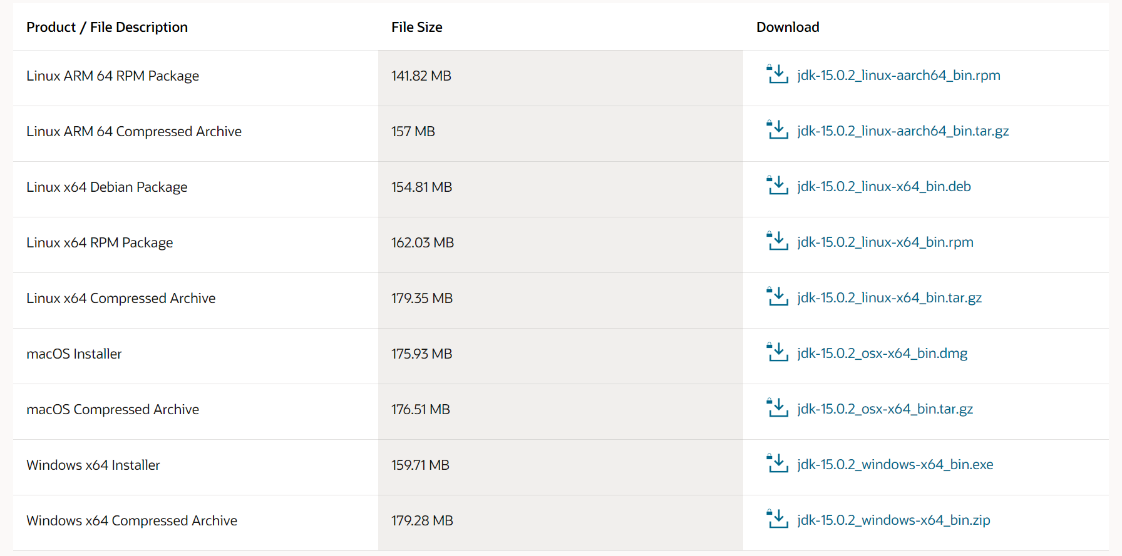
Environment setup
Install Java SE Development Kit
Download JDK15
https://www.oracle.com/java/technologies/javase-jdk15-downloads.html

Slide 4
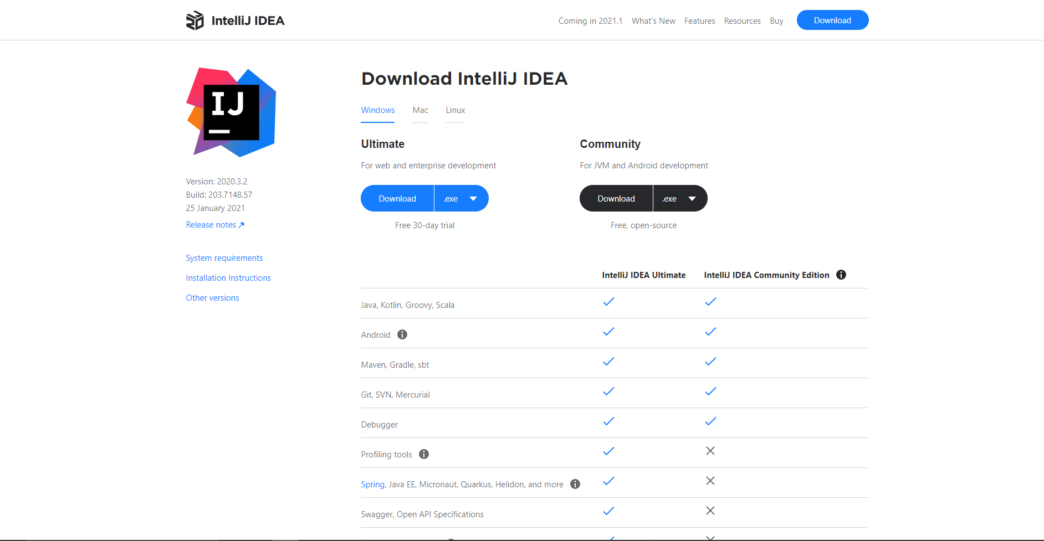
Environment setup
Install IntelliJ
Download IntelliJ IDEA
https://www.jetbrains.com/idea/download/#section=windows

Slide 5
Structure of a Java Program

Slide 6
Structure of a Java Program
Function
A function is a block of code that performs a specific task

Slide 7

Structure of a Java Program
Function
A function is a block of code that performs a specific task

Slide 8

Structure of a Java Program
Function
Example 1: a function to check how many new email you have in your inbox.

Slide 9

Structure of a Java Program
Function
Example 1: a function to check how many new email you have in your inbox.

Slide 10

Structure of a Java Program
Function
Example 2: a function to send an email.

Slide 11

Structure of a Java Program
Main function
Entry point to a Java program

Slide 12
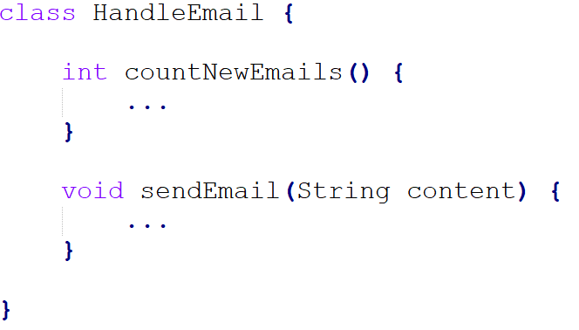
Structure of a Java Program
Class
Container for related functions.

Slide 13
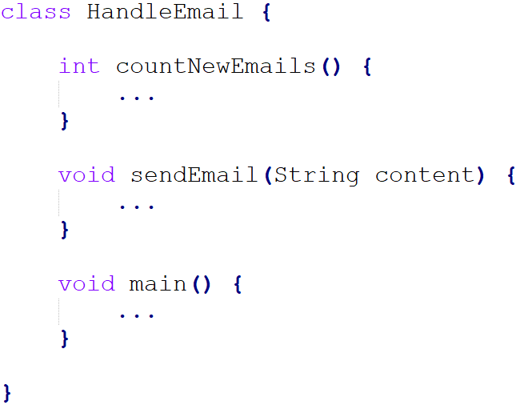
Structure of a Java Program
Class
Container for related functions.

Slide 14
Sattvik Sahai
ssahai@stevens.edu

