Slide 1
Java Programming Crash Course
Types, operators, Control flow
Sattvik Sahai
CS 284 D
Course Instructor: Jia Xu
Department of Computer Science

Slide 2
Types

Slide 3
Java Types
Primitive Types
Reference Types
For storing simple values
For storing complex objects

Slide 4
Java Types
Primitive Types
Reference Types
For storing simple values
For storing complex objects

Slide 5

Java Types
How does Java handle a variable?
For variables of Primitive Types:
score

Slide 6
Java Types
How does Java handle a variable?
For variables of Primitive Types:
How much memory
should be allocated?

Slide 7
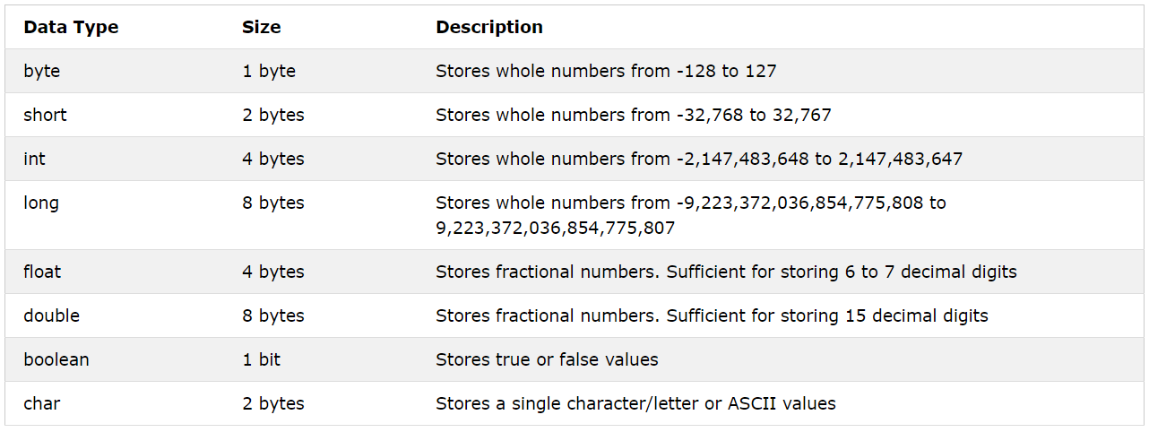
Java Types

Slide 8
Java Types
Reference Types
Primitive Types
For storing simple values
For storing complex objects

Slide 9
Java Types
How does Java handle a variable?
For variables of Reference Types:
courseName

Slide 10

Java Types
Variable assignment
Primitive types:
y
5
x
5

Slide 11

Java Types
Variable assignment
Reference types:
point2
point1
1,1

Slide 12
Operators

Slide 13
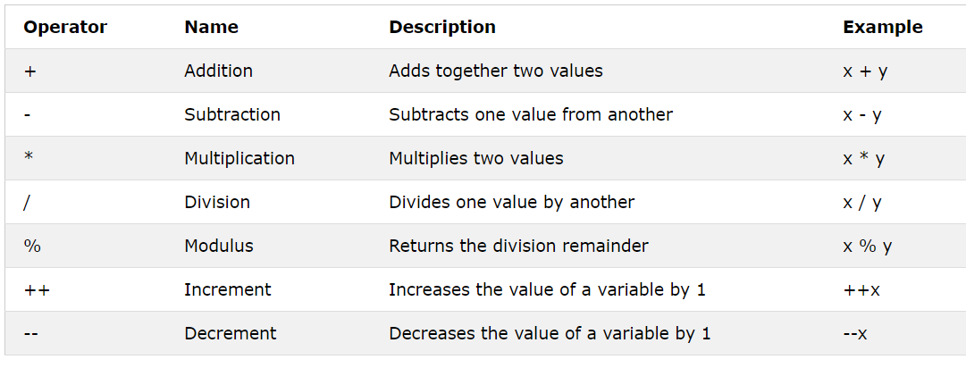
Java Operators
Arithmetic Operators

Slide 14
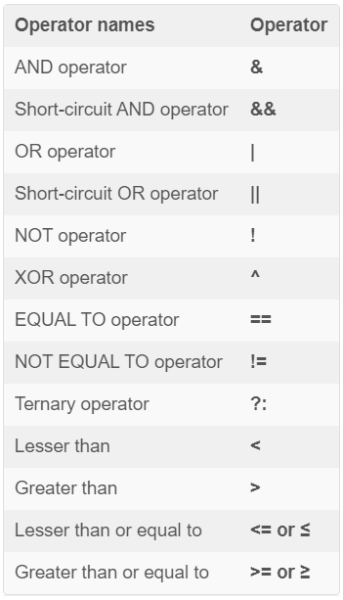
Java Operators
Arithmetic Operators

Slide 15
Control Flow

Slide 16
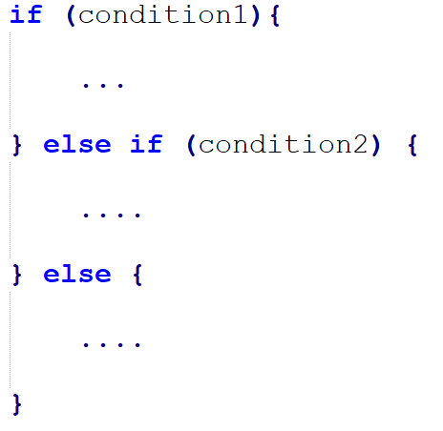
Control Flow
If - else

Slide 17
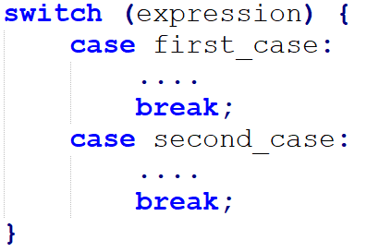
Control Flow
Switch case

Slide 18
Sattvik Sahai
ssahai@stevens.edu

